Slide 1
Context Quality in Training Fusion-in-Decoder for Extractive QA
Document Summary

Slide 2
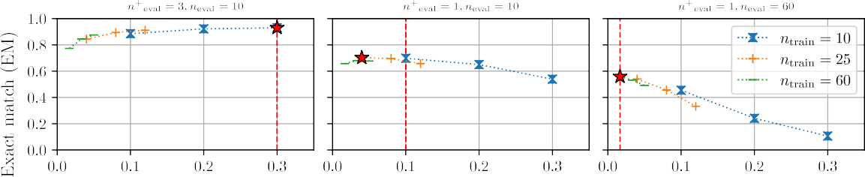
Introduction: The Challenge of Hallucinations
Large Language Models (LLMs) and Hallucinations
Retrieval-Augmented Generation (RAG) as a Solution
Context Quantity and Quality: Impact on Inference
Research Gap: Impact on Training

Slide 3
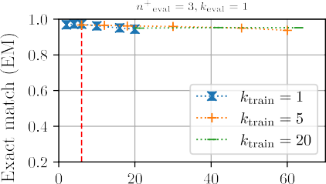
Experimental Setup
Task: Extractive Open-Domain Question Answering
Datasets: Natural Questions, TriviaQA
Model: Fusion-in-Decoder (FiD)
Context Quality and Quantity Definitions

Slide 4
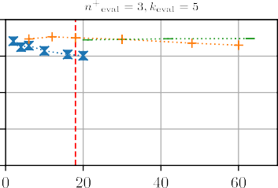
Effect of Context Quality during Training
Experimental Setting: Varying Training Context Quality
Results: Overfitting to Training Context Quality (Figure 1)
Insight: Suboptimal Performance on Different Context Quality

Slide 5
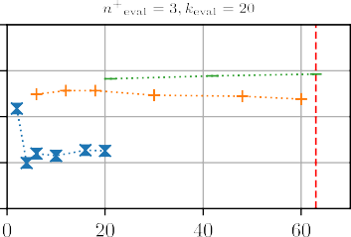
Effect of Context Quantity during Training
Experimental Setting: Varying Training Context Quantity
Results: Less Significant Impact than Context Quality (Figure 2)
Insight: Context Quantity's Influence is Relatively Insignificant

Slide 6
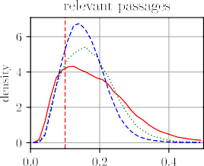
Effect of Mixed Context Quality during Training
Experimental Setting: Mixed Context Qualities
Results: Overfitting to Distribution of Context Qualities (Table 1)
Insight: Distribution of Context Qualities Matters

Slide 7
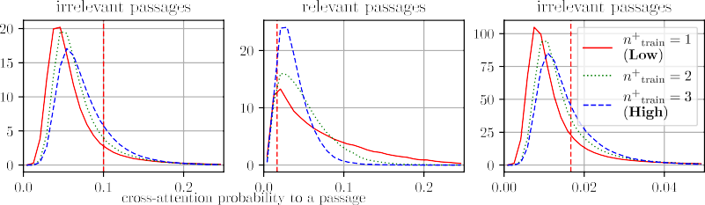
Cross-Attention Patterns and Overfitting
Hypothesis: Overfitting due to Changes in Passage Selection
Analysis: Cross-Attention Probability Distribution (Table 2, Figure 3)
Insight: Models trained with lower quality attend more selectively

Slide 8
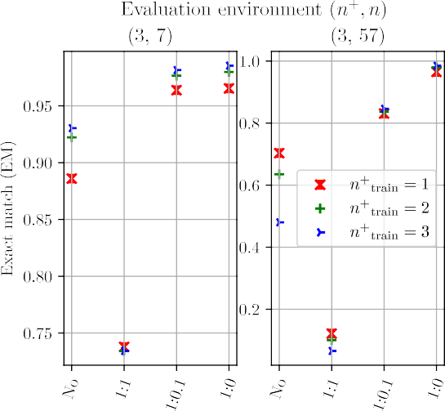
Intervention Experiment
Experimental Setting: Intervening on Cross-Attention Probability
Results: Mitigating Overfitting Effects (Figure 4)
Insight: Cross-attention Selectivity Explains Overfitting

Slide 9
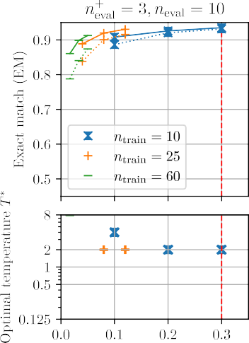
Adapting Models to Different Context Quality
Proposed Method: Adjusting Cross-Attention Selectivity with Temperature Parameter
Experimental Setting: 2-fold Cross-Validation
Results: Improved Performance Across Different Context Qualities (Figure 5)
Insight: Effective Adaptation without Retraining

Slide 10
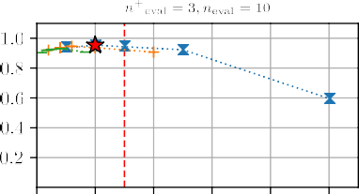
Related Works
Retrieval-Augmented Generation Models
Effect of Context Characteristics on Retrieval-Augmented Models

Slide 11
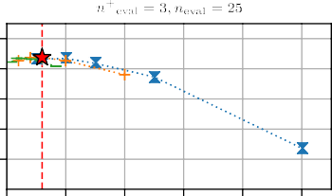
Conclusion and Future Work
Context Quality Significantly Impacts FiD Model Training
Overfitting to Context Quality Explained by Cross-Attention Patterns
Proposed Method Effectively Mitigates Overfitting
Future Directions: More sophisticated adaptation methods, other tasks and architectures

Slide 12
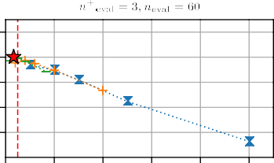
Limitations
Task Specificity
Model Architecture
Model Size
Context Characteristic Coverage
Automatic Annotation of Relevant/Irrelevant Passages

Slide 13
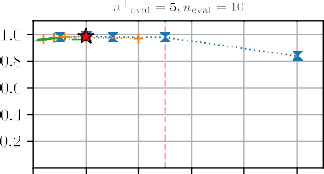
References

Slide 14
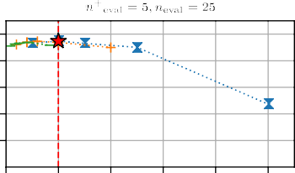
Appendix: Implementation Details
Training and Evaluation Data
FiD Training and Inference
Experimental Design
Passage Relevance Annotation
Full Experimental Results

