Slide 1
Context Quality in Training Fusion-in-Decoder for Extractive QA
Document Summary

Slide 2
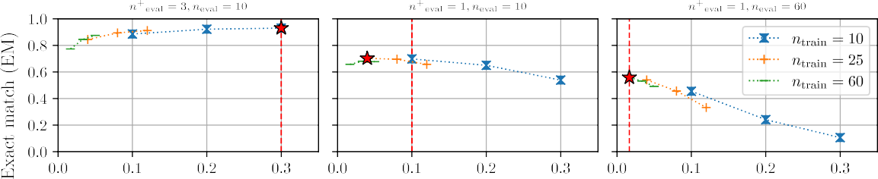
Introduction: Challenges and Retrieval-Augmented Generation
Large language models prone to hallucinations and limitations with new information.
Retrieval-augmented models address these challenges by incorporating external knowledge.
Context quantity and quality impact model performance during inference.
Limited research on how context characteristics affect model training.

Slide 3
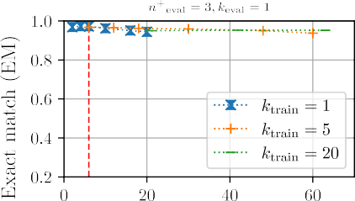
Experimental Setup: Task, Model, and Context Definitions
Extractive open-domain question answering task.
FiD model architecture (state-of-the-art retrieval-augmented generation model).
Context quality: Proportion of relevant passages.
Context quantity: Number of passages.

Slide 4
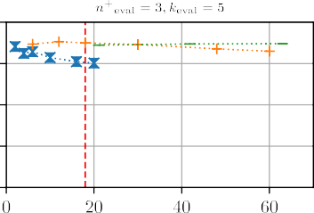
Effect of Context Quality During Training
FiD models overfit to training context quality.
Performance degrades when evaluated on different context quality (Figure 1).
Context quantity has a negligible impact compared to quality.

Slide 5
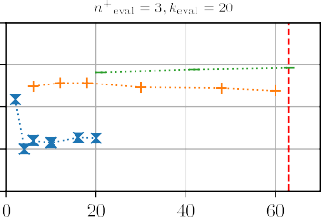
Effect of Context Quantity During Training
Context quantity's influence is less significant than context quality.
More significant influence observed for higher context quality and smaller context quantities (Figure 2).
No consistent trend observed in performance changes due to varying quantity.

Slide 6
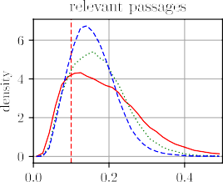
Effect of Mixed Context Quality During Training
Models overfit to the distribution of context qualities.
Optimal performance requires consistent context quality distribution between training and evaluation (Table 1).

Slide 7
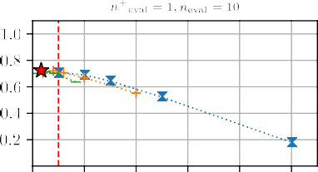
Cross-Attention Patterns and Overfitting
FiD models trained with different context qualities exhibit different cross-attention patterns.
Lower training quality leads to more selective attention to relevant passages (Table 2, Figure 3).
Higher training quality results in more uniform attention distribution.

Slide 8
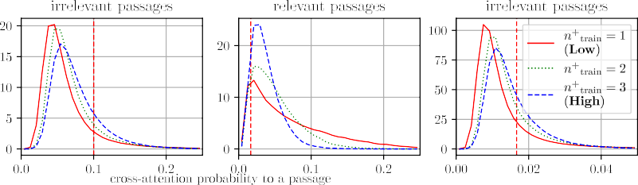
Intervention Experiment: Manipulating Cross-Attention
Intervention on cross-attention probability mitigates the overfitting effect.
Adjusting the ratio of attention to relevant/irrelevant passages improves performance (Figure 4).

Slide 9
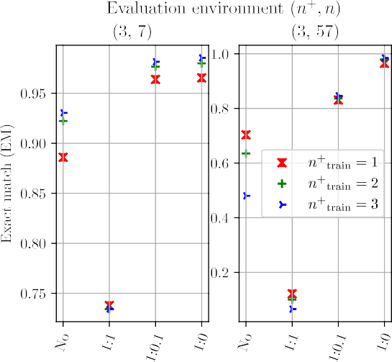
Adapting Models to Different Context Quality
Proposed method: Introduce temperature parameter to control cross-attention distribution.
Effective in improving performance in environments with different context quality (Figure 5).

Slide 10
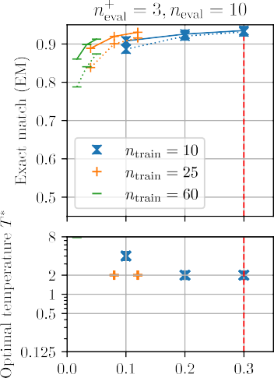
Related Works and Conclusion
Review of retrieval-augmented generation models and research on context characteristics.
FiD models overfit to context quality during training.
Proposed method effectively mitigates overfitting.
Future work: Explore other tasks, architectures, model sizes, and context characteristics.

Slide 11
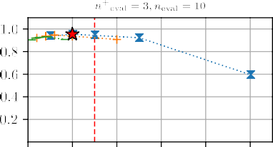
Limitations
Focus on extractive QA, FiD model, t5-base, and limited context characteristics.
Automatic annotation of relevant/irrelevant passages may affect accuracy.
Qualitative factors like readability not considered.

