Slide 1
File Security Manager EFFORTS BY- BHAVIKA ADLAKHA 19CSU064 BHAVISHYA-19CSU065 CHIRAG SARDANA -19CSU071 CHIRAG SHARMA -19CSU072 DEEPAK-19CSU074 DEV RISHI RAO -19CSU083

Slide 2
Significance of Decrypted Text file to Encrypted Text File
For Security Purpose
No One Can Read Encrypted Text File

Slide 3
Decrypted File Example
File security manager: A java application where we give an existing text file name as input
and the output will be a text file with unreadable code. This application will basically secure
the text file by converting our source file into a secured file. It will also convert the secured
file into original file when required.
Definition Of Done:
a) System should ask the user to enter a text file name and validate if the file is existing or not.
b) It will use some security algorithm and key to convert the source file into a secured file.
c) it will ask user to enter a number and generate exception if the entered number is not as per
the security algorithm used.
d) It will prompt user to enter the security key to get the original file from the secured file.
e) The algorithm and key should be same as above while converting the secured file to original
file otherwise exception will be generated.
3

Slide 4
Encrypted File Example
Iloh#vhfxulw|#pdqdjhu=#D#mdyd#dssolfdwlrq#zkhuh#zh#jlyh#dq#h{lvwlqj#wh{w#iloh#qdph#dv#lqsxw
dqg#wkh#rxwsxw#zloo#eh#d#wh{w#iloh#zlwk#xquhdgdeoh#frgh1#Wklv#dssolfdwlrq#zloo#edvlfdoo|#vhfxuh
wkh#wh{w#iloh#e|#frqyhuwlqj#rxu#vrxufh#iloh#lqwr#d#vhfxuhg#iloh1#Lw#zloo#dovr#frqyhuw#wkh#vhfxuhg
iloh#lqwr#ruljlqdo#iloh#zkhq#uhtxluhg1
Ghilqlwlrq#Ri#Grqh=
d,#V|vwhp#vkrxog#dvn#wkh#xvhu#wr#hqwhu#d#wh{w#iloh#qdph#dqg#ydolgdwh#li#wkh#iloh#lv#h{lvwlqj#ru#qrw1
e,#Lw#zloo#xvh#vrph#vhfxulw|#dojrulwkp#dqg#nh|#wr#frqyhuw#wkh#vrxufh#iloh#lqwr#d#vhfxuhg#iloh1
f,#lw#zloo#dvn#xvhu#wr#hqwhu#d#qxpehu#dqg#jhqhudwh#h{fhswlrq#li#wkh#hqwhuhg#qxpehu#lv#qrw#dv#shu
wkh#vhfxulw|#dojrulwkp#xvhg1
g,#Lw#zloo#surpsw#xvhu#wr#hqwhu#wkh#vhfxulw|#nh|#wr#jhw#wkh#ruljlqdo#iloh#iurp#wkh#vhfxuhg#iloh1
h,#Wkh#dojrulwkp#dqg#nh|#vkrxog#eh#vdph#dv#deryh#zkloh#frqyhuwlqj#wkh#vhfxuhg#iloh#wr#ruljlqdo
iloh#rwkhuzlvh#h{fhswlrq#zloo#eh#jhqhudwhg1

Slide 5
Problem Statement: Decrypted to Encrypted
Step 1: Entering Decrypted Text file name validate.
Step 2: Once valid Decrypted Text file name ,Check that File Exist or Not.
Step 3: Entering Encrypted Text file name validate.
Step 4: Once valid Encrypted Text file name.
Step 5: Convert The Decrypted Text File to Encrypted Text File.
Done…

Slide 6
Problem Statement: Encrypted to Decrypted
Step 1: Entering Encrypted Text file name and validate.
Step 2: Once valid Encrypted Text file name entered ,Check that File Exist or Not.
Step 3: Entering Decrypted Text file name and validate.
Step 4: Once valid Decrypted Text file name entered.
Step 5: Entering Security Algorithm Key and validate.
Step 6: Once valid Security Algorithm Key entered, Entering Password and validate.
Step 7: Once both validates, Convert The Encrypted Text File to Decrypted Text File.
Done…

Slide 7
Project Directory Structure
File Security Manager/
├── classes
│ └── com
│ └── ncu
│ ├── exceptions
│ ├── main
│ ├── processors
│ └── validators
├── configs
│ ├── constants
├── text file
├── securited file
└── src
└── com
└── ncu
├── exceptions
├── main
├── processors
└── validators

Slide 8
Text File and Security File
1. text file
This folder should contain all Decrypted Text files.
2. security file
This folder should contain all Encrypted Text files.
8

Slide 9
3. configs
This folder should contain config subfolder.
constants
exceptions.properties
4. src
This folder should contain different packages and source files based on their actions.
com.ncu.main
This will contain entry point java source file.
Main.java
com.ncu.validators
This will contain validators source files.
NameValidator.java - To validate file name
KeyValidator.java - To validate Key
PasswordValidator.java – To validate Password
com.ncu.exceptions

Slide 10
Exception Classes
1. EmptyFileNameException
2. FileExistException
3. FileFormatException
4. FileLengthException.
5. MissingExtensionException
6. PasswordValidatorException
7. SecurityAlgorithmKeyException
8. SpecialCharacterException
9.TxtOnlyException
10

Slide 11
EmptyFileNameException
1. public class EmptyFileNameException extends Exception
2. {
3. public EmptyFileNameException(String s)
4. {
5. super(s);
6. }
7. }
11

Slide 12
NameValidator class
Contains methods to check valid file name for TXT

Slide 13
Specifications for valid file names
System should ask to enter valid file name for source txt file.
Source file name should not be empty.
Source file name should contain valid file extension.
Source file name should not exceed 25 characters excluding file extension part.
Source file extension should be only ".txt".
Source file name should not contain special characters.
The special characters includes "@,#,$,%,^,&,(,), _".
13

Slide 14
EncryptionDecryptionProcessors class
Contains methods to convert Normal Text into Encrypted Text

Slide 15
EncryptionDecryptionProcessors
public class EncryptionDecryptionProcessors
{
public static String encrypt(String plainText)
public static String decrypt(String encryptedText)
}
15

Slide 16
ProcessTxtEncryption class
Contains methods to convert Normal Text File into Encrypted Text File.

Slide 17
ProcessTxtEncryption
public class ProcessTxtEncryption
{
public boolean processTxtEncryption(String txtFilename,String encryptedFilename)
}
17

Slide 18
ProcessTxtDecryption class
Contains methods to convert Encrypted Text File into Normal Text File.

Slide 19
ProcessTxtDecryption
public class ProcessTxtDecryption
{
public boolean processTxtDecryption(String txtFilename,String decryptedFilename)
}
19

Slide 20
Main class
Contains methods to convert Encrypted Text File into Normal Text File. And Viceversa.

Slide 21
Main
public class Main
{
public static void main(String[] args)throws Exception
static String getFileName()
static void Encrypt()throws Exception
static void Decrypt()throws Exception
static void clrscr()
static void exitOrmain()throws Exception
static void showFile(String path)throws Exception
}
21

Slide 22
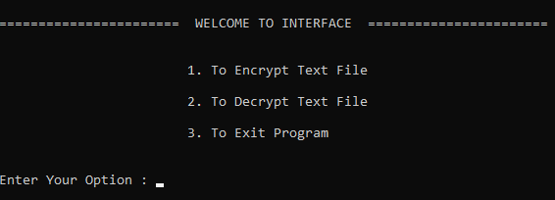
Output

Slide 23
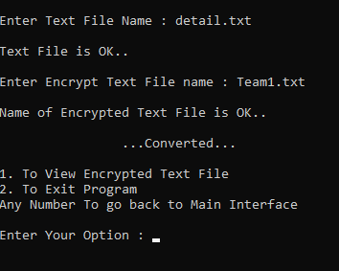
Output

Slide 24
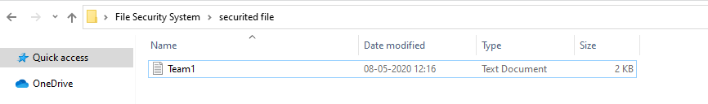
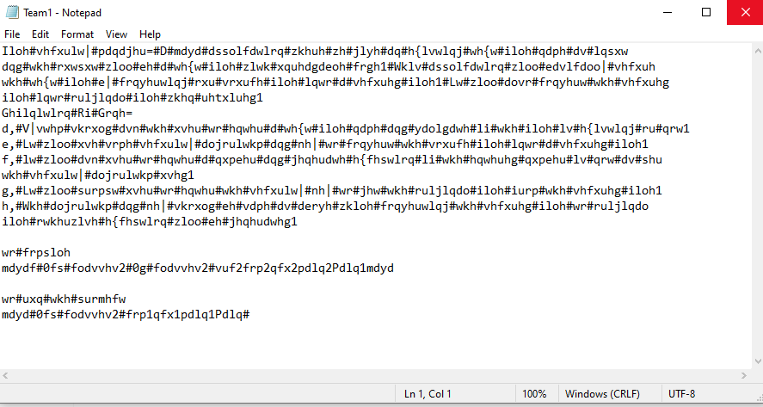
Encrypted Text

Slide 25
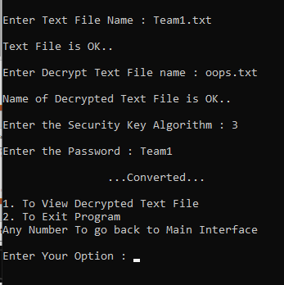
Output

Slide 26
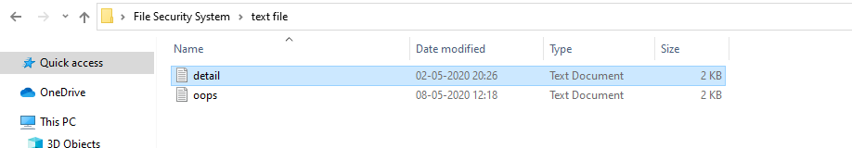
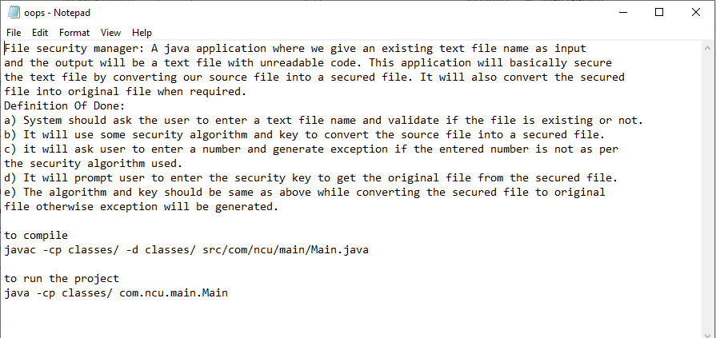
Decrypted Text

