Slide 1

Insurance Charges Prediction Analysis
A comprehensive study on predicting insurance charges using machine learning models
Presenter:
CHIRAG SHAW (C24003)

Slide 2
Introduction
Problem Statement: Understanding and predicting insurance charges is crucial for pricing strategies in the insurance industry. Accurate predictions help in assessing risk and determining premiums. Objective: Use machine learning models to predict insurance charges based on various demographic and health-related factors.

Slide 3
Dataset Overview
Description: The dataset includes information about individuals, such as age, sex, BMI, number of children, smoker status, region, and charges. Key Features: Age, BMI, smoker status, region, and charges (target variable).

Slide 4
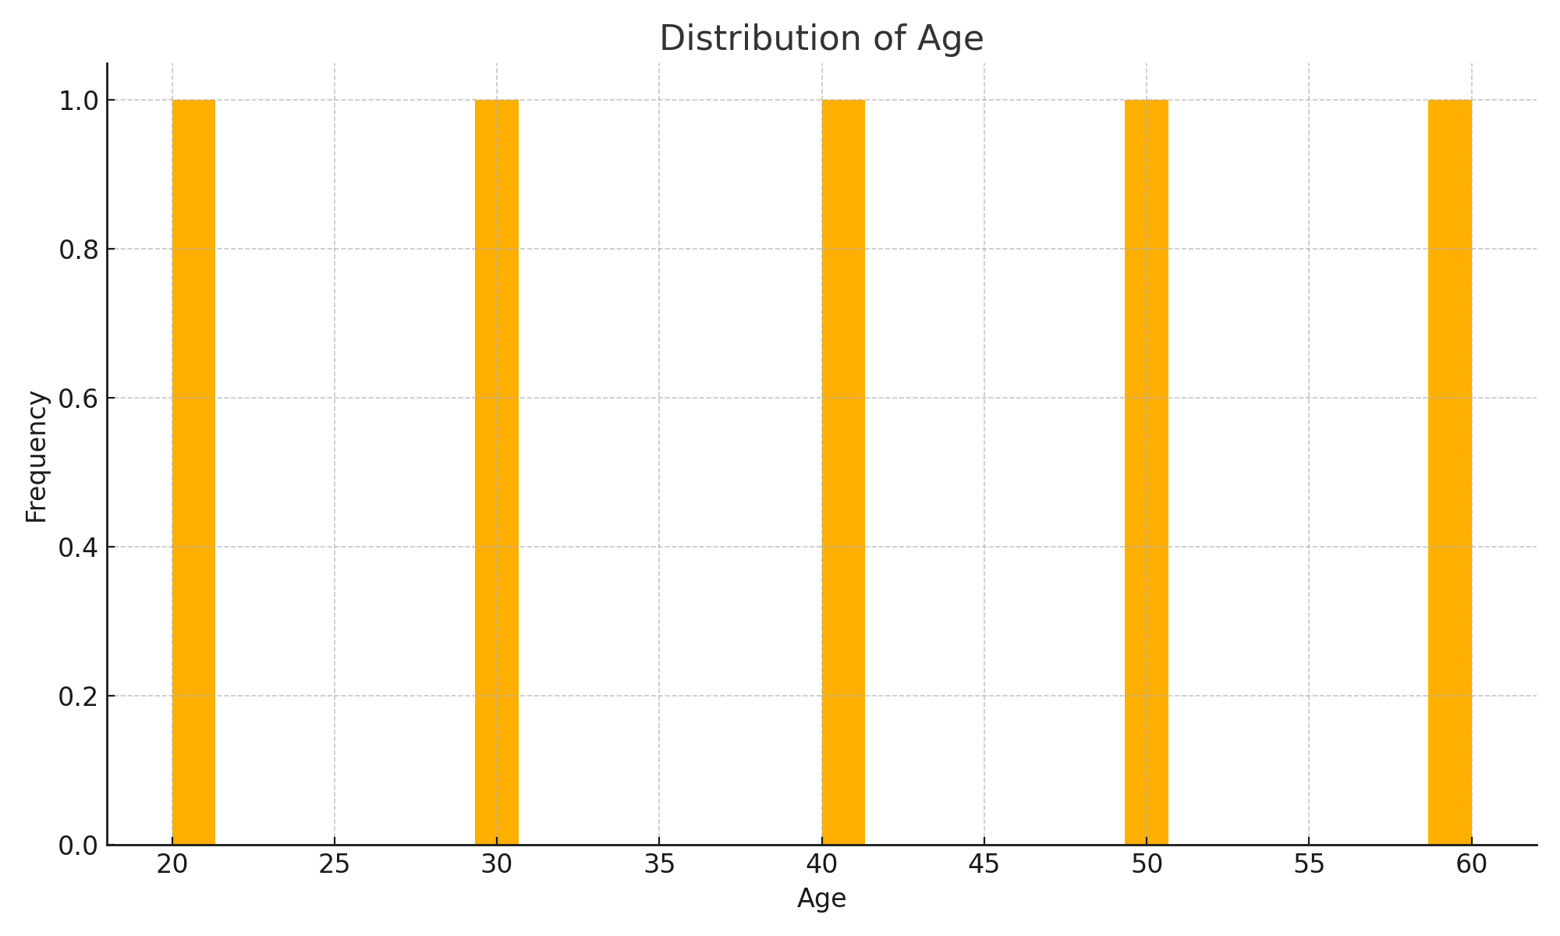
Age Distribution
Insight: The dataset has a diverse age range, with a notable concentration of younger individuals, which may influence the overall charge distribution.

Slide 5
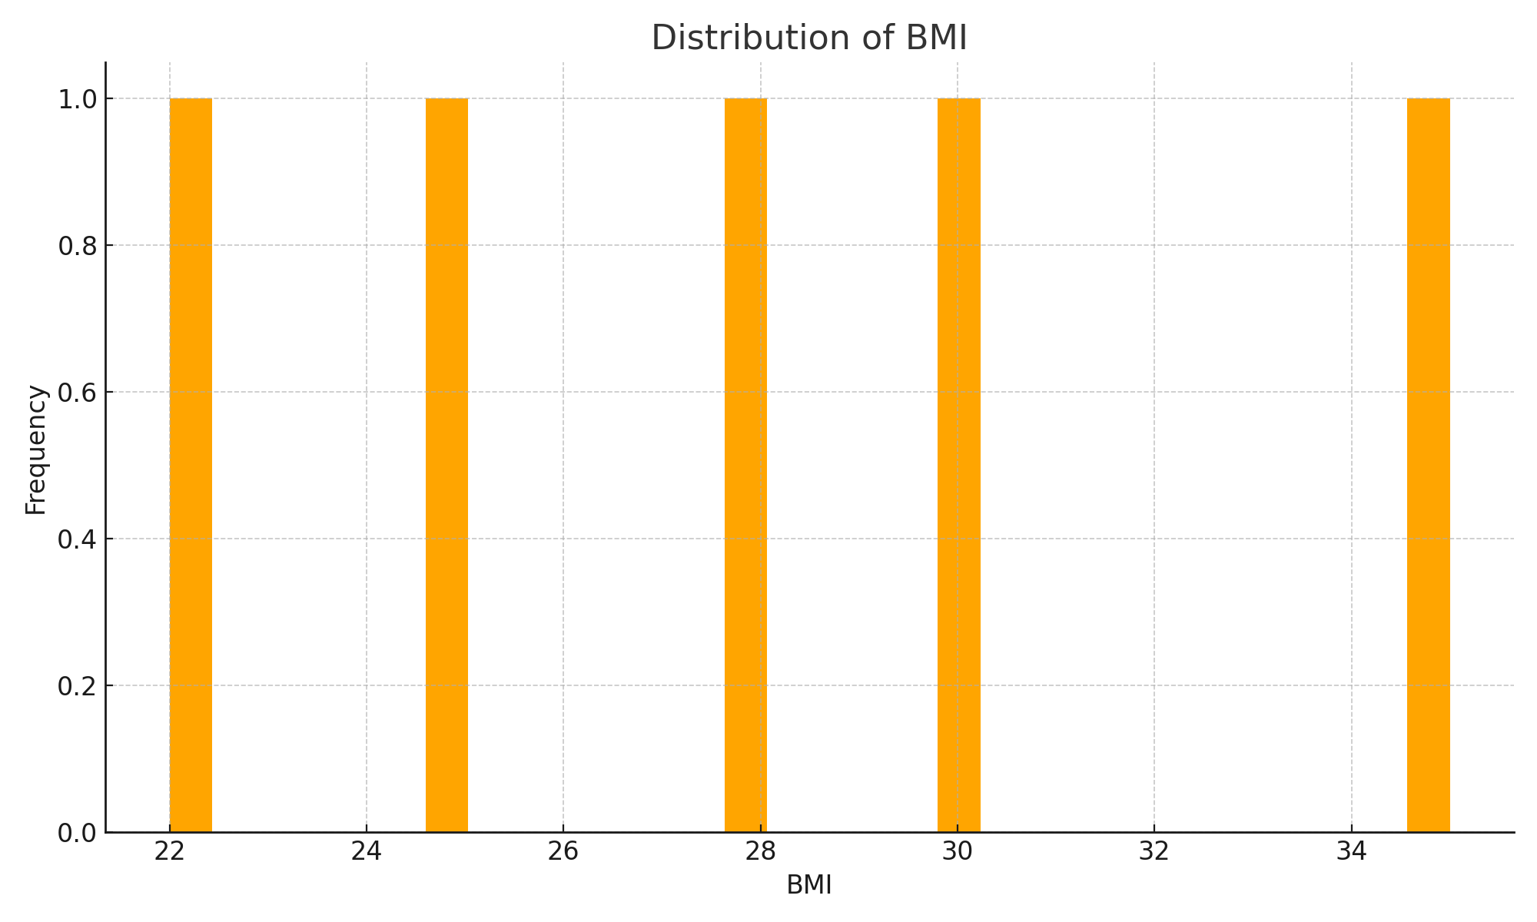
BMI Distribution
Insight: BMI values are clustered around 25-35, indicating a significant portion of the population is in the overweight category, potentially affecting health-related costs.

Slide 6
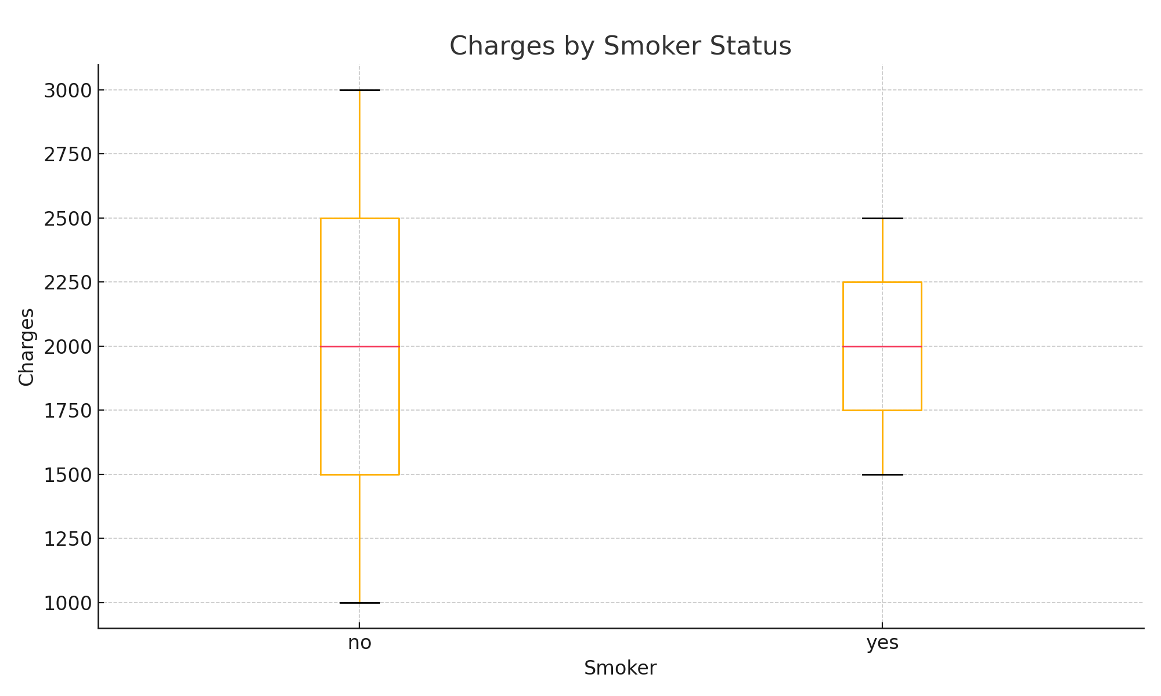
Charges vs. Smoker Status
Insight: Smokers tend to have higher medical charges, which highlights the significant impact of smoking on healthcare costs.

Slide 7
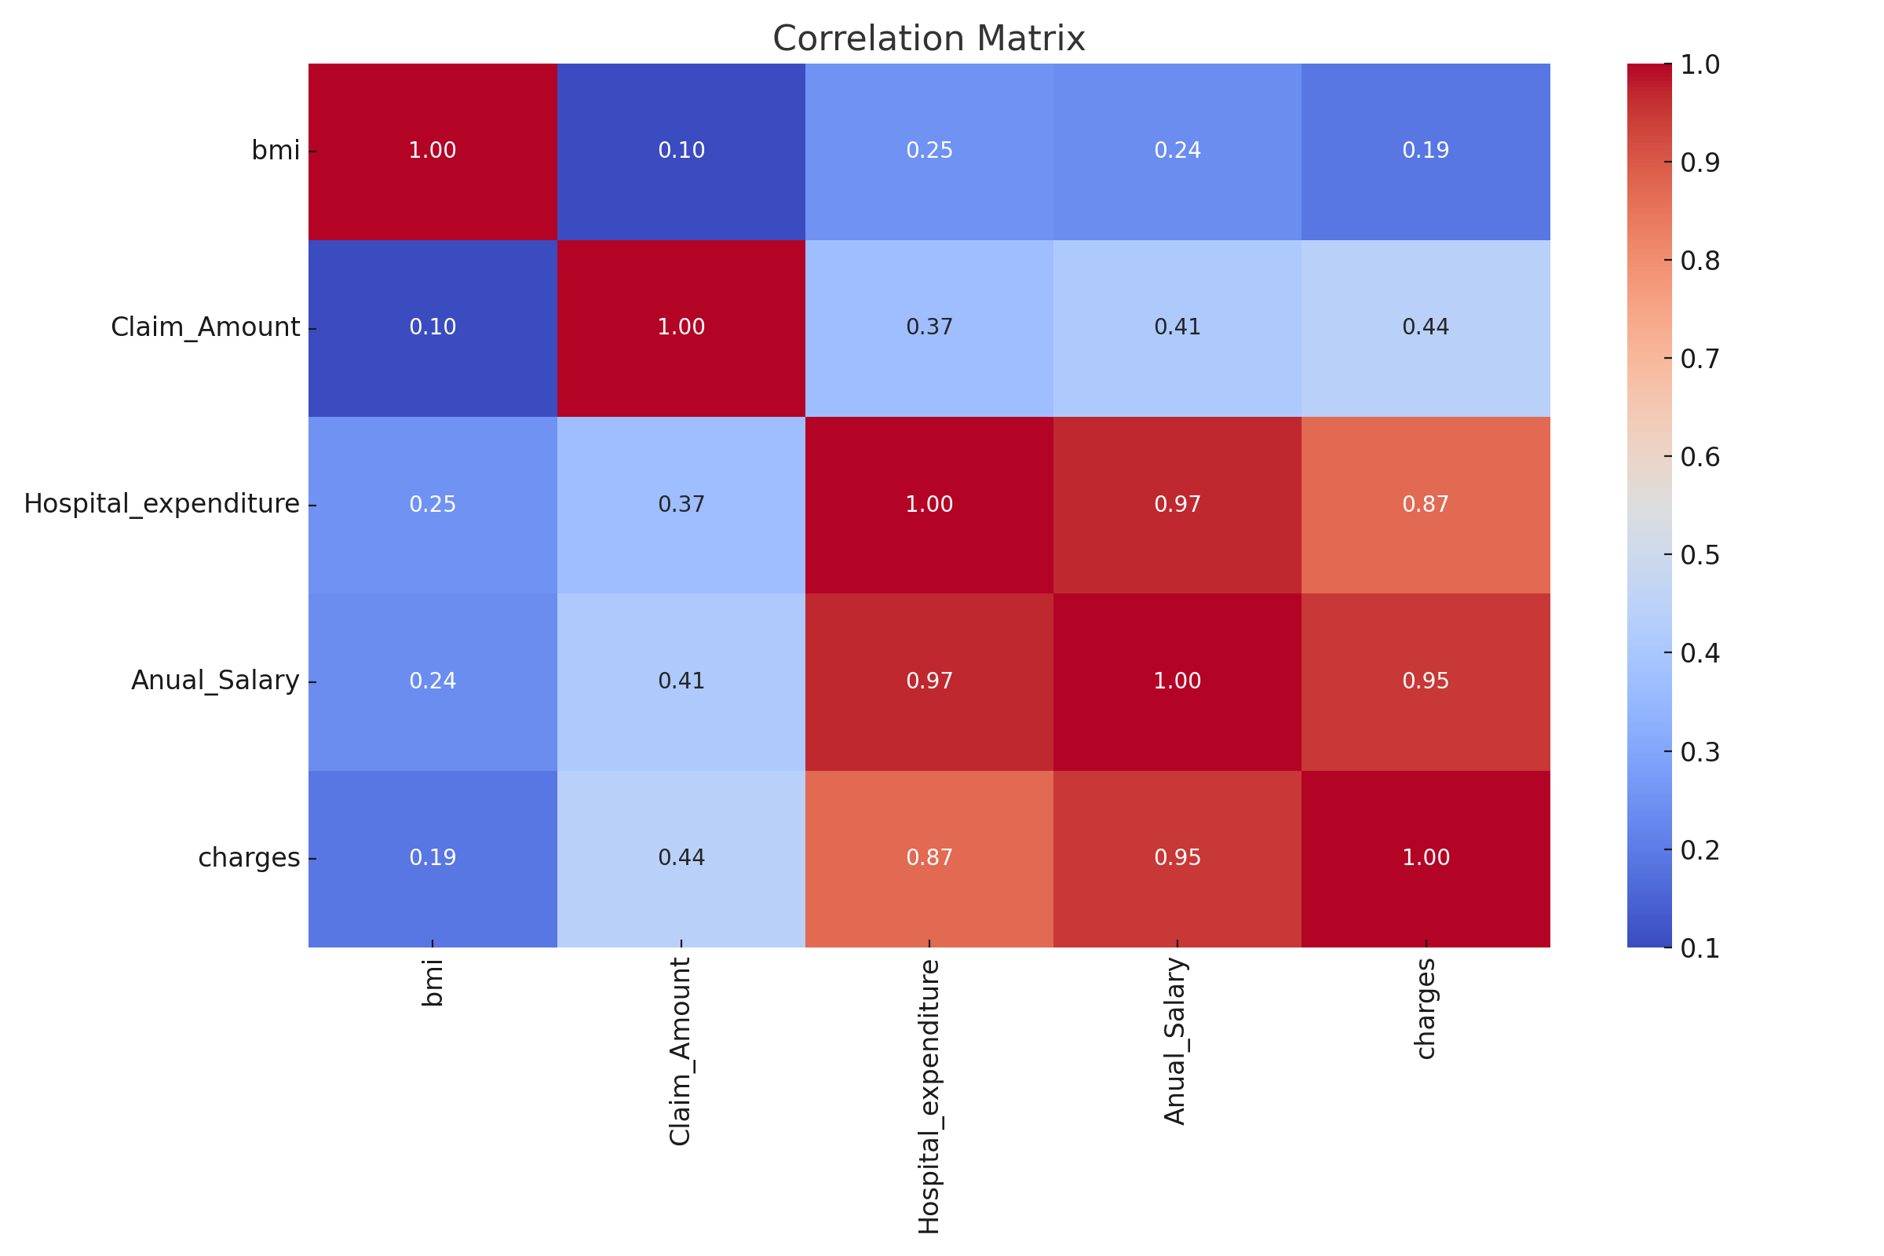
Correlation Heatmap
Insight: High correlations between 'charges' and 'smoker status', 'annual salary', and 'hospital expenditure', indicating these are key factors in predicting charges.

Slide 8
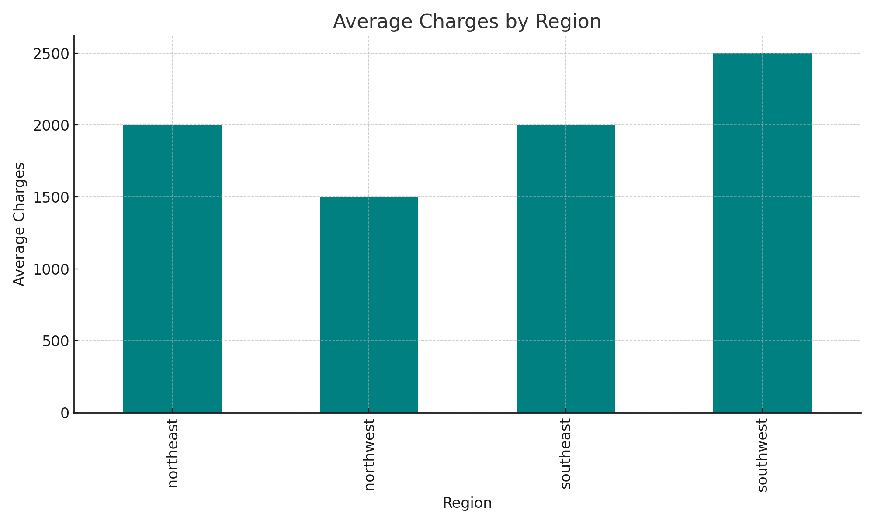
Average Charges by Region
Insight: There are noticeable regional differences in average charges, with the southeast region having the highest average charges.

Slide 9
Modeling Approach
Models Used: - Linear Regression: Assumes a linear relationship between features and target. - Decision Tree: Captures non-linear interactions and splits data based on feature values. - Random Forest: An ensemble of decision trees, providing robustness against overfitting and better generalization. Evaluation Metric: RMSE (Root Mean Squared Error) was used to assess model performance.

Slide 10
Model Performance Comparison
RMSE Values: - Linear Regression: 1010.83 - Decision Tree: 873.64 - Random Forest: 894.14 Explanation: Decision Tree had the lowest RMSE, suggesting it performed best in terms of predicting insurance charges. The Random Forest model, while slightly higher in RMSE, still performed well and offers better generalization.

Slide 11
Key Findings
1. Smokers generally incur higher medical charges, indicating significant health risks and associated costs. 2. Regional differences in charges suggest that geographic factors influence insurance costs. 3. The Decision Tree model provided the most accurate predictions, emphasizing the importance of non-linear modeling in healthcare data.

Slide 12
Conclusion
This study successfully identified key factors influencing insurance charges and demonstrated the effectiveness of using machine learning models for predictive analysis. The findings highlight the potential for improved pricing strategies in the insurance industry. Future work should focus on integrating more complex models and additional features to further enhance prediction accuracy.

Slide 13
Future Work
1. Incorporate additional features such as lifestyle habits, medical history, and geographic data to enhance model predictions. 2. Explore advanced machine learning models like Gradient Boosting, Neural Networks, and ensemble methods to improve accuracy. 3. Conduct a more detailed analysis on the impact of regional and socioeconomic factors on insurance charges.

Slide 14
Questions & Discussion
Open floor for questions and discussions

