Slide 1

First Come First Serve Algorithm
www.dextutor.com

Slide 2

Key Points
The job that arrives first is scheduled first
Is non-preemptive algorithm
Implemented using queue.
Suffers from Convoy effect.

Slide 3
Example 1
Process | Burst Time
P1 | 23
P2 | 2
P3 | 5
P1
0
23

Slide 4
Example 1
Process | Burst Time
P1 | 23
P2 | 2
P3 | 5
P1
P2
0
23
25

Slide 5
Example 1
Process | Burst Time
P1 | 23
P2 | 2
P3 | 5
P1
P2
P3
0
23
25
30

Slide 6
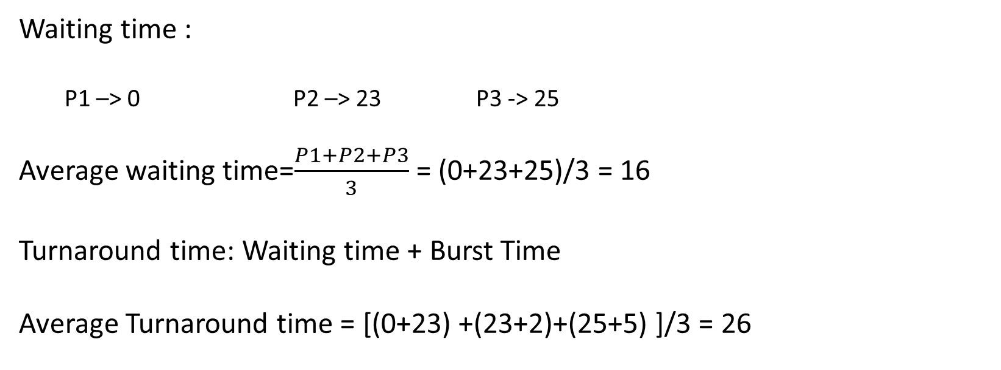
Example 1
P1
P2
P3
0
23
25
30
Waiting time :
  P1 –> 0 P2 –> 23 P3 -> 25
Average waiting time=$\frac{P1+P2+P3}{3}$ = (0+23+25)/3 = 16
Turnaround time: Waiting time + Burst Time
Average Turnaround time = [(0+23) +(23+2)+(25+5) ]/3 = 26

Slide 7
Example 2

Slide 8
Baljit Singh Saini
process | Burst time | Arrival time
P1 | 6 | 2
P2 | 2 | 5
P3 | 8 | 1
P4 | 3 | 0
P5 | 4 | 4
0
P4
0

Slide 9
Baljit Singh Saini
process | Burst time | Arrival time
P1 | 6 | 2
P2 | 2 | 5
P3 | 8 | 1
P4 | 3 | 0
P5 | 4 | 4
1
P3
P4
0

Slide 10
Baljit Singh Saini
process | Burst time | Arrival time
P1 | 6 | 2
P2 | 2 | 5
P3 | 8 | 1
P4 | 3 | 0
P5 | 4 | 4
2
P3
P1
P4
0

Slide 11
Baljit Singh Saini
process | Burst time | Arrival time
P1 | 6 | 2
P2 | 2 | 5
P3 | 8 | 1
P4 | 3 | 0
P5 | 4 | 4
3
P3
P1
P4
0
3

Slide 12
Baljit Singh Saini
process | Burst time | Arrival time
P1 | 6 | 2
P2 | 2 | 5
P3 | 8 | 1
P4 | 3 | 0
P5 | 4 | 4
3
P3
P1
P4
0
3

Slide 13
Baljit Singh Saini
process | Burst time | Arrival time
P1 | 6 | 2
P2 | 2 | 5
P3 | 8 | 1
P4 | 3 | 0
P5 | 4 | 4
4
P1
P5
P4
P3
0
3

Slide 14
Baljit Singh Saini
process | Burst time | Arrival time
P1 | 6 | 2
P2 | 2 | 5
P3 | 8 | 1
P4 | 3 | 0
P5 | 4 | 4
5
P1
P5
P2
P4
P3
0
3

Slide 15
Baljit Singh Saini
process | Burst time | Arrival time
P1 | 6 | 2
P2 | 2 | 5
P3 | 8 | 1
P4 | 3 | 0
P5 | 4 | 4
6
P1
P5
P2
P4
P3
0
3

Slide 16
Baljit Singh Saini
process | Burst time | Arrival time
P1 | 6 | 2
P2 | 2 | 5
P3 | 8 | 1
P4 | 3 | 0
P5 | 4 | 4
7
P1
P5
P2
P4
P3
0
3

Slide 17
Baljit Singh Saini
process | Burst time | Arrival time
P1 | 6 | 2
P2 | 2 | 5
P3 | 8 | 1
P4 | 3 | 0
P5 | 4 | 4
8
P1
P5
P2
P4
P3
0
3

Slide 18
Baljit Singh Saini
process | Burst time | Arrival time
P1 | 6 | 2
P2 | 2 | 5
P3 | 8 | 1
P4 | 3 | 0
P5 | 4 | 4
9
P1
P5
P2
P4
P3
0
3

Slide 19
Baljit Singh Saini
process | Burst time | Arrival time
P1 | 6 | 2
P2 | 2 | 5
P3 | 8 | 1
P4 | 3 | 0
P5 | 4 | 4
10
P1
P5
P2
P4
P3
0
3

Slide 20
Baljit Singh Saini
process | Burst time | Arrival time
P1 | 6 | 2
P2 | 2 | 5
P3 | 8 | 1
P4 | 3 | 0
P5 | 4 | 4
11
P1
P5
P2
P4
P3
0
3
11

Slide 21
Baljit Singh Saini
process | Burst time | Arrival time
P1 | 6 | 2
P2 | 2 | 5
P3 | 8 | 1
P4 | 3 | 0
P5 | 4 | 4
11
P1
P5
P2
P4
P3
0
3
11

Slide 22
Baljit Singh Saini
process | Burst time | Arrival time
P1 | 6 | 2
P2 | 2 | 5
P3 | 8 | 1
P4 | 3 | 0
P5 | 4 | 4
17
P5
P2
P4
P3
P1
0
3
11
17

Slide 23
Baljit Singh Saini
process | Burst time | Arrival time
P1 | 6 | 2
P2 | 2 | 5
P3 | 8 | 1
P4 | 3 | 0
P5 | 4 | 4
17
P5
P2
P4
P3
P1
0
3
11
17

Slide 24
Baljit Singh Saini
process | Burst time | Arrival time
P1 | 6 | 2
P2 | 2 | 5
P3 | 8 | 1
P4 | 3 | 0
P5 | 4 | 4
21
P2
P4
P3
P1
P5
0
3
11
17
21

Slide 25
Baljit Singh Saini
process | Burst time | Arrival time
P1 | 6 | 2
P2 | 2 | 5
P3 | 8 | 1
P4 | 3 | 0
P5 | 4 | 4
21
P2
P4
P3
P1
P5
0
3
11
17
21

Slide 26
Baljit Singh Saini
process | Burst time | Arrival time
P1 | 6 | 2
P2 | 2 | 5
P3 | 8 | 1
P4 | 3 | 0
P5 | 4 | 4
23
P4
P3
P1
P5
P2
0
3
11
17
21
23

Slide 27
Baljit Singh Saini
process | Burst time | Arrival time
P1 | 6 | 2
P2 | 2 | 5
P3 | 8 | 1
P4 | 3 | 0
P5 | 4 | 4
23
P4
P3
P1
P5
P2
0
3
11
17
21
23

Slide 28

Baljit Singh Saini
process | Burst time | Arrival time
P1 | 6
P2 | 2
P3 | 8
P4 | 3
P5 | 4
2
5
1
0
4
P4
P3
P1
P5
P2
0
3
11
17
21
23
Waiting time = Start time – Arrival time
P4 =
0 - 0 = 0
P3 =
3 - 1 = 2
P1 =
11 - 2 = 9
Av. Waiting Time = $\frac{0+2+9+13+16}{5} =\frac{40}{5}=8$
P5 = 17 – 4 = 13
P2 = 21 – 5 = 16

Slide 29
Question?

Slide 30
process | Burst time | Arrival time
P1 | 6 | 2
P2 | 2 | 5
P3 | 8 | 3
P4 | 3 | 1
P5 | 4 | 8

Slide 31
Next
Shortest Job First (SJF)

Slide 32
PPT Link
https://dextutor.com/cpu-scheduling-algorithms/

