Slide 1
CineMatch

Slide 2
CineMatch
~
a movie recommendation model
Chirag Tiwari
chiragtiwari6842@gmail.com

Slide 3
Problem Statement
AIM: To Build a Movie Recommendation System on a subset of MovieLens Database.
With a massive catalog of movies, users often struggle to find movies they would enjoy.
This project provides a solution by recommending movies based on user preferences.
Chirag Tiwari
chiragtiwari6842@gmail.com

Slide 4
Dataset
Subset of MovieLens Dataset:
Ratings: 100k
Movies: 1600 (1922 – 1998)
Chirag Tiwari
chiragtiwari6842@gmail.com

Slide 5
Analysis
Chirag Tiwari
chiragtiwari6842@gmail.com

Slide 6
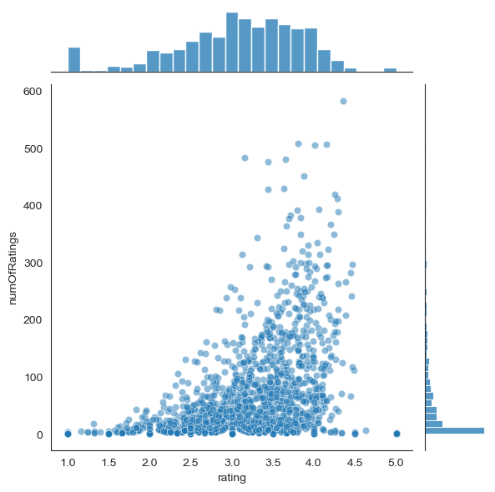
Analysis
Chirag Tiwari
chiragtiwari6842@gmail.com

Slide 7
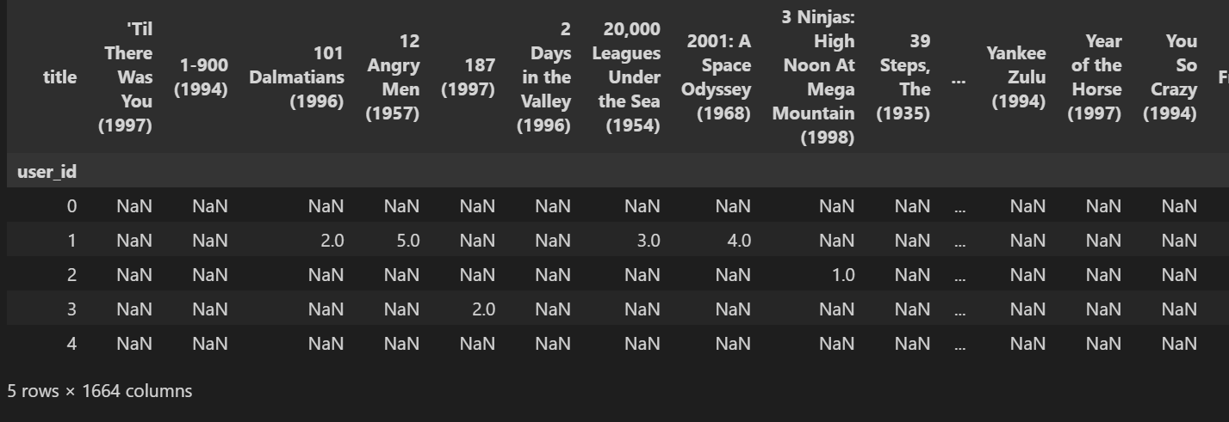
Analysis
Chirag Tiwari
chiragtiwari6842@gmail.com

Slide 8
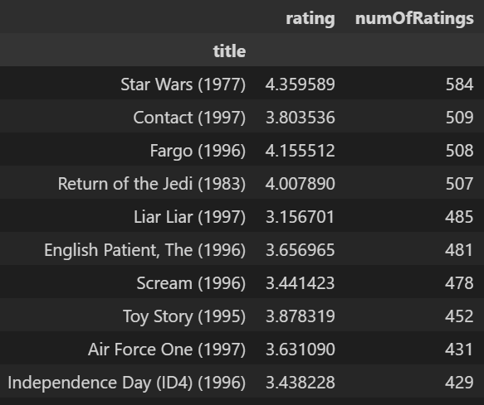
Analysis
Chirag Tiwari
chiragtiwari6842@gmail.com

Slide 9
Methodology
For each movie, the system identifies other movies with similar rating patterns
based on user ratings..
Chirag Tiwari
chiragtiwari6842@gmail.com

Slide 10
Methodology
For each movie, the system identifies other movies with similar rating patterns
based on user ratings..
The system computes the correlation between user ratings of the target movie
and all other movies. Higher correlation indicate similar movie.
Chirag Tiwari
chiragtiwari6842@gmail.com

Slide 11
Methodology
For each movie, the system identifies other movies with similar rating patterns
based on user ratings..
The system computes the correlation between user ratings of the target movie
and all other movies. Higher correlation indicate similar movie.
The system selects the top four correlated movies as recommendations for each
movie in the dataset.
Chirag Tiwari
chiragtiwari6842@gmail.com

Slide 12
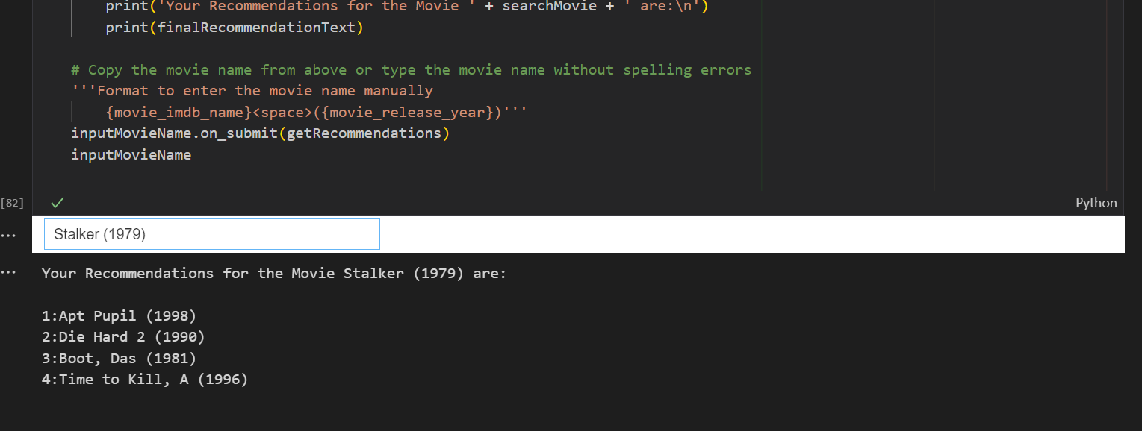
Key Results
Chirag Tiwari
chiragtiwari6842@gmail.com

Slide 13
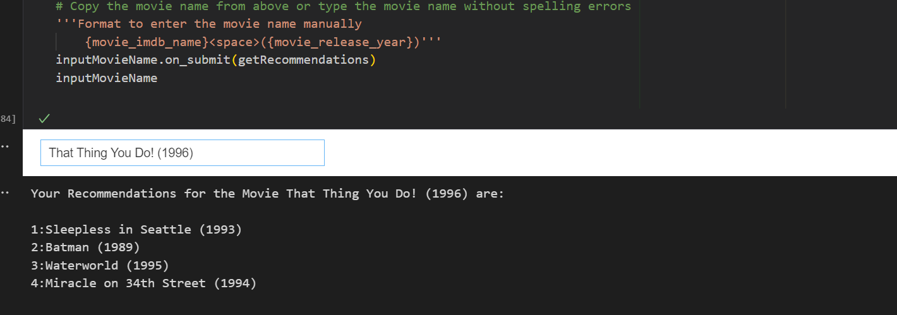
Key Results
Chirag Tiwari
chiragtiwari6842@gmail.com

Slide 14
CONCLUSION
Key Takeaways
A simple correlation-based method provides practical movie recommendations
based on user ratings.
Chirag Tiwari
chiragtiwari6842@gmail.com

Slide 15
CONCLUSION
Key Takeaways
A simple correlation-based method provides practical movie recommendations
based on user ratings.
The approach is efficient and easily interpretable for small- to medium-scale
recommendation needs.
Chirag Tiwari
chiragtiwari6842@gmail.com

Slide 16
CONCLUSION
Key Takeaways
A simple correlation-based method provides practical movie recommendations
based on user ratings.
The approach is efficient and easily interpretable for small- to medium-scale
recommendation needs.
Future Enhancements
Incorporate Sentimental Analysis of user reviews for better performance and use
Collaborative Filtering.
Chirag Tiwari
chiragtiwari6842@gmail.com

Slide 17
Thank You

