Slide 1
Nvidia GTX480 Design and Heat Dissipation Trend Exploration Qiyu Chen, Junzhe Huang
EECS - Computer Science and Engineering
Dec 8, 2022

Slide 2
Tools and methodologies
Tools:
GPGPU-Sim [1]
HotSpot [2]
Conda
Methodologies:
CUDA kernels design: MatMul and Needleman-Wunsch
GPU design: a 4-layer, 3D floor plan of GTX480 (Fermi architecture)
Heat dissipation analysis with different
kernel operations
tensor sizes
Heatmap visualization
Power traces
[1] https://github.com/gpgpu-sim/gpgpu-sim_distribution
[2] https://www.cs.virginia.edu/rodinia/doku.php

Slide 3
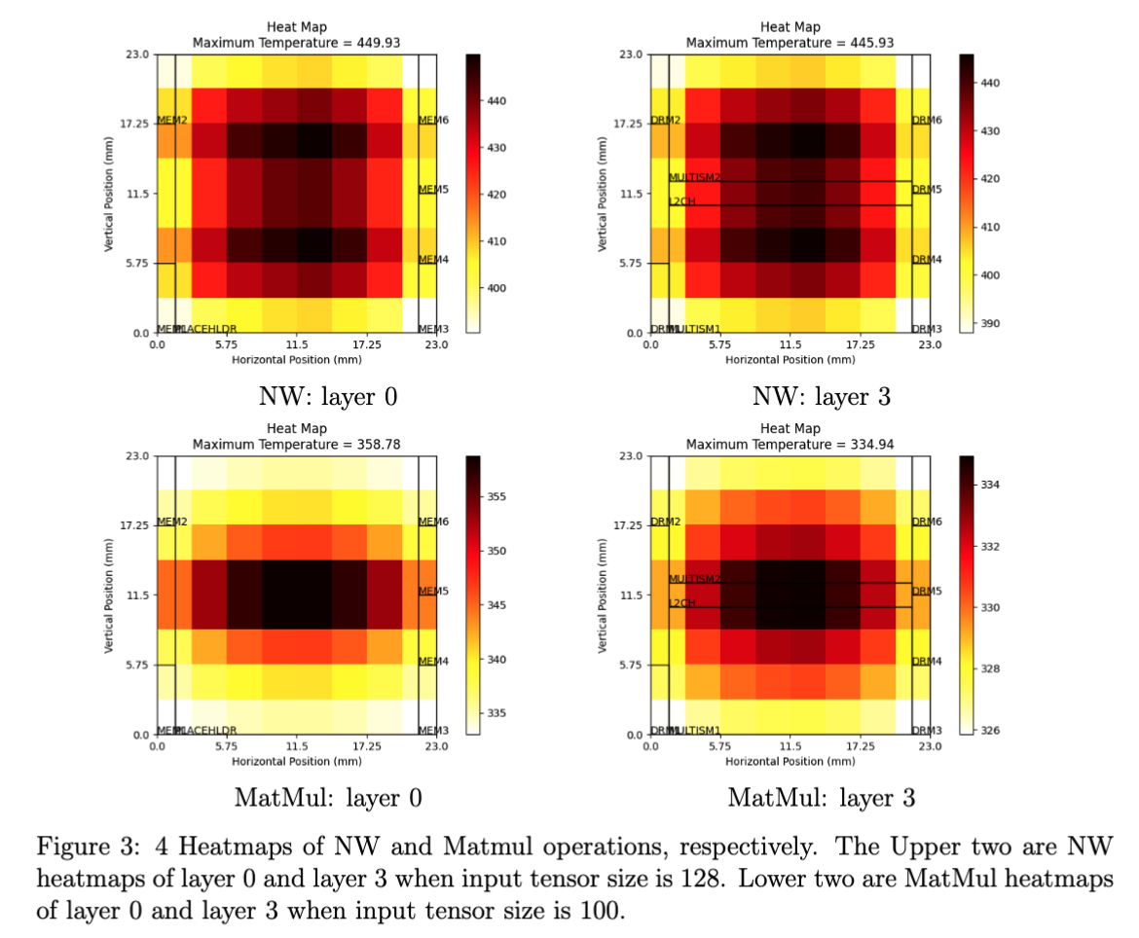
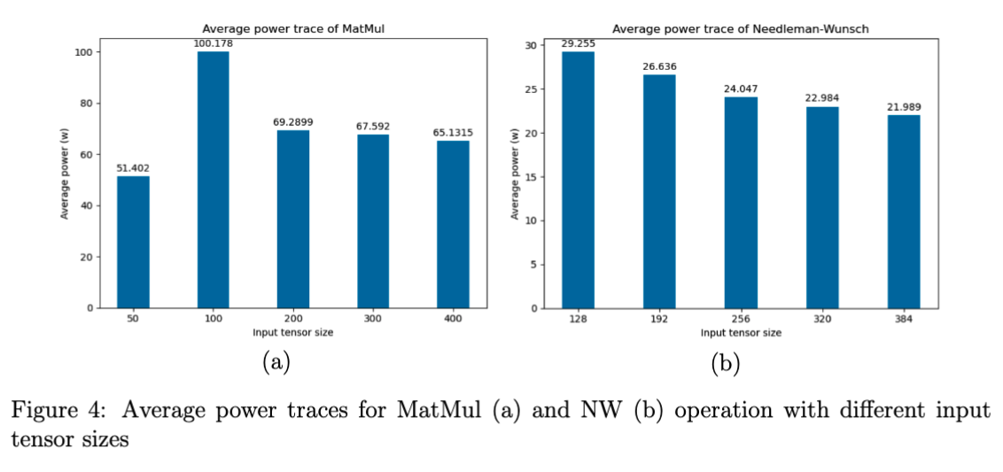
Experimental results
Heatmaps
Power traces

Slide 4
Summary
MatMul takes longer time to run
The average power consumption of MatMul is higher than that of NW. Both power traces show downward trends when input tensor sizes increases
except the power of MatMul when input size is fairly small (50), which is 51.402w (compared to 100.178w when input size is 100)
The average and maximum temperatures of NW are obviously higher than MatMul

