Slide 1
Nvidia GTX480 Design and Heat Dissipation Trend Exploration Qiyu Chen, Junzhe Huang
EECS - Computer Science and Engineering
Dec 8, 2022

Slide 2
Overview
Tools and methodologies
Experimental results and technical insights
Qualitative summary

Slide 3
Tools and methodologies
Tools:
GPGPU-Sim [1]
HotSpot [2]
Conda
Methodologies:
CUDA kernels design: MatMul and Needleman-Wunsch
GPU design: a 4-layer, 3D GTX480 floor plan
Heat dissipation analysis with different
kernel operations
tensor size
Heatmap visualization
[1] https://github.com/gpgpu-sim/gpgpu-sim_distribution
[2] https://www.cs.virginia.edu/rodinia/doku.php

Slide 4
Experimental results
Input tensor sizes:
MatMul: 50, 100, 200, 300, 400
Needleman-Wunsch: 128, 192, 256, 320, 384
Outputs (along with corresponding input tensor sizes):
3D floor plan configurations based on Fermi architecture
Heatmaps for all 4 layers and 2 operations
Power logs for 2 operations:
Average
Max
Min
Automation script to make it a one-click system

Slide 5
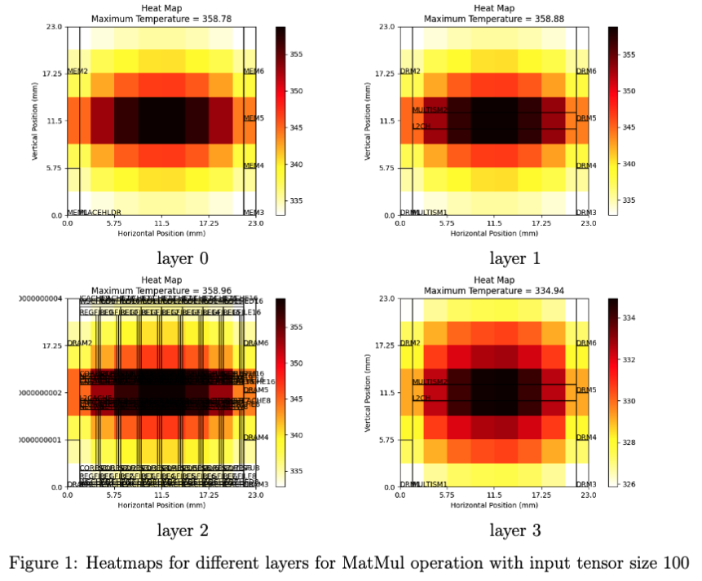
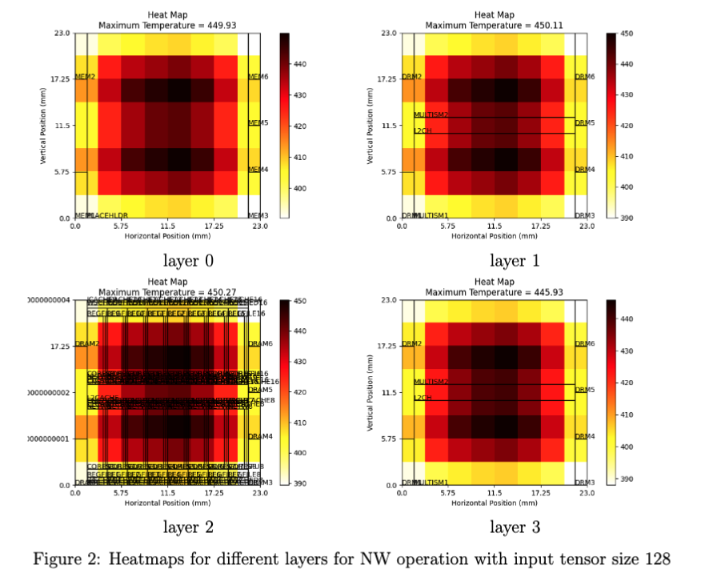
Experimental results
Heatmaps

Slide 6
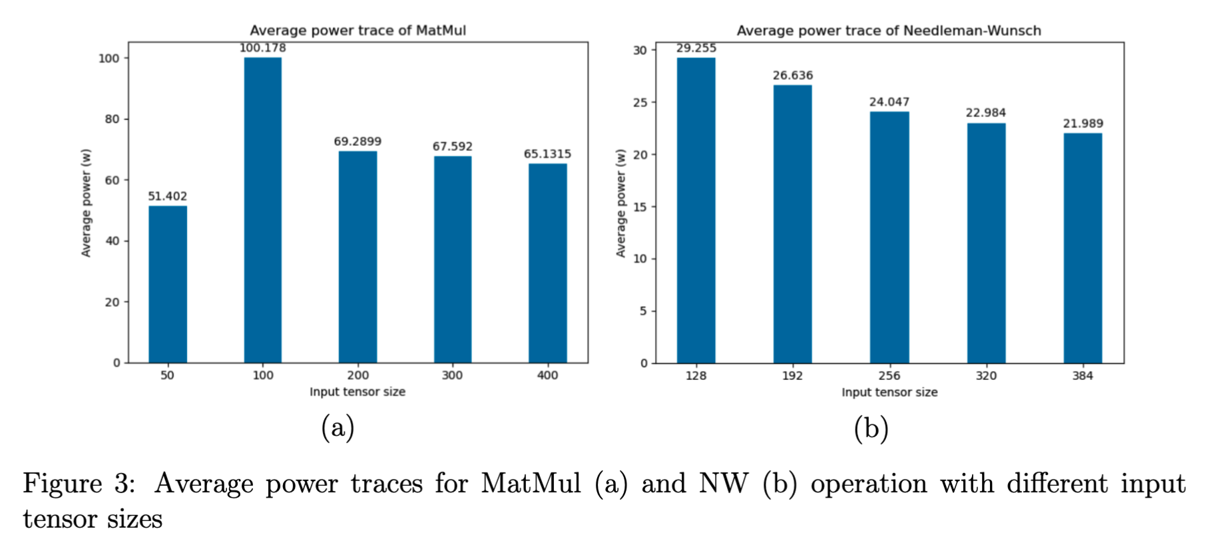
Experimental results
Power traces

Slide 7
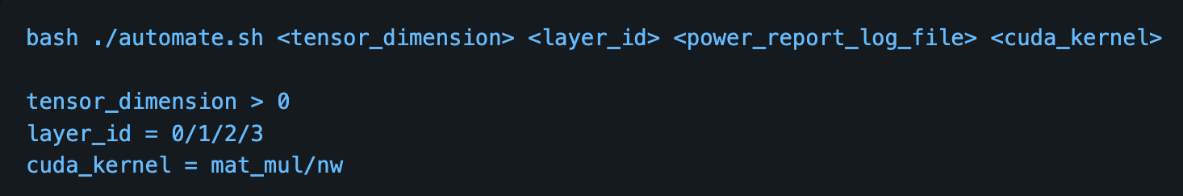
Experimental results
Automation script

Slide 8
Summary
MatMul takes longer time to run
The average power consumption of MatMul is higher than that of NW. Both power traces show downward trends when input tensor sizes increases
except the power of MatMul when input size is fairly small (50), which is 51.402w (compared to 100.178w when input size is 100)
The average and maximum temperatures of NW are obviously higher than MatMul

