Slide 1
TMVA – Plots
Used settings:
Depth: 2
MinNodeSize: 2.5
NTrees: 800
AdaBoost: 0.5
Cuts: 150

Slide 2
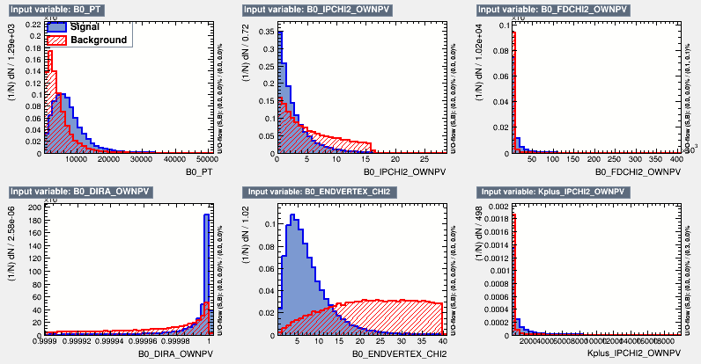
Inputvariables (1/5)

Slide 3
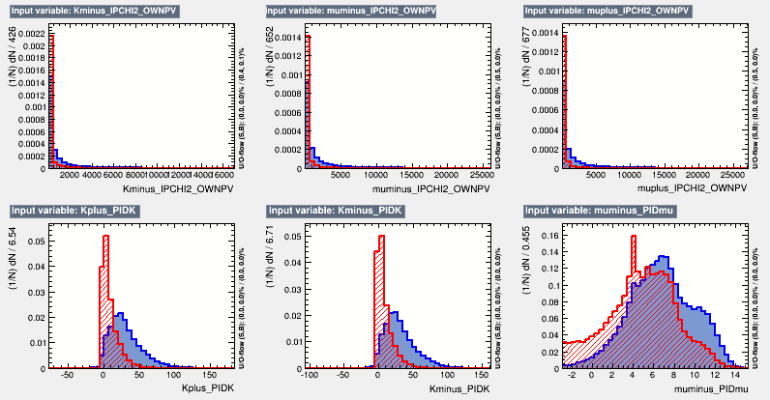
Inputvariables (2/5)

Slide 4
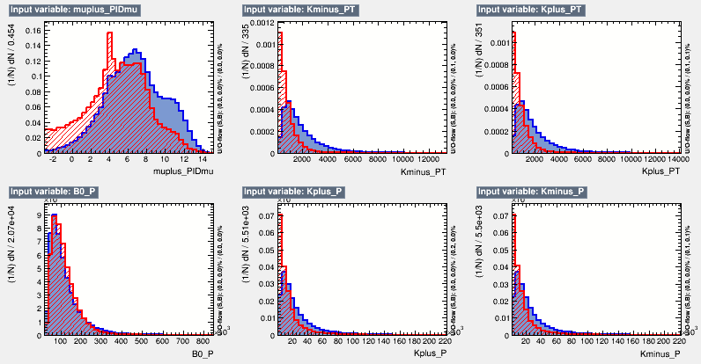
Inputvariables (3/5)

Slide 5
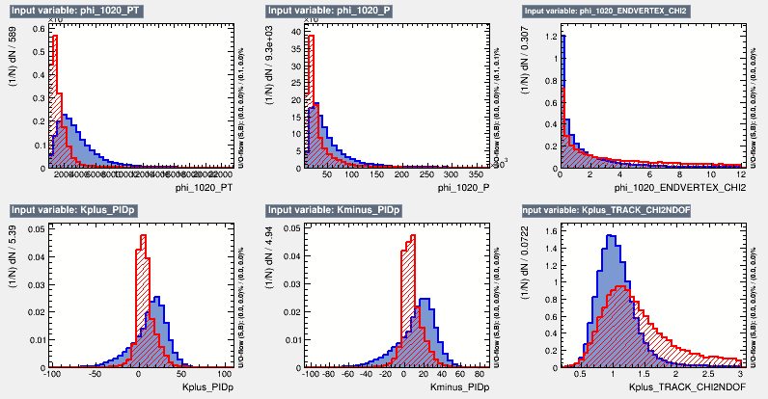
Inputvariables (4/5)

Slide 6
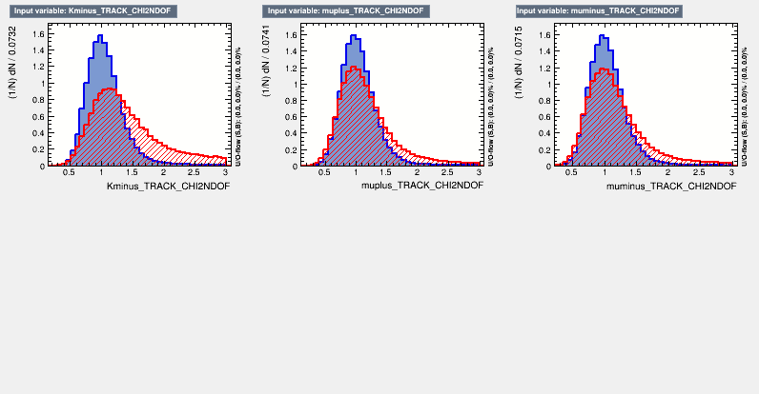
Inputvariables (5/5)

Slide 7
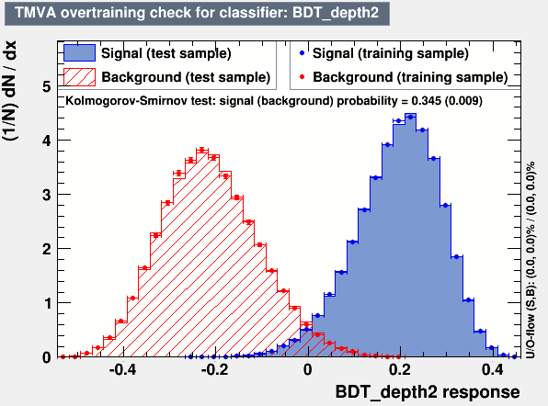
Overtraining-Check

Slide 8
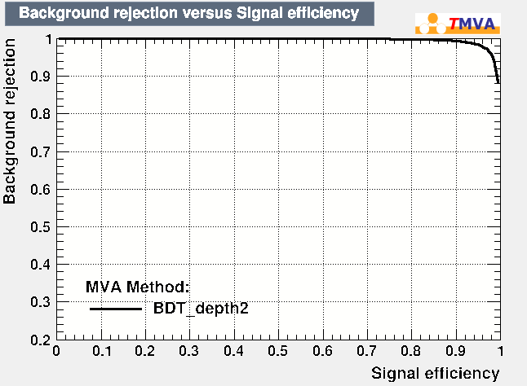
ROC-Curve

