Slide 1
Health Care Data Analytics
Lecture 1: Risk Adjustment and Predictive Modeling
Md. Jubayer Hossain
Instructor
@cblast.du.ac.bd

Slide 2
Health Care Data Analytics Learning Objectives - 1
Define risk adjustment, predictive modeling, and validations of models in health care. (Lecture a)
Identify the health care and other data needed to perform risk adjustment and predictive modeling. (Lecture a)
Relate risk adjustment and population segmentation to allocation of health care resources and health care redesign. (Lecture b)
Notes:
The objectives for this unit, Risk Adjustment and Predictive Modeling, are to:
Define risk adjustment, predictive modeling, and validations of models in health care,
Identify the health care and other data needed to perform risk adjustment and predictive modeling,
Relate risk adjustment and population segmentation to allocation of health care resources and health care redesign,

Slide 3
Health Care Data Analytics Objectives - 2
Discuss uses of risk adjustment and modeling in value-based models of care. (Lecture b)
Delineate the use of health information technology in the creation, delivery, and evaluation of prediction models. (Lecture c)
Describe ethical considerations in risk adjustment in population management. (Lecture c)
Notes:
Discuss uses of risk adjustment and modeling in value-based models of care,
Delineate the use of health information technology in the creation, delivery, and evaluation of prediction models,
And, describe ethical considerations in risk adjustment in population management

Slide 4

Wanda, our Chief Analytics Officer
Leads HealthWest’s analytic efforts
HealthWest has:
2 hospitals
90 clinics
800 providers
350,000 patients
Improve value using data, information, and knowledge
Pixabay, CC0 Public Domain
Notes:
In this lecture, we will examine a scenario that employs data analytics in a health care setting, define some of the terms frequently used when doing risk adjustment and data analytics, give an overview of how to perform risk adjustment and predictive modeling, describe several types of risk adjustment, and identify the data needed to perform risk adjustment and predictive modeling.
To understand the purpose of risk adjustment and predictive modeling, let’s imagine a concrete scenario. In our scenario, Wanda is the Chief Analytics Officer at HealthWest. HealthWest consists of 2 hospitals, 90 clinics, 800 providers, and 350,000 patients. Her job is to improve value at HealthWest using its data, information, and knowledge.

Slide 5
Wanda’s 3 Main Strategies - 1
Improve effectiveness of and reduce harm from care
Notes:
To tackle her job, Wanda employs three main strategies.
Number one, improve the effectiveness of and reduce the harm from care by providing just-in-time data, information, and knowledge to decision makers.
There is a lot of data in HealthWest’s system and they could waste a lot of resources analyzing data that does not have any relevance. Instead, Wanda focuses on decisions that are being made now and what information will affect those decisions.

Slide 6
Wanda’s 3 Main Strategies - 2
Improve effectiveness of and reduce harm from care
Improve allocation of resources by analyzing data
Notes:
Her second strategy is to improve the allocation of resources by analyzing data. HealthWest’s resources include its staff, its supplies and equipment, and its facilities. While together they can do great things, when allocated poorly they can be wasteful.

Slide 7
Wanda’s 3 Main Strategies - 3
Improve effectiveness of and reduce harm from care
Improve allocation of resources by analyzing data
Add value to care by increasing benefit and reducing cost
Notes:
Wanda’s third main strategy is to add value to care by increasing benefits and reducing costs to the health system. Better application of the same technology can achieve both of these.

Slide 8
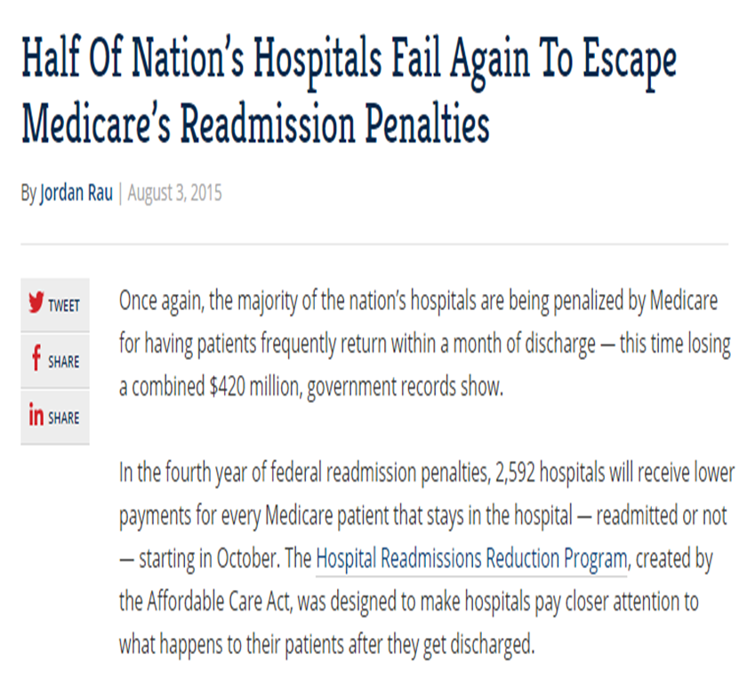
Wanda’s Problem
30 day readmission rate is high
They lose money on readmissions due to a new Medicare program.
Rau, 2015
Notes:
The current problem Wanda is facing is that the health system’s 30 day readmission rate is high. HealthWest will pay a penalty due to a new Medicare program that does not pay for readmissions that occur within 30 days of discharge. She needs to see what decisions are being made and see what analytics could be useful.

Slide 9
How can Wanda use data to help?
Examine readmission rates to see if they are properly risk adjusted
Use predictive modeling to identify patients:
At risk for readmission
Responsive to a particular intervention
For example: in-home monitoring
Notes:
How can Wanda use data to help with this problem?
First, she might want to examine the 30 day readmission rates to see if they have been properly risk adjusted. While their rates are high, it may be due to predictable factors.
Next, she could generate a predictive model to identify patients who are at risk for readmission. She knows that the health system has an in-home monitoring program that could be deployed, but because there are so few patients who would really need it and be responsive to it, deploying it unnecessarily is wasteful. Instead, she would like to use the program only for those who are at risk.

Slide 10
Definitions
Risk Adjustment
Adjusting the level of measured outcomes to account for risk factors of the patient, environment, and system
Alternative Payment Model
You pay a provider based on something other than just the count of services performed.
Predictive Modeling
Predicting an outcome based on factors of the patient, environment, and system
Notes:
So far, we have highlighted the two main terms of the lecture: risk adjustment and predictive modeling. Let’s pause to define them more clearly.
The term risk adjustment can be used in many contexts, but when speaking in relationship to health information technology, or HIT, risk adjustment refers to how we adjust the level of measured outcomes to account for risk factors of the patient, the environment, and the health care system. Historically, this calculation was performed by actuaries concerned with understanding the expected cost of a person or group of persons, based on measurable factors. Currently, as health systems become responsible for the cost of patients they see, risk adjustment is being used to facilitate alternative payment models and risk stratification.
Alternative payment models refer to when you pay a provider based on something other than just the count of services performed. It may mean you pay a fixed amount, or a capitated payment-regardless of services, or it may involve the quality or performance of services.
The term predictive modeling refers to predicting an outcome, or the likelihood of an outcome, based on the factors of the patient, the environment, and the health care system. One example of this is to identify which patients undergoing obesity surgery are most likely to have complications.

Slide 11
Key Concepts
Outcomes
Measured levels
Constructed values
Characteristics related to outcome
Called different names
Examples
Age, sex, marital status
Diagnoses
Notes:
Risk adjustment and predictive modeling share several key concepts. First, both are concerned with outcomes. The outcomes can be measured levels, such as cost or blood pressure; or constructed values, such as whether a patient has been readmitted after an initial stay in the hospital.
When designing a risk adjustment or predictive model, costs, also known as expenditures, are measured continuously from 0 to any total amount.
Other outcomes, like readmission, mortality, or complications are events that are simply measured with a yes or no, and are typically coded as a 1 or a 0 in the data.
The other concept common to both risk adjustment and predictive modeling are characteristics related to the outcome. These can be called factors, predicting variables, or independent variables. Some common examples in health care include age, sex, and marital status. Additionally, diagnoses-such as heart disease and diabetes-represent a rich array of information about a person.

Slide 12
Factors Explaining Health Spending
Van de Ven, W. and Ellis, R. (2000)
Notes:
For health spending, the diagram from Van de Ven and Ellis’s book on risk adjustment suggests that most of the variation in health care expenditures is random and cannot be explained by systematic features.
The chart does not empirically estimate the proportions, but lists the different types of factors that could be included in risk adjustment, such as: age and sex, health status, socio-economic, provider, input prices, market power, and benefit plan. The last three apply more directly to health spending than the other outcomes do.

Slide 13
How to Perform Risk Adjustment and Predictive Modeling - 1
Estimate relationship between factors and outcome
One factor - take the mean of each value
More than one - regression model is needed
Predict outcomes using factors only
Using mean value or coefficients from step 1
Value obtained is primary output of predictive modeling
Notes:
The basic process of risk adjustment and predictive modeling can be summarized with the following four steps.
Step one, estimate the relationship between the factors and the outcome. If there is only one factor, such as sex, with two values-male and female-the mean outcome level for each value will work. If there is more than one factor, a regression model is needed.
Step two, predict the outcomes for each observation. This could be based on the mean value or the coefficients from the regression model in step 1. The predicted outcome is the primary output of predictive modeling.

Slide 14
How to Perform Risk Adjustment and Predictive Modeling - 2
If risk adjustment is needed:
Calculate ratio of predicted levels to actual levels for each observation
Ratio is the risk-adjusted index value
Multiply ratio by the mean outcome level
Produces the risk-adjusted level of outcome
Notes:
Step three, if risk adjustment is needed for a group of observations, such as a clinic, then for each group of observations, calculate the ratio of the mean predicted levels from step 2 to the mean actual levels. The ratio is the risk-adjusted index value for the group’s outcome.
Step four, multiply the ratio by the mean outcome level. This produces the risk-adjusted level of the outcome for the group.

Slide 15
Risk Adjustment Types
Retrospective
Use factors in the previous period to predict previous period outcome
Concurrent
Use factors in the current period to predict final current period outcome
Prospective
Use factors from previous period, including the outcome (if available), to predict future period outcome
Notes:
There are three main types of risk adjustment that are worth noting.
Retrospective risk adjustment uses factors in the previous period to predict previous period outcomes.
Concurrent risk adjustment uses factors up through and in to the current period to predict the final level of the current period. In particular, it can include the current level of the outcome of interest, though it is not yet completed.
Prospective risk adjustment uses factors from the previous period, including the outcome, if available, to predict future period outcome. It is worth noting that some factors may not predict the future very well, despite being good retrospective factors, if the factor is unlikely to persistently affect the outcome. For instance, the diagnosis of a broken leg is likely to affect the retrospective and concurrent risk, but much less so the prospective risk. Most patients will not have ongoing care if a broken leg is able to heal properly.

Slide 16
Risk Adjustment and Predictive Modeling Performance
Many measures depending on application
Most common measures include:
R-squared (R²)
Percentage of total variation explained by factors in the model
Mean Absolute Prediction Error (MAPE)
Tells you how far off you are in your prediction from the values
Can be presented as a number or percent.
Notes:
Not all models are the same and it is worth knowing how they perform. The most common measures used to evaluate risk adjustment and predictive models include the R-Squared and mean absolute prediction error.
The r-squared is the percentage of the total variation explained by factors in the model.
The mean absolute prediction error, or MAPE, computes the difference between each outcome and its predicted level, then takes the mean of this error across all observations. Lower numbers are better for the MAPE.

Slide 17
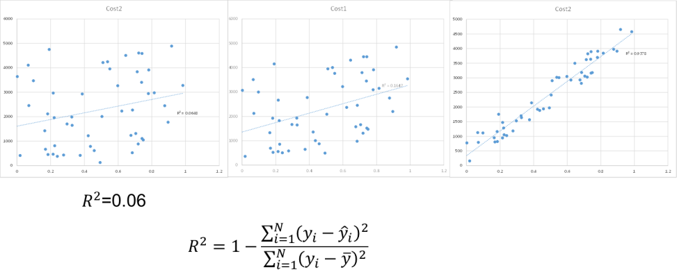
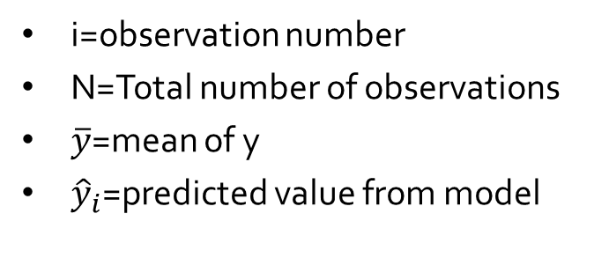
Sample Scatter Plots By R-Squared Value
i=observation number
N=Total number of observations
$\overline{y}$=mean of y
${\hat{y}}_{i}$=predicted value from model
Notes:
To get a sense of the how the R-squared relates to the data, the scatter plots of cost and risk score on the slide show the r-squared at 3 levels: 0.06, 0.16, and 0.93.
As is evident in the third panel, an r-squared value of 0.93 means the observed values on the y-axis are closer to the predicted values, which are shown on the blue line. Unfortunately for health care outcomes, most models are more similar to the first or second panels and thus the risk score does not provide as much information about what is likely to occur.

Slide 18
Predictive Models: Accuracy - 1
When the predicted score from a model is used to categorize patients, various classification statistics can evaluate the accuracy of the model
Sensitivity
Specificity
False positive/negatives
Positive predictive value
Notes:
In predictive modeling it is typical to use the predicted score to categorize patients into different types. For instance, all patients with a risk score above a threshold of 90 on a scale of 0 to 100, may be considered “high risk”.
After this threshold has been established, it is possible to calculate various measures of how the predicted category compared to the actual category. The most common measures are the sensitivity, or percent of true positives-of those being high risk-that were predicted to be high risk.
Specificity refers to how well the predictive model rules out negatives, or patients who are not high risk. For example, the model could essentially declare all patients to be high-risk and the sensitivity would be very high. Though to be useful, it also needs to rule out some patients. Thus specificity is calculated as the percentage of true negatives that were predicted as negative.

Slide 19
Predictive Models: Accuracy - 2
Classification accomplished by setting thresholds of risk score to categorize observations
Receiver Operating Characteristic (ROC): A statistic assessing both sensitivity and specificity equally across all possible thresholds
Notes:
One additional term that is worth knowing about for risk adjustment models is the C-Statistic. This takes a little explaining, which is why you don’t see the word C-Statistic on the slide yet.
As mentioned on the previous slide, when the predicted values are classified, a threshold is used.
Since the performance statistics will be different based on that threshold, it is common to calculate a statistic which captures the accuracy, both sensitivity and specificity equally, across all possible thresholds. This is displayed as the receiver operating characteristic, or ROC curve.

Slide 20
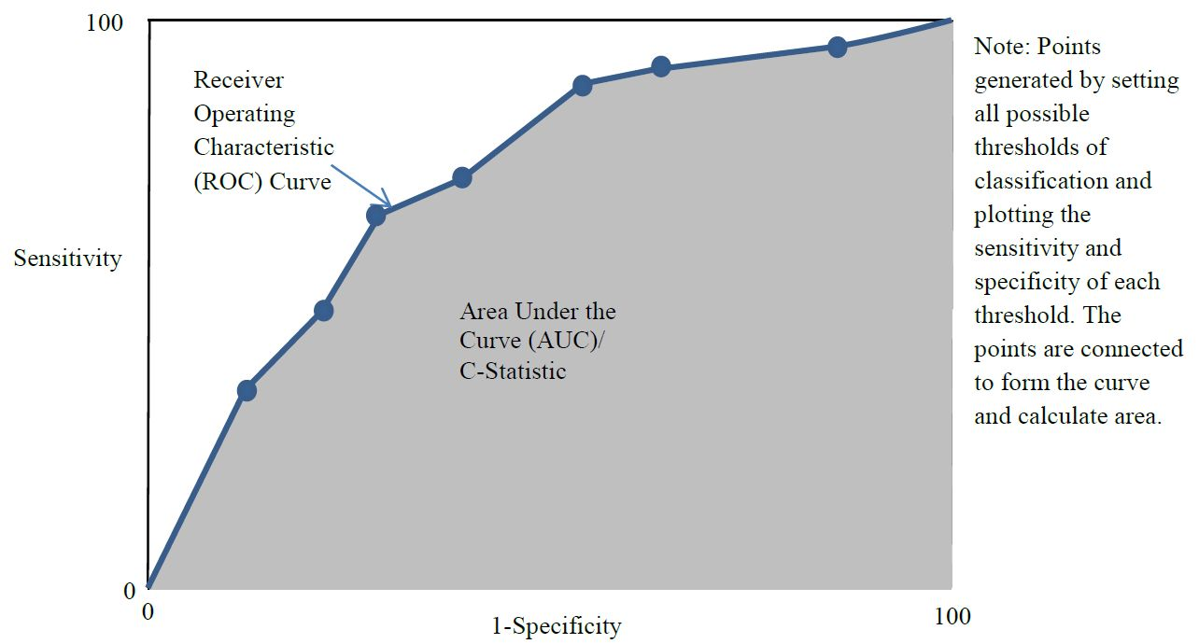
Predictive Models: Accuracy - 3
Curve generated by selecting all possible threshold values, plotting the sensitivity and specificity of each, and connecting the dots
Graven, P. 2016
Area under curve is C-statistic; the larger the area, the better the performance
Notes:
It is the area under the curve that is known as the C-statistic. Ranging between 0 and 100 percent, values above 50 indicate the model is performing better than randomly picking observations to exceed the threshold.

Slide 21
Data Sources
Factors and outcomes can be gathered from various sources:
Claims Data
Diagnoses, procedures, prescriptions, billable events
Enrollment Files
Demographic data not included in claims
Records of people without claims
Electronic Health Record
Detailed clinician notes, lab values, etc.
Notes:
Factors and outcomes for estimating or predicting models can be gathered from many sources.
Claims data are the records between providers and payers of services performed. These data typically include the diagnosis and basic demographic information, such as age and sex.
Enrollment data can provide additional demographic information that is not included in the claim record. Importantly, these data will include factors for individuals who have not had claims submitted on their behalf.
Finally, many organizations have electronic health records which can include detailed clinician notes, lab values, and other measurements not included in claims or enrollment data.

Slide 22
Vendors - 1
Adjustment and predictive models need to be estimated, larger population = greater accuracy
Organizations may not have access to data or lack the expertise to estimate the models
Sell software systems which have the coefficients embedded/hidden
Apply to characteristics of the records
Organization is then able to obtain scores for each record
Notes:
As indicated previously, the adjustment and predictive models need to be estimated, and for more accuracy, those estimates should be based on a large population. Because organizations may not have access to the data needed to estimate the models or they may lack the expertise necessary to estimate the models, they frequently acquire existing models from vendors. The vendors sell software systems which have the coefficients embedded, sometimes even hidden in the software, and then apply them to characteristics of the records at the organization. The organization is then able to obtain scores for each record to use for risk adjustment or predictive modeling.
Can you guess why the software sometimes just gives a list of people above a threshold rather than the score itself?
If the score was provided, the organization may be able to test different values and figure out the coefficient for each factor and no longer need to purchase the product.

Slide 23
Vendors - 2
Private
Symmetry/Optum: Episode Risk Groups (ERG)
3M: Clinical Risk Groups (CRG)
Verisk: (DxCG)
Truven: Medical Episode Grouper (MEG)
Public
CMS: Hierarchical Clinical Classifications (HCC)
Johns Hopkins: Adjusted Clinical Groups (ACG)
UC San Diego: (Chronic Disability Payment System (CDPS)
Notes:
Some of the larger private vendors of risk adjustment models include the Symmetry product from Optum which calls its scores episode risk groups.
The 3M company produces scores called clinical risk groups.
Verisk produces risk scores given by the abbreviation DxCG.
Truven has a product called the Medical Episode Grouper.
Some public entities have also created ways to adjust risk. The Centers for Medicare and Medicaid Services, or CMS, created the hierarchical clinical classifications.
Johns Hopkins University created the adjusted clinical groups, or ACG.
The University of San Diego has maintained the chronic disability payment system, or CDPS, which is targeted at the Medicaid population.
There are many other risk adjustment models for sale and use.

Slide 24
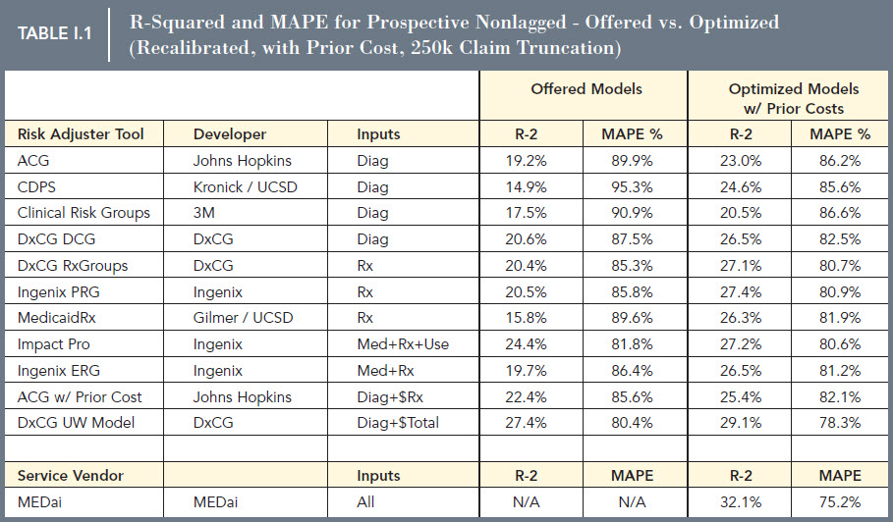
Vendor Model Performance
Winkelman, R. and Mehmud, S. (2007)
Notes:
So, which product is best? A 2007 study by Winkelman and Mehmud for the Society of Actuaries compared various risk adjustment models using the performance statistics we discussed: R-Squared and mean absolute prediction error. While many versions of the comparison were conducted, it is worth noting that the highest performing risk score, Verisk DxCG, using only diagnosis information - and age and sex - had an R-squared value of 20.6, and 26.5 when previous cost information is included. The CDPS model was the lowest, with an R-squared of 14.9.
The Mean Absolute Prediction Error is presented as a percent of the prediction itself, so the errors often are nearly as large as the prediction itself. Lower MAPEs are better, and generally follow the R-squared.

Slide 25
Wanda’s Task
Purchase or construct a risk adjustment model
Compare risk adjusted readmission rates to a benchmark to assess size of problem
Create a predictive model to identify cases that are responsive to an intervention
See Data Exercise!
Notes:
Returning to Wanda’s problem of adjusting her 30-day readmission rate for risk and trying to predict patients at risk of readmission, we are left with two general options: She could purchase a product from a vendor or construct her own.
With either approach, she will want to compare her risk adjusted rates to the benchmarks against which she is judged, and assess the size of the problem.
Next, she can use predictive modeling features to identify cases that are responsive to an intervention. The data exercise associated with this unit will provide a similar activity.

Slide 26
Risk Adjustment and Predictive Modeling Summary – Lecture a
Risk adjustment adjusts outcomes by patient and other characteristics.
Predictive modeling predicts outcomes.
Validation involves comparing predictions to reality with measures like R² and MAPE; area under the curve shows benefit of classification.
Data used commonly come from health care claims, enrollment, and electronic health record data.
Notes:
This concludes lecture a of Risk Adjustment and Predictive Modeling.
In this lecture, we showed that risk adjustment is the process of adjusting outcomes by patient variables, such as age, health status, and other conditions, while predictive modeling attempts to predict the likelihood of an outcome.
We discussed how validating the models requires comparing predictions to reality; we discussed R-squared, or proportion of variation explained, the mean absolute prediction error, area under the curve, and other classification metrics.
Finally, data come from many different sources, but most common are health care claims, enrollment, and electronic health record data.

Slide 27
References
References
Rau, J. (215, August 3). Half of Nation's Hospitals Fail Again to Escape Medicare's Readmission Penalties. Retrieved May 7, 2016, from http://khn.org/news/half-of-nations-hospitals-fail-again-to-escape-medicares-readmission-penalties/
Van de ven, & Ellis. (2000). Risk adjustment in competitive health plan markets. In Handbook of Health Economics (1st ed., pp. 755-45). Elsevier B.V. doi:10.1016/S1574-0064(00)80173-0
Winkelman, R. (2007, April 20). A comparative analysis of claims-based tools for health risk assessment. Retrieved May 7, 2016, from https://www.soa.org/research/research-projects/health/hlth-risk-assement.aspx
Notes:
References slide. No audio.

Slide 28
Health Care Data Analytics Risk Adjustment and Predictive Modeling Lecture a
This material was developed by Oregon Health & Science University, funded by the Department of Health and Human Services, Office of the National Coordinator for Health Information Technology under Award Number 90WT0001.
Notes:
No audio.

