Slide 1
Health Care Data Analytics
Lecture 1: Risk Adjustment and Predictive Modeling
Md. Jubayer Hossain
Instructor
@cblast.du.ac.bd

Slide 2
Health Care Data Analytics Learning Objectives - 1
Define risk adjustment, predictive modeling, and validations of models in health care. (Lecture a)
Identify the health care and other data needed to perform risk adjustment and predictive modeling. (Lecture a)
Relate risk adjustment and population segmentation to allocation of health care resources and health care redesign. (Lecture b)
Notes:
The objectives for this unit, Risk Adjustment and Predictive Modeling, are to:
Define risk adjustment, predictive modeling, and validations of models in health care,
Identify the health care and other data needed to perform risk adjustment and predictive modeling,
Relate risk adjustment and population segmentation to allocation of health care resources and health care redesign,

Slide 3
Health Care Data Analytics Objectives - 2
Discuss uses of risk adjustment and modeling in value-based models of care. (Lecture b)
Delineate the use of health information technology in the creation, delivery, and evaluation of prediction models. (Lecture c)
Describe ethical considerations in risk adjustment in population management. (Lecture c)
Notes:
Discuss uses of risk adjustment and modeling in value-based models of care,
Delineate the use of health information technology in the creation, delivery, and evaluation of prediction models,
And describe ethical considerations in risk adjustment in population management.

Slide 4
Future Needs for Predictive Modeling
More and Better Health Information Technology
More and Better Data
Cultural Transformation
Ethical Considerations: public sharing and responsible use, benefits versus risks
Notes:
In this lecture, we will describe the systems used in the creation, delivery, and evaluation of prediction models, including health information technology systems. We will also describe the significant ethical considerations required when implementing these models.
What do we need to better complete risk adjustment and predictive modeling? We must improve the systems we use to deliver health information technology. More importantly, however, our data must improve in quality: we need more sources of data and we need our cultural systems – how people think, feel, and react to risk scores and models – to change. We must also reflect on the ethical considerations in more detail – how and when to share, what is acceptable to society and individuals, and how we manage benefits and risks.

Slide 5
More and Better Health Information Technology (HIT)
How is HIT used now?
How might it be used in the future?
Notes:
How do we use Health Information Technology, or HIT, now? How can we use it better in the future?
The entire trajectory of HIT use is changing so fast that it is difficult to keep up. Many innovations exist now that could change health care significantly, but are not widely distributed. For instance, using genetic data, we can predict who is likely to get muscle aches or even muscle breakdown from a class of cholesterol lowering drugs known as statins. We do not do these tests now, however, because the genetic testing is difficult to get, the storage and retrieval of this information is not possible in most HIT systems in structured, or encoded, fashion, and most providers don’t know what to do instead of using statins.

Slide 6
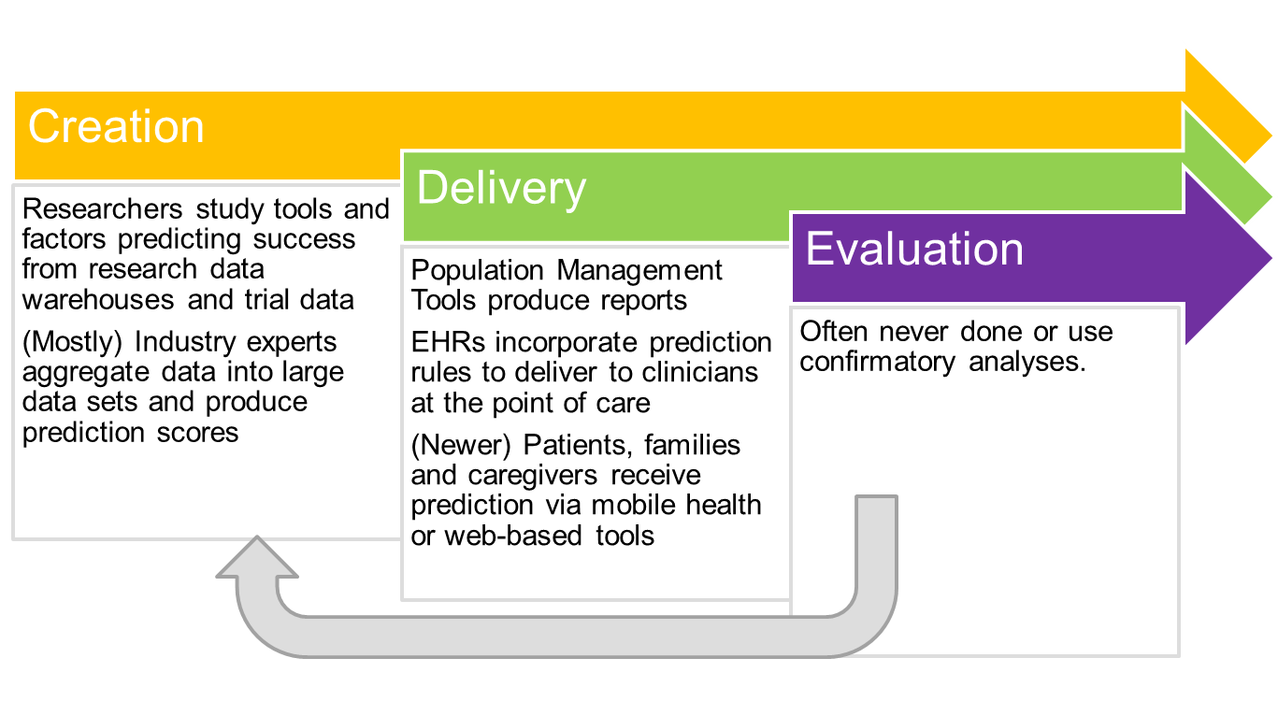
HIT Used for Prediction
Dorr, D. 2016
Notes:
HIT is used for prediction in three ways: creation, delivery, and evaluation.
Researchers and people in industry often create algorithms that risk stratify or predict outcomes. Researchers study a condition or group of patients, analyze their data, and propose a risk score.
Industry also analyzes data, but they use it for the benefit of program planning. The word industry, in this situation, is loosely defined as large health plans, health product companies, and data oriented companies that work with health care, such as Siemens or Optum. Some examples of questions industry would try to answer using HIT in prediction would be:
How much of our health care resources will a specific group of patients use?
Which patients will benefit most from certain procedures?
How can data collected from person-tracking devices, like FitBits, be used to provide feedback and increase use?
In terms of delivery, HIT is used in reports produced by health systems. Additionally, rules might be put in Electronic Health Record Systems, or EHRs, to deliver recommendations at the point of care. Patients and families use HIT when they receive information via email or the web.
The use of HIT for evaluation in terms of implementation and benefit/harm analysis in the real world is often limited. Industry sees the algorithms as important intellectual capital, and researchers only rarely have taken the time to see what happens after their rules are implemented. This is changing, however, as more informatics research looks at dissemination and implementation.

Slide 7
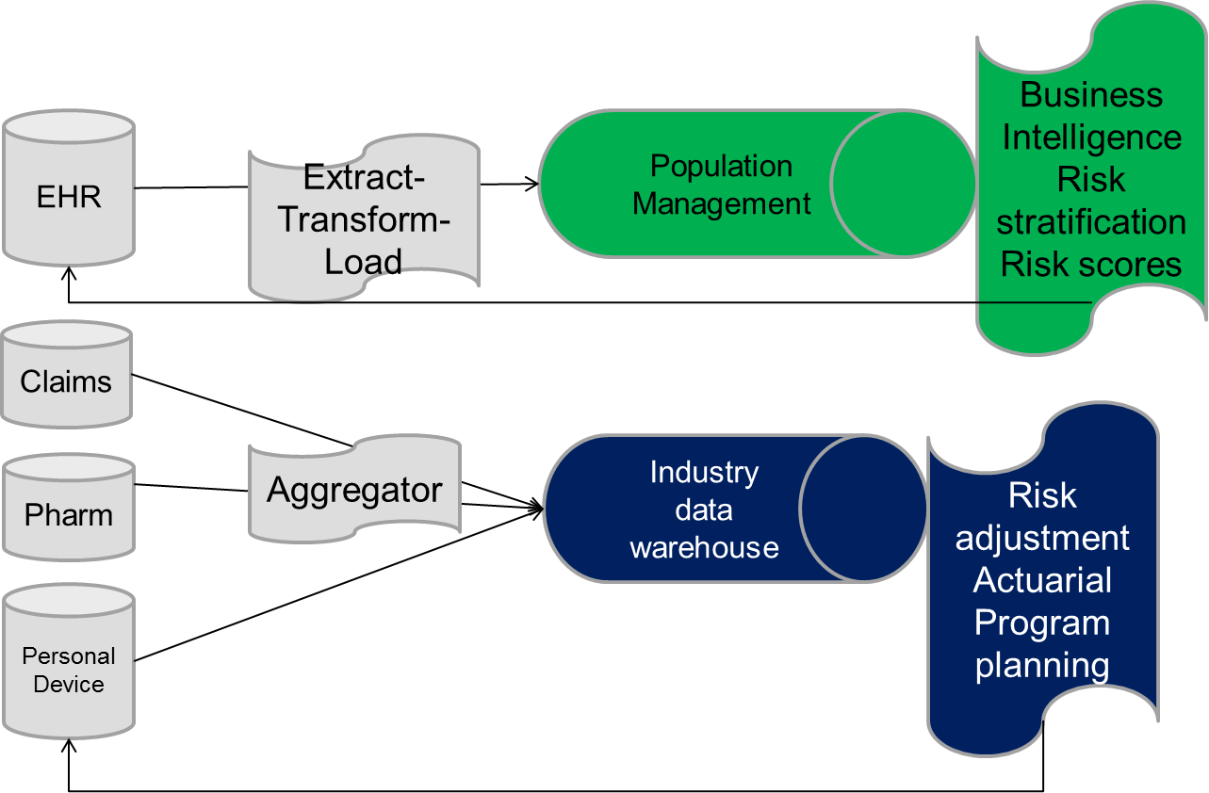
HIT Components and Data Flow (an example)
Dorr, D. 2016
Notes:
Here is an example of the steps required to produce these risk scores. On the far left, a group of data sources are shown.
Starting from the top, EHR data is collected about health care delivered to patients and the results of their studies. Historically, this information is highly context-dependent and largely narrative, with narrative meaning notes about patient conditions and treatments. For instance, researchers have shown that the diagnosis of diabetes is often recorded for billing purposes when a test to rule out diabetes is completed; this ‘billing’ code would go to the next data source, known as claims, but not the result of the test that ruled out diabetes. Claims, therefore, has the bills for procedures, visits, and diagnoses.
Pharmacy benefits, a kind of claim, has information about medications covered by insurance.
Finally, personal device data may track a person’s steps, workouts, or diet. In the top diagram, EHR data alone is extracted, transformed, and loaded into population management systems or enterprise data warehouses. This workflow usually occurs at a health system. Next, the ‘business intelligence’ or ‘analytics’ team at the health system might produce reports and risk scores. Sometimes this information is put back in to the EHR. The other sources – claims, pharmacy data, and device data - might be purchased and go into an ‘aggregation’ program at an industry data warehouse, where risk adjustment, actuarial analyses, or program planning might occur. Industry might also use this information to anticipate new markets for products. In either case, the data is taken away from where and how it was collected, leading to significant confusion, at times, about the meaning of the scores.

Slide 8
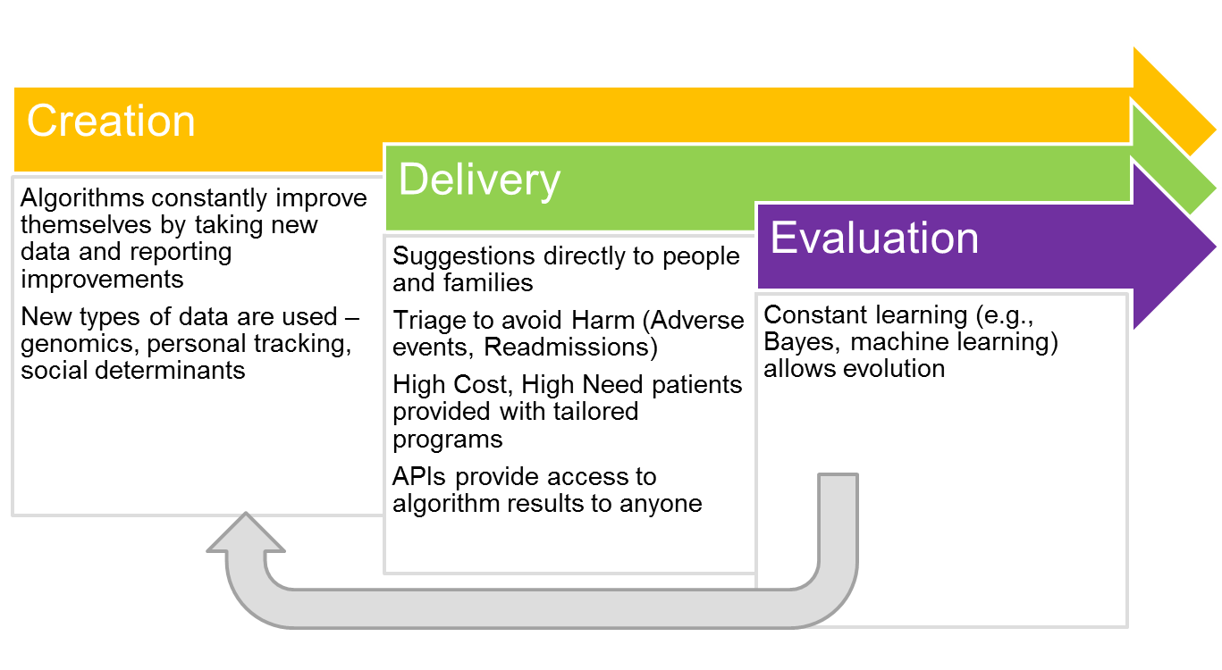
Future Use of HIT for Prediction
Image: Dorr, D.; Key examples: Bates, DW
Notes:
In the future, we may have new ways to create, deliver, and evaluate risk predictions using HIT.
For creation, new ‘self-evolving’ algorithms may be programmed to periodically evaluate themselves and report potential improvements to their ability to predict. In addition, new types of data will completely revolutionize prediction. For example:
Genetic and protein data will change how we predict response to treatments and future risks
Personal tracking devices such as heart rate monitors will be used to detect risks of future problems from heart dysrhythmias or sedentary lifestyles,
And finally, social determinants of health will be used to better allocate societal resources and programs. Included here are things such as the environment and local social capital, like parks or the availability of healthy food.
Delivery will increasingly go to multiple parties – people and families, providers more directly through application programming interfaces, or APIs. In fact, universal APIs are now being built on standards like Fast Healthcare Interoperable Resources, or FHIR and others.
As David Bates and colleagues point out, patients will be more quickly triaged in health care settings to determine urgency and treatment as well as to avoid harm from adverse events from drugs and readmissions from complications.
Patients who are high-cost, high-need – the 5% who need 50% of health care resources – will have more integrated, tailored programs. Finally, evaluation will be built in to creation, but will also allow more careful consideration and tailoring.

Slide 9
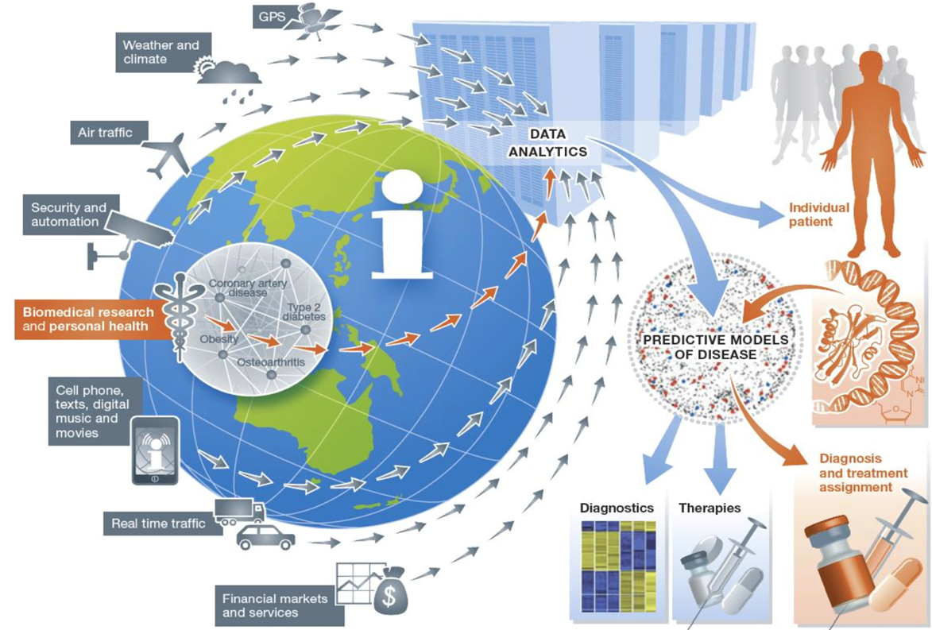
More and Better Data: Ecosystem
Eric Schadt, 2014
Notes:
You can’t deliver risk scores or models without data; data has historically come from a few sources but the data ecosystem, shown here in an image by Eric Schadt, is growing. Global positioning systems, weather, traffic, and other sources will be combined with increasing amounts of biomedical and personal health data to produce better predictive models of disease for diagnosis, therapy selection, and treatment. Our understanding of genetics is evolving rapidly; soon, our idea of disease will be much more nuanced – rather than leukemia as the condition, we will have clear markers of the dominant clones in leukemia, potential treatments, and monitor evolution of the cancer and react more quickly to treat more effectively.

Slide 10
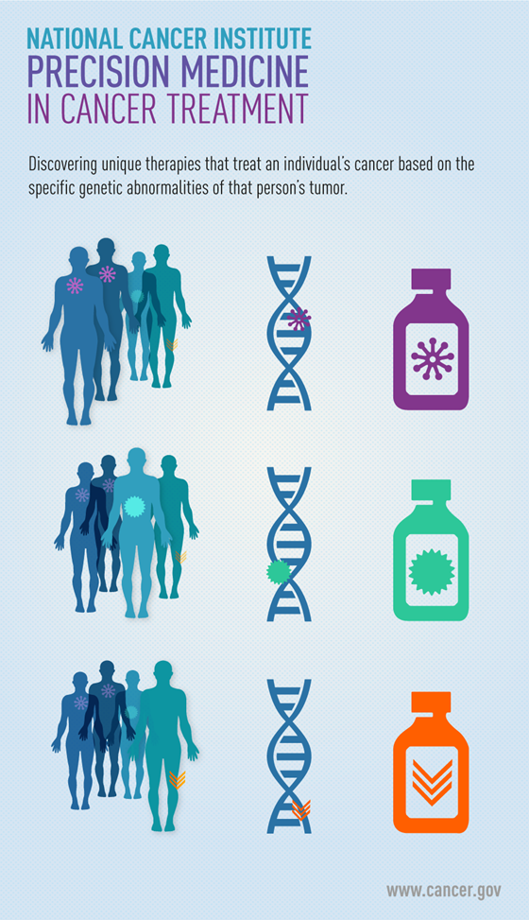
More and Better Data: Precision Medicine - 1
Uses specific new data types – genomic, proteomic, and others – to predict and even develop treatments that will lead to positive responses
Still new as of 2016, but more and more evidence suggests it will transform medicine.
For extra knowledge, look up cas9/crispr or immunotherapy
Notes:
The mechanism of using very precise information about a patient and disease is called Precision Medicine. Precision Medicine is a prediction technique. As shown in the image from the National Cancer Institute, cancers can be genotyped and specific treatments found or even created for each cancer. Although this approach is new, it highlights how prediction models might be used in every treatment for every patient. If you are interested in this topic, read about immunotherapy or Cas9/CRISPR approaches in the news or on health care blogs.

Slide 11
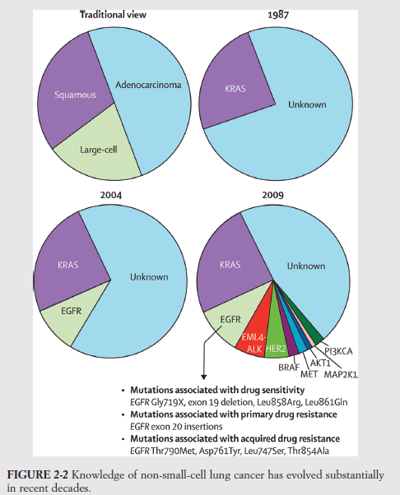
More and Better Data: Precision Medicine - 2
Prediction of treatment resistance for non-small cell lung cancer was limited in 1987 to a single source: KRAS; in 2009, 9 separate sources have been found.
Prediction of treatment response will continue to evolve massively as this new data becomes available
Notes:
The evolution of precision medicine is shown here. Historically, our knowledge of small-cell lung cancer was limited to 3 traditional cell types: squamous, large cell, and adenocarcinoma. And in 1987, one genetic mutation, KRAS, was discovered that represented about 27% of cases. In 2004, we found one more genetic mutation, EGFR, which represented about another 10% of cases. By 2009, we had added 7 more genetic mutations for a total of 9; now diagnosing the genetic mutation in more than 50% of cases. This massive change is meaningful because we can attack the mutations in different ways; we won’t use a drug where the genetic mutation gives resistance to it, instead opting for other therapies.

Slide 12
Gaps and Issues: The 4 V’s
Volume: Amount of data
Velocity: Increasing speed data is generated, decreasing time to act on it
Variety: Diversity of data sources
Veracity: Is the data appropriate for your use?
Notes:
What are some of the problems with our view of the future? The first is the four v’s of data: volume, velocity, variety, and veracity. As data increases in volume from terabytes to petabytes, the size of our HIT systems must increase to accommodate such large amounts of data.
Processing power and algorithm efficiency must also increase. Efficiency is very important, because the velocity of data is increasing – velocity being both the rapidity with which the data is generated and the decreasing time for us to act on that data. Imagine a thousand patients with heart monitors; for each patient the heart is beating 80 times per minute with continuous electrical output for each beat. If we could act quickly enough, we might detect a string of 10-15 beats – a few seconds – that are the precursor to a heart attack and act to save the life of the individual.
Variety indicates the diversity of data sources – how do you combine them? How do you make sense of their many storage forms?
And finally, veracity – how appropriate is the data for the use to which you want to put it? Or any use? Is it inaccurate? Too old? Incomplete?

Slide 13
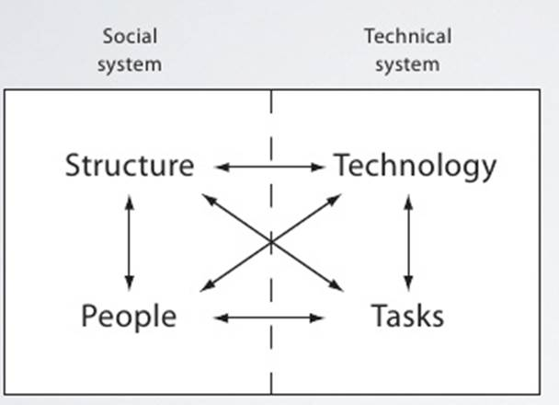
HIT and Data isn’t Nearly Enough: Cultural Transformation
Validity and Reliability of current predictions are limited – AUCs .60-.80
Response to prediction depends on the structure and people
People get fatigued and distrustful easily; alert fatigue > 80%
~80% social system – structures, people, and interaction
~20% technical system : HIT, tasks
Notes:
Although data issues are important, the way in which we take up data and use it in society and in our organizations depends largely on cultural issues. We have a saying in informatics that only 20% of the issues are technical – the HIT or specific tasks – and 80% are social – the norms, the structures, the people and their interaction.
Our ability to process and use information is limited, and the prediction rules are never perfect. Dealing with this uncertainty is difficult. The validity and reliability of the predictions for something like readmission is only accurate a fraction of the time, and response depends in large part on how much people trust the data, their current attention, their sense of what to do and how to do it, and what other people think. Currently, any alerting from the EHR has significant fatigue associated with it, meaning people ignore the alerts they receive from EHRs upwards of 80% of the time. This is the real dilemma.

Slide 14
New Opportunity and New Ethical Dilemma: Internet of DNA
Will millions of genomes be available across the world?
New technical standards from the Global Alliance for Genomics and Health allow sharing of genomes
Several initiatives are collecting millions of genomes, BUT
This is the most personal information available – how will we address privacy and confidentiality?
Notes:
In addition, we have strong beliefs about privacy, confidentiality, and security. The Harvard Business Review highlights how the creation of truly innovative algorithms based on genetics requires very personal information, like DNA, to be shared widely. How can we do this safely and give people confidence that the benefits are greater than the risks? This is the nature of the ethical principles.

Slide 15
Core Ethical Principles in Research and Data Science
Moral principles – Belmont Report
Respect for persons
Beneficence
Justice
Regulations – HIPAA for example
Practices – Make it easy to do the right thing
Notes:
In ethics around health care, we think about 3 major things – one, the moral principles; two, the regulations, and three, the practices. Each of these is important.
For this discussion, we will consider the Belmont Report, created in the 1970s, which highlighted three important moral principles:
* Respect for persons – meaning we must respect individuals and their rights and autonomy, protecting those with limitations to their autonomy
* Beneficence, meaning that we must act for active good;
* And justice, meaning we must consider equity and fairness.
For data and risk prediction, we must engage the consent of persons whose data is shared; we must use the information for good purposes rather than to discriminate or act against people; and we must be fair, providing the outcome of the data equitably. These are difficult issues.
Some regulations, like the health insurance portability and accountability act, or HIPAA, try to encode these principles. Enacted in 1996 and updated over the last few decades, the act establishes guidelines for protecting privacy, allowing patients to get their own data and decide when it can be shared, and punishing those who violate these laws. For practice, we must improve our ability to provide good by making it easy to do the right thing. When the data can be used appropriately, do we provide it in an easy to consume fashion to give benefit? Or is it unstructured or kept in a proprietary format?

Slide 16
Categories of Ethical Problems in Analytics
Health Care – Has harms and benefits, is neither globally available nor distributed equitably
Information/data – Management of information, EHRs, data exchange, confidentiality
Software – The tools we develop and use to manage information, diagnostics, analysis
Notes:
In a more focused analysis, we see that ethical problems in health care and prediction modeling are large. For health care, it isn’t equitably distributed or available; will our models improve this or make it worse? How we handle data through these transformations is also important – data used out of context may be misused or misappropriated, violating respect for persons. Finally, how we produce and share our algorithms through software is important – poorly programmed software may fail to produce outcomes we want, and may harm persons.

Slide 17
Public Access to Data
Are there cases when it is important to have public access to personal health data?
Personal autonomy / right to choose
Public health – surveillance, epidemiological investigations, population-based interventions
Research
Quality assurance / monitoring fraud / abuse
Notes:
When should we provide public access to data? For example, to be effective, the Internet of DNA would require making genomes public; this would likely be covered under the ethical area of personal autonomy – if you accept the risks, and potential benefits, of releasing all of your genetic information, you should be able to do so. However, what about the wishes of those who share parts of your genome, your children or relatives? Could the release of your genome adversely affect them?
Public health has often trumped individual desire to keep data private. For example, a restaurant owner whose business fails a health inspection may not want that data made public. But, if making that information public would limit the outbreak of a potentially deadly disease such as e. coli, the wishes of the business owner will be overridden.
Similarly, the mortality rate of a hospital with a surprising number of deaths might be released to the public due to concerns about quality assurance and potential abuse.
Finally, research requires significant amount of data to create, test, and validate predictions – but should the data be released to accommodate that? At this stage, nearly all of the efforts focus on the first ethical area from the Belmont Report – allowing individuals the right to choose by fully informing them of the risks and benefits.

Slide 18
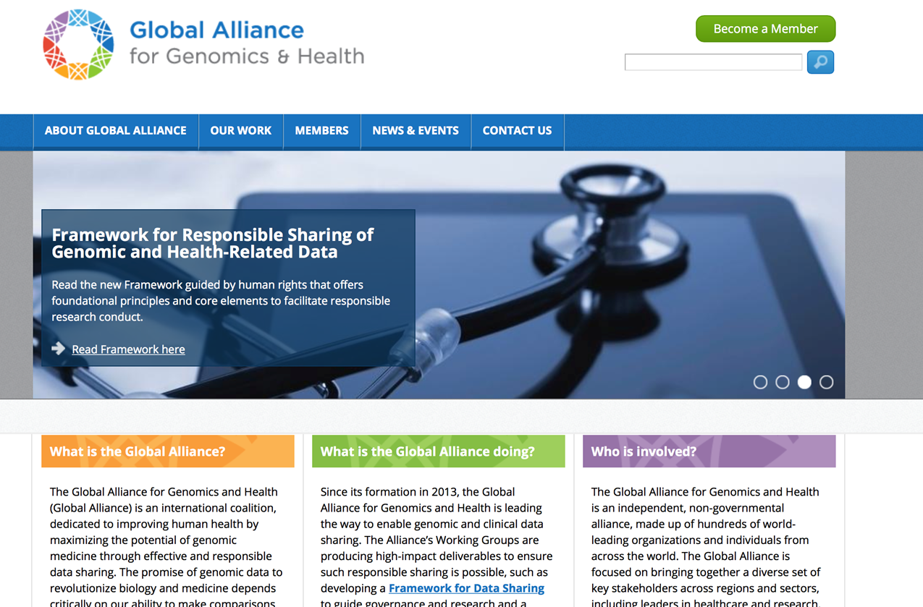
How to Address Ethical Dilemmas: Data Sharing: GA4GH http://genomicsandhealth.org
Notes:
A huge amount of effort is going into learning how to share data while maintaining these ethical principles. The Global Alliance for Genomics and Health, or GA4GH, is a large international effort intended to help explore and learn how to share this data ethically and appropriately. The image on the screen is from their webpage, which highlights their framework for responsible sharing of such data. The link given can provide a great deal of information.
Ultimately, the solution to these ethical dilemmas is to explore different frameworks and approaches that satisfy ethical concerns and can help capitalize on the potential for new ways to analyze data, to stratify risk, and to predict diagnoses, outcomes, and response to treatments.

Slide 19
Risk Adjustment and Predictive Modeling Summary - Lecture c
Delineate the use of health information technology in the creation, delivery, and evaluation of prediction models.
Describe ethical considerations in risk adjustment in population management.
Notes:
This concludes lecture c of the unit on Risk Adjustment and Predictive Modeling.
In this lecture, we:
Described the systems used in the creation, delivery and evaluation of prediction models
Described some of the ethical considerations involved when implementing risk adjustment and prediction models

Slide 20
Risk Adjustment and Predictive Modeling - Unit Summary
Risk adjustment and predictive modeling has much promise, is starting to be used, but is in its infancy.
Future prediction will use better data, better HIT, and will need to address cultural and ethical concerns about public sharing, responsible data use, and effect on disparities.
Notes:
This also concludes the unit titled Risk Adjustment and Predictive Modeling.
This unit covered the basics of risk adjustment and predictive modeling, highlighting the current state in health care reform and redesign, value-based care, and its use in HIT. We discussed the data and ethical principles, identifying that the field is still in its infancy but is evolving quickly.

Slide 21
Risk Adjustment and Predictive Modeling References – Lecture c
References
Bates, D. W., Saria, S., Ohno-Machado, L., Shah, A., & Escobar, G. (2014). Big Data in Health Care: Using Analytics to Identify and Manage High-Risk and High-Cost Patients. Health Affairs, 33(7), 1123-1131. doi:10.1377/hlthaff.2014.0041
Dorr, D. HIT Used for Prediction
MuhammadAbulHijleh. (2016, January 17). BigDataVs [Venn diagram of Big Data's Vs: Variety, Volume, and Velocity]. Retrieved June 20, 2016, from https://commons.wikimedia.org/wiki/File:BigDataVs.png
Regalado, A. (n.d.). Internet of DNA: A Global Network of Millions of Genomes Could be Medicine's Next Great Advance. MIT Technology Review. Retrieved October 5, 2016, from https://www.technologyreview.com/s/535016/internet-of-dna/.
Notes:
References. No Audio.

