Slide 1
Health Care Data Analytics
Lecture 1: Data Analytics in Clinical Settings
Md. Jubayer Hossain
Instructor
@cblast.du.ac.bd

Slide 2
Data Analytics in Clinical Settings Learning Objectives - 1
Describe the current state of data analytics in clinical settings. (Lecture a)
Identify key tools and approaches to improve analytics capabilities in clinical settings. (Lecture b)
Describe different governance and operations strategies in analytics in clinical settings. (Lecture b)
Notes:
The learning objectives for this unit, Data Analytics in Clinical Settings, are to:
Describe the current state of data analytics in clinical settings,
Identify key tools and approaches to improve analytics capabilities in clinical settings,
Describe different governance and operations strategies in analytics in clinical settings,

Slide 3
Data Analytics in Clinical Settings Learning Objectives - 2
Discuss value-based payment systems and the role of data analytics in achieving their potential. (Lecture c)
Analyze data used in population management and value-based care systems. (Lecture c)
Notes:
Discuss value-based payment systems and the role of data analytics in achieving their potential,
And analyze data used in population management and value-based care systems

Slide 4
What is Data Analytics - 1
“The extensive use of data, statistical and quantitative analysis, explanatory and predictive models, and fact-based management to drive decisions and actions.”
Davenport & Harris
Notes:
First, let’s review some definitions of data analytics before we start to explore analytics in clinical settings.
According to an influential piece written by Davenport and Harris, data analytics is “The extensive use of data, statistical and quantitative analysis, explanatory and predictive models, and fact-based management to drive decisions and actions.”

Slide 5
What is Data Analytics - 2
“The extensive use of data, statistical and quantitative analysis, explanatory and predictive models, and fact-based management to drive decisions and actions.”
“The systematic use of data and related business insights developed through applied analytical disciplines (e.g. statistical, contextual, quantitative, predictive, cognitive, other models) to drive fact-based decision making for planning, management, measurement and learning.”
Davenport & Harris
IBM
Notes:
Another definition, from IBM, describes data analytics as “The systematic use of data and related business insights developed through applied analytical disciplines, such as statistical, contextual, quantitative, predictive, cognitive, and other models to drive fact-based decision making for planning, management, measurement, and learning.”
So there is a common flavor to uses of the term “Data Analytics” but no textbook definition.

Slide 6

What is Data Analytics - 3
“The extensive use of data, statistical and quantitative analysis, explanatory and predictive models, and fact-based management to drive decisions and actions.”
“The systematic use of data and related business insights developed through applied analytical disciplines (e.g. statistical, contextual, quantitative, predictive, cognitive, other models) to drive fact-based decision making for planning, management, measurement and learning.”
Davenport & Harris
Analytics provides insights into decision making
IBM
Notes:
Both of these definitions specifically highlight the influence of analytics on decisions through new insights from models and analyses. This is very different from only measuring something and putting it in a report. While reporting can be useful, here we are concerned with how this kind of analytics is applied in clinical settings.

Slide 7
Top Four Uses of Analytics in Health Care
Identify patients for care management: 66%
Clinical outcomes: 64%
Performance measurement: 64%
Clinical decision making at point of care: 57%
Adapted from Kassakian, source: http://www.healthcareitnews.com/news/pop-health-analytics-top-aco-priority
Notes:
How do health systems and other health related entities use analytics? From a survey reported on by Health Care IT news, we see that the top uses are:
Identifying patients for care management,
Predicting clinical outcomes,
Understanding how to improve performance across the system,
And providing support to decision makers while providing direct care to patients.
Different examples of these uses might include identifying patients with multiple chronic physical and mental health needs who need a health professional called a care manager to help them with their care planning and goals. Similarly, we might provide advice through the Electronic Health Record system, or EHR, when a child comes in with head trauma, to determine whether the risk for brain injury is high enough to warrant a CT scan.
Although this lecture will deal with particular approaches, it is very important to remember that this kind of analytics requires a significant amount of data, often from different sources, and the work to combine them to be useful for analytics can be a major issue.

Slide 8
Internal vs External Data Sources
Internal
Data collected by the organization
Patient registration, billing, and demographic data
Electronic health records and structured clinical data
Extracting data from notes using natural language processing
External
Data obtained from outside the organization
Prescription fills
Utilization/Costs from payers or through HIE
Notes:
In clinical settings, it is important to distinguish between data that are internal to the organization versus data that are external to the organization which were acquired for analytics purposes. For instance, a clinic may obtain utilization and cost information from data produced by other organizations or sources. Examples of this would be obtaining hospital visit information, emergency department visit information, or obtaining the claims data for a patient.
Organizations might have access to sources of their own data, such as those stored when patients register for treatment or when bills are submitted for certain treatments. These data sources are nearly always electronic, even when practices don’t have an EHR.
When practices do have an EHR, an organization can access structured clinical data – such as vital signs, medications and other treatments, and lab values. Even with electronic data, the majority of the data is in narrative or note form, and therefore unstructured. Many advanced systems have started to use techniques called natural language processing to extract structured data from the notes. However, for many analytic uses, information about utilization in other settings is needed, so organizations may need to purchase or acquire this data. For instance, most systems know if they prescribe a medication, but they don’t know whether the patient actually fills the prescription at a pharmacy. Some studies have shown that up to 50% of prescriptions do not get filled. Predicting outcomes for patients who are unable to take the treatment provided can be challenging, so knowing if the patient will be unable to fill the prescription for reasons of cost or unreported adverse effects is important.
Most important in clinical data analytics, however, is information about previous utilization of expensive health care services, like hospitalizations, which is often completed in different systems: in the hospital, the emergency department, or even through the total claims that a patient submitted to the payer. Some communities share this information with each other through health information exchanges, or HIEs, which can improve the timeliness of the data, since HIEs often exchange data immediately whereas payers can take a long time to release claims data.

Slide 9
Role of Organization Type
Organization type affects analytics type
Health systems and providers
Clinical and financial/admin data
Payers (insurers, Medicaid, Medicare)
Claims data (all sources)
Integrated health systems
Clinical, financial, admin data
Smaller health systems / practices
What are they able to do with EHR data?
Notes:
The goals of your analytics will change dramatically depending on the type of organization you work in.
Organizations that provide direct patient care, like clinics and hospitals, often have clinical and administrative data related to their own patients. They do not usually have complete utilization data, though, since they may represent a small portion of a particular patient’s health care experience.
Conversely, payers have mostly claims data – visits to providers and hospitals, procedures completed such as immunizations or lab tests – and the diagnoses used to support those choices. They do not generally have clinical results. For instance, payers know a cholesterol test was done, but not the values returned in the lab results. This obviously limits analytics that might predict clinical outcomes. Similarly, payers often do not get their information quickly, so usually have difficulty performing point-of-care analytics. It is important to note that these data are not necessarily collected for analytic purposes and instead may be aimed at documentation for transactions.
Integrated health systems, which often have the health professionals, the hospitals, the clinics, and, frequently, the payers integrated together, might have all the sources together and can do more. Kaiser Permanente is one of the largest integrated delivery systems in the United States. They can perform highly complex planning and decision making analytics by combining data.
Some payers acquire this data and offer services related to it, since they may be naturally more inclined to use predictive models for future utilization, for instance, than providers, as their business model depends on it.
Independent practices, however, may truly struggle to get data out of the EHR and have few people with informatics experience to work with the data.

Slide 10

Governance - 1
Notes:
Governance of analytics is a particularly difficult area. The figure that will be presented here demonstrates the different groups that may have significant effect on the governance model. Although many models are possible, we will present one that is challenging.
Here, executive leadership, such as the Chief Executive Officer and related positions, might have 4 groups reporting to them.

Slide 11
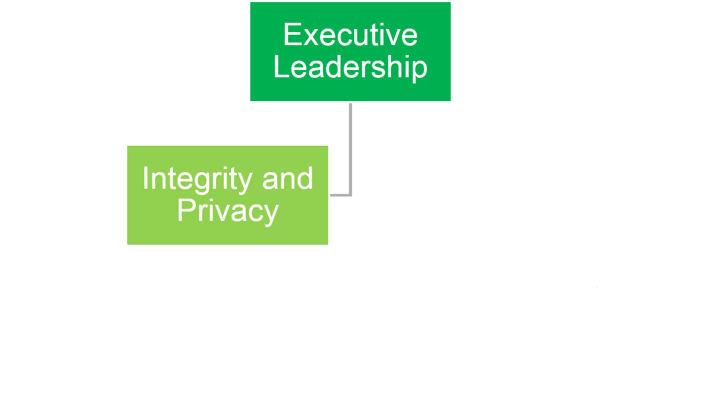
Governance - 2
Notes:
The integrity and privacy group, whose functions may be to mitigate risk against information loss and oversee the overall safety and security of the information, may have an elevated role since they may need to act quickly if there is an information breech.

Slide 12
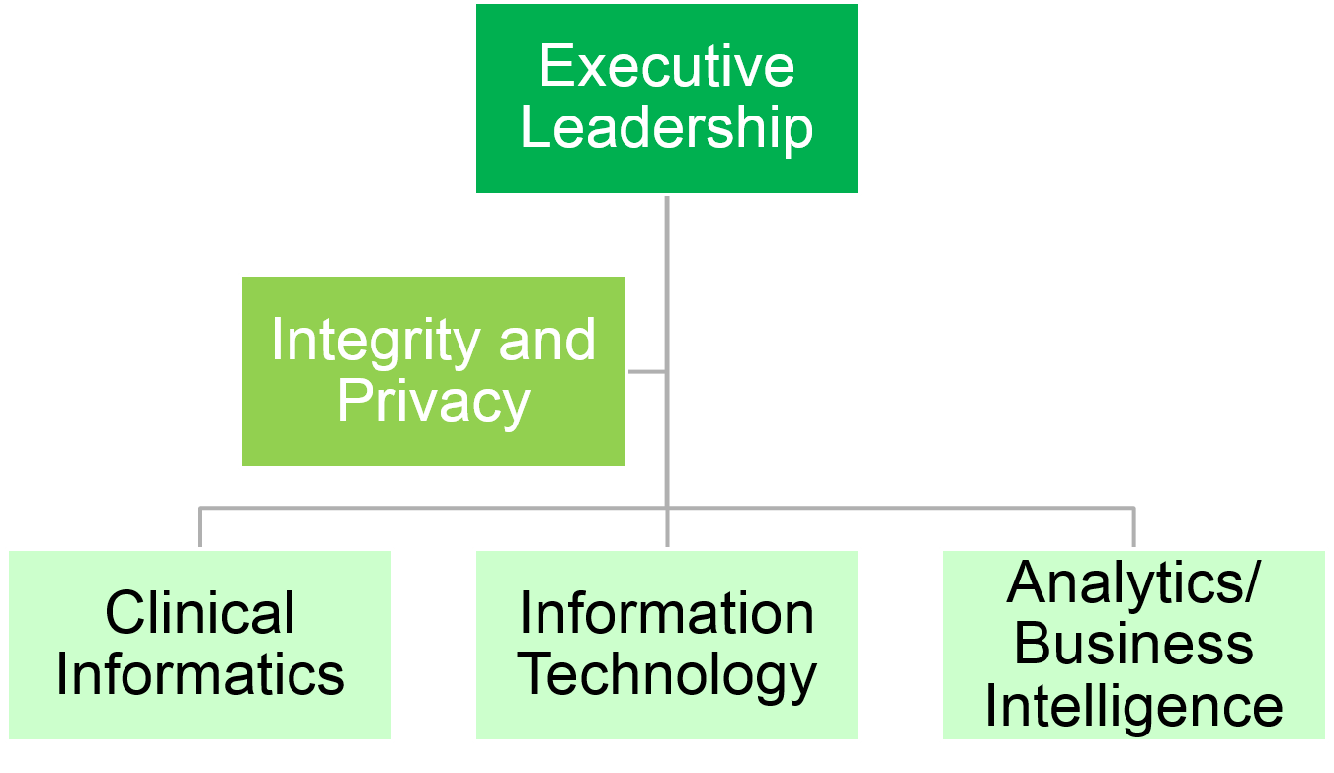
Governance - 3
Dorr, 2016
Notes:
Then, three related groups – clinical informatics, information technology, and the analytics or ‘business intelligence’ group. Each of these may have equal influence over a number of topics.
The clinical informatics group, led, perhaps, by a Chief Medical and Nursing Informatics Officer, may have roles in knowledge management and data integrity. They may receive requests from users and help to further configure the systems to better capture data and meet the strategic goals.
The information technology group may handle hardware, software maintenance, and user account access and verification. They may have key roles in regulatory compliance, security, as well as data integrity.
Finally, the analytics group may have the largest role in knowledge management and data and information curation.
These overlapping roles can cause some chaos and confusion, resulting in different reports and algorithms that address similar issues. In addition, analytics may become mission-critical, and maintenance may be shared with the IT group. Strong leadership and careful consideration of the each team’s relationship to the strategic aims are important, as is frequent communication and an investment in standard data models, metadata, and documentation.

Slide 13
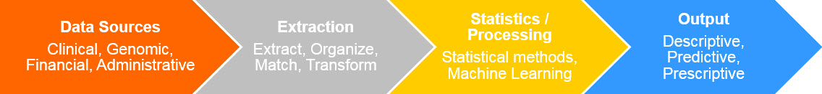
Analytics Pipeline - 1
Adapted from Hersh, Kamur
Notes:
How does it work to put the data together and analyze it to produce useful analytics? This figure, adapted from Hersh and Kamur, demonstrates the general idea in what’s called the Analytics Pipeline.

Slide 14
Analytics Pipeline - 2
Adapted from Hersh, Kamur
Data Source Examples:
Clinical: Diagnosis, procedure, BMI
Genomic: BRCA2 gene
Financial: Charge, bill, supply cost
Administrative: Nurse hours, occupancy
Notes:
First there’s the input to the pipeline where you must identify the different data sources you will need and where they are. For instance, if you want to do a study predicting high risk of breast cancer, you may want clinical data, such as family history of breast cancer, and genomic data, such as the BRCA2 results for patients, whereas if you are optimizing revenue from operating rooms, you may need financial and administrative data.

Slide 15
Analytics Pipeline - 3
Adapted from Hersh, Kamur
Extraction Examples:
Extract: SQL query
Organize: Person level
Match: SSN, Name, DOB
Transform: Change data structure to analytical
Notes:
Once identified, you must extract the data either with SQL queries from the databases or scripting or programming languages, like R, SAS, SPSS, or Python.
Then, you have to organize the data at the right level of analysis, match across databases with key information, and then work to transform the data appropriately so it can be analyzed most efficiently.

Slide 16
Analytics Pipeline - 4
Adapted from Hersh, Kamur
Statistics/Processing Examples:
Statistical methods: Regression
Machine learning: Decision tree, k-means procedure
Notes:
Next, you have to choose appropriate processing techniques. For some analytics, this may as simple as visually comparing data to see changes, such as in statistical process control charts, but usually involves more advanced techniques such as regression or machine learning models.

Slide 17
Analytics Pipeline - 5
Adapted from Hersh, Kamur
Output Examples:
Descriptive: Table of mean values
Predictive: Probability a patient readmits
Prescriptive: Short stay related to readmits
Notes:
Naturally, you need to be thinking about the output you want – do you plan on better describing the data for population-based decision making? Or will you be predictive – trying to determine whether a patient who is admitted to the hospital has a high probability of readmission upon discharge. Or is it better to be prescriptive – where you might identify something the patient needs, such as a particular treatment or a care protocol to shorten a stay if there is a readmission.

Slide 18
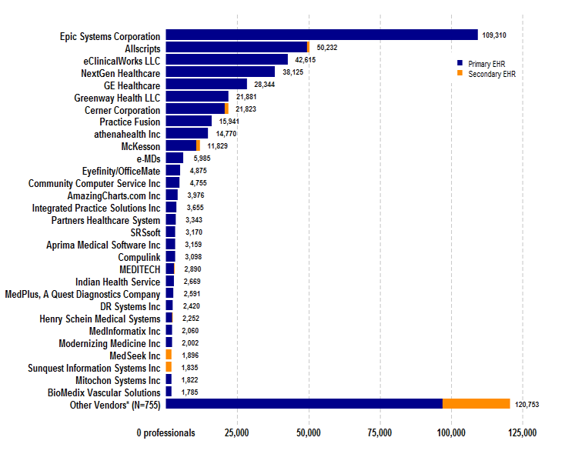
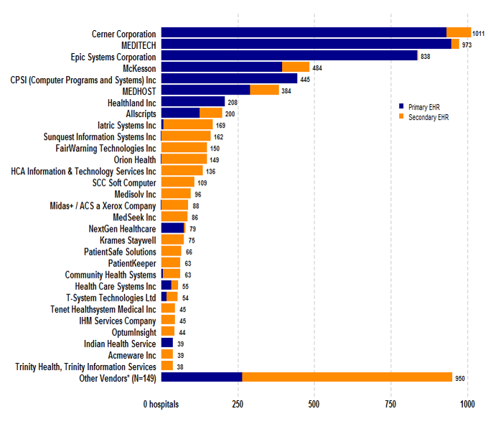
EHR Vendors
Professionals
Hospitals
Dashboard.healthit.gov
Dashboard.healthit.gov
Notes:
There are a number of EHR vendors in the marketplace to provide infrastructure supporting data analytics. As described previously, many of these systems may have been designed initially for other operational processes, such as payment. The figure in this slide shows the relative market shares for EHR systems used by professionals and hospitals. The EPIC Systems Corporation is the one most often used by professionals, an indication of its uses in clinics, while the Cerner corporation is has the largest share of systems in hospitals.

Slide 19
Applications in Clinical Settings
Dashboards
Performance aggregated by time period, department, or provider
Decision Support: Alerts and Reminders
Linked to patient EHR based on clinical data – can use risk scores, for instance
Clinical Summaries
Prioritized relevant information about a patient
Notes:
There are several relevant applications for data analytics in clinical settings. One common use is to create dashboards which display performance information and can be aggregated by time period, department, or provider.
There are many ways to think about applying analytics in clinical settings. We focus here on three primary components: dashboards, decision support, and clinical summaries.
Dashboards may provide information about a number of metrics, and allow visual analysis for organizations or even use algorithms to determine when a metric changes significantly or is improved compared to others.
Decision support is generally defined as the provision of data, information, and knowledge to facilitate more informed decision making. We think of EHR-based decision support as alerts and reminders at the point of care, but analytics may provide recommendations about populations of patients and their risks to facilitate more of our limited attention and resources on those most at risk.
Clinical summaries may provide prioritized information about individual patients, allowing decision makers to quickly come to conclusions about potential treatment options or confounding factors. We’ll cover each of these in more detail.

Slide 20
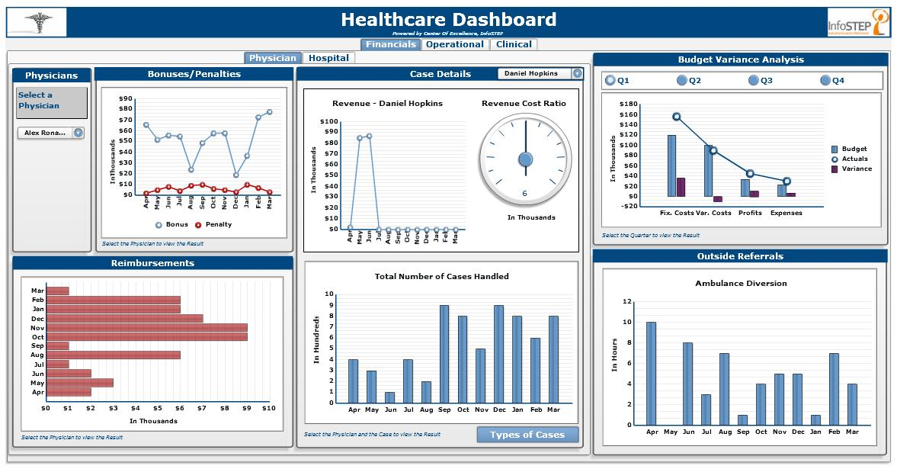
Dashboards - 1
https://commons.wikimedia.org/wiki/File:Healthcare_Infostep.JPG
Notes:
Dashboards are visual displays for understanding how an organization, team, or even individual health care professionals are performing across a variety of areas. This generic example focuses on volume, revenue, and budget categories. The central graphs show revenue by month for a single provider, with the revenue to cost ratio a very positive 6 to 1.
Reimbursements and total number of cases handled show variation over time. Although the data is nonsensical in this example, the variation may be concerning for those reviewing the information. Systems may adjust their incentives, seek out root causes for variation, change their supply of staff, or start quality improvement projects to address concerns. Visual analysis is a very powerful tool, but one that has to be used carefully.

Slide 21
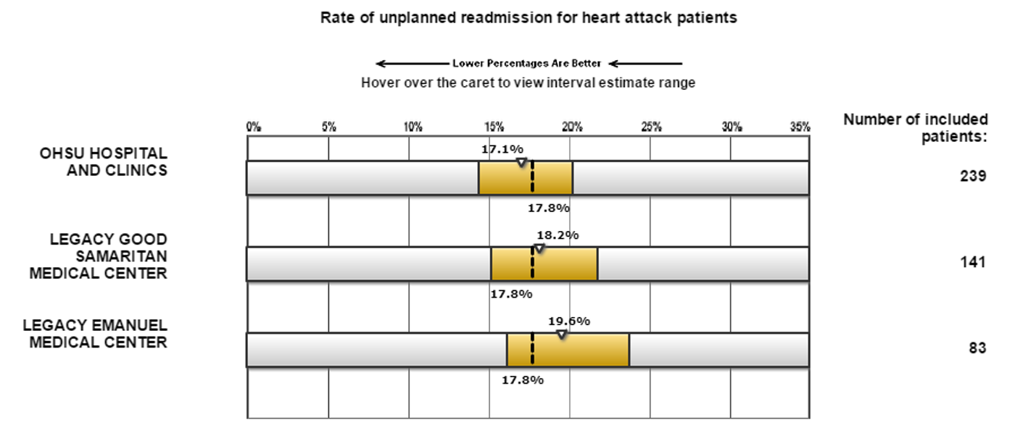
Dashboards - 2 https://www.medicare.gov/hospitalcompare/
Notes:
For instance, it can be useful to compare hospitals to each other to understand what is possible to achieve for certain outcomes. Here, a group of Portland, Oregon hospitals are compared in their readmission rates for heart attack patients. With lower rates being better, a hospital with a higher rate, such as the one on the bottom, may be concerned about public perception of their care, and seek to address it. The yellow bars, however, show that the variation expected with these small numbers of patients is high, so the difference in rates may be random, rather than from real problems.
The ability to display error bars related to variation is another useful analytic technique.

Slide 22
Dashboards - 3 https://www.medicare.gov/hospitalcompare/
How is Risk Adjustment especially important here?
Notes:
Outcomes such as readmission also have another issue – take a minute to think about why risk adjustment for patient factors would be especially important here.
If you thought that the risk of readmission may vary widely between patients with heart attacks, you would be correct. Risk adjustment would allow ‘fair’ comparisons between systems that attract very complex patients and those with more straightforward needs.

Slide 23
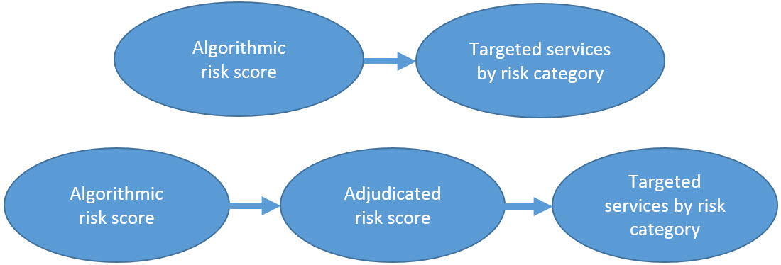
Implementing Analytics in Decision Support – Human and EHR Elements
Dorr, 2016
In the EHR: Use advanced decision support
Add to standard preventive and chronic health maintenance workflow (Very high risk -> follow-up needed)
Add column to schedule, patient lists -> risk status
Add alerts to patient banner
Notes:
Decision support is providing information that should help improve health care decision making. When using analytics, people may be confused by the ‘help’ if the source isn’t clear. If we use algorithms to produce an overall risk score, and ask clinicians to target services to patients at higher risk, they may resist. If you let them adjudicate, or judge the score based on their sense of what the person needs, it may help them use your analysis more easily. However, this is only the start of the issue; patients may not be interested in the services or may need to have those services explained to them carefully. Thus, successful risk prediction implementation is mostly about how best to get the analysis in front of people in a way they understand and doesn’t over burden them cognitively. If you think very carefully about how to integrate the information into their normal clinical workflows, this will help. If you can provide the prediction right in the EHR system, for instance, and allow them to change the score in the same place, you might have much more success than just providing a score. Similarly, you might attach the risk score to a standard chronic illness or preventive care workflow, adding the risk score as another piece of information to address with clear guidelines about what to do next. That may be to follow-up more frequently, discuss the issues, or provide a referral. Another consideration would be adding the information in very obvious locations, such as the ‘banner’ with the patient’s name and other information about them.

Slide 24
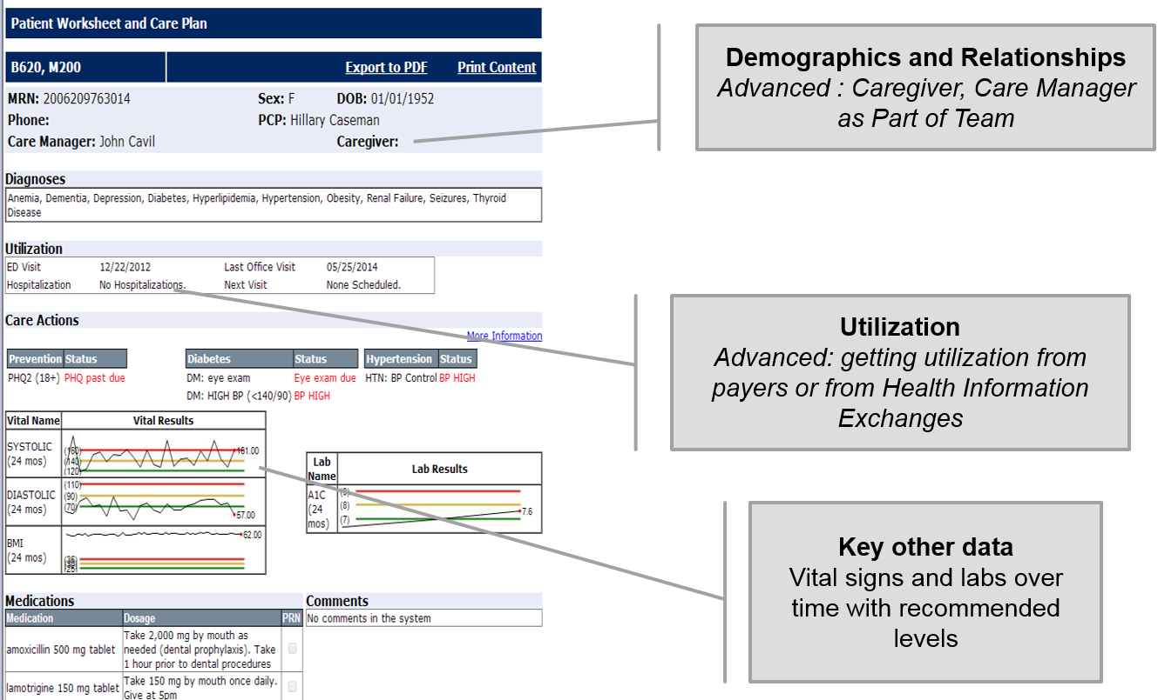
Clinical Summaries: For Patients with Complex Needs
Notes:
Clinical summaries can be very helpful. Here is one from an open source system called the Integrated Care Coordination Information System that Dorr et al. developed. Here you see key information about demographics and relationships, and you can see that a care manager relationship is provided – this might tell the user the patient is in intensive care management. Similarly, the empty caregiver data may prompt the provider to ask the patient with dementia who helps care for them. Other data, such as providing a history of utilization or even utilization risk scores if available, may be provided in graphs with variation over time and recommended levels by color to remind providers to act.

Slide 25
Using Comparison as a Tool - 1
Some metrics are meant to be zero (wrong site surgery)
Marginal cost of an improvement typically increases as it approaches zero
Notes:
One key aspect of analytics is generating some result about the way care was delivered or the outcomes that were achieved. How do you know if this information is important? By using comparison and logic as a tool to guide future efforts. For instance, some outcomes should never happen – such as wrong site surgery, where the surgeon operates on the wrong limb or the wrong side of the patient – but trying to predict and prevent every instance of an event will get more and more expensive as the number of events approaches zero. This marginal cost – the cost to reduce one adverse outcome – can grow so rapidly that all the available effort is used trying to prevent all events from occurring.

Slide 26
Using Comparison as a Tool - 2
For others (A1C control), a comparison is needed
Other institutions
“Worse than average”, “better than average”
Over time
Among providers
Notes:
Others may need other standards to compare to, such as the percent of patients with diabetes whose disease is under control via a lab test known as Hemoglobin A1c. Other institutions can also be used. Seeing what is achievable by the best institutions and then who is truly better and worse than average may be helpful to understand how to target analytic efforts. You can compare to your own performance over time, even using ‘statistical’ controls by generating rules based on previous variation to detect surprising changes in outcomes. You can also look among providers, although often the number of people treated for a certain condition by a particular provider may be small enough that differences can’t be reliably detected.

Slide 27
Applications in Value-Based Care - 1
Value = Benefit or Quality/Cost
Benefit or quality are generic concepts
Includes:
Health (effectiveness, safety)
Satisfaction
Difficult to measure
Notes:
What is value-based care and how can we apply analytics in value-based care?
First, value is benefit over cost or quality over cost. What do these terms mean? First ‘Benefit’ or ‘quality’. They are very generic concepts, which may mean ‘health produced’ or ‘harm avoided’. They may mean the satisfaction derived by patients from care. At times, they mean that the expected evidence-based approaches were followed. These can be difficult to measure. However, analytics is often used to predict when these outcomes are more or less likely to occur, and provide guidance for when the system should intervene to raise quality. Most value-based care programs use a mix of health outcomes, quality measures, and patient satisfaction to try to capture the diverse benefit, meaning that the analysis may need to predict a similarly complex set of benefits.

Slide 28
Applications in Value-Based Care - 2
Cost is a generic as well
Not necessarily what is charged due to market impacts
Internal costs are better
Surgery may be straight-forward (wages, equipment, facility)
Not all simple (eg. care management)
Notes:
Cost is generic as well; the charges or bills for health care are not at all predictable, in part because the contracts and health entities in the market, like insurers and large health systems, are complex and haven’t been transparent to costs. Some costs may be straightforward, like the time, wages, equipment, and facility costs needed to perform surgery. ‘Bundled’ payments attempt to provide a single cost for an ‘efficient’ surgery by summing all components and letting the surgeon and system try to provide a high quality product under a single cost. The system may try to predict complex procedures or how to reduce variations that are expensive without being useful. Many costs, however, are very complex. If a patient has expensive health care needs, we can add up those costs, but what about care management that tries to reduce those costs? How do you know when the costs aren’t occurring. Often, comparisons are used but are not performed.

Slide 29
Data Analytics in Clinical Settings Summary – 1 – Lecture a
Data analytics has no single definition in clinical settings, but uses analysis to help aid in decision making.
Its use in clinical settings is still limited, but growing.
Dashboards, decision support, and clinical summaries are some tools that can be used.
Notes:
Finally, we summarize this lecture by reminding you that
Data analytics has no single definition, but uses analysis to help make better decisions in health care,
Data analytics in clinical settings is still quite limited but growing,
And, there are many tools to facilitate analytics including dashboards, decision support, and clinical summaries.

Slide 30
Data Analytics in Clinical Settings Summary – 2 – Lecture a
Governance of analytics is important to stay focused on the goal of improving care value.
Notes:
Governance of how analytics is organized, implemented, and interpreted is very important, especially as we try to improve the value of care by improving benefit of care services at the same or lower cost.

Slide 31
Data Analytics in Clinical Settings References – 1 – Lecture a
References
Corada, J. A., Gordon, D., & Lenihan, B. (2012, January). The value of analytics in healthcare: From Insights to Outcomes (Rep. No. James W. Cortada, Dan Gordon and Bill Lenihan). Retrieved January 13, 2017, from https://www-935.ibm.com/services/us/gbs/thoughtleadership/ibv-healthcare-analytics.html
Denny, J. C. (2012). Mining electronic health records in the genomics era. PLoS Comput Biol, 8(12), e1002823.
Example dashboard: https://www.youtube.com/watch?v=AdXt8BfiGJg
Hersh, W. R. (2014). Healthcare Data Analytics. Health Informatics: Practical Guide for Healthcare.
Kumar A, Niu F, and Ré C. Hazy: Making it easier to build and maintain big-data analytics. Communications of the ACM, 2013. 56(3): 40-49.
Notes:
References. No audio.

Slide 32
Data Analytics in Clinical Settings References – 2 – Lecture a
References
Miliard, M. (2013, March 15). Pop Health Analytics Top ACO Priority. Retrieved July 11, 2016, from http://www.healthcareitnews.com/news/pop-health-analytics-top-aco-priority
Office of the National Coordinator for Health Information Technology. 'Certified Health IT Vendors and Editions Reported by Hospitals Participating in the Medicare EHR Incentive Program,' Health IT Quick-Stat #29. https://dashboard.healthit.gov/quickstats/pages/FIG-Vendors-of-EHRs-to-Participating-Hospitals.php July 2016.
Office of the National Coordinator for Health Information Technology. 'Certified Health IT Vendors and Editions Reported by Health Care Professionals Participating in the Medicare EHR Incentive Program,' Health IT Quick-Stat #30. https://dashboard.healthit.gov/quickstats/pages/FIG-Vendors-of-EHRs-to-Participating-Professionals.php July 2016.
Office of the National Coordinator for Health Information Technology. 'Electronic Health Record Vendors Reported by Health Care Professionals Participating in the CMS EHR Incentive Programs and ONC Regional Extension Centers Program,' Health IT Quick-Stat #30. https://dashboard.healthit.gov/quickstats/pages/FIG-Vendors-of-EHRs-to-Participating-Professionals.php June 2015.
Notes:
References. No audio.

Slide 33
Health Care Data Analytics Data Analytics in Clinical Settings Lecture a
This material was developed by Oregon Health & Science University, funded by the Department of Health and Human Services, Office of the National Coordinator for Health Information Technology under Award Number 90WT0001.
Notes:
No audio.

