Slide 1
Health Care Data Analytics
Lecture 1: Data Analytics in Clinical Settings
Md. Jubayer Hossain
Instructor
@cblast.du.ac.bd

Slide 2
Data Analytics in Clinical Settings Learning Objectives - 1
Describe the current state of data analytics in clinical settings (Lecture a)
Identify key tools and approaches to improve analytics capabilities in clinical settings (Lecture b)
Describe different governance and operations strategies in analytics in clinical settings (Lecture b)
Notes:
The learning objectives for Data Analytics in Clinical Settings are to:
Describe the current state of data analytics in clinical settings
Identify key tools and approaches to improve analytics capabilities in clinical settings
Describe different governance and operations strategies in analytics in clinical settings

Slide 3
Data Analytics in Clinical Settings Learning Objectives - 2
Discuss value-based payment systems and the role of data analytics in achieving their potential (Lecture b)
Analyze data used in population management and value-based care systems (Lecture c)
Notes:
Discuss value-based payment systems and the role of data analytics in achieving their potential
And, analyze data used in population management and value-based care systems

Slide 4
Tools and Approaches for Analytics: Using Data and Measurement Effectively
Data is diverse and fragmented; needs to be integrated for most clinical applications
Measurement specifications – how you should measure key clinical concepts and outcomes – have detailed development processes
Standard measurements (e.g., for quality and safety) can help jump start analytics
Notes:
In this lecture, we will provide some examples of how to address the complex issues related to data and measurement for data analytics in clinical settings. First, we’ll describe a case where data is diverse and fragmented, and how data needs to be integrated to perform effective analysis. Then, we’ll describe the importance of using detailed measure specifications and standard measures to ensure that your analytics are predicting what is important and related to broader health and health care goals.

Slide 5
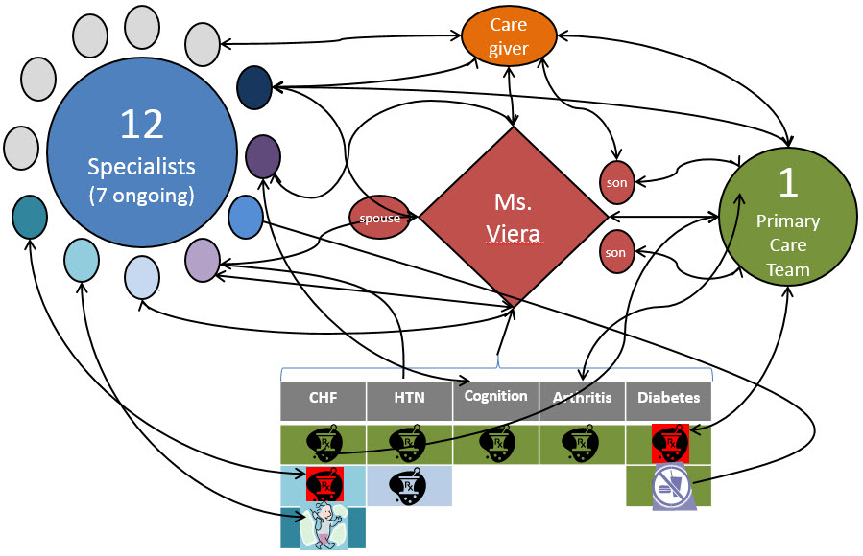
Ms. Viera, a 75 year person with multiple chronic conditions…
Dorr, 2009
Notes:
This messy diagram is intended to show the information flow as Ms. Viera, a person with 5 complex chronic conditions, interacts with the health care system over the course of one year. If we were to estimate outcomes for her, we would find that she has ninety times the rate of hospitalizations as someone with no chronic conditions, that she takes on average 14 medications, and that she’ll see 12 specialists during that one year. How can analytics help us measure her risks and whether her care is of high quality and safe?

Slide 6
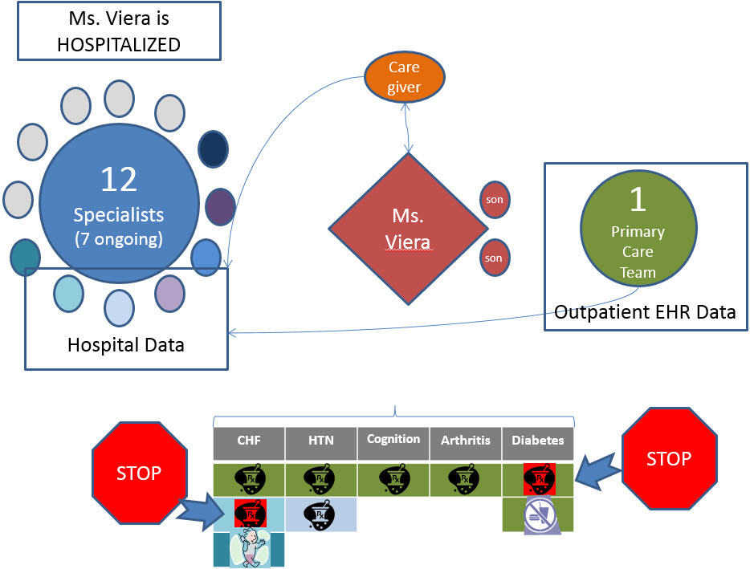
Communication Breakdown
Dorr, 2009
Notes:
Where does the system break down when we are trying to measure the quality of her care and predict her needs? First, the more interaction with the health care system she has, the more likely her data is to be fragmented. Often when someone is hospitalized, the hospital’s information system is not the same as the outpatient system, so the information about her previous care is not available to the hospital. And, if the hospital changes two drugs, then the primary care setting may not get a notification about that. In fact, the primary care setting may never know she is in the hospital! The only complete source of data about her health care utilization may be in the bills that go to health insurance companies or the federal government for Medicare. These bills are stored in so-called ‘claims databases’, and are not integrated back to EHRs in most cases. This can cause serious problems as we try to analyze data to understand Ms. Viera’s care and health outcomes.

Slide 7
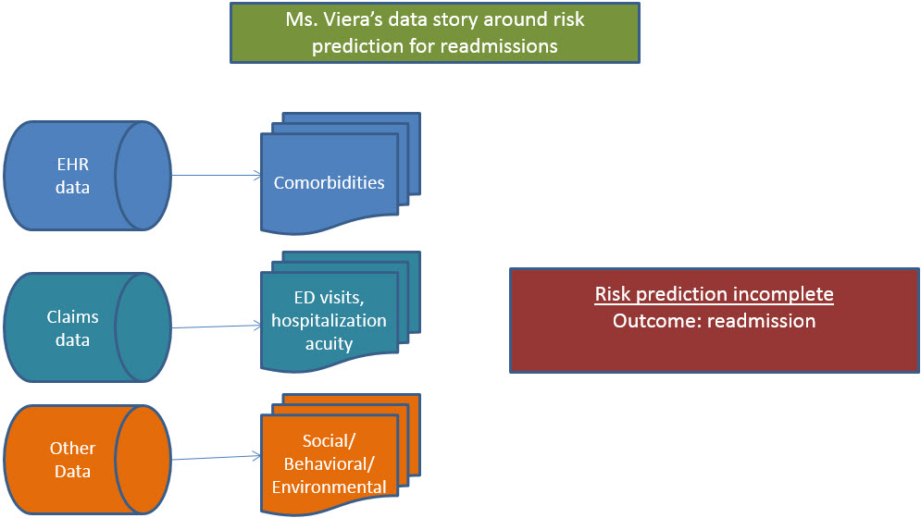
View by Data Source
Notes:
Let’s explore this data measurement issue in a different way, by data sets. EHR data in our example is stored by the primary care providers. It has a longitudinal record of all the data collected at the clinic and associated laboratory. This information can be useful in analysis when ongoing patient factors are needed. For instance, when we are predicting risk of readmissions, comorbidities are helpful to understand if the patient’s health is complicated by multiple other diseases. The claims data, which are the set of bills for health care, may contain other equally important information. Information about ED visits, the acuity of the hospitalization and final diagnoses may only be available through these claims, since the hospital may be on a different system. Finally, other data, usually not stored in either the EHR or the claims data, may be helpful, such as social, behavioral, and environmental data. Environmental, in this case, means information about where people live – the availability of healthy food, for instance, may be low in certain urban settings. The lack of integration of this data leads to poor prediction in health care settings, and Ms. Viera may be readmitted because the system did not adapt.

Slide 8
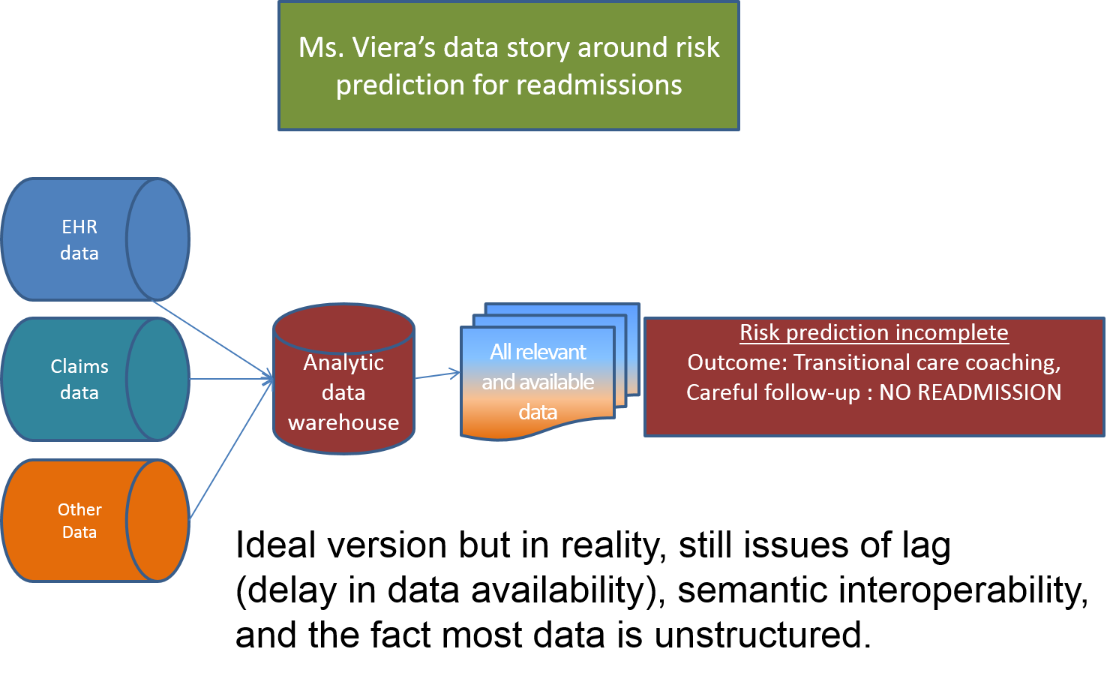
A Different Outcome if Data is Integrated
Notes:
It is possible, however, to integrate data from these sources, or at least exchange it, as in Health Information Exchange programs. To truly analyze risk, the data can be integrated into an analytic data warehouse, where all relevant and available data can be processed. Then, a more accurate and complete risk score can be calculated, and programs like transitional care coaching or the Care Transitions Intervention can be targeted to her needs. These programs can reduce readmission risk by working with patients more closely before and upon discharge.
This is an ideal version; in the real world, there are still many issues to be dealt with. For instance, claims data often takes a long time to be available, sometimes more than a year. Quicker access to the information is needed in many cases, and so communities may exchange information electronically. Similarly, data that means the same thing is not stored in the same way across settings. We must strive for semantic interoperability, where we can recognize when things mean the same thing. Finally, we have the issue that, even electronically, most data is stored as unstructured notes or reports, which makes it difficult to predict issues.

Slide 9
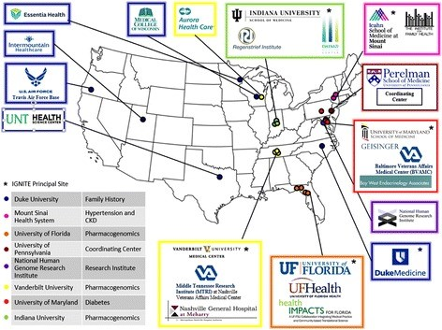
Genomic Data Integration
Genomic data may assist in prediction of patient risks, but is not integrated into Electronic Health Record systems.
The IGNITE (Implementing GeNomics In pracTicE; https://ignite-genomics.org) Network is working on this.
Example:
Mt. Sinai : Why do African-Americans with hypertension have higher risk of end stage renal disease? Use APOL1 locus on Chrom. 22 to predict risk and treat
Indiana : Use pharmacogenomics to predict risk of drugs and explore change in costs when provided at the point of care
Weitzel et al 2016, PMC, Creative Commons Attributional License
Notes:
Another kind of data that is increasingly important but is not integrated is genomic data. We have rapidly increased our ability to process genomic information, but we can’t exchange it easily and it is not integrated into most analytic or health care systems. The Implementing Genomics in Practice, or IGNITE, network was funded by the National Institutes of Health to improve the integration of this data. Shown are the more than a dozen sites involved in the network. Two examples are given from the network. Mt. Sinai, in New York, is looking at why African Americans with hypertension have more kidney failure or ‘end stage renal disease’. They found that particular alleles from the APOL1 locus vary by race and may help predict risk and provide insight into different approaches to treatment. Similarly, Indiana is using what we know about how people process drugs based on their genetics, known as pharmacogenomics, to help people pick both the right drugs and the right doses to avoid costly complications. The IGNITE network wants to see if providing this information reduces overall health care costs.

Slide 10
Integrating Outcomes: Patient-Reported and Environmental - 1
Social determinants, such as environment, patient-reported and behavioral elements, have a stronger effect on health and well-being than health care.
Historically, these haven’t been consistently integrated into clinical EHRs and analytic databases.
Notes:
Data about where a person lives and how they live can be more important than the health care they receive in many cases. For instance, your day-to-day behaviors, such as how much you walk or what you eat, may affect your risk of hospitalization from heart failure more than medications or health care. Similarly, the walkability of your neighborhood and availability of healthy foods may also affect your health more than particular treatments or procedures. We have not previously had good ways to integrate this data into health and health care, but that is changing as people recognize this data’s value. Similarly, the outcomes they perceive – such as the amount of pain they feel or the things they can do – are more important than many lab tests or other study results.

Slide 11
Integrating Outcomes: Patient-Reported and Environmental - 2
Now, standards and methods are increasing for Patient Reported Outcomes and Environmental data
For instance, the Patient Reported Outcomes Measurement Information System (PROMIS) has many standard ways to measure these outcomes
https://commonfund.hih.gov/promis/index
Notes:
There a number of new standards and methods to record and integrate information about patient outcomes and environmental data. For instance, Patient Reported Outcomes are stored and can be retrieved from a Measurement Information System known as PROMIS. This system provides structured, validated ways for patients to report on outcomes that may be important to them, such as their depression symptoms or their overall function for daily activities.

Slide 12
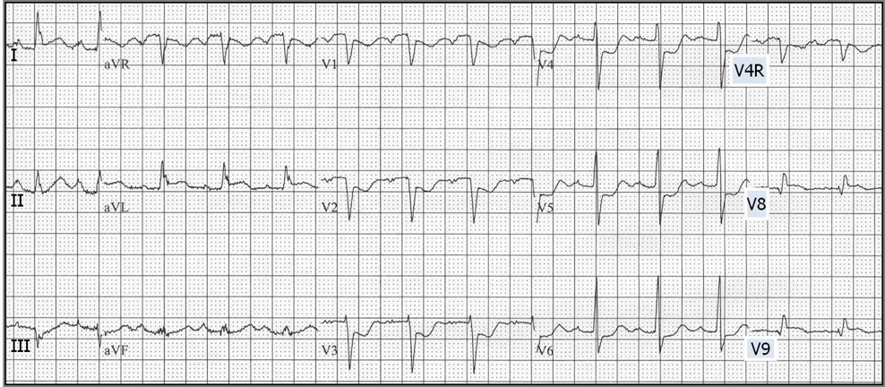
Quality Measures in Health Care: Mr. Smythe
Mr. Smythe is an active 68 year old man who has sudden onset of chest pain while gardening in 2001.
He is rushed to the hospital where his EKG looks like this:
Source: ECG learning center, http://ecg.utah.edu/lesson/9, Creative Commons License
Notes:
Now, let’s think about measures of health care quality and how they help us to better analyze the care we deliver and the health it provides. Let’s think about a particular person, Mr. Smythe. At 68 years old, he is out gardening in 2001 when suddenly he has chest pain. He is rushed to the hospital where the EKG, shown, is demonstrating ST wave elevations that definitely show something going on with his heart.

Slide 13
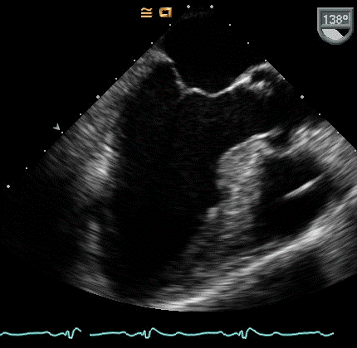
Mr. Smythe’s Echocardiogram
His Echo looks like this
With persistent shortness of breath and swelling after initial treatments.
Source: Echopedia, http://www.echopedia.org/index.php/Case_93, Creative Commons License
Notes:
With an echocardiogram that shows his heart is not pumping well, and with other ongoing symptoms, the medical team notes he is having an active heart attack.

Slide 14
What Does Mr. Smythe Need?
What are effective treatments for his posterior myocardial infarction, or ‘heart attack’?
What is needed to address his congestive heart failure?
Notes:
Many people assume that he will get exactly the treatment he needs in the vast majority of cases. What evidence do we have about what are effective treatments for heart attack? And, what about his congestive heart failure, where his heart can no longer pump efficiently enough to meet the needs of his body?

Slide 15
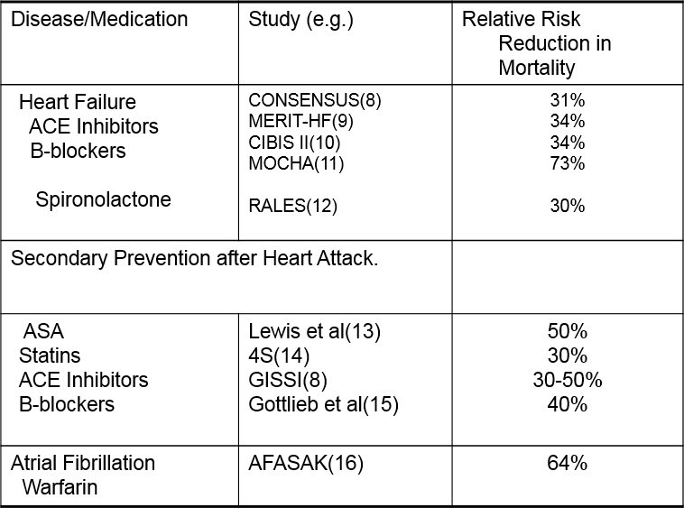
Evidence of Effect
During and after heart attack and heart failure, providing key medications prolongs life
Notes:
There is very good evidence from a variety of clinical trials that he needs medications to limit the damage from the heart attack and improve the function of his heart. The medications are shown here, along with their related studies, and the reduction in deaths from effectively using them. Other treatments are important, too, such as cardiac rehabilitation. With this number of lifesaving treatments available, we anticipate he will get the great care he needs. But to be sure, we must measure how well we did.

Slide 16
How Likely is He to Receive These Effective Treatments?
In 2001?
In 2010?
In 2012?
Notes:
Now, pause, and think to yourself – how often would a patient like Mr. Smythe receive these treatments in 2001?
How about more recently, in 2010
Or 2012?
100% of the time? 95% of the time? Perhaps 80%?

Slide 17
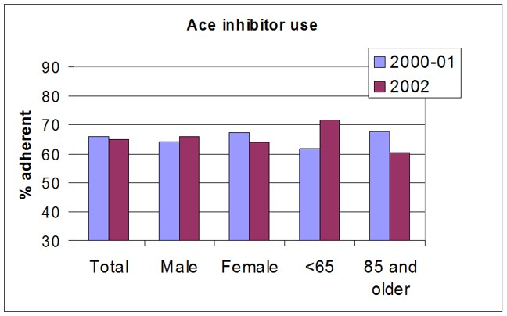
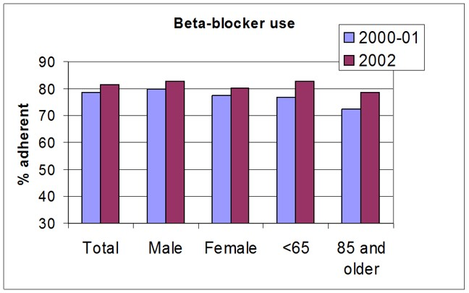
Everyone Should Do This, Right?
Notes:
In 2001, the answer is just a bit less than two thirds of the time, 65%, for ACE inhibitor use, and 80% for Beta-blocker use.

Slide 18
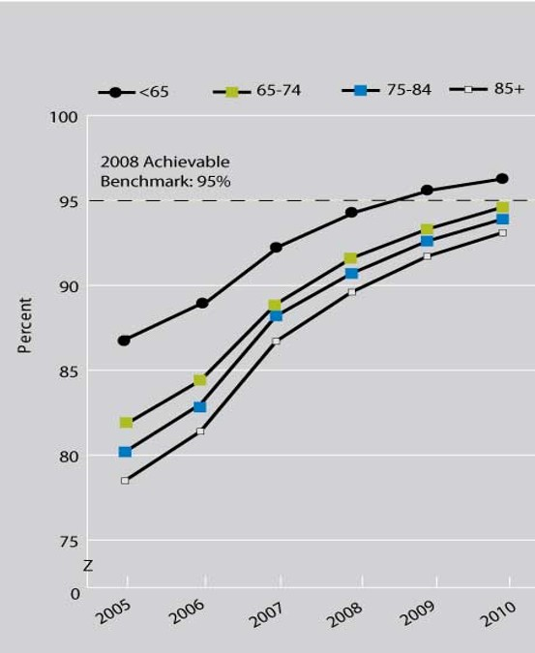
Care of Heart Conditions is Improving!
Ace in LVSD
AHRQ quality report, 2012
http://www.ahrq.gov/research/findings/nhqrdr/nhqr12/chap2.html#cvd
Notes:
We’ve seen significant improvements over time, in part because people started to measure their rate of providing these medications and reporting them to each other and to various quality measurement programs. We can calculate an achievable benchmark of 95% for Ace inhibitor use, about 30% higher than when Mr. Smythe had his heart attack.

Slide 19
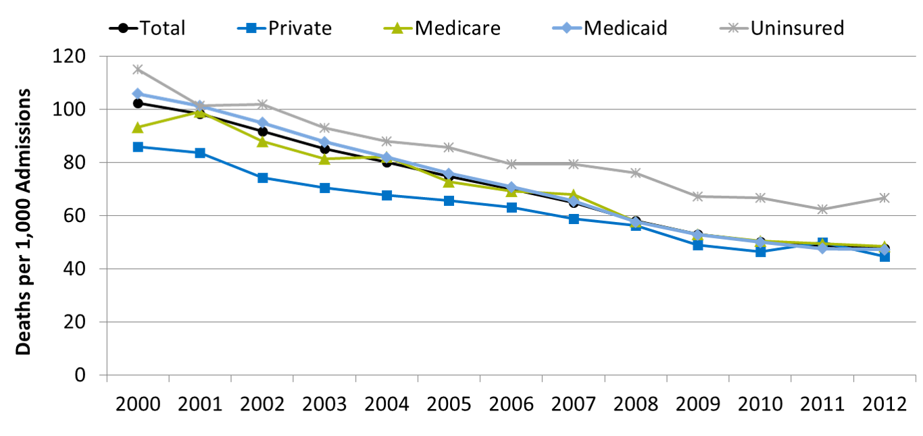
Mr. Smythe is Increasingly Likely to Live:
Inpatient deaths per 1,000 adult hospital admissions with heart attack, by expected payment source, 2000-2012
Source: Agency for Healthcare Research and Quality, Healthcare Cost and Utilization Project, Nationwide Inpatient Sample and AHRQ Quality Indicators, version 4.4, 2000-2012.
Denominator: Adults age 18 and over admitted to a non-Federal community hospital in the United States with acute myocardial infarction as principal discharge diagnosis.
Note: For this measure, lower rates are better. Rates are adjusted by age, major diagnostic category, all payer refined-diagnosis related group risk of mortality score, and transfers into the hospital.
Notes:
And, the benefit of this treatment is decreasing deaths. In 2000, about 10% of patients died in the hospital when they came in with a heart attack; now it is just above 4%. These are the effects better quality measurement and better quality care can achieve.

Slide 20
Measurements to Jump Start Analytics
Historically in the U.S., most payments based on a fee for a service
Now, shifting to new models, like Accountable Care Organizations or the Merit-based Incentive Program
All of these require measurement and many benefit from deep analytics
You must decide what to measure!
Notes:
We haven’t had the ability or drive to focus on analytics in the United States before, in part because we couldn’t measure or change care effectively. Now, programs like Accountable Care Organizations benefit from predicting what treatments are best for which patients, and which may not be helpful or useful. To be effective, one must measure what will be analyzed carefully.

Slide 21
Measurement Specifications: General Approach
1. Philosophy
2. Concepts to be measured
3. Indicators for concepts
4. Precise definition of indicator
5. Plan and collect data
6. Ongoing analysis of data
7. Act!
Notes:
Historically, one had to define the measures of interest based on the goals and related concepts, then define how to measure them – through indicators which had to be defined, and then data was collected and analyzed. In each clinical setting, the information technology and informatics staff had to define their own metrics based on their available data and the goals of the project. This long list of steps would be needed to start to measure anything you wanted to analyze.

Slide 22
Measurement Definitions
National Quality Forum
HHS Measure Set
Physician Consortium for Performance Improvement, AMA
National Committee for Quality Assurance (NCQA) – HEDIS measures (health plans)
…but local measures are still important
Notes:
Instead of a numbered list of steps to start measuring, many measurement definitions and specifications come from large collaboratives that define the measures for you based on evidence, feasibility, and expert input. Some measures for analysis will still be local; however, most of them come from these collaboratives. For instance, the Health and Human Services, or HHS, branch of the government uses a highly standardized set of definitions for their measures to pay for high quality care, or to reduce payments for certain care, such as when readmissions could have potentially been avoided.

Slide 23
Measurement Specifications: Philosophy
Organizational belief that measuring can lead to positive change
Major concepts:
Culture of learning
Culture of justice
Quality / safety part of expectations
Get beyond pathology and bureaucracy
Notes:
Philosophy is still important, however. Measuring quality of care feels very different to those being measured than fee-for-service medicine; that is, normally, a clinical team decides to provide a treatment or service and then bills for it. Quality measurement tries to measure whether that service would be recommended by the medical evidence, and whether all services recommended were provided. Thus, establishing your measurement philosophy in a clinical setting is important. A key part of a good measurement philosophy is a culture that is felt to encourage learning, not judging, but that when people truly and repeatedly make errors, that there is justice in the way they are treated. Cultures of pathology blame the person solely, and not the system of care, and bureaucracy forms committees without acting on the information directly.

Slide 24
Measurement Specifications: Concept and Indicator
What measures matter most to you?
Read the measure’s justification and explore its applicability to you and your organization
Let’s explore the HHS measure inventory at AHRQ http://www.qualitymeasures.ahrq.gov/hhs/index.aspx
Notes:
If you are starting an analytics effort, it is worthwhile to explore what you truly want to measure, and then look at the specifications for yourself. The HHS measure inventory at AHRQ has a number of worthwhile measures.

Slide 25
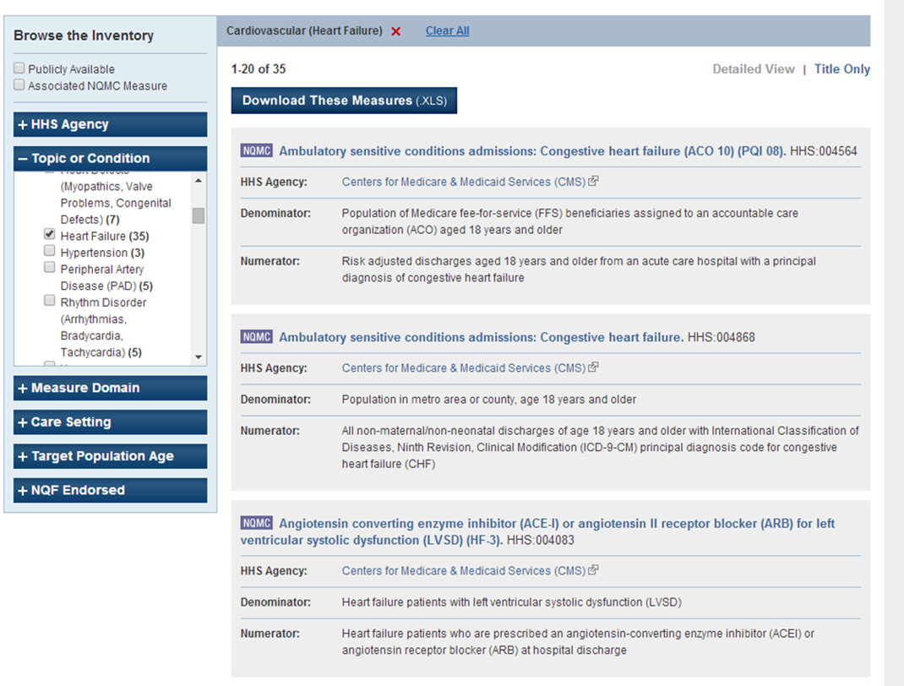
Describe the Problem, then Search on the Topic
Persons with heart failure are admitted at a high rate
Source: http://www.qualitymeasures.ahrq.gov; Federal Website
Notes:
If we go to the site listed on the previous slide, this screenshot shows us how a search might lead to specific measures. Here, we’ve looked at admissions and readmissions for heart failure, as well as some of the medication measures we were discussing before. If you drill down into the measures, you can compare the reason for the measure, the detailed definitions, and even where else it is used.

Slide 26
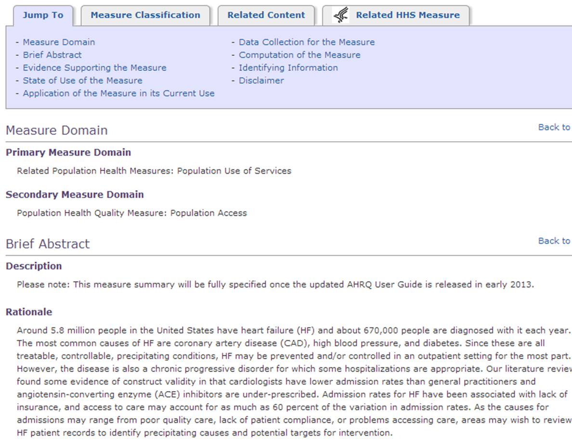
Does the Rationale Match Yours? Is This a Good Fit?
Go to the measure.
Then to the NQMC registry.
Note the differences. http://www.qualitymeasures.ahrq.gov/content.aspx?id=49196&search=heart+failure
Notes:
Here we see the rationale of one of the measures in the registry. It focuses on the detailed information about the measure. Note that this version of the measure has been withdrawn, but the link can show related measures. In this measure, they outline the reasons for admissions and readmissions, and offer some suggestions on how people might use the measure.

Slide 27
Measurement Specifications 4-7: eCQM Implementation
A certified EHR requires that a set of measures be available for implementation – Check your ‘vendor’
This process has a set of recommendations for workflow and structured data input
Alternatively, you can look on the Value Set Authority Center page.
Notes:
Some of the measures are now electronic Clinical Quality Measures, or eCQMs. These require electronic data from clinical sources, such as EHRs. They have very specific sets of codes and logic that should be used. The Value Set Authority Center, or VSAC, allows you to drill down into these specifications.

Slide 28
VSAC
https://vsac.nlm.nih.gov/ (requires UMLS license – if you are eligible – U.S. resident, very much worth it)
Form is a bit wonky. The value sets are NOT presented as measures, but the individual concepts you need to map.
You can ‘filter’ to select a measure.
Notes:
Here is the link to the VSAC. The following slides will show images of it; these images show the workflow of using the specifications.

Slide 29
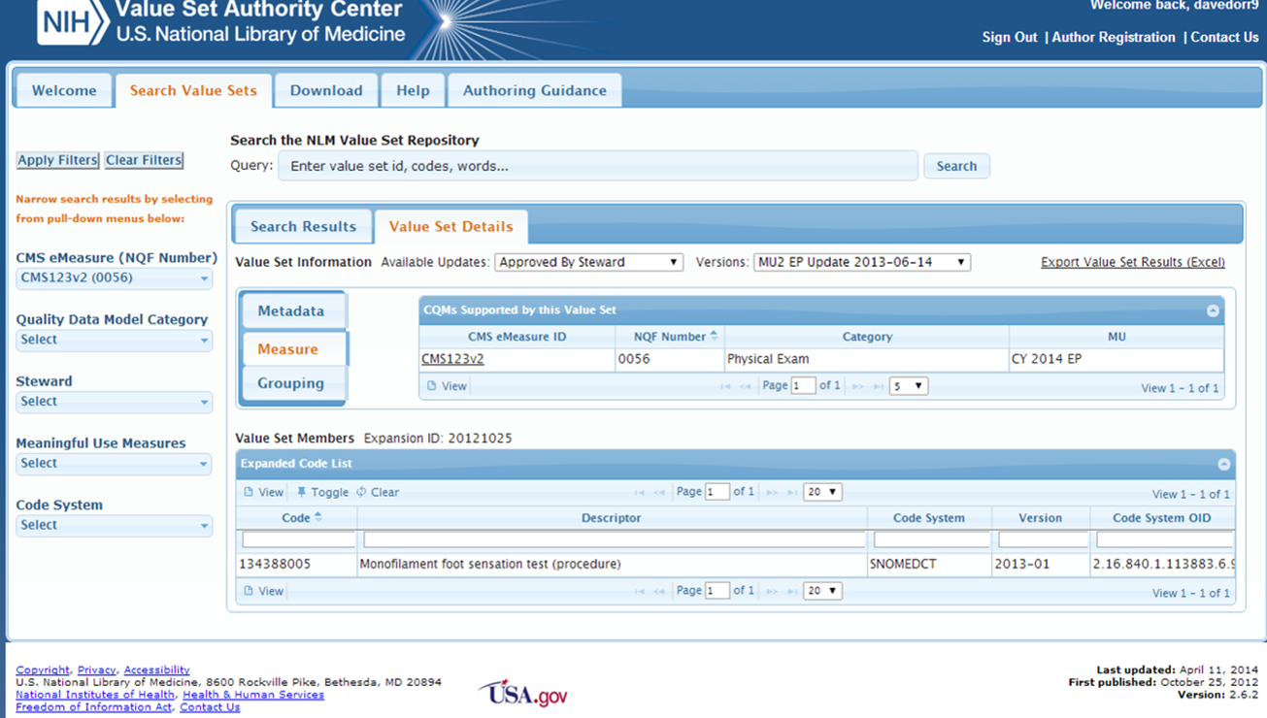
VSAC Example – Foot Exam in Patients with Diabetes (0056)
Source: Value Set Authority Center, vsac.nlm.nih.gov
Notes:
Here is shown an example of a measure definition component. These ‘value sets’ have one or more codes that are important to the analysis of the measure. Here, a foot exam code measured in the SNOMED-CT taxonomy is shown. In this value set, there is only one eligible code, so those wishing to report on this measure would need to map their workflow for a foot exam for patients with diabetes to this code to have it count as complete.

Slide 30
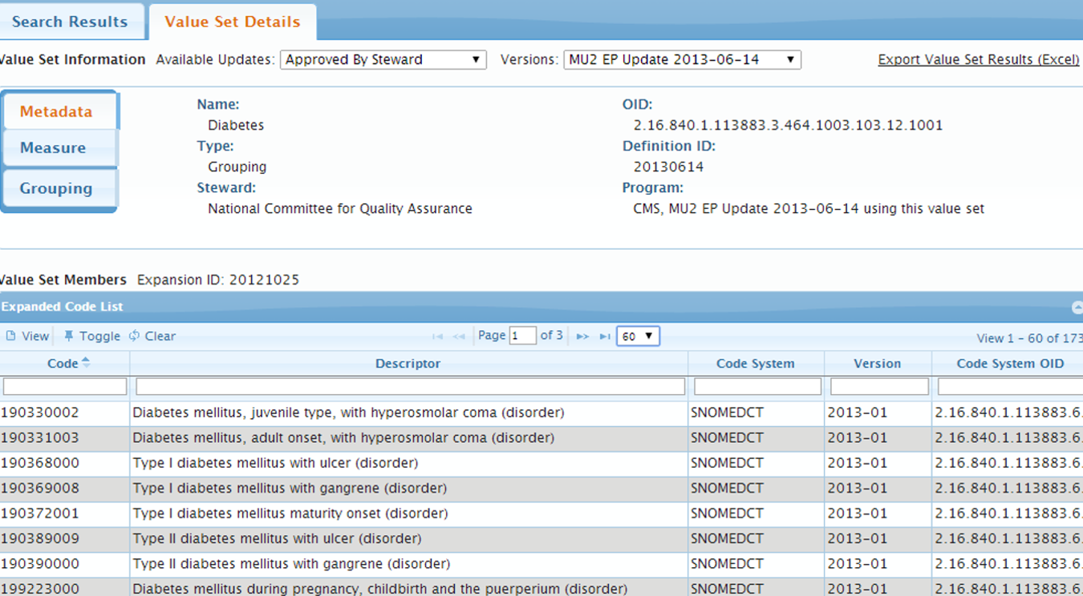
Diabetes – LOTS of Options (173 codes)
Source: Value Set Authority Center, vsac.nlm.nih.gov
Notes:
Here is another example, the broad definition of diabetes used in several measures. Here, 173 codes from 3 different taxonomies may be used.

Slide 31
Reliable or Useful Sources
https://qualitymeasures.ahrq.gov – Not all high quality but evaluated
Initiatives – like “Meaningful use”, “hhs”, or “Physician Group Practice” demo (google search)
https://www.Qualityforum.org/home.aspx – The National Quality Forum – vetted measures
AMA – Physician Consortium for Performance Improvement https://www.thepcpi.org/
http://ncqa.org/ – HEDIS measures (for health plans) and a set of accreditation measures
http://Commonwealthfund.org/ - Commonwealth fund – more international comparisons
Many more (http://www.ihi.org/Pages/default.aspx)
Notes:
There are a number of useful sources to check for measure specifications. There are many organizations that develop measures, and you can learn a great deal from looking at their websites to understand how they developed them and how they are intended to be used. For instance, the commonwealth fund has measures that compare health care systems across countries; these are helpful to understand how other countries with very different systems do in promoting healthy populations and meeting expectations of care.

Slide 32
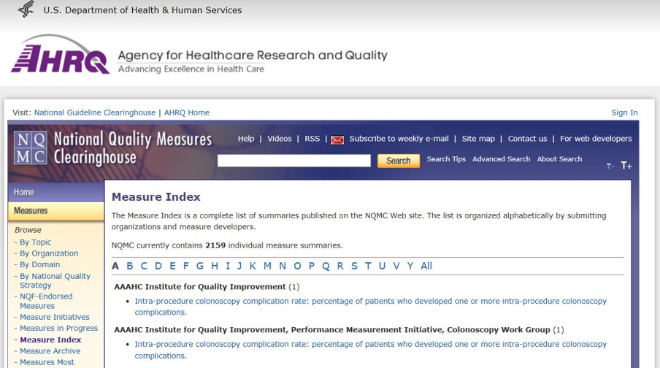
Measure Developer Example: American Geriatrics Society - 1
In a Web browser, enter this address: http://www.qualitymeasures.ahrq.gov/browse/index.aspx?alpha=A
Notes:
One example is the American Geriatrics Society, focused on the needs of older adults. To find this article, point your web browser to the URL on the screen.

Slide 33
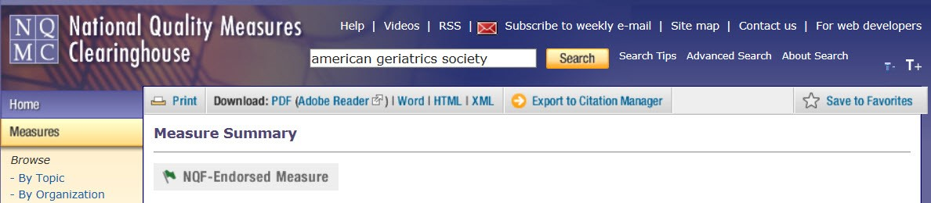
Measure Developer Example: American Geriatrics Society - 2
Search for American Geriatrics Society
Notes:
When the National Quality Measures Clearinghouse site opens, type American Geriatrics Society in the search box, then click the Search button.

Slide 34
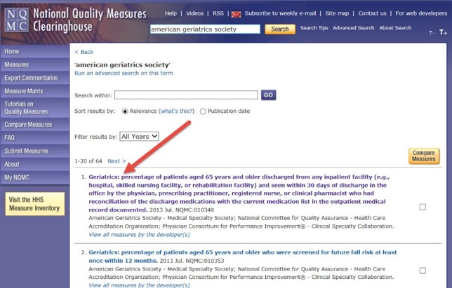
Measure Developer Example: American Geriatrics Society - 3
Choose “Geriatrics: percentage of female patients aged 65 years and older who were assessed for the presence or absence of urinary incontinence within 12 months”
Notes:
Look for the item titled Geriatrics: percentage of female patients aged 65 years and older who were assessed for the presence or absence of urinary incontinence within 12 months
This looks at whether female patients over 65 were assessed for involuntary urine loss, or urinary incontinence.

Slide 35
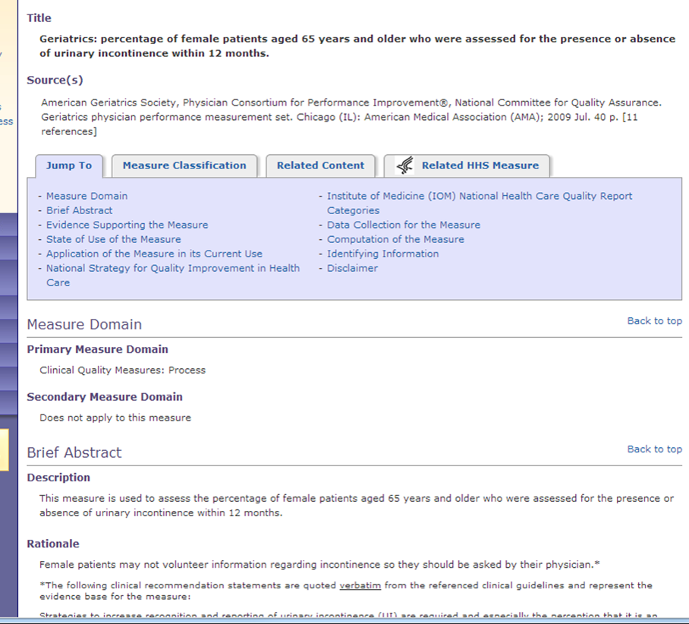
Description / Rationale
What do you see?
http://www.qualitymeasures.ahrq.gov/content.aspx?id=49446
Notes:
Is this a good measure? Look at the rationale and evidence. Sometimes, as in this measure, it requires additional reading to understand the purpose of the measure in health care.

Slide 36
What is a Good Measure?
Importance
Scientific Acceptability
Usability
Feasibility
Notes:
How do we know if measures are ‘good’? We can ask ourselves if they are important, as many of our heart failure measures were. Do they measure something that has a real and true effect on health and well-being? We can look at scientific acceptability; these mean that we are truly measuring what we mean to measure, also called validity, and that if we measure twice in the same situation, we get the same result, also called reliability. We also need people to understand the measure, use it, and be able to calculate the measures reasonably, also called feasibility.

Slide 37
How Can These Jumpstart Analytics?
Quality and safety measures are often required by payers and regulators
Thus, focusing on these definitions can help you align efforts to improve patient care
They also encode key requirements for care
Using the same definitions reduces maintenance and avoids redundant work
Validation is needed for analytics, and quality and safety measures
Notes:
How do these strategies help jumpstart your analytics program? First, quality and safety measures may already need to be reported at your institution, and therefore you can leverage that infrastructure to select measures that relate to your analytic goals. It can also be more efficient in that it aligns efforts, reduces maintenance, and avoids duplicating work. Finally, the validation work done on the quality measures, if done at all, may help your analytics efforts be more effective.

Slide 38
Data Analytics in Clinical Settings Summary - Lecture b
Tools and approaches to jumpstart analytics
Data integration -> need to put together outcomes with process, to understand context broadly
Quality and safety measures are predefined and can increase efficiency
Validation of measures can help your analytics be more effective
Notes:
This concludes lecture b of the unit on Data Analytics in Clinical Settings. In summary, this lecture focused on how to jump start your analytics process by better integrating data, by using standard measures rather than making up your own, and by validating the measures you implement. These are very important tools and approaches to enhance your analytic processes.

Slide 39
Data Analytics in Clinical Settings References - Lecture b
References
Jensen et al. http://www.ncbi.nlm.nih.gov/pmc/articles/PMC4801509/
Mattingly CJ et al., https://www.ncbi.nlm.nih.gov/pubmed/26871594/
Weitzel KW, Alexander M, Bernhardt BA, Calman N, Carey DJ, Cavallari LH, Field JR, Hauser D, Junkins HA, Levin PA, Levy K, Madden EB, Manolio TA, Odgis J, Orlando LA, Pyeritz R, Wu RR, Shuldiner AR, Bottinger EP, Denny JC, Dexter PR, Flockhart DA, Horowitz CR, Johnson JA, Kimmel SE, Levy MA, Pollin TI, Ginsburg GS; IGNITE Network. The IGNITE network: a model for genomic medicine implementation and research. BMC Med Genomics. 2016 Jan 5;9:1. doi: 10.1186/s12920-015-0162-5. PMID: 26729011
Images
Slide 5-8: Dorr DA. Released under a Creative Commons Attributional License
Slide 9: Weitzel et al 2016, PMC, Creative Commons Attributional License.
Slide 12: ECG learning center, http://ecg.utah.edu/lesson/9, Creative Commons License
Slide 13: Echopedia, http://www.echopedia.org/index.php/Case_93, Creative Commons Licence
Slide 17: Dorr DA. Adapted from data from AHRQ quality reports.
Slide 18: AHRQ Quality Report 2012
Slide 25, 26, 32, 33, 34, 35: Source: qualitymeasures.ahrq.gov
Slide 29-30: Value Set Authority Center, vsac.nlm.nih.gov
Slide 31: Dorr DA. Edited organizational governance from OHSU; publically available from ohsu.edu
Notes:
No Audio.

Slide 40
Health Care Data Analytics Data Analytics in Clinical Settings Lecture b
This material was developed by Oregon Health & Science University, funded by the Department of Health and Human Services, Office of the National Coordinator for Health Information Technology under Award Number 90WT0001.
Notes:
No Audio.

