Slide 1
Health Care Data Analytics
Lecture 1: Introduction to Health Care Data Analytics
Md. Jubayer Hossain
Instructor
@cblast.du.ac.bd

Slide 2
Learning Objectives
Give a basic overview of data analytics in health care (Lecture a)
Describe the nine steps of the data analytics process (Lecture a)
Categorize data into the different types (Lecture b)
Define or apply common terms used in data analysis, such as sample, paired, histogram, population, correlation vs. causation, and descriptive (Lecture b)
Determine whether data fits the definition of Big Data (Lecture b)
Summarize the challenges faced when working with Big Data (Lecture b)

Slide 3
Introduction
“Information is the oil of the 21st century, and analytics is the combustion engine.”
Peter Sondegaard, Senior Vice President and Global Head of Research for Gartner

Slide 4
A Learning Healthcare System
IOM 2012 report “Best Care at Lower Cost: The Path to Continuously Learning Health Care in America”
Designed to:
Generate and apply the best evidence for the collaborative healthcare choices of each patient and provider
Drive the process of discovery as a natural outgrowth of patient care
Ensure innovation, quality, safety, and value in health care
Requires fundamental commitments to incentives, culture, and leadership that foster continuous "learning”

Slide 5
The Big Picture of Patient Data
Multiple systems in a hospital
These systems are designed for clinical use, not reporting purposes
None has a complete set of data for
Individual patients
Groups of patients

Slide 6
Clinical Data Warehouse
Aggregates data for a patient from multiple sources
CDW used for analysis and reporting, not clinical care
Requires an extraction-transform-load process (ETL)
1.1 Figure: (Smith, 2016)

Slide 7
Introduction to Analytics
Definition
Types of analytics
Descriptive
Diagnostic
Predictive
Prescriptive
Notes:
Now that you have an understanding of the need for a centralized, coordinated location for patient data that can then be used for analysis and reporting, we’ll now define the term ”analytics” and explore the different types of analytics.

Slide 8
What is Analytics?
“The discovery of meaningful patterns in data, and is one of the steps in the data life cycle of collection of raw data, preparation of information, analysis of patterns to synthesize knowledge, and action to produce value.”
(NIST Big Data, 2015)

Slide 9
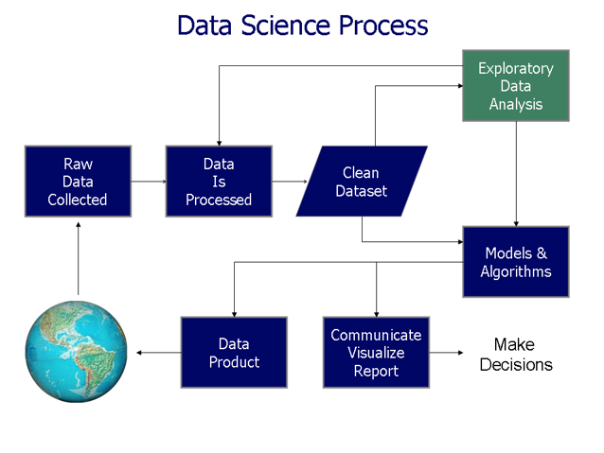
What is Analytics? (Cont’d – 1)
Entire process of data collection, extraction, transformation, analysis, interpretation, and reporting
Farcaster, 2014, CC BY-NC-SA 3.0

Slide 10
What is Analytics? (Cont’d – 2)
“Analytics is used to refer to the methods, their implementations in tools, and the results of the use of the tools as interpreted by the practitioner.”
(NIST Big Data, 2015)
The analytics process is the synthesis of knowledge from information

Slide 11
Types of Analytics: Overview
Descriptive: uses business intelligence and data mining to ask: “What has happened?”
Predictive: uses statistical models and forecasts to ask: “What could happen?”
Prescriptive: uses optimization and simulation to ask: “What should we do?”
(IBM Software, 2013)
Diagnostic: examines data to answer “Why did it happen?”
("Diagnostic Analytics - Gartner IT Glossary", 2015)

Slide 12
Types of Analytics: Overview (Cont’d – 1)
1.2 Figure: (Gartner, 2012)

Slide 13
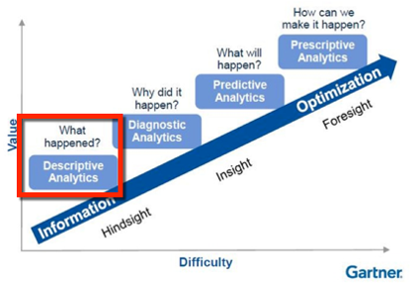
Descriptive Analytics
Describe the data
Common statistics:
counts
averages
Typical reporting methods:
Tables
Pie charts
Column / bar charts
Written narratives
1.3 Figure: (Gartner, 2012)

Slide 14
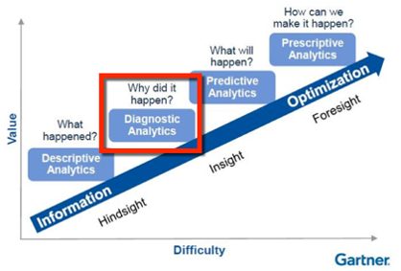
Diagnostic Analytics
Attempts to answer, “why did it happen?”
Drill-down techniques
Data discovery
Correlations
1.4 Figure: (Gartner, 2012)

Slide 15
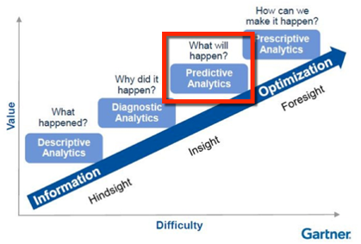
Predictive Analytics
Predicts instead of describing or classifying
Rapid analysis
Relevant insights
Ease of use
1.5 Figure: (Gartner, 2012)

Slide 16
What Predictive Analytics Cannot Do
The purpose of predictive analytics is NOT to tell you what will happen in the future.
It cannot do that.
In fact, no analytics can do that.
Predictive analytics can only forecast what might happen in the future, because all predictive analytics are probabilistic in nature.
("Big Data Analytics: Descriptive Vs. Predictive Vs. Prescriptive - InformationWeek", 2014)

Slide 17
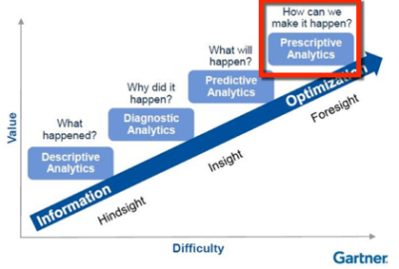
Prescriptive Analytics
Examines data or content to answer the question “What should be done?” or “What can we do to make _______ happen?
Is characterized by techniques such as
graph analysis
Simulation
complex event processing
neural networks
recommendation engines
heuristics
machine learning
1.6 Figure: (Gartner, 2012)

Slide 18
Steps in Data Analytics
Identify the problem and the stakeholders
Identify what data are needed and where those data are located
Develop a plan for analysis and a plan for retrieval
Extract / transform/ load the data
Check, clean, and prepare the data for analysis
Analyze and interpret the data
Visualize the data
Disseminate the new knowledge
Implement the knowledge into the organization

Slide 19
Step 1. Identify the Problem or Question and the Stakeholders
Why is this an important problem?
How will the results impact patient care or the institution?
What is the business case?
Who are the stakeholders?

Slide 20
Step 2. Identify what data are needed
What data elements, such as date of birth, gender, medications, laboratory results, and so on are needed?
Where are these data elements located – in what system or systems and what database tables?
Is there a clinical data warehouse?
Who is the contact person for each system who will be responsible for retrieving the data?

Slide 21
Step 3. Develop plans for retrieval and analysis
Retrieval
Enlist database administrator for each system
Develop specific plan for retrieving the required data elements
Method for cross-checking number of records as well as completeness – how many should you expect, and did you get everything?
Analysis
Enlist statistician
Identify population, sample size, statistical tests to be performed

Slide 22
Step 4. Extract / Transform/ Load (ETL) Process
Extraction
May be an iterative process
The data are retrieved
Checked for completeness
Descriptive statistics
Errors corrected; empty fields addressed
Transformation
Data synchronized (“transformed”) – e.g. M, F, U vs 1, 2, 9
Loading
Data then imported into destination system

Slide 23
Step 5. Check, clean, and prepare the data
Data are now in the system where analysis will be run
Should be a complete set of data
Need to check that everything is ready for analysis
Descriptive statistics
Double-check problem or question being investigated
Double-check against analysis plan

Slide 24
Step 6. Analyze and interpret the data
Use the data analysis plan
Perform the actual statistical analyses as described in the plan
Consult with statistician to confirm interpretations and conclusions

Slide 25
Step 7. Visualize the Data
Nominal (categorical) data: column or bar charts, tables, pie charts, pivot tables
Quantitative data: histograms, scatter plots, star plots
Examples of tools
Microsoft® Excel Chart function
Tableau®
PIE CHART
HISTOGRAM
Innesw, 2014, CC BY-NC-SA 3.0

Slide 26
Step 8 & 9: Disseminating and Implementing
Disseminating the new knowledge
Write up the findings
Disseminate to the stakeholders
Implementing the new knowledge
Requires participation of stakeholders

Slide 27
For Additional Information
For more information on these topics read articles:
Six Steps of an Analytics Project by Jaideep Khanduja
The Seven Key Steps of Data Analysis by Gwen Shapira

Slide 28
Lecture 1: Summary
Analytics is the entire process of data collection, extraction, transformation, analysis, interpretation, and reporting
It can be categorized into three types: Descriptive, Predictive, and Prescriptive

Slide 29
Lecture 1: Introduction to Health Care Data Analytics References
References
Big Data Analytics: Descriptive Vs. Predictive Vs. Prescriptive - InformationWeek. (2014). InformationWeek. Retrieved 2 May 2016, from http://www.informationweek.com/big-data/big-data-analytics/big-data-analytics-descriptive-vs-predictive-vs-prescriptive/d/d-id/1113279
The Definition Of Nominal Scale". Dictionary.com. N.p., 2017. Web. 7 Feb. 2017. http://www.dictionary.com/browse/nominal-scale
Descriptive Analytics - Gartner IT Glossary. (2015). Gartner IT Glossary. Retrieved 2 May 2016, from http://www.gartner.com/it-glossary/descriptive-analytics
Diagnostic Analytics - Gartner IT Glossary. (2015). Gartner IT Glossary. Retrieved 28 April 2016, from http://www.gartner.com/it-glossary/diagnostic-analytics
Escobar, G. J., Puopolo, K. M., Wi, S., Turk, B. J., Kuzniewicz, M. W., Walsh, E. M., ... & Draper, D. (2014). Stratification of risk of early-onset sepsis in newborns≥ 34 weeks’ gestation. Pediatrics, 133(1), 30-36. Retrieved 2/21/2016 from http://pediatrics.aappublications.org/content/pediatrics/133/1/30.full.pdf
Gartner Says Worldwide Enterprise IT Spending to Reach $2.7 Trillion in 2012. (October 17, 2011). Retrieved April 28, 2016, from http://www.gartner.com/newsroom/id/1824919
Health and Medicine Division. (September 6, 2012). Retrieved April 28, 2016, from http://www.nationalacademies.org/hmd/Reports/2012/Best-Care-at-Lower-Cost-The-Path-to-Continuously-Learning-Health-Care-in-America.aspx

Slide 30
Lecture 1: Introduction to Health Care Data Analytics References (Cont’d – 1)
References
Health and Medicine Division. (n.d.). Retrieved April 28, 2016, from http://www.nationalacademies.org/hmd/Activities/Quality/LearningHealthCare.aspx
IBM (2013). Descriptive, predictive, prescriptive: Transforming asset and facilities management with analytics. Retrieved from http://www-01.ibm.com/common/ssi/cgi-bin/ssialias?infotype=SA&subtype=WH&htmlfid=TIW14162USEN.
Managing a Data Dictionary. (2012). Journal Of AHIMA, 83(1), 48-52. Retrieved from http://library.ahima.org/PB/DataDictionary#.WI9uCVMrJhE
Murdoch, T. & Detsky, A. (2013). The Inevitable Application of Big Data to Health Care.JAMA, 309(13), 1351. http://dx.doi.org/10.1001/jama.2013.393. Requires Paid Subscription to JAMA.
National Institute of Standards and Technology,. (2015). NIST Big Data Interoperability Framework: Volume 1, Definitions. Retrieved from http://nvlpubs.nist.gov/nistpubs/SpecialPublications/NIST.SP.1500-1.pdf
NIST/SEMATECH e-Handbook of Statistical Methods. (n.d.). Retrieved May 02, 2016, from http://www.itl.nist.gov/div898/handbook/
Overview - Sepsis - Mayo Clinic. (2016). Mayoclinic.org. Retrieved 2 May 2016, from http://www.mayoclinic.org/diseases-conditions/sepsis/home/ovc-20169784

Slide 31
Lecture 1: Introduction to Health Care Data Analytics References (Cont’d – 2)
Schneeweiss, S. (2014). Learning from big health care data. New England Journal of Medicine, 370(23), 2161-2163.
http://www.nejm.org/doi/full/10.1056/NEJMp1401111#t=article
Shapira, G. (2016). The Seven Key Steps of Data Analysis. Oracle.com. Retrieved 28 April 2016, from http://www.oracle.com/us/corporate/profit/big-ideas/052313-gshapira-1951392.html
Six Steps Of An Analytics Project - Quality Assurance and Project Management. (2015). Quality Assurance and Project Management. Retrieved 2 May 2016, from http://itknowledgeexchange.techtarget.com/quality-assurance/six-steps-of-an-analytics-project/
What is Hadoop?. (2016). Sas.com. Retrieved 2 May 2016, from http://www.sas.com/en_my/insights/big-data/hadoop.html
What is Big Data? | Data Science at NIH. (2015). Datascience.nih.gov. Retrieved 2 May 2016, from http://datascience.nih.gov/bd2k/about/what
Charts, Tables and Figures
1.1 Figure: Smith, K. (2016). Clinical Data Warehouse. Used with permission from Kimberly Smith.
1.2-1.6 Figures: Definition, P. (2012). Big Data Analytics - Predictive Analytics - Gartner Glossary. Gartner IT Glossary. Retrieved 28 April 2016, from http://www.gartner.com/it-glossary/predictive-analytics

Slide 32
Lecture 1: Introduction to Health Care Data Analytics References (Cont’d – 3)
Images
Slide 9: Farcaster. (2014). Data visualization process v1 [Online Image]. Retrieved April 28, 2016 from https://commons.wikimedia.org/wiki/File:Data_visualization_process_v1.png#/media/File:Data_visualization_process_v1.png
Slide 25: Innesw. (2014). Simple pie chart [Online Image]. Retrieved May 2, 2016 from
https://commons.wikimedia.org/wiki/File%3ACharts_SVG_Example_5_-_Simple_Pie_Chart.svg

