Slide 1
Health Care Data Analytics
Lecture 3: Working with Data
Md. Jubayer Hossain
Instructor
@cblast.du.ac.bd

Slide 2
Learning Objectives
Describe reasons why data needs to be cleaned or modified before analysis
Demonstrate ability to identify and correct basic errors in data
Demonstrate ability to perform descriptive statistics
Demonstrate ability to use pivot tables
Describe the relationship between a database in an health IT system and data analysis tools

Slide 3
Technologies and Tools
Common technologies and tools used for data analytics include:
Spreadsheet programs such as Microsoft Excel®
Statistical programs such as R, SAS, SPSS, and Stata
Database management systems such as MySQL and Microsoft SQL Server® - can perform some basic analysis
Business intelligence applications such as Tableau®, QlikView®, IBM Cognos

Slide 4
Install the Excel Analysis ToolPak
You must already have Microsoft Office with Excel on your computer
Click the File tab, then click Options.
Click Add-Ins, and then in the Manage box, select Excel Add-ins.
Click Go.
In the Add-Ins available box, select the Analysis ToolPak check box, and then click OK.
After you load the Analysis ToolPak, the Data Analysis command is available in the Analysis group on the Data tab.

Slide 5
Cleaning Data
Identify errors
Descriptive statistics
Categorical data
Use of pivot tables
Determine correct values or infer/impute
If uncorrectable delete the record
Work with a copy of your dataset and log all changes!

Slide 6
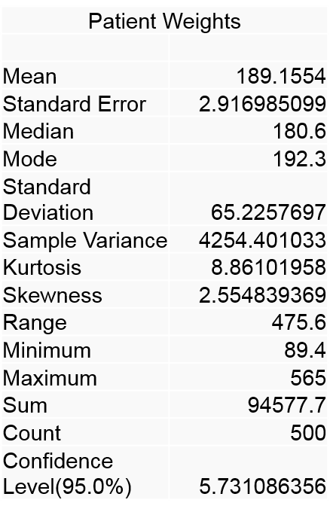
Data Cleaning – Continuous Data Descriptive Statistics
To generate descriptive statistics in Excel:
Data → Data Analysis → Descriptive Statistics
2.1 Figure: (Smith, K. 2016)

Slide 7
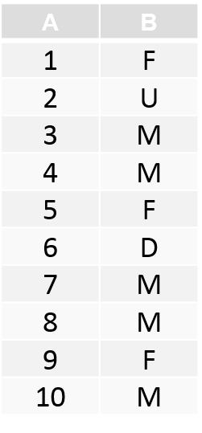
Data Cleaning – Categorical Data
COUNTIF function
=COUNTIF(range, criteria)
=COUNTIF($B$1:$B$10, “M”) - will give 5
=COUNTIF($B$1:$B$10, “F”) - will give 3
=COUNTIF($B$1:$B$10, “U”) - will give 1
Can identify some errors
2.2 Figure: (Smith, K. 2016)

Slide 8
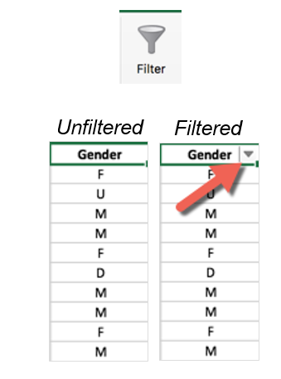
Filtering Records
Displays only those records that meet certain criteria
Click a cell in the column to be filtered
On the Data tab, click the Filter icon
2.3 Figure: (Smith, K. 2016)

Slide 9
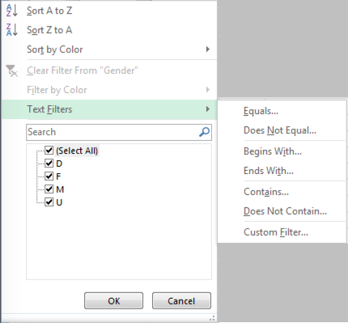
Filtering Records, continued
Dialog box displays all the values present in the column
Can check only values you are interested in – Excel will display only those records
2.4 Figure: (Smith, K. 2016)

Slide 10
Column Graph
Column graph shows individual weights
But doesn’t show us how many patients are in a particular weight category
2.5 Figure: (Smith, K. 2016)

Slide 11
Frequencies and Histograms
Frequency: “How many of X and Y are there?”
A frequency calculation gives how many times a particular value occurs
Can be shown as:
Frequency table
Histogram: a graph of the number of times values occur in a set of data

Slide 12
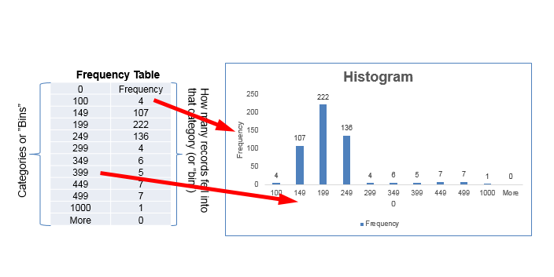
Example Frequency Table and Histogram
2.6 Figure: (Smith, K. 2016)

Slide 13
Example
How many patients are in each of the following weight categories (in pounds)?
< 100 300-349
100-149 350-399
150-199 400-499
200-249 500-1000
250-299 1000+

Slide 14
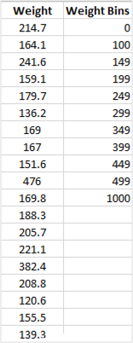
Set up the category bins
Add a column to your Excel spreadsheet with the bins that you want to use to categorize the patient weights
2.7 Figure: (Smith, K. 2016)

Slide 15
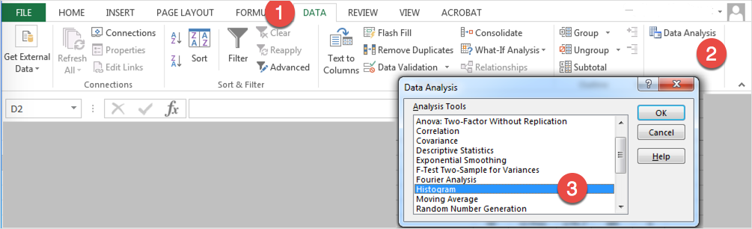
Creating a Frequency Table and Histogram
2.8 Figure: (Smith, K. 2016)

Slide 16
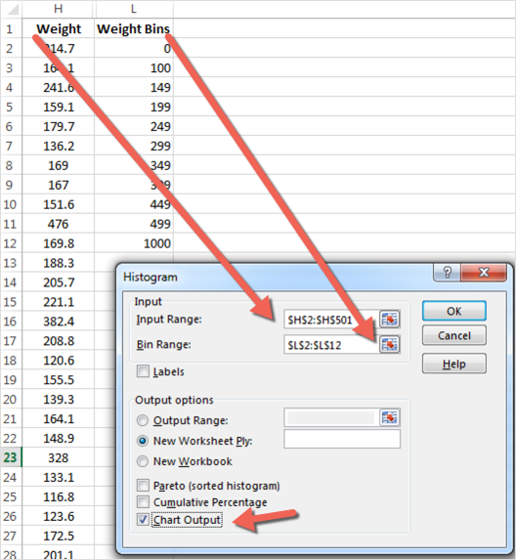
Creating a Frequency Table and Histogram
In the Input Range field, enter the range of cells that contain the weights
In the Bin Range field, enter the range of cells that contain the category bins that you created
Click Chart Output
1.9 Figure: (Smith, K. 2016)

Slide 17
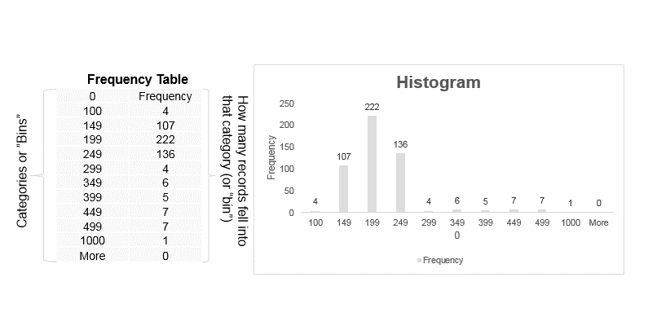
Frequency Table and Histogram Output
2.10 Figure: (Smith, K. 2016)

Slide 18
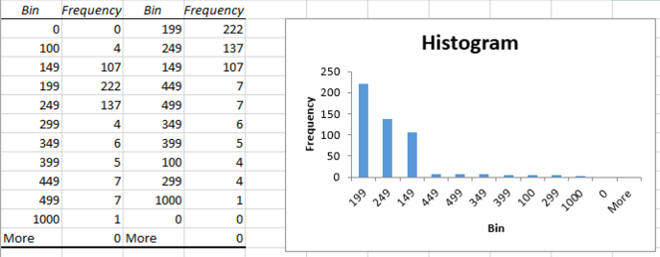
Sorted Histogram
2.11 Figure: (Smith, K. 2016)

Slide 19
Pivot Tables
Pivot tables are an Excel tool that let you summarize, analyze, and create different views of your data. You can arrange how the data is displayed.
Pivot tables are very useful for identifying trends or relationships among data in large datasets.
Use the laboratory exercise on pivot tables to explore data on hospital-acquired infections

Slide 20
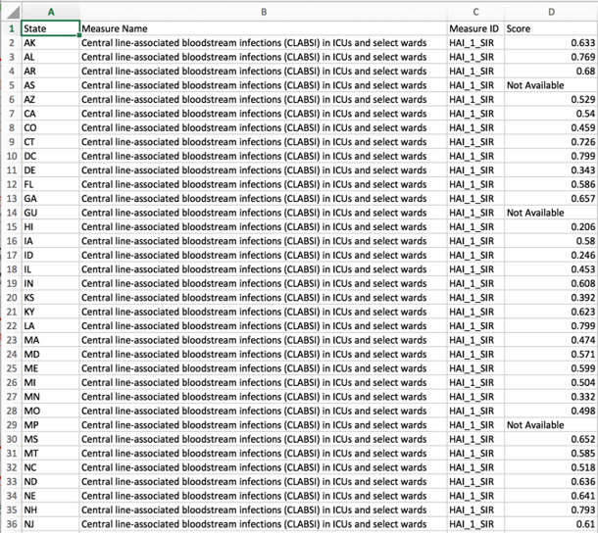
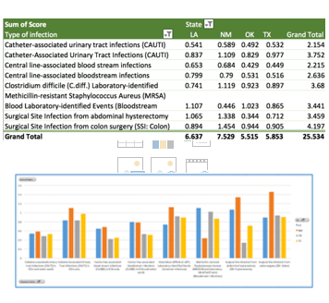
Example Pivot Table
2.13 Figure: (HealthData.gov, n.d.)
2.12 Figure: (HealthData.gov, n.d.)

Slide 21
Chi-Square Test
Are two categorical variables related?
Categorical variable examples:
Gender
Ethnicity
Age group (e.g. 40-49, 50-59)
Disease stage (I, II, III, IV)
Presence or absence of a disease

Slide 22
Lecture 3: Summary
Before you start doing any analysis, you must examine your data, identify any problems, and determine how to address them
We discussed descriptive statistics, pivot tables, histograms, frequency tables, and chi-square test
Pivot Tables describe the relationship between a database in an HIT system and data analysis tools

Slide 23
Lecture 3: References
References
Load the Analysis ToolPak. (n.d.). Retrieved May 03, 2016, from https://support.office.com/en-us/article/Load-the-Analysis-ToolPak-305c260e-224f-4739-9777-2d86f1a5bd89
Charts, Tables, and Figures
2.1 – 2.11 Figure: Smith, K. (2016). Used with permission from author.
2.12 – 2.13 Figure: Healthcare Associated Infections - State | HealthData.gov. (n.d.). Retrieved May 03, 2016, from http://www.healthdata.gov/dataset/healthcare-associated-infections-state

