Slide 1
Health Care Data Analytics
Lecture 1:Secondary Use of Clinical Data
Md. Jubayer Hossain
Instructor
@cblast.du.ac.bd

Slide 2
Secondary Use of Clinical Data Learning Objectives
Describe the secondary uses of clinical data, including EHRs (Lecture a)
Discuss the limitations and challenges of re-using clinical data (Lecture b)
Conduct a data re-use analysis for health care quality measurement utilizing a sample data set
Notes:
The objectives for this unit, Secondary Use of Clinical Data, are to:
Describe the secondary uses or reuses of clinical data including, but not limited to, the electronic health record, or EHR
Discuss the limitations and challenges of reusing clinical data
And, conduct a data re-use analysis for health care quality measurement utilizing a sample data set.

Slide 3
Opportunities for Secondary Use
Using data to improve health care delivery
Health care quality measurement and improvement
Clinical and translational research
Public health surveillance
Implementing the learning health system
Notes:
In this lecture, we will see that there are many opportunities for the so-called secondary use or reuse of clinical data. By re-use, we mean making use of patient data beyond its primary use of documenting care that is delivered. These secondary uses were first enumerated in a white paper from the American Medical Informatics Association in 2007. These opportunities, which we will explore in detail in the following slides, are using data to improve health care delivery, health care quality measurement and improvement, clinical and translational research, public health surveillance, and implementing the learning health system.

Slide 4
Using Data to Improve Health Care
Shift of payment from “volume to value”
Organizations need to manage information better
Predictive analytics
Use of data to anticipate poor outcomes or increased resource use
Applied to problem of early hospital re-admission
A requirement for “precision medicine”
Notes:
Let's begin by talking about the use of data to improve health care delivery. There is a growing shift in how health care is paid for in the United States. We are moving from payment for volume, that is, for doing things paid for by fee-for-service, to value, where there is reward for improved outcomes or efficiency. As this happens, health care organizations need to manage their information better to provide better care and maximize their reimbursement. One approach that can be used is predictive analytics, where we use data to anticipate potential poor outcomes for patients or increased resource use. One area where this has been applied is the problem of early hospital readmission. However, there are many other areas where we can use data to improve care. In addition, as we move into the new era of precision medicine, having access to data to more precisely make diagnoses and prescribed treatments will be a requirement.

Slide 5
Quality Measurement and Improvement
Quality measures increasingly used to make care more “accountable”
Some quality measures found to lead to improved patient outcomes but not in others
Desire is to derive automatically from EHR data, but has proven challenging
Notes:
Another area where we may reuse clinical data is in efforts to measure and improve the quality of care that is delivered in the United States and elsewhere. Quality measures are increasingly used in an effort to make health care delivery more accountable. The record for improving quality is somewhat mixed, as some quality measures have been found to be associated with improved patient outcomes in some instances, but not in others. There is a desire to derive quality measures from EHR data automatically, in other words without requiring manual extraction or modification. This has proved challenging with current systems for a variety of reasons.

Slide 6
Clinical and Translational Research - 1
Activities of NIH Clinical and Translational Science Award (CTSA) Program
Helped many institution develop clinical data repositories
eMERGE Network
Associate genotypes and phenotypes
http://emerge.mc.vanderbilt.edu
Uses EHR data to identify genomic variants associated with several diseases
Notes:
An additional area where we may reuse clinical data is in clinical and translational research. This has been led in part by the activities of the National Institutes of Health’s, or NIH’s, Clinical and Translational Science Award or CTSA Program, which has led many institutions to develop clinical data repositories to facilitate research. Another effort has been the Electronic Medical Records and Genomics or eMERGE Network, which attempts to associate genotypes and phenotypes. The network has used EHR data to identify pheontypes, such as diseases, that are associated with genomic variants. This has been done successfully for a number of diseases.

Slide 7
Clinical and Translational Research - 2
Other successes include replication of clinical studies
Randomized controlled trials
Women’s Health Initiative
Other cardiovascular diseases and value of statin drugs in primary prevention of coronary heart disease
Observational studies
Metformin and reduced cancer mortality rate
Notes:
Another area of reuse of clinical data for clinical and translational research has been the replication of clinical studies. Analyses have shown that the results of randomized controlled trials, or RCTs, can be replicated. A couple of analyses looked at the results of the Women's Health Initiative RCTs and were able to replicate the results through the analysis of clinical data in EHRs and other sources. There have also been replications of other studies of cardiovascular disease as well as those demonstrating the value of statin drugs in primary prevention of coronary heart disease. There has also been replication of observational studies, such as a study looking at the drug metformin and its association with a reduced cancer mortality rate in patients with diabetes mellitus.

Slide 8
Public Health
Syndromic surveillance
Aims to use data sources for early detection of public health threats
Interest increased after 9/11 attacks
Ongoing effort in Google Flu Trends
https://research.googleblog.com/2015/08/the-next-chapter-for-flu-trends.html
Search terms entered into Google predicted flu activity but not early enough to intervene
Performance in recent years has been poorer
Notes:
The reuse of clinical data has also been applied in public health, in particular in the area of syndromic surveillance, where we aim to use data sources for early detection of public health threats from sources such as bioterrorism and emergent diseases. This interest increased after the attacks of September 11, 2001. One ongoing effort has been Google Flu Trends, where the ability to predict outbreaks of the flu has been associated with the queries that individuals type into the Google search engine. At the beginning of flu outbreaks, there tends to be increased queries about different symptoms and treatments related to the flu. Unfortunately, while search terms entered can predict the uptick of the flu in the population, there is not sufficient time for early intervention. In recent years, performance of the Google Flu Trends algorithm has been poorer. However, this secondary use of data may find other value in the future.

Slide 9
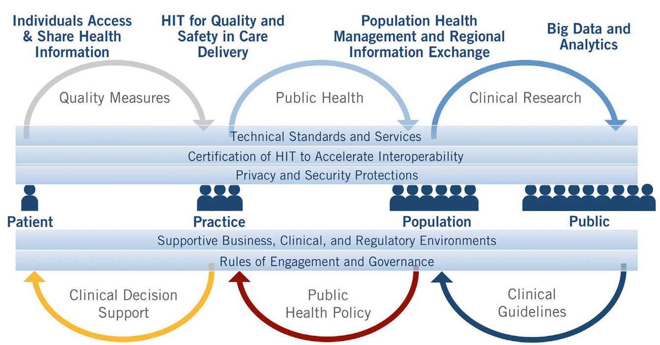
Implementing the Learning Health System
(ONC, 2014)
Notes:
Bringing this all together is the notion of the learning health system, where the health care system learns from data that we collect, measure, and analyze. This figure, from the Office of the National Coordinator for Health IT, shows the various uses of clinical data. The system begins with measures on individuals, typically quality measures. The system then extends those measures to the population for public health, thus enabling clinical research to increase our understanding of what works and what does not. We start to close this loop by producing clinical guidelines that inform public health policy and can be implemented in clinical decision support and feedback to the patient.

Slide 10
Secondary Use of Clinical Data Summary – Lecture a
The are many potential secondary uses or re-uses of clinical data, especially that from the EHR
Such data can be used to improve care delivery. quality measurement and improvement, clinical and translational research, and public health surveillance
This may all come together to implement the learning health system
Notes:
This concludes Lecture a of Secondary Use of Clinical Data.
In summarizing this lecture, we saw that there are many potential secondary uses or reuses of clinical data, especially data that comes from the electronic health record. Such data can be used to improve care delivery, quality measurement and improvement, clinical and translational research, and public health surveillance. It also has the potential to all come together in the learning health system.

Slide 11
Secondary Use of Clinical Data References – 1 – Lecture a
References
Amarasingham, R., Patel, P., Toto, K., Nelson, L., Swanson, T., Moore, B., . . . Halm, E. (2013). Allocating scarce resources in real-time to reduce heart failure readmissions: a prospective, controlled study. BMJ Quality & Safety, 22, 998-1005.
Anonymous. (2011). Toward Precision Medicine: Building a Knowledge Network for Biomedical Research and a New Taxonomy of Disease. Washington, DC: National Academies Press.
Anonymous. (2014). Connecting Health and Care for the Nation: A 10-Year Vision to Achieve an Interoperable Health IT Infrastructure. Retrieved from Washington, DC: http://www.healthit.gov/sites/default/files/ONC10yearInteroperabilityConceptPaper.pdf
Barkhuysen, P., deGrauw, W., Akkermans, R., Donkers, J., Schers, H., & Biermans, M. (2014). Is the quality of data in an electronic medical record sufficient for assessing the quality of primary care? Journal of the American Medical Informatics Association, 21, 692-698.
Burwell, S. (2015). Setting value-based payment goals - HHS efforts to improve U.S. health care. New England Journal of Medicine, 372, 897-899.
Butler, D. (2013). When Google got flu wrong. Nature, 494, 155-156.
Notes:
No Audio.

Slide 12
Secondary Use of Clinical Data References – 2 – Lecture a
References
Chapman, W., Christensen, L., Wagner, M., Haug, P., Ivanov, O., Dowling, J., & Olszewski, R. (2004). Classifying free-text triage chief complaints into syndromic categories with natural language processing. Artificial Intelligence in Medicine, 33, 31-40.
Collins, F., & Varmus, H. (2015). A new initiative on precision medicine. New England Journal of Medicine, 372, 793-795.
Danaei, G., Rodríguez, L., Cantero, O., Logan, R., & Hernán, M. (2011). Observational data for comparative effectiveness research: An emulation of randomised trials of statins and primary prevention of coronary heart disease. Statistical Methods in Medical Research, 22, 70-96.
Gerbier, S., Yarovaya, O., Gicquel, Q., Millet, A., Smaldore, V., Pagliaroli, V., . . . Metzger, M. (2011). Evaluation of natural language processing from emergency department computerized medical records for intra-hospital syndromic surveillance. BMC Medical Informatics & Decision Making, 11, 50.
Gildersleeve, R., & Cooper, P. (2013). Development of an automated, real time surveillance tool for predicting readmissions at a community hospital. Applied Clinical Informatics, 4, 153-169.
Notes:
No Audio.

Slide 13
Secondary Use of Clinical Data References – 3 – Lecture a
References
Ginsberg, J., Mohebbi, M., Patel, R., Brammer, L., Smolinski, M., & Brilliant, L. (2009). Detecting influenza epidemics using search engine query data. Nature, 457, 1012-1014.
Gottesman, O., Kuivaniemi, H., Tromp, G., Faucett, W., Li, R., Ritchie, M., . . . Williams, M. (2013). The Electronic Medical Records and Genomics (eMERGE) Network: past, present, and future. Genetics in Medicine, 15, 761-771.
Hebert, C., Shivade, C., Foraker, R., Wasserman, J., Roth, C., Mekhjian, H., . . . Embi, P. (2014). Diagnosis-specific readmission risk prediction using electronic health data: a retrospective cohort study. BMC Medical Informatics & Decision Making, 14, 65.
Henning, K. (2004). What is syndromic surveillance? Morbidity and Mortality Weekly Report, 53(Suppl), 5-11.
Jha, A., Joynt, K., Orav, E., & Epstein, A. (2012). The long-term effect of Premier pay for performance on patient outcomes. New England Journal of Medicine, 366, 1606-1615.
MacKenzie, S., Wyatt, M., Schuff, R., Tenenbaum, J., & Anderson, N. (2012). Practices and perspectives on building integrated data repositories: results from a 2010 CTSA survey. Journal of the American Medical Informatics Association, 19(e1), e119-e124.
Notes:
No Audio.

Slide 14
Secondary Use of Clinical Data References – 4 – Lecture a
References
Newton, K., Peissig, P., Kho, A., Bielinski, S., Berg, R., Choudhary, V., . . . Denny, J. (2013). Validation of electronic medical record-based phenotyping algorithms: results and lessons learned from the eMERGE network. Journal of the American Medical Informatics Association, 20(e1), e147-154.
Parsons, A., McCullough, C., Wang, J., & Shih, S. (2012). Validity of electronic health record-derived quality measurement for performance monitoring. Journal of the American Medical Informatics Association, 19, 604-609.
Pathak, J., Bailey, K., Beebe, C., Bethard, S., Carrell, D., Chen, P., . . . Chute, C. (2013). Normalization and standardization of electronic health records for high-throughput phenotyping: the SHARPn consortium. Journal of the American Medical Informatics Association, 20, e341-e348.
Safran, C., Bloomrosen, M., Hammond, W., Labkoff, S., Markel-Fox, S., Tang, P., & Detmer, D. (2007). Toward a national framework for the secondary use of health data: an American Medical Informatics Association white paper. Journal of the American Medical Informatics Association, 14, 1-9.
Notes:
No Audio.

Slide 15
Secondary Use of Clinical Data References – 5 – Lecture a
References
Tannen, R., Weiner, M., & Xie, D. (2008). Replicated studies of two randomized trials of angiotensin-converting enzyme inhibitors: further empiric validation of the 'prior event rate ratio' to adjust for unmeasured confounding by indication. Pharmacoepidemiology and Drug Safety, 17, 671-685.
Tannen, R., Weiner, M., & Xie, D. (2009). Use of primary care electronic medical record database in drug efficacy research on cardiovascular outcomes: comparison of database and randomised controlled trial findings. British Medical Journal, 338, b81.
Tannen, R., Weiner, M., Xie, D., & Barnhart, K. (2007). A simulation using data from a primary care practice database closely replicated the Women's Health Initiative trial. Journal of Clinical Epidemiology, 60, 686-695.
Wang, T., Dai, D., Hernandez, A., Bhatt, D., Heidenreich, P., Fonarow, G., & Peterson, E. (2011). The importance of consistent, high-quality acute myocardial infarction and heart failure care results from the American Heart Association's Get with the Guidelines Program. Journal of the American College of Cardiology, 58, 637-644.
Notes:
No Audio.

Slide 16
Secondary Use of Clinical Data References – 6 – Lecture a
References
Weiner, M., Barnhart, K., Xie, D., & Tannen, R. (2008). Hormone therapy and coronary heart disease in young women. Menopause, 15, 86-93.
Xu, H., Aldrich, M., Chen, Q., Liu, H., Peterson, N., Dai, Q., . . . Denny, J. (2014). Validating drug repurposing signals using electronic health records: a case study of metformin associated with reduced cancer mortality. Journal of the American Medical Informatics Association, Epub ahead of print.
Notes:
No Audio.

