Slide 1
Health Care Data Analytics
Lecture 1: Communicating Data Analysis Results
Md. Jubayer Hossain
Instructor
@cblast.du.ac.bd

Slide 2
Communicating Data Analysis Results Lecture – Learning Objectives
Select the best data communication mode, given the analysis goals and results
Interpret data analysis results
Present solutions for a variety of technical data communication challenges.
Prepare a simple data visualization using open-source tools
Participate in the design and development of a complex data visualization
Notes:
The Objectives for this Unit are to:
Select the best data communication mode, given the analysis goals and results
Interpret data analysis results
Present solutions for a variety of technical data communication challenges and,
Prepare a simple data visualization as well as design and develop a complex data visualization

Slide 3
Communication Basics
Delineate the Problem
Define Your Audience
Choose the Right Mode
Choose the Right Words
Choose Supporting Visuals
Have an “Elevator” Speech
Notes:
So when you are talking about communicating your data results for value-based purchasing or population health management or care coordination, there are some basics of communication. The first one is to delineate the problem or delineate the question.
What exactly is it that you are trying to communicate? Define your audience. Choose the right mode based on your problem and your audience. Make sure you use the right words. Visuals almost always help because many of us are very visual. Then finally, having an “Elevator Speech.”
So let’s look at each of these in turn.

Slide 4
Delineate the Problem
What are you trying to do with this communication?
Is there a particular timeframe involved?
Does the number of people matter?
Notes:
So when you delineate the problem or decide what question, it’s really about what you are trying to do with this communication. What is the purpose for the communication? Is there a particular time frame involved with this communication? Do you need to do it today, tomorrow, next month, next year? How long does the communication need to last – today, tomorrow, next month, next year? Does the number of people you are trying to reach matter?
You really need to be very clear about your purpose for communicating and what you intend to do with it. That’s an important part of delineating the problem.

Slide 5
Define Your Audience
Colleagues or co-workers
Staff or supervisors
Subject matter experts
Other scientists
Journalists
Policymakers
Others
Notes:
Once you have done that, if you have done that well hopefully it can help you define your audience. Are you going to be doing this to colleagues or co-workers, staff or supervisors? Are you going to be communicating to the subject matter experts? If that’s the case you will approach it differently. Are you going to be communicating to scientists in other fields? Again, that might change how you communicate. Possibly you are being interviewed by a journalist, or you are trying to make a case for particular policymakers. It could be others – you could be doing a presentation to a room full of school children. The audience you are trying to communicate to is very important.

Slide 6
Choose the Right Mode
Brainstorm the possible communication channels
Email
Website or blog
Podcast or YouTube
Peer-reviewed manuscript
Conference presentation
Dashboard
Notes:
Both what you are trying to communicate as well as who you are communicating to will help you determine what the right mode of communication is, that means what are the communication channels you are going to use. Now it could be that you will use all of these in different ways but you really need to brainstorm what are the possible different communication channels. Some of this is going to depend on your problem and your audience but it may also depend on the resources available for your communication effort. So are you going to may be, send out an email blast, are you going to publish a website or a blog. There are people who feel they reach a larger audience with a blog that if they utilized say a, peer-reviewed manuscript. All of these channels, and probably more than you can think of, are available if you’re trying to communicate your data results.

Slide 7
Choose the Right Words
For the audience
Be careful of acronyms (ONC, EHR or MU, as examples)
Jargon can hard to follow
Short words and short sentences
Not too many!
Notes:
Then its very important again to choose the right words for your audience, if its subject matter experts or children or adults who may not be familiar with your field, those are all you would communicate differently and may use different words with each one of those audiences. You need to be very careful of acronyms. We may be very familiar now with the Office of the National Coordinator ONC, Electronic Health Record EHR or Meaningful Use (MU), however, your audience may not be. So be careful of your acronyms. Also be careful of your jargon, and by this I mean if you are talking about very specific types of things almost using a code the way we talk about it. So just be careful of that.
Typically, to have a very clear message – especially if it’s to non-scientific people – you would want to use short words and short sentences. You may have a vast array of educational levels in an audience, so you want to be sure to use words that everyone can understand. And then finally be careful of the number of words that you are using especially if you are creating a data display or if you trying to communicate results and you are also going to include a data display where may be the visual is more important and too many words would distract and typically people don’t read too many words if you have got a really good visual.

Slide 8
Data Visualization
Show the data
Induce the viewer to think about the substance rather than the methodology, graphic design, the technology, or other things
Avoid distorting what the data have to say
Present many numbers in a small space
Make large data sets coherent
Encourage the eye to compare different pieces of data
Reveal the data at several levels of detail
Serve a reasonably clear purpose
Closely integrate the statistical and verbal descriptions of the data set
(Tufte, 2001)
Notes:
Let’s talk a little bit about data visualization. Edward Tufte is well known in the field of visualizations and actually has a book on the visual display of quantitative information, and here we see some of his main points about creating the ideal graph. So he contends you need to show the data and you really want them to be thinking about what is reflected in that data rather than other points of your visual display. Sometimes I have seen very, very colorful displays where the vivid colors take away from the data that’s in the display, and I am paying more attention to the colors than I am to what the display is trying to actually tell me. Don’t distort what the data have to say so that its misleading.
You can present many numbers in a small space with an ideal graph. It can help to make large data sets coherent and we are going to be looking at a couple of examples in the following slides. It can encourage the eye to compare different pieces of data. Again we are going to see some examples of that.
Sometimes it can also reveal the data at several levels of detail. Hopefully serve a clear purpose and if you have done the data visualization well all of your statistical and verbal descriptions of the data set can be explored with that data visualization. Data visualization is often very necessary when we are talking about communicating our results. So let’s look at some of the more common types of data visualizations.

Slide 9
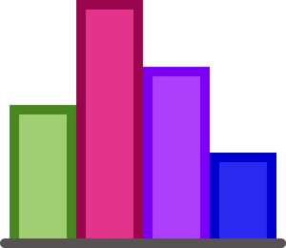
Bar Charts
Show comparisons between groups
Types of Bar Charts:
Vertical (aka column charts) or horizontal
Histogram (next slide)
Pareto (most to least)
4.1 Figure: Sample Bar Chart created from fictional data
Notes:
We will start with Bar Charts. Typically bar charts are used to show comparisons between groups. You may have groups of people, you may have groups of hospitals, groups of providers, groups of physicians and bar charts can show comparisons between the groups. It can be vertical also known as column charts as you see here or you can put this chart on the side and it can become horizontal. It can be Histogram, which we will look at in the next slide. It can also be called a Pareto chart, which is when you have the results starting from the most going to the least. So bar charts are pretty flexible and there are a lot of different types of bar charts.

Slide 10
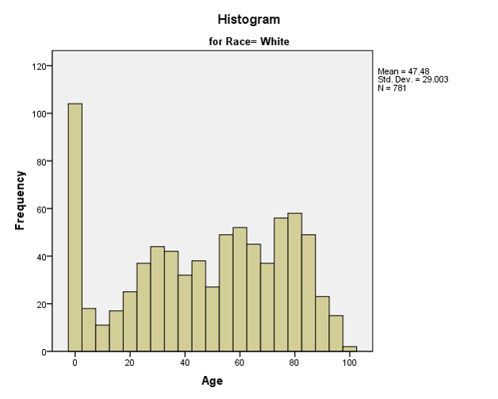
Histogram
4.2 Figure: Sample of Histogram. Created from fictional data
Notes:
The example that we see here is from false data but it’s a histogram where race equals white for a given data set. We are looking at the frequency of the different ages. And in this data set you can see the very young was the most frequent. These are the things that a histogram can tell you if it’s done correctly.

Slide 11
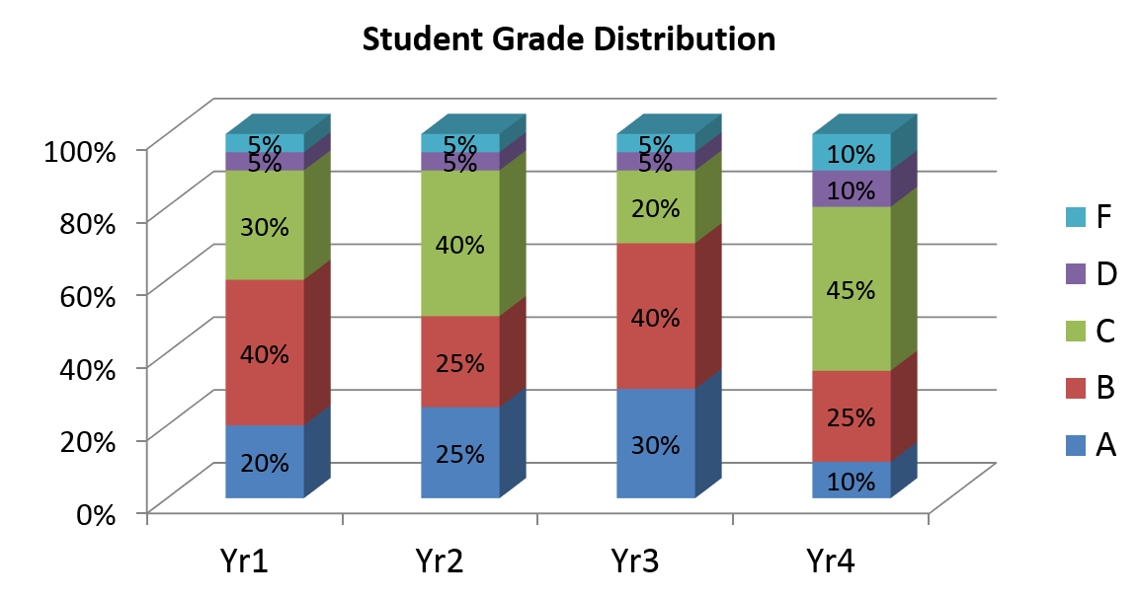
Stacked Bar Graph
4.3 Figure: Same of Stacked Bar Graph. Created from fictional data, and does not represent actual grade distribution.
Notes:
The stacked bar graph that we see here is also false data and you can see here we are taking a look at student grade distribution. So stacked bar graphs are nice and we will see another example of this.

Slide 12
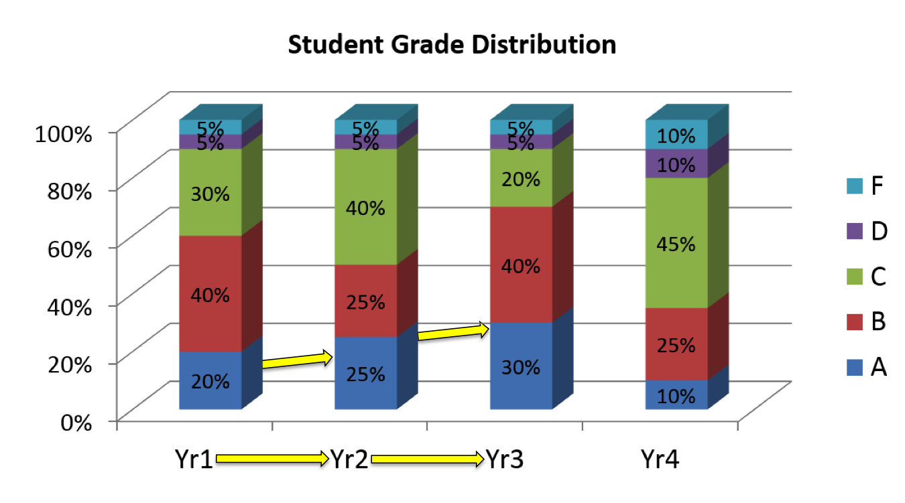
Stacked Bar Graph (2)
4.3 Figure: Same of Stacked Bar Graph. Created from fictional data, and does not represent actual grade distribution.
Notes:
So between year one, year two and year 3 you can see your A’s were steadily increasing.

Slide 13
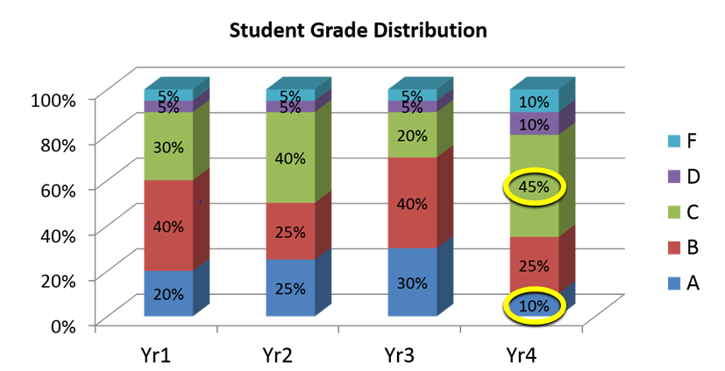
Stacked Bar Graph (3)
4.3 Figure: Same of Stacked Bar Graph. Created from fictional data, and does not represent actual grade distribution.
Notes:
And then all of a sudden in year four, you had an immediate and really telling decrease and you don’t know why and your C’s really increased.

Slide 14
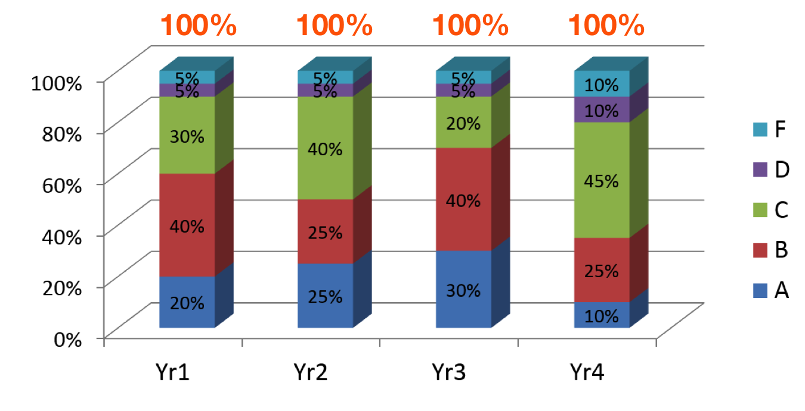
Stacked Bar Graph (4)
4.3 Figure: Same of Stacked Bar Graph. Created from fictional data, and does not represent actual grade distribution.
Notes:
So, stacked bar graphs are nice if you can categorize your data and each one can equal a 100%. So this is a 100% of the students, a 100% of the students, a 100% of the students, and so forth and so on and we see the grade distribution.

Slide 15
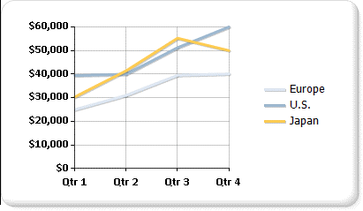
Line Charts
Used for large amounts of data occurring over time
4.4 Figure: Sample of Line Chart. Created from fictional data
Notes:
Line charts are typically used for large amounts of data occurring over time. The most common way we see line charts used in healthcare is for any sort of results over time, so for example lab results over time such as an HB1CA result over time or blood pressure readings over time, so large amounts of data occurring over time lend themselves very well, very easily to a line chart.

Slide 16
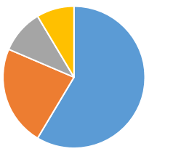
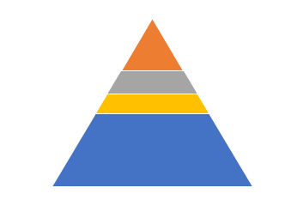
Pie Charts (or Shape Charts)
Display data as a proportion of a whole
No axes
Can explode out for emphasis
Can be any shape
4.5 Figure: Sample of Pie Chart created from fictional data
4.6 Figure: Sample of Shape Chart created from fictional data
Notes:
Pie Charts or shape charts because they don’t always have to be in a pie shape display the data as a proportion of the whole, what does that mean? It means you have 100% of something and you are going to split it into different categories. So for example this pie chart here could represent percentage of patients with a particular pair. So it’s the proportion of a whole. A pie chart does not have any axis like you find with the bar charts or line chart, it can be any shape and as you see here on this pie chart you can explore parts of your pie chart or you can break it apart for emphasis.

Slide 17
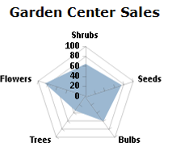
Polar or Radar Charts
Multiple series or categories of data
Larger values are farther from the center
4.7 Figure: Sample of Radar Chart created from fictional data.
Notes:
Polar or Radar Charts such as the one you see here use Multiple series or categories of data, Larger values are farther from the center and so if used correctly this can be a very novel and interesting way to display the data.

Slide 18
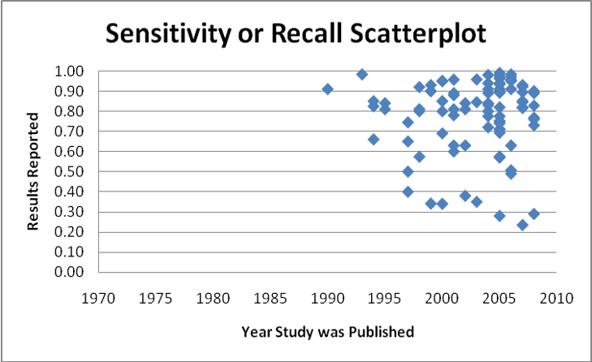
Scatterplots or scatter charts
Values represented as a series of points on a chart
Distributions of values and clusters of data
Displaying and comparing numerical data
4.8 Figure: (Stanfill, Williams, Fenton, Jenders, & Hersh, 2010)
Notes:
Scatterplots or scatter charts show your data values represented as a series of points on a chart, you are looking at one here. So it can show you the distribution of the data. It can show you any clusters of data. It can be used for displaying and comparing large amounts of numerical data. And this particular scatter plot here, the results were reported, what this is, is a sensitivity or recall scatterplot for computer assisted coding that was tested between 1970 to 2010.
The intent was hopefully that you would see over time the sensitivity or recall improved, and instead what you see is still over here in 2010 you have sensitivity and recall that is 30% below. You do have it also up here in the higher regions, but not all of the study reported a very high sensitivity or recall. There was no clear discernible movement in terms of the sensitivity or recall in the data. Scatterplots are really great to see what’s going on if you have very large amounts of data.

Slide 19
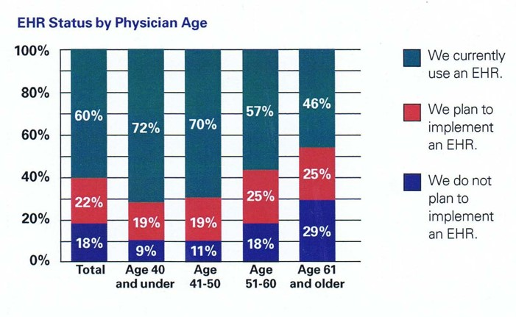
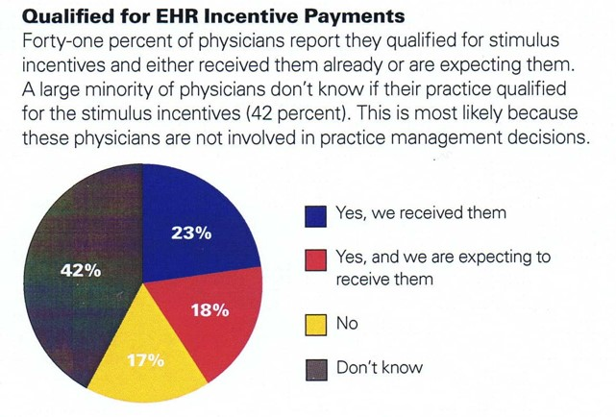
Display in Action!
4.9 Figure: (Texas Medical Association, 2012)
4.10 Figure: (Texas Medical Association, 2012)
Notes:
So lets take a look at Display in Action. In this instance here, these are some meaningful use EHR results from a publically available report and what we see here is they used both the pie chart and they used the stacked bar chart.
In the stacked bar chart we see by physician age and the EHR status. You can see clearly if the physician was 40 and under. 72% currently used an HER, another 19% plan to implement it versus age 61, where only 46% currently used an EHR, 25% plan to implement, but 29% – more than a quarter – did not plan to implement an EHR. So you can see clearly comparing across the different age groups.
And then for the pie chart, you can see whether or not the physician qualified for the EHR-incentive payments – this totals a 100. And you see 42% do not even know.

Slide 20
Practice Creating Visualizations
Component 24, Unit 2 – more basic visualization
Component 24, Unit 10 – more complex visualization
Notes:
For practice creating visualizations you can go to Component 24, Unit 2 for more basic visualization practice, and go to Component 24, Unit 10 for more complex visualization practice.

Slide 21
The “Elevator” Speech
Can you tell the story in the time it takes to ride the elevator?
Three main points
Meaningful
Easy to understand
Notes:
Of that list of Communication Basics, the last step was “Elevator Speech.” And the “Elevator Speech” is so named because it can you tell the story in the time it takes to ride the elevator. Often this is all of the time you may get to tell someone your message and tell them why it’s important to them. So typically when you are trying to do an Elevator Speech you want to make sure that you have no more than three main points because to go longer would be longer than the elevator ride and it also becomes very difficult for them to remember. You want to make it very meaningful, again, so they remember it and it sticks with them and as before, you want to make it easy to understand. So no complex topics, no real complex words, certainly no Jargon or acronyms that they might know, it needs to be easy to understand. You should always have an Elevator Speech if you are trying to communicate an idea multiple times.

Slide 22
Unit 4 Summary: Communicating Data Analysis Results
Effective data communication requires thought and planning
All communication is not equal for all audiences
The visual presentation is particularly important, but can be more difficult
Have an “elevator” speech
Notes:
This concludes Component 24, Health Care Data Analytics, Unit 4, Communicating Data Analysis Results.
To summarize:
Effective data communication requires thought and planning
It is not equal for all audiences so you must know the audience you are communicating with.
The visual presentation can be very important, but also more difficult.
And it always helps to have an elevator speech or a short description summarizing your communication.

Slide 23
Unit 4: Communicating Data Analysis Results References
References
Communication 101: Communication Basics for Scientists and Engineers. (2013). Retrieved May 16, 2016, from http://www.aaas.org/pes/communication-101-communication-basics-scientists-and-engineers
Stanfill, M., Williams, M., Fenton, S., Jenders, R., & Hersh, W. (2010). A systematic literature review of automated clinical coding and classification systems. Journal Of The American Medical Informatics Association, 17(6), 646-651. http://dx.doi.org/10.1136/jamia.2009.001024
Texas Medical Association,. (2012). TMA April 2012 Survey of Texas Physicians Preliminary Research Findings. Retrieved from http://www.texmed.org/WorkArea/DownloadAsset.aspx?id=24815
Tufte, E. (2001). The visual display of quantitative information. Cheshire, Conn.: Graphics Press.
Charts, Tables and Figures
4.8 Figure: Stanfill, M., Williams, M., Fenton, S., Jenders, R., & Hersh, W. (2010). A systematic literature review of automated clinical coding and classification systems. Journal Of The American Medical Informatics Association, 17(6), 646-651. http://dx.doi.org/10.1136/jamia.2009.001024
4.9 Figure and 4.10 Figure: Texas Medical Association. (2012). TMA April 2012 Survey of Texas Physicians Preliminary Research Findings. Retrieved from http://www.texmed.org/WorkArea/DownloadAsset.aspx?id=24815
Notes:
No Audio.

Slide 24
Unit 4: Communicating Data Analysis Results
This material was developed by The University of Texas Health Science Center at Houston, funded by the Department of Health and Human Services, Office of the National Coordinator for Health Information Technology under Award Number 90WT0006.
Notes:
No Audio.

