Slide 1
Health Care Data Analytics
Lecture 1: Patient Identification
Md. Jubayer Hossain
Instructor
@cblast.du.ac.bd

Slide 2
Patient Identification Learning Objectives - 1
Define the key attributes of patient identifiers (Lecture a)
Describe the challenges of duplicate and overlaid records (Lecture a)
Discuss the pros and cons of standard identifiers vs. linking records (Lecture a)
Notes:
The learning objectives for this unit, Patient Identification, are:
Define the key attributes of patient identifiers
Describe the challenges of duplicate and overlaid records
Discuss the pros and cons of standard identifiers vs. linking records

Slide 3
Patient Identification Learning Objectives - 2
Describe the methods used for patient record-matching (Lecture a)
Match a sample set of patient records (Lecture a)
Discuss the benefits and limitations of de-identified data (Lecture b)
Notes:
Describe the methods used for patient record-matching
Match a sample set of patient records
And discuss the benefits and limitations of de-identified data

Slide 4
Patient Identification
Patient identifiers
Duplicate and overlaid records
Standard identifiers
Record linkage methods
De-identification of data
Notes:
In the previous lecture of this unit, we talked about patient identifiers, duplicate and overlaid records, standard identifiers, and record linkage methods. In this lecture, we will discuss the value and limitations of the de-identification of data.

Slide 5
What is De-Identified Data?
Health data from which information that could be used to identify an individual has been removed.
Two accepted methods for de-identification
Removing 18 elements of PHI
https://privacyruleandresearch.nih.gov/pr_08.asp
Statistical de-identification
Notes:
De-identified health information is health data from which information that could be used to identify an individual has been removed.
There are two accepted methods under HIPAA for data to be de-identified. One is to remove the 18 elements of protected health information, which are listed at the link provided here. The other is the statistical de-identification by, “a person with appropriate knowledge of and experience with generally accepted statistical and scientific principles and methods for rendering information not individually identifiable.”

Slide 6
De-Identified Data Uses
Not subject to HIPAA Privacy Rule
Can still be useful in research and other aggregations
Notes:
Health information that has been de-identified is not subject to the HIPAA Privacy Rule. However, it is still useful. De-identified health information can be used in research and other aggregations.

Slide 7
De-Identified Data = Secure?
87% of U.S. population uniquely identified by three data elements
One analysis identified Governor William Weld of Massachusetts in health insurance database for state employees
More recent re-analysis finds prominence of Gov. Weld aided in re-identification
Same voter registration data allowed re-identification of participants in a Personal Genome Project
Notes:
So if health data has been de-identified, that means the identities of the individuals whose data it is are secure, right? Not necessarily.
Research done by Sweeney and colleagues found, for example, that 87% of the U.S. population can be uniquely identified by using as few as three data elements: the five-digit zip code of where they live, their gender, and their date of birth. Think about that for a minute. If someone has just these three pieces of data, they can identify the individual to whom it belongs 87% of the time.
In some additional early work by Sweeney in 1997, she showed that after spending 20 dollars to purchase a voter registration list for Cambridge, Massachusetts, she was able to identify the Governor of Massachusetts, William Weld, in a health insurance database for state employees simply by linking zip code, gender, and date of birth from the voter registration list to the de-identified health data in the health insurance database. We’ll talk more about this on the next slide, but it must be noted that recent re-analysis of the population demographics found the fact that Mr. Weld was a public figure who experienced a much-publicized hospitalization played a part in his being so easily identifiable in the insurance database.
However, in 2013 using voter registration data of participants in the Massachusetts-based Personal Genome Project, Sweeney was also able to show that people who have agreed to have their genomic data published, are relatively easily identified individually using that voter registration data.

Slide 8
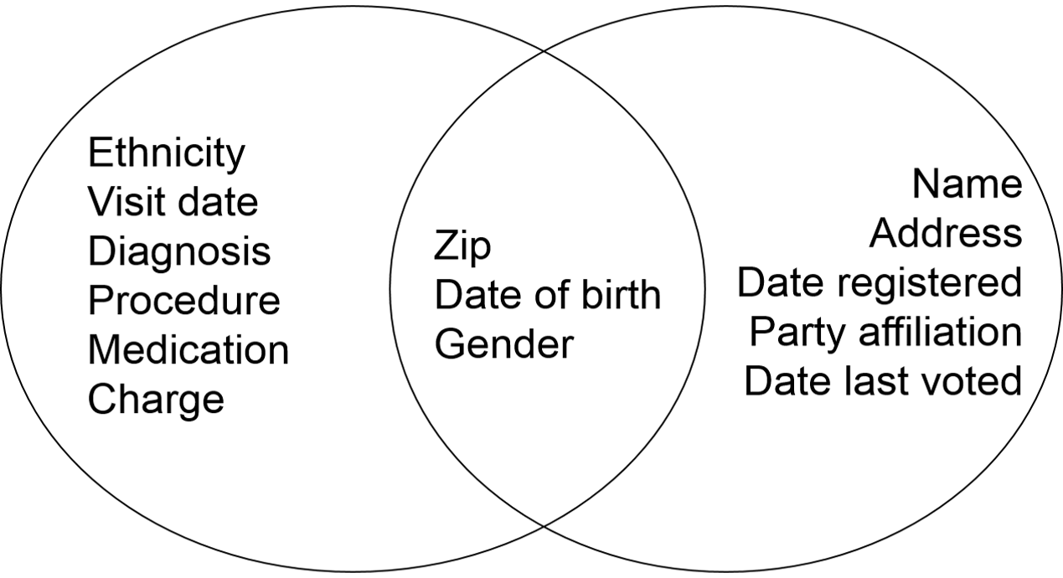
How Governor Weld was Re-Identified
Notes:
The figure on this slide shows how the medical information about Gov. Weld was re-identified. To the left is the de-identified medical database. It has various medical data, including diagnoses, procedures, medications, etc. It also has the de-identified person’s zip code, date of birth, and gender. This latter information is also in the voter registration database on the right, which also has the individual’s name and address, not to mention some voting related information. This demonstrates how the Governor’s medical data was discovered.

Slide 9
Other Examples of Re-Identification of De-Identified Data
Genomic data can aid re-identification in clinical research studies
SSN can be predicted from public data
“Chrononymization” of laboratory data
Credit card data
1.1M people over three months allowed re-identification of 90% of people with only 4 “spatiotemporal” points
Notes:
There are other examples of re-identification from de-identified data. A couple analyses have found that genomic data can help re-identify patients who are in databases of clinical research studies. Aquistie found that Social Security numbers can sometimes be predicted from public data sets. Cimino and colleagues have looked at chrononymization of laboratory data, in other words, taking the panels of test results where the combinations of values are likely to be unique and using this to then re-identify patients. Credit card data also turns out to be a source of re-identification of data, with one analysis looking at 1.1 million people over three months and finding that 90% could be re-identified with only four of what they call spatiotemporal points, so knowing where and when the credit card was used. Clearly there are many ways to re-identify supposedly de-identified data.

Slide 10
De-Identified Data Is Not A Panacea
If complete success is not achievable, how much accuracy is acceptable?
“Over-scrubbing” may eliminate data important to analysis being done
De-identified data may also
Eliminate temporal information
Undermine accuracy of techniques such as machine learning and natural language processing
Notes:
It's also important to remember that when we de-identify data, there are a number of issues. It's not necessarily a panacea.
First of all, we know that complete 100 percent de-identification is difficult if not impossible to achieve. So if we can't achieve complete success at de-identifying data, how much accuracy is acceptable?
We also know that some personal health information elements may be more acceptable to not having, for example, parts of street addresses which sometimes fall through programs that aim to de-identify data versus say names, which we probably want to be absolutely sure never pass through.
By the same token when we over-scrub the data, in other words, when we remove identifiers, we may end up eliminating data that is important to the analysis being done, whether it's research or quality measurement, et cetera. When we de-identify data, we may eliminate things like temporal information. We may de-link the various health care episodes that a patient has had, and this information may be important in longitudinal analysis. In addition, we may undermine the accuracy of techniques, such as machine learning and natural language processing that operate on this data. When it is de-identified, we don't know how that affects the accuracy of these computational processes

Slide 11
Internet and Privacy - 1
“Recreational” genetic genealogy databases allow identification of personal genomes
75-80% of “anonymous” posters on medical Web forums can be re-identified by text analysis
Individual traits can be discerned from Facebook “likes” with high accuracy
Notes:
The Internet may be particularly problematic for maintaining privacy. There are so-called “recreational” genetic genealogy databases that allow identification of personal genomes when that data is combined with other data, such as age, name, and state. One analysis found that over three-quarters of those who post on medical web forms who thought they were posting anonymously could be re-identified by text analysis. Another well-known study looked at “likes” from various Facebook users and found that individual traits such as sexual orientation, political affiliation, personality types, and ethnicity could easily be gleaned from them.

Slide 12
Internet and Privacy - 2
Many high-profile health Web sites track user searches
Sell the information to third-party tracking entities
Few laws and regulations governing such use
Only 31% of 600 most commonly used health-related smartphone apps have privacy policies
Notes:
It is also known that many web sites, including high profile health websites, track user searches and sell that information to third-party tracking entities, usually for advertising or potentially for other purposes. There are few laws and regulations that govern such use. This is why, for example, you may be surfing the web and see an ad on a page that may be relevant to something you have recently been shopping for or looking at. Finally, there is the proliferation of health-related smart phone apps, with one assessment of the 600 most commonly used health-related smart phone apps finding that only 31% of them had privacy policies.

Slide 13
Patient Identification Summary - Lecture b
Defined what de-identified data is
Described the two HIPAA-acceptable methods to de-identify data
Examined why de-identified data is not always secure
Explored issues with de-identified data
Identified problems maintaining privacy while on the Internet
Notes:
This concludes lecture b of patient identification. In this lecture, we:
Defined what de-identified data is
Described the two methods under HIPAA for de-identifying data
Examined why de-identified data isn’t necessarily secure data
Explored some of the issues with de-identified data
And identified problems maintaining privacy while on the Internet

Slide 14
Patient Identification Summary
Patient identifiers, including national identifiers, have benefits and risks
Methods for linking patient records algorithmically work well but can be challenged by data standard, data quality, and inconclusive matches
De-identified patient data can be useful but has some risk of re-identification and may have limits in its clinical value
Notes:
This also concludes our unit on patient identification. In this unit, we saw that patient identifiers, including national identifiers, have benefits and risks. Methods for linking patient records algorithmically work well but can be challenged by data standard, data quality, and inconclusive matches. De-identified patient data can be useful, but has some risk of re-identification and may have limits in its clinical value.

Slide 15
Patient Identification References – 1 – Lecture b
References
Acquisti, A and Gross, R (2009). Predicting Social Security numbers from public data. Proceedings of the National Academy of Sciences. 106: 10975-10980.
Barth-Jones, DC (2012). The 'Re-Identification' of Governor William Weld's Medical Information: A Critical Re-Examination of Health Data Identification Risks and Privacy Protections, Then and Now, Social Science Research Network. http://papers.ssrn.com/sol3/papers.cfm?abstract_id=2076397
Bobicev, V, Sokolova, M, et al. (2013). Can anonymous posters on medical forums be reidentified? Journal of Medical Internet Research. 15(10): e215. http://www.jmir.org/2013/10/e215/
Caine, K and Hanania, R (2013). Patients want granular privacy control over health information in electronic medical records. Journal of the American Medical Informatics Association. 20: 7-15.
Cimino, JJ (2012). The false security of blind dates: chrononymization’s lack of impact on data privacy of laboratory data. Applied Clinical Informatics. 3(4): 392-403.
deMontjoye, YA, Radaelli, L, et al. (2014). Unique in the shopping mall: on the reidentifiability of credit card metadata. Science. 347: 536-539.
Gymrek, M, McGuire, AL, et al. (2013). Identifying personal genomes by surname inference. Science. 339: 321-324.
Notes:
No Audio.

Slide 16
Patient Identification References – 2 – Lecture b
References
Huesch, MD (2013). Privacy threats when seeking online health information. JAMA Internal Medicine. 173: 1838-1839.
Kosinski, M, Stillwell, D, et al. (2013). Private traits and attributes are predictable from digital records of human behavior. Proceedings of the National Academy of Sciences. 110: 5802-5805.
Libert, T (2015). Privacy implications of health information seeking on the Web. Communications of the ACM. 58(3): 68-77.
Lumley, T and Rice, K (2010). Potential for revealing individual-level information in genome-wide association studies. Journal of the American Medical Association. 303: 859-860.
Malin, B and Sweeney, L (2005). How (not) to protect genomic data privacy in a distributed network: using trail re-identification to evaluate and design anonymity protection systems. Journal of Biomedical Informatics. 37: 179-192.
Meystre, SM, Friedlin, FJ, et al. (2010). Automatic de-identification of textual documents in the electronic health record: a review of recent research. BMC Medical Research Methodology. 10: 70. http://www.biomedcentral.com/1471-2288/10/70
Notes:
No Audio.

Slide 17
Patient Identification References – 3 – Lecture b
References
Schwartz, PH, Caine, K, et al. (2015). Patient preferences in controlling access to their electronic health records: a prospective cohort study in primary care. Journal of General Internal Medicine. 30(Suppl 1): S25-S30.
Sunyaev, A, Dehling, T, et al. (2014). Availability and quality of mobile health app privacy policies. Journal of the American Medical Informatics Association: Epub ahead of print.
Sweeney, L (1997). Guaranteeing anonymity when sharing medical data, the Datafly System. Proceedings of the 1997 AMIA Annual Fall Symposium, Nashville, TN. Hanley & Belfus. 51-55.
Sweeney, L (2002). k-anonymity: a model for protecting privacy. International Journal on Uncertainty, Fuzziness and Knowledge-based Systems. 10: 557-570.
Sweeney, L, Abu, A, et al. (2013). Identifying participants in the personal genome project by name, Social Science Research Network. http://papers.ssrn.com/sol3/papers.cfm?abstract_id=2257732
Notes:
No Audio.

Slide 18
Health Care Data Analytics Patient Identification Lecture b
This material was developed by Oregon Health & Science University, funded by the Department of Health and Human Services, Office of the National Coordinator for Health Information Technology under Award Number 90WT0001.
Notes:
No Audio.

