Slide 1
Health Care Data Analytics
Lecture 1: Learning Health Systems
Md. Jubayer Hossain
Instructor
@cblast.du.ac.bd

Slide 2
Objectives
Define a learning health system.
Compare the current state of health systems versus the promise of learning health systems
Discuss different models of learning health systems in theory and practice
Evaluate the capabilities of learning health systems
Characterize the data and data systems necessary for a learning health system
Notes:
The learning objectives for this unit are to:
Define a learning health system,
Compare the current state of health systems versus the promise of learning health systems,
Discuss different models of learning health systems in theory and practice,
Evaluate the capabilities of learning health systems,
And characterize the data and data systems necessary for a learning health system

Slide 3
What is a Learning Health System?
“Science, informatics, incentives, and culture are aligned for continuous improvement and innovation, with best practices seamlessly embedded in the care process, patients and families active participants in all elements, and new knowledge captured as an integral by-product of the care experience.”
Smith et al, Institute of Medicine, 2012
Notes:
What is a learning health system? It is a system where best practices can be provided more reliably in care, and the data and information used from care and patients to generate new knowledge. The system combines science, informatics, incentives, and culture to create continuous learning.
To quote from the book Best Care at Lower Cost, a learning health system is:
“Science, informatics, incentives, and culture are aligned for continuous improvement and innovation, with best practices seamlessly embedded in the care process, patients and families active participants in all elements, and new knowledge captured as an integral by-product of the care experience.”

Slide 4
Why Do We Need a Learning Health System - 1
Evidence is growing exponentially, with > 1 million articles published each year
Patient complexity is advancing, more than 75 million have multiple chronic conditions
Care complexity is increasing; 21 hours/day to manage a primary care provider’s panel, or 180 actions per patient in the ICU
Source: Smith et al, IOM, 2012
Notes:
Why do we need a learning health system? Isn’t our current health care system good enough? The fact is, our current health care system is constantly stressed by a number of factors.
First, the evidence is fast growing about what works and doesn’t work to promote health and well-being for patients and families, with more than 1 million new articles published each year.
In addition, as we’ve learned more about how to sustain life and fight disease, patients have lived with more and more diseases; 75 million people in the U.S. have multiple chronic conditions. Knowing how these diseases and their treatments interact is difficult to understand from standard research studies.
As we learn more, we have increasing demands on the health care teams. Managing the 2000 patients in an average primary care provider’s panel was estimated to take up to 21 hours per day for standard preventive and chronic illness care recommendations, and Intensive Care Unit patients – the sickest of the sick – require more than 180 actions per day to address standards of care.

Slide 5
Why Do We Need a Learning Health System - 2
Fragmentation is increasing: a PCP’s 2000 patients see over 200 providers altogether/year
Costs are increasing; over 76% in the decade of the 00s alone
Notes:
Fragmentation is increasing as well, with people seeing more and more providers in more settings. The 2,000 patients in a primary care physician’s panel may see over 200 providers during the course of a year. Finally, costs are increasing significantly, in part due to our inability to provide the right care at the right time. In the decade from the year 2000 to 2009, health care costs increased 76 percent. All of these factors combine to make health care both more out of date and more inefficient than ever before.

Slide 6
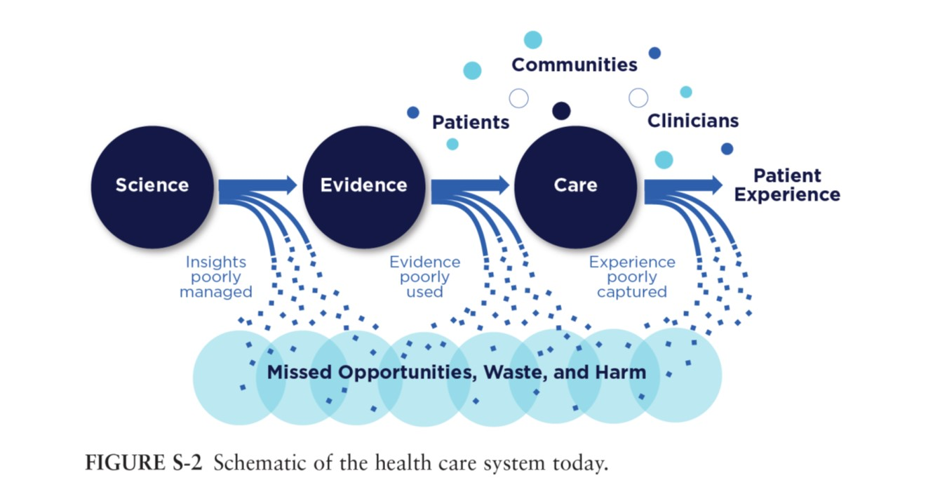
What Does This Health System Look Like?
Source: Smith et al, IOM, 2012
Notes:
Here is a graphic visualization of these issues. We don’t apply the insights from science, nor add the evidence to care, nor include patient and family experience and outcomes, leading to significant numbers of missed opportunities, waste, and harm to patients.

Slide 7
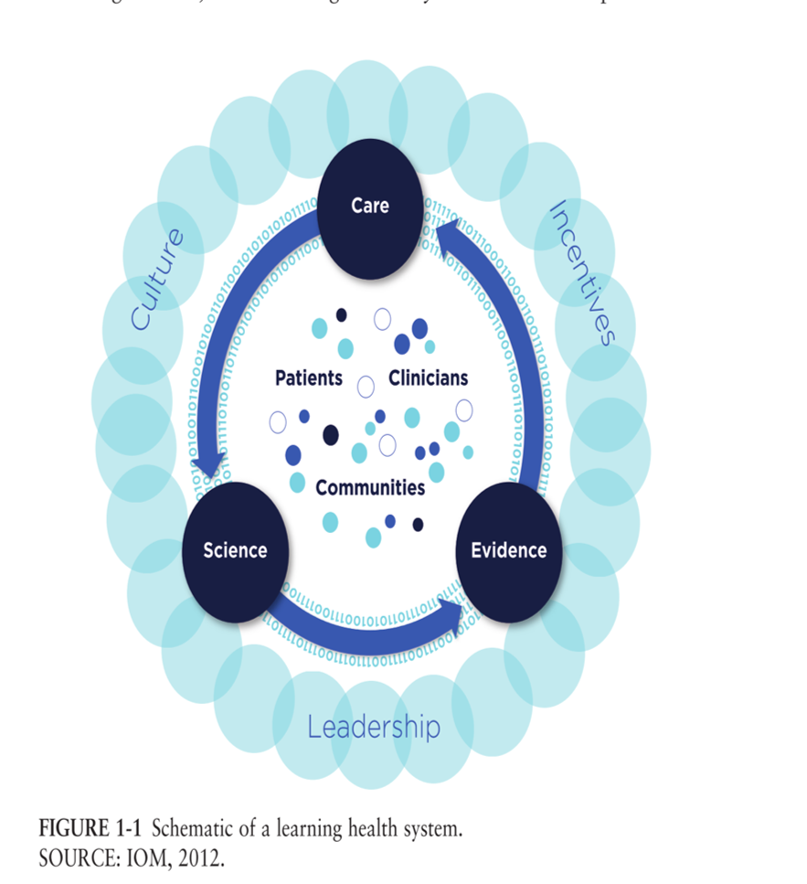
What Might a Learning Health System Look Like?
Closed loop: care -> science -> evidence
Central: patients and communities
Surrounded by: culture, incentives, and leadership
Notes:
The learning health system intends to address this by creating a closed loop for science and evidence to be included in care, and then for care to generate more knowledge that can be added and used to further adjust care. An important part of a learning health system is that patients and communities are at the center, and that culture, incentives, and leadership help provide an environment where this is possible.

Slide 8
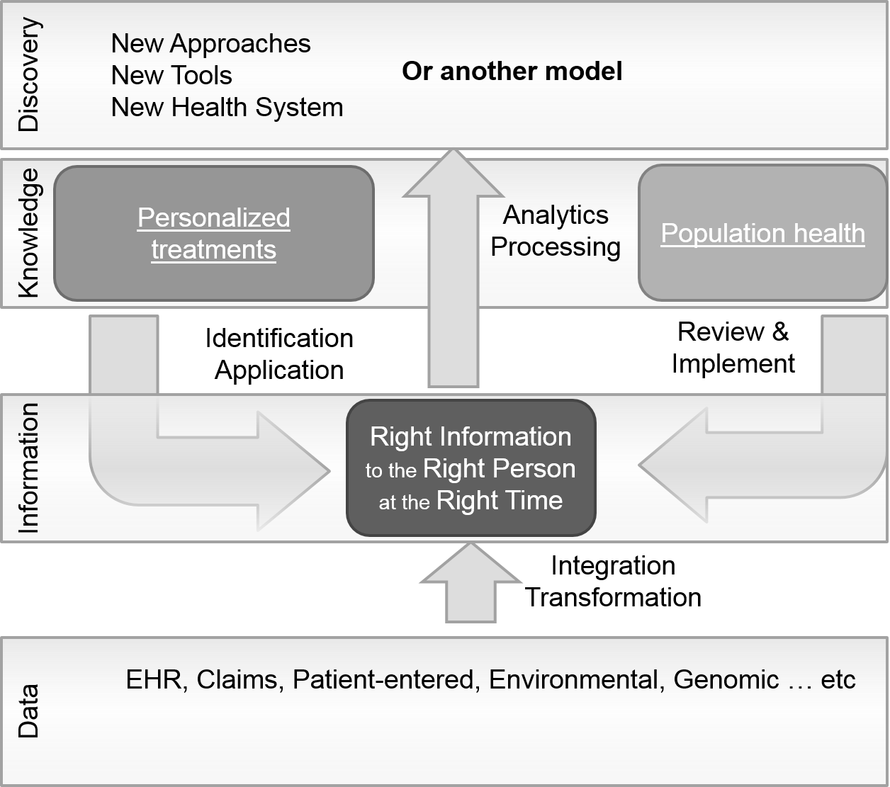
From Data to Information
Dorr, 2016
Notes:
Another way to think about this is how we use data and information to generate knowledge and discovery, and then provide that back to the right person at the right time. This model, developed by Dorr, considers data to be the raw bits and bytes in databases. After the data is integrated and transformed, then it can be considered information, that is, data with context and relationships. Information, combined with knowledge, can be used to drive decisions. For example, clinical decision support can control how information and knowledge are presented to people working to improve health and well-being. Information can also be analyzed, both at the individual and population level, to generate new approaches, tools, and even a new kind of health system infrastructure. The knowledge generated from these discoveries can be fed back to care.

Slide 9
What is Needed to Start to Actively Learn?
Foundational elements
Computational power
Connectivity
Human and organizational processes that are reliable and efficient
Collaborative teams
Notes:
What kinds of foundational elements are needed to start a learning health system? Previously, to change care, we were limited by people slowly generating evidence through controlled clinical trials and other experiments, writing those up in papers, and then people reading those papers.
Now, we have data and information about patients stored in large databases with massive computational power behind them; this data can be connected electronically, and then analyzed.
We also need to work on our processes and teams, however, so that we are ready to learn. We must understand our processes, measure them, and determine whether they are reliable and efficient. Otherwise, we can’t incorporate the new knowledge into care. Similarly, everyone must be working collaboratively since the collection of data and information and the provision of new knowledge may happen at many points, and everyone needs to understand how they can contribute to the process and why they may be given guidance about changes. They must be hungry, in a sense, to learn and change together.

Slide 10
Capabilities of a Learning Health System
Informatics: Real time access to knowledge, capture of data and information
Patients: Empowered to provide values and preferences
Incentives: Aligned for value – reduced cost, maximum benefit
Culture of learning: Leadership, training, belief
Notes:
What are the primary capabilities or characteristics of a learning health system? First, you must have substantial investments in informatics, in other words, be able to capture data and information effectively and, most importantly, have real time access to knowledge. Patients are crucial, since we have to learn what they prefer and how it matches with their values; many outcomes are driven by the patient’s goals and experiences, whether providers recognize it or not. We also need to change incentives. If we are paid on volumes of visits or procedures, the system is set up to generate as many as possible, not learn whether or not a particular treatment is beneficial in a particular setting. Rewarding that learning is important. Finally, you need a culture of learning. One of the most difficult parts of a learning health system is that people are quite resistant to change. However, in a learning health system, change needs to be encouraged and rewarded. People must learn to seek change and understand how to get there.

Slide 11
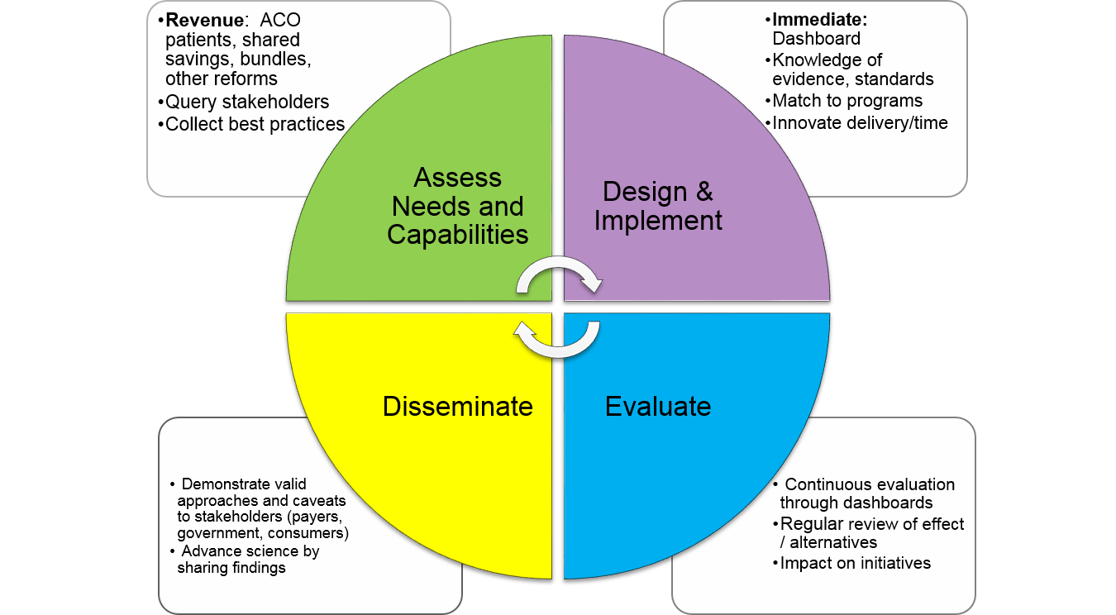
Another Vision
Dorr, 2016
Notes:
This model, developed by Dorr from a variety of sources, shows a vision of how one might move to a learning health system. Here, the various needs of the institution could be analyzed. Are there payment models to reward more efficient and effective care, such as Accountable Care Organization global payments or bundled care? Then, you might query stakeholders, including patients, and collect best practices for implementation. Next, you design improvements for your own health system. A dashboard would help you start to monitor key aspects of care. You might collect knowledge in certain areas and match to programs. You need to innovate how they can be more easily delivered at the point of care. Then, you’d evaluate what you see in the system. If you have changed assessments to better capture patient needs and experience, are the fields being used? If you added the ability to select ‘patients like this’ via a green button, is the button being used? How is the adherence to recommendations? Do you see savings? Then, the learning health system needs to share its findings and continuously repeat the cycle.

Slide 12
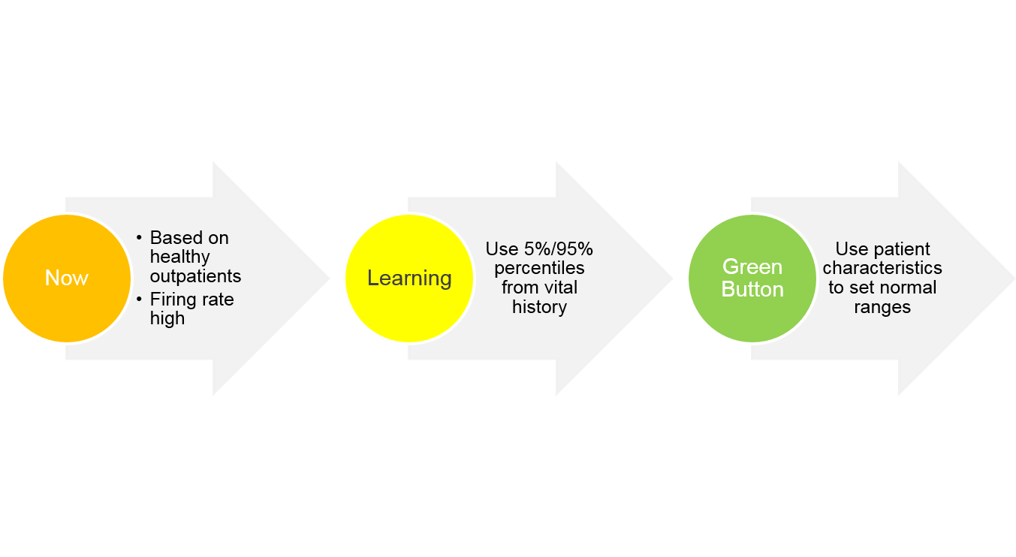
Examples of Learning Health Systems: the Green Button
Longhurst et al., Health Affairs, 2014
Notes:
Let’s go through some examples. At the Lucille Packard Children’s Hospital, they noticed that ICU alarms were firing frequently and the vast majority of times they were not useful for care. Besides wasted time, these distractions may prevent excellent care from being administered. They looked at the alarm characteristics, which were set for healthy outpatients by the vended alarm systems. Then, they analyzed their own data, and set the alarms to fire only when vital signs were at the 5% or 95% percentile level for historical ICU patients. This learning algorithm can be updated regularly as patient populations shift. Finally, they introduced the idea of the ‘green button’. Instead of using the overall ICU patient population, this button would use normal ranges from similar patients. Thus, if the patients had conditions that lowered or raised blood pressure without significant harm, other patients with those same conditions could be used to set normal ranges. In a similar example, outpatients with high blood pressure might normally be treated with the same set of initial drugs to lower blood pressure. Learning systems might adapt this based on the population rates of successful treatment, but the green button might allow an individual patient to be matched to others with similar characteristics to see what worked for them.

Slide 13
Examples of Learning Health Systems: Mini-Sentinel
FDA and CDC collaborate for post-marketing surveillance of drugs
Discover key adverse events, change in usage rates
Identify potential for serious harm from drugs, missed in usual trials
Notes:
Another example is monitoring adverse drug events after release of the drug into the open market. The mini-sentinel program, established by the FDA, uses standard data models and transmission of data from medications prescribed in practice to identify adverse events that may not have been identified by standard clinical trials. These events are often not seen in these trials either due to their rarity, the broader patient population, prescribing practices in the ‘real world’, or because the trials are not well set up to detect them.

Slide 14
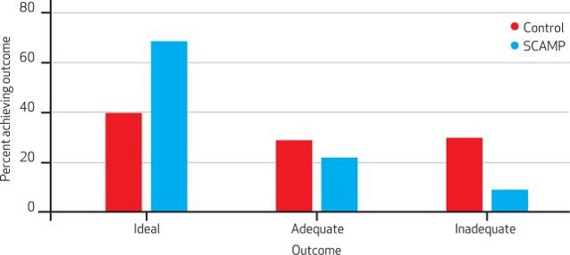
Standardized Clinical Assessment and Management Plans (SCAMPs)
More specific than care guidelines, less prescriptive than protocols
Decision trees, implemented into the EHRs as much as possible
M. Farias et al. Health Affairs, May 2013 32(5):911–20.
Notes:
Finally, let’s look at the work by Boston Children’s Hospital to develop Standardized Clinical Assessment and Management Plans, also known as SCAMP. These plans are more specific than guidelines of care, but less prescriptive than protocols. They are designed by the health system, based on extant knowledge and internal observational studies. At Boston Children’s, there are decision trees, where each characteristic leads down a different path with different probabilities for outcomes. They attempt to enter these into the EHR, both in terms of what data needs to be collected and to support the SCAMP. Their initial work showed providers liked the decision trees, as the decision trees reduced variability, and, in the case shown here, improved outcomes. Here, heart catheterization outcomes for children are shown, comparing the control period to the post-SCAMP period. The percentage of ideal outcomes grew substantially and the inadequate outcomes were reduced.

Slide 15
Data Systems for Learning Health Systems
Data needs
Patient and interaction characteristics
Treatments over time
Outcomes over time
Data systems’ key principles:
Integration
Standardization and Transformation
At-the-elbow analytic tools
Notes:
What kind of data and data systems are needed? Data is needed about the patients, their key characteristics, such as demographics; their treatments; and their outcomes over time. The last two are particularly tricky. You can quickly understand that looking for variation in responses to diabetes medications might see a patient on several medications over time and not know which medication led to the eventual positive outcome. Rules that detect short duration of prescriptions or more heavily weight more recent prescriptions, might allow these experiences to be combined more appropriately to understand how different populations of patients fared. Doing these calculations requires significant data integration, standardization, and transformation. For instance, combining patient-entered outcomes with the medical treatments may be required at this stage. Similarly, patients with diabetes of several subtypes might be combined for general questions. The ability to analyze the data, either visually or through more advanced algorithms, is needed at the point of care or at the elbow.

Slide 16
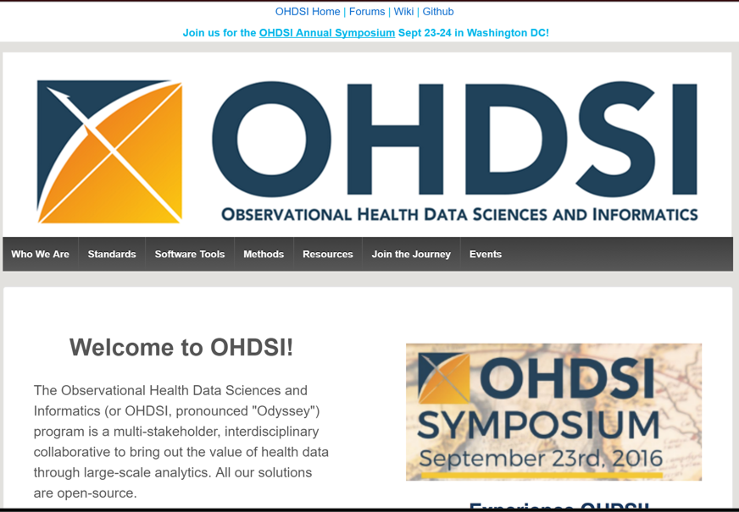
Data System Example: OHDSI
Common Data Model (OHDSI CDM) Open source software for:
Cohort IDs
Data quality
Analysis
Sharing
http://www.ohdsi.org/
Notes:
An example of the specifications for data and data systems is given by Observational Health Data Sciences and Informatics, or OHDSI – pronounced Odyssey. They define the standard data models that may be used, provide data specifications, and have a whole set of tools to define cohorts for observational studies, look at data quality, facilitate analysis, and then help share results.

Slide 17
Learning Health Systems Summary
Learning Health Systems generate and incorporate knowledge to change care quickly and efficiently.
Examples include a ‘green button’ to see results of similar patients, standard assessment and planning tools, and post-marketing surveillance of drugs.
A significant amount of informatics infrastructure and work is needed, as well as payment, cultural and organizational changes.
Notes:
This concludes the lecture on Learning Health Systems. What did we learn about learning health systems? With the complexity of care increasing, we need to know when and how to change care more quickly for certain groups of patients. A learning health system describes one way to do that. Examples were provided about green buttons to see results of similar patients, approaches to provide more standard tools and management plans, and the mini-sentinel program to surveil drugs after they are on the market. Learning health systems require a number of changes to our current informatics infrastructures to allow real time analysis, as well as changes to our payment systems, our cultural approaches to learning, and the organizations themselves.

Slide 18
Learning Health Systems References
References
Dorr, D.
Smith M. et al. (2012). Best Care at Lower Cost: The Path to Continuously Learning Health Care in America. Institute of Medicine. Harvard Business Press.
Longhurst CA, Harrington RA, Shah NH. A 'green button' for using aggregate patient data at the point of care. Health Aff (Millwood). 2014 Jul;33(7):1229-35. doi: 10.1377/hlthaff.2014.0099. PubMed PMID: 25006150.
M. Farias, K. Jenkins, J. Lock et al., “Standardized Clinical Assessment and Management Plans (SCAMPs) Provide a Better Alternative to Clinical Practice Guidelines,” Health Affairs, May 2013 32(5):911–20.
Sentinel Program Interim Assessment (FY15). (2015, September 24). Retrieved June 25, 2016, from http://www.fda.gov/downloads/ForIndustry/UserFees/PrescriptionDrugUserFee/UCM464043
Notes:
No audio.

Slide 19
Health Care Data Analytics Learning Health Systems
This material was developed by Oregon Health & Science University, funded by the Department of Health and Human Services, Office of the National Coordinator for Health Information Technology under Award Number 90WT0001.
Notes:
No audio.

