Slide 1
Foundations of Health Data Science (FHDS)
Lecture 1: Machine Learning in Healthcare
Md. Jubayer Hossain
Instructor
@cblast.du.ac.bd

Slide 2
Learning Objectives
Describe the major tasks for which machine learning is used
Compare and contrast the major approaches for machine learning
Notes:
The learning objectives for this unit, Machine Learning and Natural Language Processing, are to:
Describe the major tasks for which machine learning is used
Compare and contrast the major approaches for machine learning
Describe the major tasks for which natural language processing is used
And discuss the major approaches and challenges for processing clinical narratives

Slide 3
Machine Learning
Definitions
Tasks
Approaches
Steps
Tools
Notes:
In this lecture, we will begin by talking about definitions of machine learning.
Then we will describe tasks for which machine learning is used.
This will be followed by discussion of the approaches to machine learning, followed by the steps in the process and the tools employed.

Slide 4
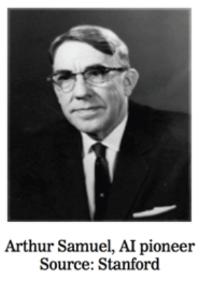
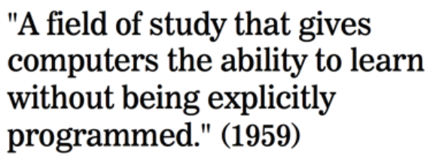
What is Machine Learning?

Slide 5
What is Machine Learning?
One definition: “Machine learning is the semi-automatic extraction of knowledge from data.”
Knowledge from data: Starts with a question that might be answerable using data
Automatic extraction: A computer provides the insight
Semi-automatic: Requires many smart decisions by a human

Slide 6
Statistical Learning vs. Machine Learning
Is there any difference between Statistical Learning and Machine Learning?
Statistical Learning: Statistical learning is about models usually developed through human decisions/inputs, which are generally interpretable.
Machine Learning: Machine learning is somewhat or fully automated (although human input is inevitable), which are generally less or not interpretable.

Slide 7
Statistical Learning vs. Machine Learning
Another notable difference between statistical learning and machine learning is the intended application:
Machine Learning is more geared towards predicting on outcome
Statistical learning is more about describing and decision making.

Slide 8
What is Statistical Learning
“It is one thing to estimate the probability of rain and another thing to decide whether it’s worth carrying an umbrella” –Frank Harrel

Slide 9
Relationship between Sales and Advertising Dollars
The Advertising data set consists of the sales of that product in 200 different markets
Advertising budgets for the product in each of those markets for three different media: TV, Radio, and Newspaper.
Client can not impact directly to increase sales of the product
They can not control the advertising dollars spent expenditure in each of the three media

Slide 10
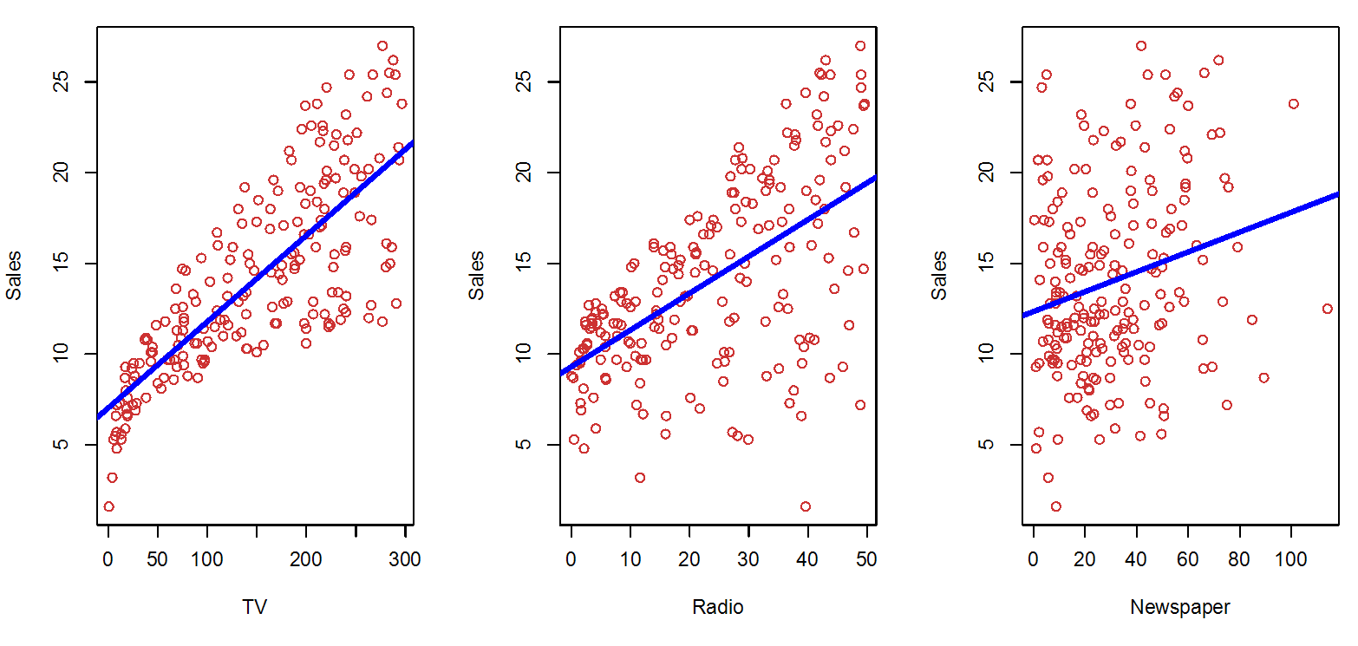
Association between Sales and Advertising Dollars
Figure: The Advertising data set. The plot displays sales, in thousands of units, as a function of TV, radio, and newspaper budgets, in thousands of dollars, for 200 different markets. In each plot we show the simple least squares fit of sales to that variable, as described in Chapter 3. In other words, each blue line represents a simple model that can be used to predict sales using TV, radio, and newspaper, respectively.

Slide 11
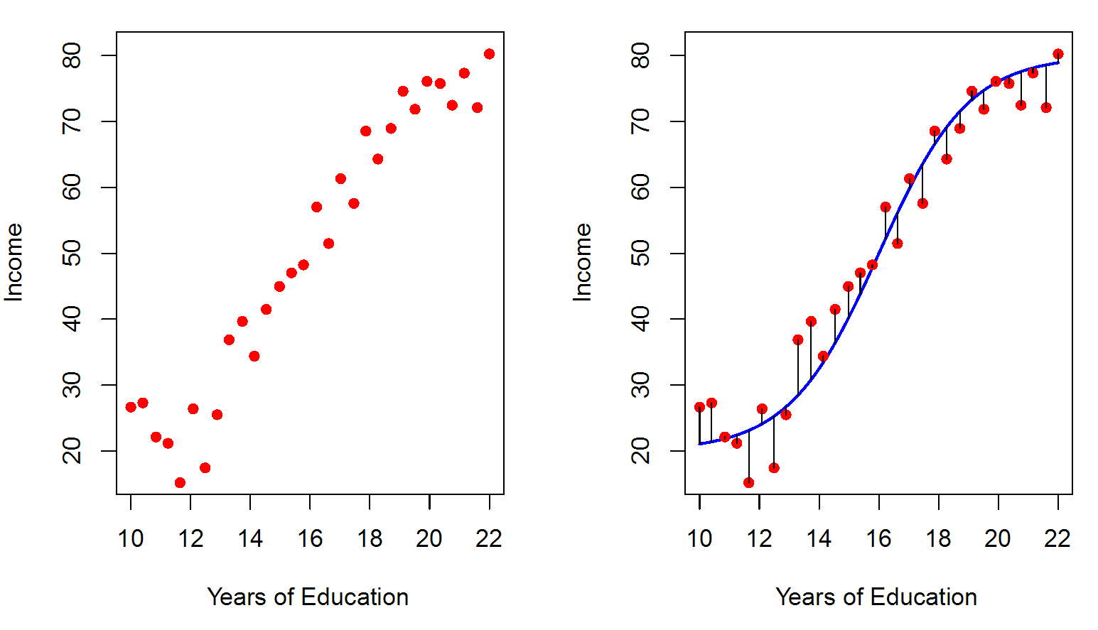
Predicting Income using Years of Education
The red dots are the observed values of income (in tens of thousand dollars)
The years of education for 30 simulated individuals
Individual | Years of Education | Income
1 | 10 | 15
2 | 16 | 55
3 | 20 | 70
Simulated data for 30 individuals
Figure: Relationship between years of education and income

Slide 12
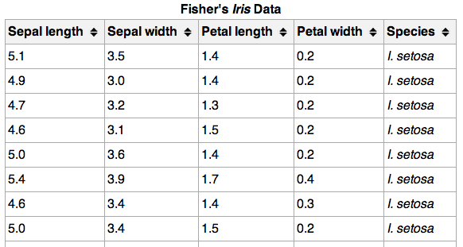
Machine Learning Terminology
}
150 observations
(n = 150)
{
Feature matrix “X” has n rows and p columns
Response “y” is a vector with length n
{
Response/target
4 features (p = 4)

Slide 13
Machine Learning Terminology
Observations are also known as: samples, examples, instances, records
Features are also known as: predictors, independent variables, inputs, regressors, covariates, attributes
Response is also known as: outcome, label, target, dependent variable
Regression problems have a continuous response. Classification problems have a categorical response. The type of supervised learning problem has nothing to do with the features!

Slide 14
Input and Output Variables
Outcome Variables (Dependent): The ones that we are interested to predict.
Income
Sales
Input Variables(Independent): The ones that we use to predict the outcome of interest.
TV, Radio, Newspaper
Years of Education

Slide 15
Example 1 - Input and Output Variables
Figure: The Advertising data set. The plot displays sales, in thousands of units, as a function of TV, radio, and newspaper budgets, in thousands of dollars, for 200 different markets. In each plot we show the simple least squares fit of sales to that variable, as described in Chapter 3. In other words, each blue line represents a simple model that can be used to predict sales using TV, radio, and newspaper, respectively.

Slide 16
Example 2 - Input and Output Variables
The red dots are the observed values of income (in tens of thousand dollars)
The years of education for 30 simulated individuals
Individual | Years of Education | Income
1 | 10 | 15
2 | 16 | 55
3 | 20 | 70
Simulated data for 30 individuals
Figure: Relationship between years of education and income

Slide 17
Input and Output Variables Notations
In general, we denote the outcome variable as Y
And the predictor variables as X1, X2, … and so on.

Slide 18
Mathematical Formulation of Relationship between Input and Output Variables
The observed outcome/response variable Y and different predictors X1, X2,… Xp
The functional relationship between them is expressed as
Y = f(x) + e
Here, f is an unknown function of the input variables, and the e is the random error term.

Slide 19
Types of Machine Learning
There are two main categories of machine learning: supervised learning and unsupervised learning.
Supervised learning (aka “predictive modeling”):
Predict an outcome based on input data
Example: predict whether an email is spam or ham
Goal is “generalization”

Slide 20
Types of Machine Learning
Unsupervised Learning
Evaluation Metrics
Supervised Learning

Slide 21
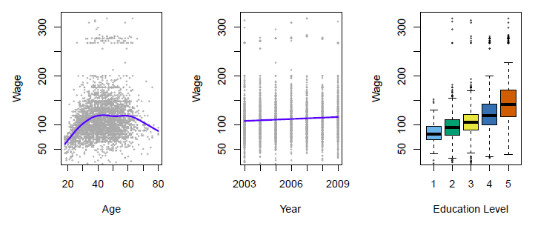
Supervised Learning
Predictive Modeling Pipeline
Gradient and Stochastic gradient descent
Income survey data for males from the central Atlantic region of the USA in 2009
Source: https://class.stanford.edu/c4x/HumanitiesScience/StatLearning/asset/introduction.pdf

Slide 22
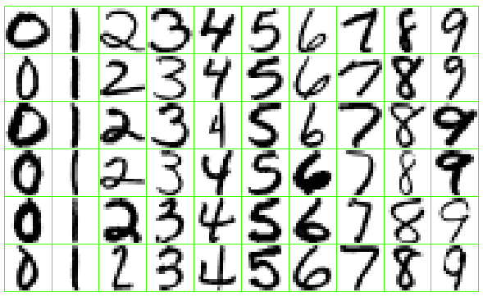
Supervised Learning
Predictive Modeling Pipeline
Gradient and Stochastic gradient descent
Identify the numbers in a handwritten zip code
Source: https://class.stanford.edu/c4x/HumanitiesScience/StatLearning/asset/introduction.pdf

Slide 23
Supervised Learning
There are two categories of supervised learning:
Regression
Outcome we are trying to predict is continuous
Examples: price, blood pressure
Classification
Outcome we are trying to predict is categorical (values in a finite set)
Examples: spam/ham, cancer class of tissue sample

Slide 24
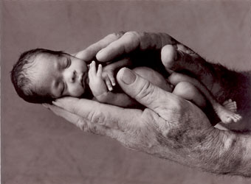
Regression or Classification?
Problem: Children born prematurely are at high risk of developing infections, many of which are not detected until after the baby is sick
Goal: Detect subtle patterns in the data that predicts infection before it occurs
Data: 16 vital signs such as heart rate, respiration rate, blood pressure, etc…
Impact: Model can predict the onset of infection 24 hours before the traditional symptoms of infection appear
Image: http://www.babycaretips4u.com/wp-content/uploads/2014/03/premature-baby.jpg;
Case Study: http://www.amazon.com/Big-Data-Revolution-Transform-Think/dp/0544002695

Slide 25
How does Supervised Learning Work?
How does supervised learning “work”?
Train a machine learning model using labeled data
“Labeled data” is data with a response variable
“Machine learning model” learns the relationship between the features and the response
Make predictions on new data for which the response is unknown
The primary goal of supervised learning is to build a model that “generalizes”: It accurately predicts the future rather than the past!

Slide 26
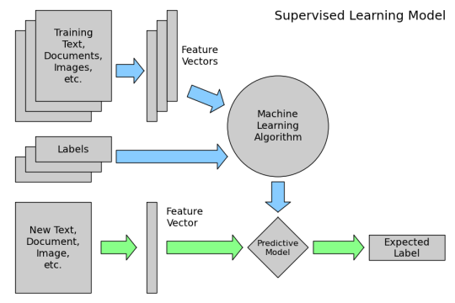
How does Supervised Learning Work?
How does supervised learning “work”?

Slide 27
Supervised Learning
Supervised learning example: Coin classifier
Observations: Coins
Features: Size and mass
Response: Coin type, hand-labeled
Train a machine learning model using labeled data
Model learns the relationship between the features and the coin type
Make predictions on new data for which the response is unknown
Give it a new coin, predicts the coin type automatically

Slide 28
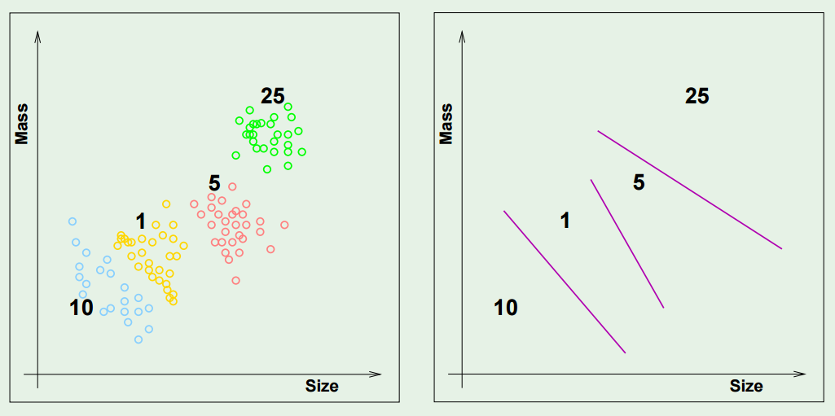
Supervised Learning

Slide 29
Types of Machine Learning
There are two main categories of machine learning: supervised learning and unsupervised learning.
Unsupervised learning:
Extracting structure from data
Example: segment grocery store shoppers into “clusters” that exhibit similar behaviors
Goal is “representation”

Slide 30
Unsupervised Learning
Common types of unsupervised learning:
Clustering: group “similar” data points together
Dimensionality Reduction: reduce the dimensionality of a dataset by extracting features that capture most of the variance in the data

Slide 31
Unsupervised Learning
Unsupervised learning has some clear differences from supervised learning. With unsupervised learning:
There is no clear objective
There is no “right anwser” (hard to tell how well you are doing)
There is no response variable, just observations with features
Labeled data is not required

Slide 32
Unsupervised Learning
Unsupervised learning example: Coin clustering
Observations: Coins
Features: Size and mass
Response: There isn’t one (no hand-labeling required!)
Perform unsupervised learning
Cluster the coins based on “similarity”
You’re done!
Sometimes, unsupervised learning is used as a “preprocessing” step for supervised learning. (How?)

Slide 33
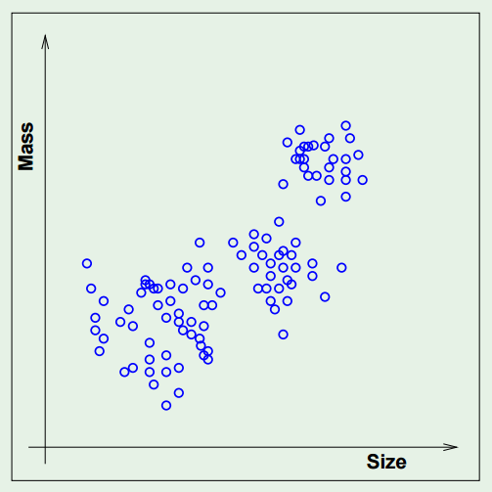
Unsupervised Learning

Slide 34









Predictive Modeling Pipeline
1.
Prediction Target
6. Performance Evaluation
2.
Cohort
Construction
5.
Predictive Model
3.
Feature
Construction
4.
Feature Selection

Slide 35

Predictive Modeling Pipeline
1.
Prediction Target
6. Performance Evaluation
2.
Cohort
Construction
5.
Predictive Model
3.
Feature
Construction
4.
Feature Selection

Slide 36


Prediction Target
Interesting
Possible
Target

Slide 37


How Do You Know The Target Is Interesting?
Talk to domain experts
Read domain publications
General common-sense metrics
High cost
Long time
Bad quality
Interesting
Possible
Target

Slide 38
How Do You Know The Target Is Possible?
Human performance
Interesting
Possible
Experience from similar projects
Results from prior publications ?
Target

Slide 39


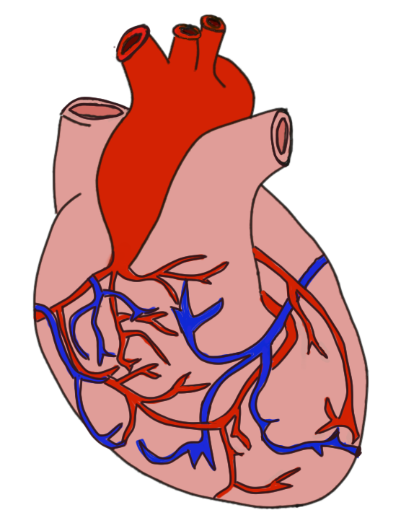
Prediction Target
Interesting
Possible

Slide 40
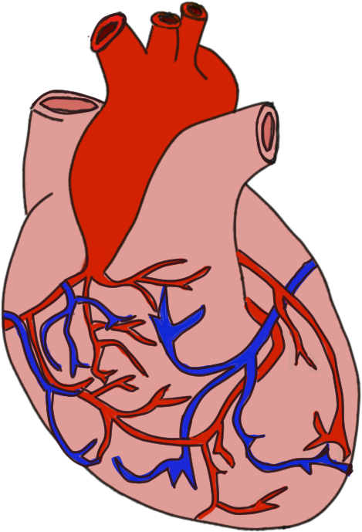

Heart Failure Quiz
How many new cases of heart failure occur each year in
A. 17,000
B. 260,000
C. 550,000
D. 1,250,000

Slide 41
Motivations For Early Detection Of Heart Failure
Heart failure is a complex disease.
Reduces cost and hospitalization.
Improves existing clinical guidelines of HF prevention.
Early intervention can slow down disease progression.

Slide 42

Predictive Modeling Pipeline
1.
Prediction Target
6. Performance Evaluation
2.
Cohort
Construction
5.
Predictive Model
3.
Feature
Construction
4.
Feature Selection

Slide 43
Why Do We Need Cohort Construction?
General ML practice:
Give a dataset => build a model
Healthcare predictive modeling
Create a dataset (cohort, feature) => build a model
Reasons:
Avoid obvious models: e.g., age predicts mortality
Focus on the population of interests
Data acquisition cost

Slide 44
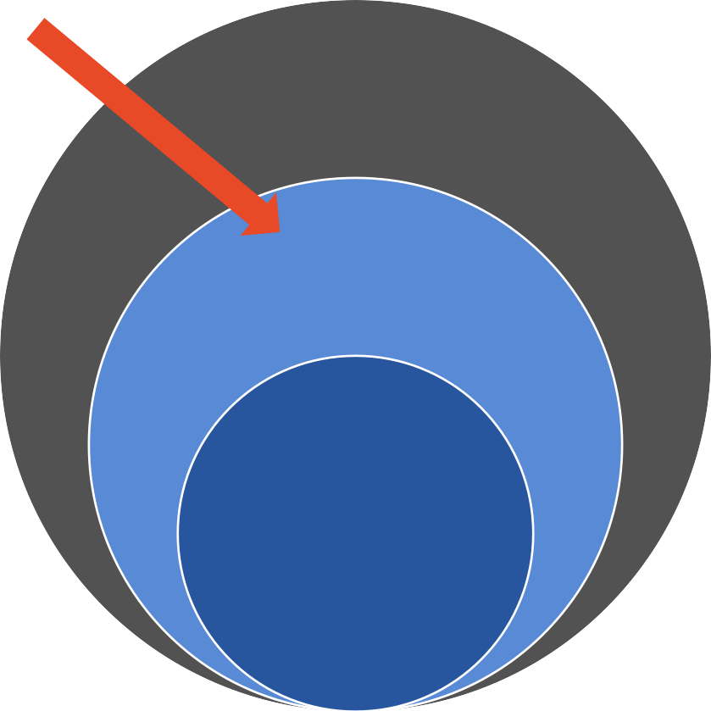
Cohort Construction - Study Design
DEFINE
CASE-CONTROL
COHORT STUDY
STUDY
Whole
Population
PROSPECTIVE
Prospective Cohort | Prospective Case-Control
Retrospective Cohort | Retrospective Case-Control ^{at}
S
Pop
tudy
ulation
RETROSPECTIVE
S D
tudy
aset

Slide 45
Prospective vs. Retrospective
PROSPECTIVE
RETROSPECTIVE
Identify cohort
Collect data
Retrieve data
Identify cohort
Time
Identify the study population P
Trace back the historical data of P
Time
Identify the study population P
Then start to collect data on P

Slide 46
QUIZ: PROSPECTIVE VS. RETROSPECTIVE
Property | Prospective Study | Retrospective Study
More noise in the data |  | ✓
More expensive | ✓
Takes a longer time | ✓
Common on large dataset |  | ✓

Slide 47







Cohort Study
Select a group of patients who are exposed to the risk TARGET: Heart Failure Readmission
COHORT: all HF patients discharged from hospital
KEY: define the right inclusion/exclusion criteria
COHORT
All Patients
Relevant Patients

Slide 48


Case-control Study
CASES: patients with positive outcome (have the disease)
CONTROLS: patients with negative outcome (healthy) but otherwise similar
KEY: matching criteria between cases and controls
Cases Control
+ =
Cohort

Slide 49
Example Of Case-control Study
Goal: Predict Heart Failure cases against control patients
Population: 50,625 Patients
Case Patients: 4,644
Controls: 45,981 (matched on age, gender and clinic)
Population
Control
Cases

Slide 50

Predictive Modeling Pipeline
1.
Prediction Target
6. Performance Evaluation
2.
Cohort
Construction
5.
Predictive Model
3.
Feature
Construction
4.
Feature Selection

Slide 51



Feature Construction
Index Date
Prediction Window
Observation Window
Diagnosis Date
Time

Slide 52








Feature Construction Quiz 1
Which one of these timelines is the easiest for modeling?
A.✓
B.
C.
D.

Slide 53
Feature Construction Quiz 2
Which one of these timelines is the most useful model?
A.
B.✓
C.
D.

Slide 54


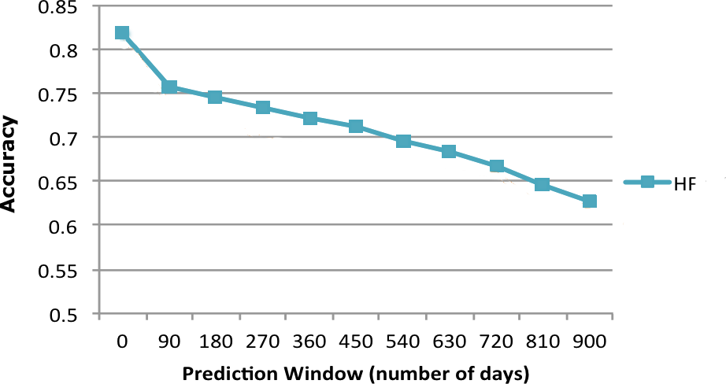
Prediction Performance On Different Prediction Windows

Slide 55
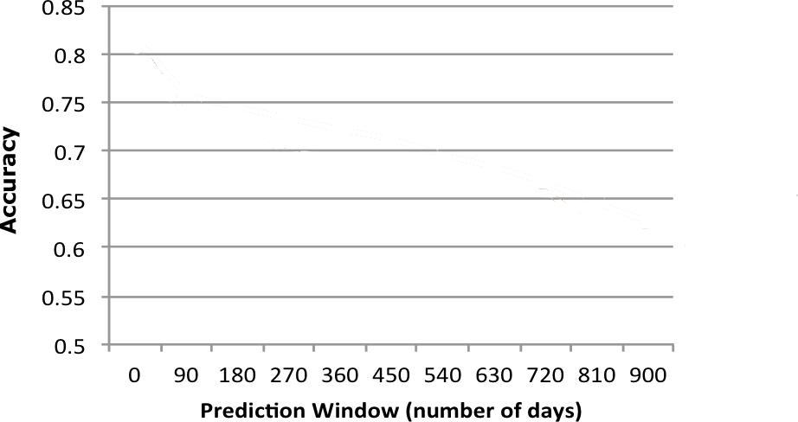
Prediction Window Quiz
Which of these options is the most desirable prediction curve?
A
B
A
C
D
✓ _{B}
C D

Slide 56

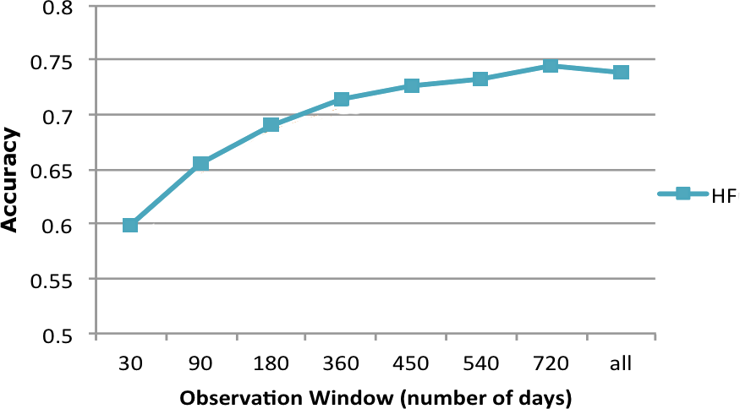
Prediction Performance On Different Observation Windows

Slide 57
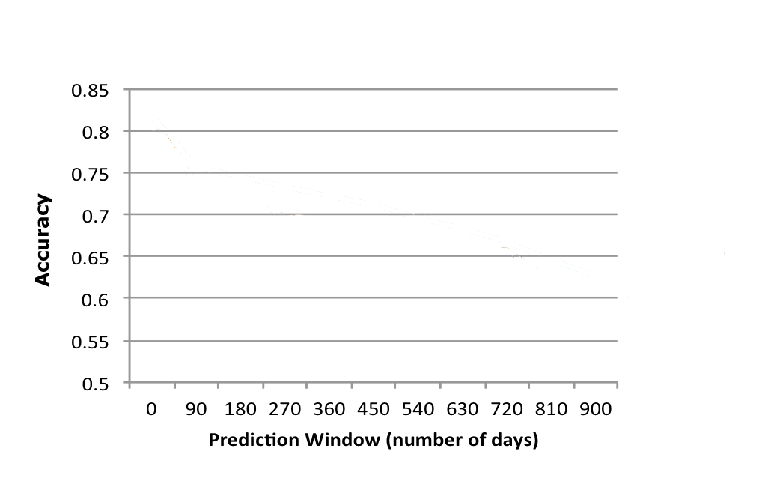

Observation Window Quiz
What is the optimal observation window?
90 days
270 days
C. 630 days
D. 900 days
Observation

Slide 58

Predictive Modeling Pipeline
1.
Prediction Target
6. Performance Evaluation
2.
Cohort
Construction
5.
Predictive Model
3.
Feature
Construction
4.
Feature Selection

Slide 59


Feature Selection
Index Date
Predictio
n Window
Observati on Window
Diagnosis Date
Time

Slide 60





Feature Selection
Feature Types
Demographics
Diagnosis
Lab result
Symptoms
Medications
Vitals

Slide 61
Feature Selection
Cruz, Andrea
Davis, John
Age | 34
Sex | F
Race | White
Blood Pressure | 114/72
Diabetes, Type II | YES
Hypertension | NO
Age | 67
Sex | M
Race | African American
Blood Pressure | 160/100
Diabetes, Type II | NO
Hypertension | YES

Slide 62
Feature Selection
Cruz, Andrea
Davis, John
----------- -----------
----------- | -------------------
₋₋₋₋₋₋₋₋₋₋₋ -------------- | --------------- ⁻⁻⁻⁻⁻
---------------- --------------------- | ----------- -------------------------
----------- | -----------
--------------------- | ---------------------
----------- | ---------------
--------------------- | ---------------------
---------------- | -----------
----------- | -----------
---------------- ----------- | --------------- -----------
-------------------------------- | ------------------------------------
---------------- | -----------
-------⁻-⁻-⁻-⁻----------- | ----------- ---------------------
----------- --------------------- | -------------------
--------------------- | ---------------------
----------- | -----------
---------------- | -------------------
----------- | -----------
----------- | ----------- -----------
-----------
----------- ⁻⁻⁻⁻⁻⁻⁻
----------- -----------
-------------------------- ---------------------
----------- -----------
-----------
---------------
-----------
-----------
----------- -----------
----------------
-----------
----------- ⁻⁻⁻⁻⁻⁻⁻⁻⁻
₋₋₋₋₋₋₋₋₋₋₋ -------------
-----------
-----------
----------- -----------
---------------------
---------------------
-----------
-----------
----------- -----------
-----------
---------------------
---------------------
-----------
---------------
----------- ---------------
-----------
---------------
----------------
-----------
--------------------------
---------------------
-----------
-----------
-----------
-----------
----------------
---------------
---------------------- ----------------------
---------------------
------------------------------------
-----------
---------------------- ----------------------
---------------------
⁻-⁻-⁻-⁻-⁻-⁻-⁻-⁻-⁻-⁻-⁻-----------
--------------------- ---------------------
-----------
-----------
----------- -----------
----------------
-----------
---------------
---------------------
----------- ⁻⁻⁻⁻⁻⁻⁻⁻⁻
-------------------
---------------------
-----------
--------------------- ---------------------
-----------
-----------
-----------
-----------
----------- -----------
----------- ⁻⁻⁻⁻
-------------------
-----------
-----------
---------------- -----------
-----------
----------- -----------
-----------
----------- -----------
-----------
-----------
-----------
-----------
-----------
-----------

Slide 63


Feature Selection
Cruz, Andrea
Davis, John
-----------
-----------
----------- | -----------
----------- ₋₋₋₋₋₋₋₋₋₋₋ -------------- | ----------- --------------- ⁻⁻⁻⁻⁻
----------- | -----------
---------------- | -----------
--------------------- | -------------------------
--------------------- | ---------------------
----------- | ---------------
---------------- | -----------
----------- | -----------
---------------- ----------- | --------------- -----------
-------------------------------- | ------------------------------------
⁻⁻⁻-⁻-⁻-⁻-⁻-⁻-⁻-⁻-⁻------------- | ⁻-⁻-⁻-⁻-⁻-⁻-⁻-⁻-⁻-⁻-⁻-----------
---------------- | -----------
-------⁻-⁻-⁻-⁻----------- | ----------- ---------------------
----------- --------------------- | ----------- ⁻⁻⁻⁻⁻⁻⁻
----------- | ----------- -----------
----------- | -------------------
----------- | -----------
---------------- ----------- | ----------- -----------
----------- | -----------
----------- -------------------
----------- -------------------
-----------
-----------
--------------------------
---------------------
----------- ---------------
----------- -----------
----------------
-----------
----------- ⁻⁻⁻⁻⁻⁻⁻⁻⁻
₋₋₋₋₋₋₋₋₋₋₋ -------------
----------- -----------
-----------
-----------
---------------------
---------------------
-----------
-----------
----------- -----------
-----------
---------------------
---------------------
-----------
---------------
-----------
---------------
---------------- -----------
--------------------------
---------------------
-----------
-----------
----------- -----------
----------- -----------
-----------⁻⁻⁻⁻⁻
---------------
---------------------
---------------------
-₋-₋-₋-₋-₋-₋-₋-₋-₋-₋-₋
---------------------- ----------------------
-------------------------
---------------------
-----------
-----------
----------- -----------
---------------- -----------
---------------
---------------------
----------- ⁻⁻⁻⁻⁻⁻⁻⁻⁻
-------------------
---------------------
-----------
---------------------
---------------------
--------------------- ---------------------
-----------
-----------
-----------
----------------
-------------------
----------- -----------
-----------
-----------
---------------- -----------
----------- -----------
-----------
-----------
----------- -----------
-----------
-----------
-----------
-----------
-----------
-----------

Slide 64
Predictive Modeling Pipeline
1.
Prediction Target
6. Performance Evaluation
2.
Cohort
Construction
5.
Predictive Model
3.
Feature
Construction
4.
Feature Selection

Slide 65
Predictive Models
Target Error
𝘧 = ⨍ 𝑥 + 𝑒
Features
REGRESSION
CLASSIFICATION
Target y is categorical
Popular Methods
Logistic regression
Support vector machine (SVM)
Decision tree, random forest
Neural networks
Target y is continuous
Popular Methods
Linear Regression
Generalized Additive Models

Slide 66


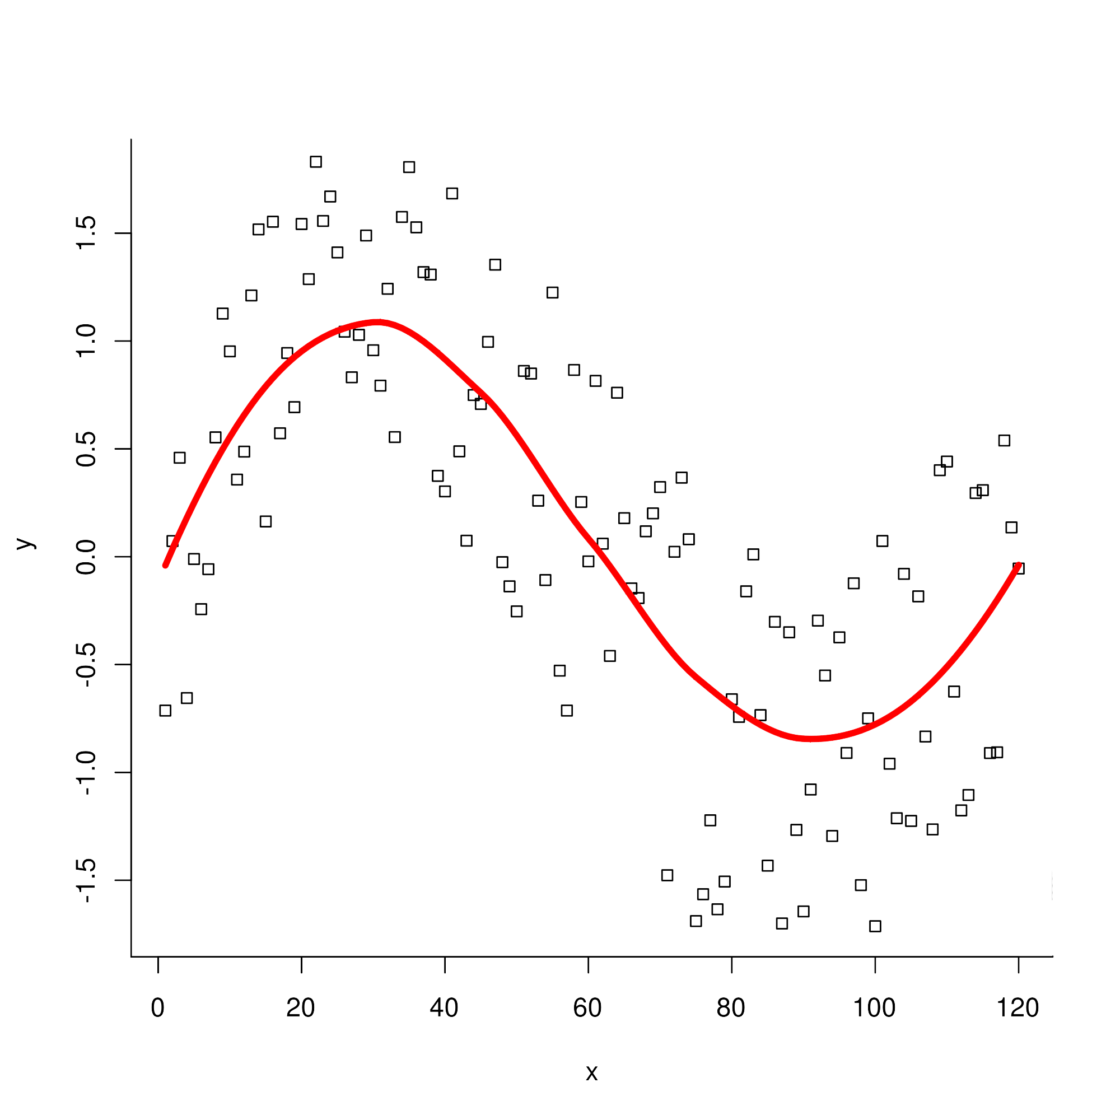
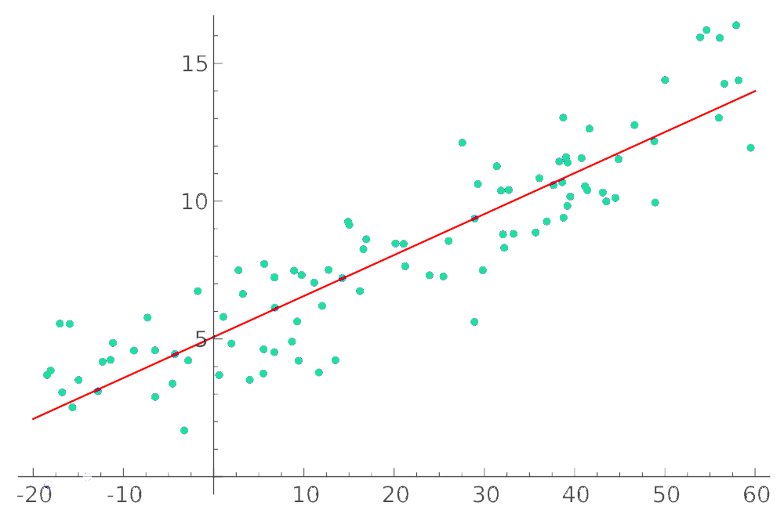
REGRESSION
LINEAR REGRESSION
GENERALIZED ADDITIVE MODEL
37

Slide 67
Predictive Modeling Pipeline
1.
Prediction Target
6. Performance Evaluation
2.
Cohort
Construction
5.
Predictive Model
3.
Feature
Construction
4.
Feature Selection

Slide 68
EVALUATION
Training error is NOT very useful
Testing error is the key metric
Approach:
Cross-validation (CV)
Training Samples
Testing
Model
Unseen
Samples

Slide 69
Cross-validation (CV)
Leave-1-out CV
K-fold CV
Randomized CV
Training Samples
Testing
Model
Unseen
Samples

Slide 70
Leave-1-out CV
Training Samples
Testing
Model
Unseen
Samples

Slide 71
K-Fold CV
1
2
3
.
.
.
k
Training Samples
Testing
Model
Unseen
Samples

Slide 72
Randomized CV
Training Samples
Testing
Model
Unseen
Samples

Slide 73
Best Practice of Predictive Modeling Evaluation
Data
Split
Training | Validation | Test
Validation and test sets can be small,
but should be similar to each other
Training data can be flexible
High volume is preferred
Some low quality data can be allowed

Slide 74
Predictive Modeling Pipeline
1.
Prediction Target
6. Performance Evaluation
2.
Cohort
Construction
5.
Predictive Model
3.
Feature
Construction
4.
Feature Selection

Slide 75
Unsupervised learning
Dimensionality Reduction
Clustering methods

Slide 76
Dimensionality Reduction
Singular Value Decomposition (SVD)
Principal Component Analysis (PCA)

Slide 77
Singular Value Decomposition (SVD)
X = UΣV^{T}
U
where U^{T}U = V^{T}V = I
X
x₁
x₂
x_{M}
u₁
u₂
u_{k}
_{V}T
Σ
σ₁
v₁
.
σ₂
.
v₂
=
σ_{k}
v_{k}
singular values
right singular vectors
input data
left singular vectors

Slide 78

SVD Example
X = UΣV^{T} = σ₁ 𝑢₁ 𝑣₁ ^{T} + σ₂ 𝑢₂𝑣₂ ^{T}
matrix view spectral view
+…
_{𝑣1} T
^{𝑢}1 ^{𝑢}2 ^{σ}1
CS Doc
=
σ₂
_{𝑣2} T
c
Med Do
CS
Med
Term
Term

Slide 79
Quiz: SVD - Interpretation
Given a document-by-term matrix A, what is A^{T}A?
document-to-document similarity matrix
term-to-term similarity matrix term-to-document similarity matrix

Slide 80
X =(UΣ)V^{T}
Principal Component Analysis (PCA)
PC
k
loading
k
n
loading
k
n
m
≈ m
Direction of 1st PC
PC
1st PC

Slide 81
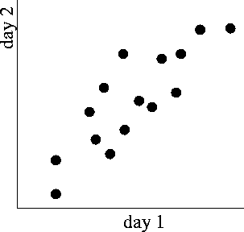
PCA Interpretation
Direction of 1st PC
1st PC

Slide 82
What is Clustering?
P₁ P₂ P₃
Patient (P)
f

Slide 83
What is Clustering?
Disease (D)
Patient (P)
f
D D D
1 2 3

Slide 84
K-means
INPUT
Data points (x₁, x₂, …, x_{n} ), # of clusters k
OUTPUT
k clusters S₁, S₂, …, S_{k}
Objective
:
𝑘
𝑚𝑖𝑛 * * 𝑥 − 𝜇_{𝑖}
i"1 𝑥∈𝑆i
2
𝜇_{𝑖} is the center in 𝑆_{𝑖}

Slide 85

K-means Algorithm
Specify K
Initialize K centers
Assign each point
x to closest center
1
0 𝑥
𝑥∈𝑆)
Update K centers
𝜇 =
No
𝑖
|𝑆𝑖|
Converge?
Yes Done

Slide 86
K-means Example

Slide 87

K-means Quiz
Specify K
Given
n: # of points
k: clusters
d: dimensionality of each point
i: number of iterations
Initialize K centers
Assign each point
x to closest center
Update K centers
What is the computational
No Converge?
Yes Done
complexity?
O(n•k•d•i)

