Slide 1
Foundations of Health Data Science (FHDS)
Lecture 1: Introduction
Md. Jubayer Hossain
Instructor
@cblast.du.ac.bd

Slide 2
Learning Objectives
The Problem
Introduction to Data Science
Brief history of AI and ML in healthcare
Why machine learning in healthcare?
Health applications with machine learning
Examples of how ML will transform healthcare
What is unique about ML in healthcare?

Slide 3

Why this course?
“Information is the oil of the 21st century, and analytics is the combustion engine.”
- Peter Sondegaard, Senior Vice President and Global Head of Research for Gartner

Slide 4
The Problem
Cost of health care expenditures rising
Despite having some of the best clinicians in the world, chronic conditions are
Often diagnosed late
Often inappropriately managed
Medical errors are pervasive

Slide 5


Focus of FHDS
Machine learning
Models
Algorithms
Healthcare
Data
Applications

Slide 6

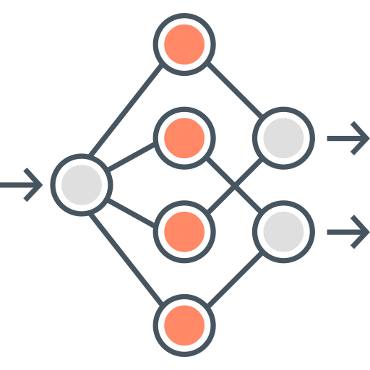
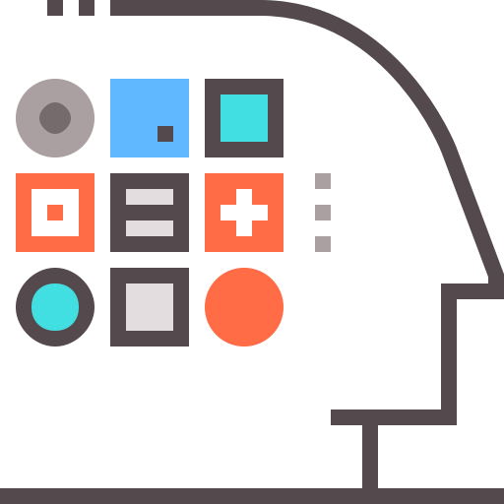

After Finishing this Course
+
=
Understand health data
Apply machine learning models
Health applications

Slide 7
Big Data in Healthcare
Volume
Genomic data
Medical imaging
Variety
Electronic health records
Medical knowledge base
Velocity
Real-time monitoring in ICU
mHealth
Veracity
Noises are everywhere
– Missing data, errors in the data, false alarms

Slide 8
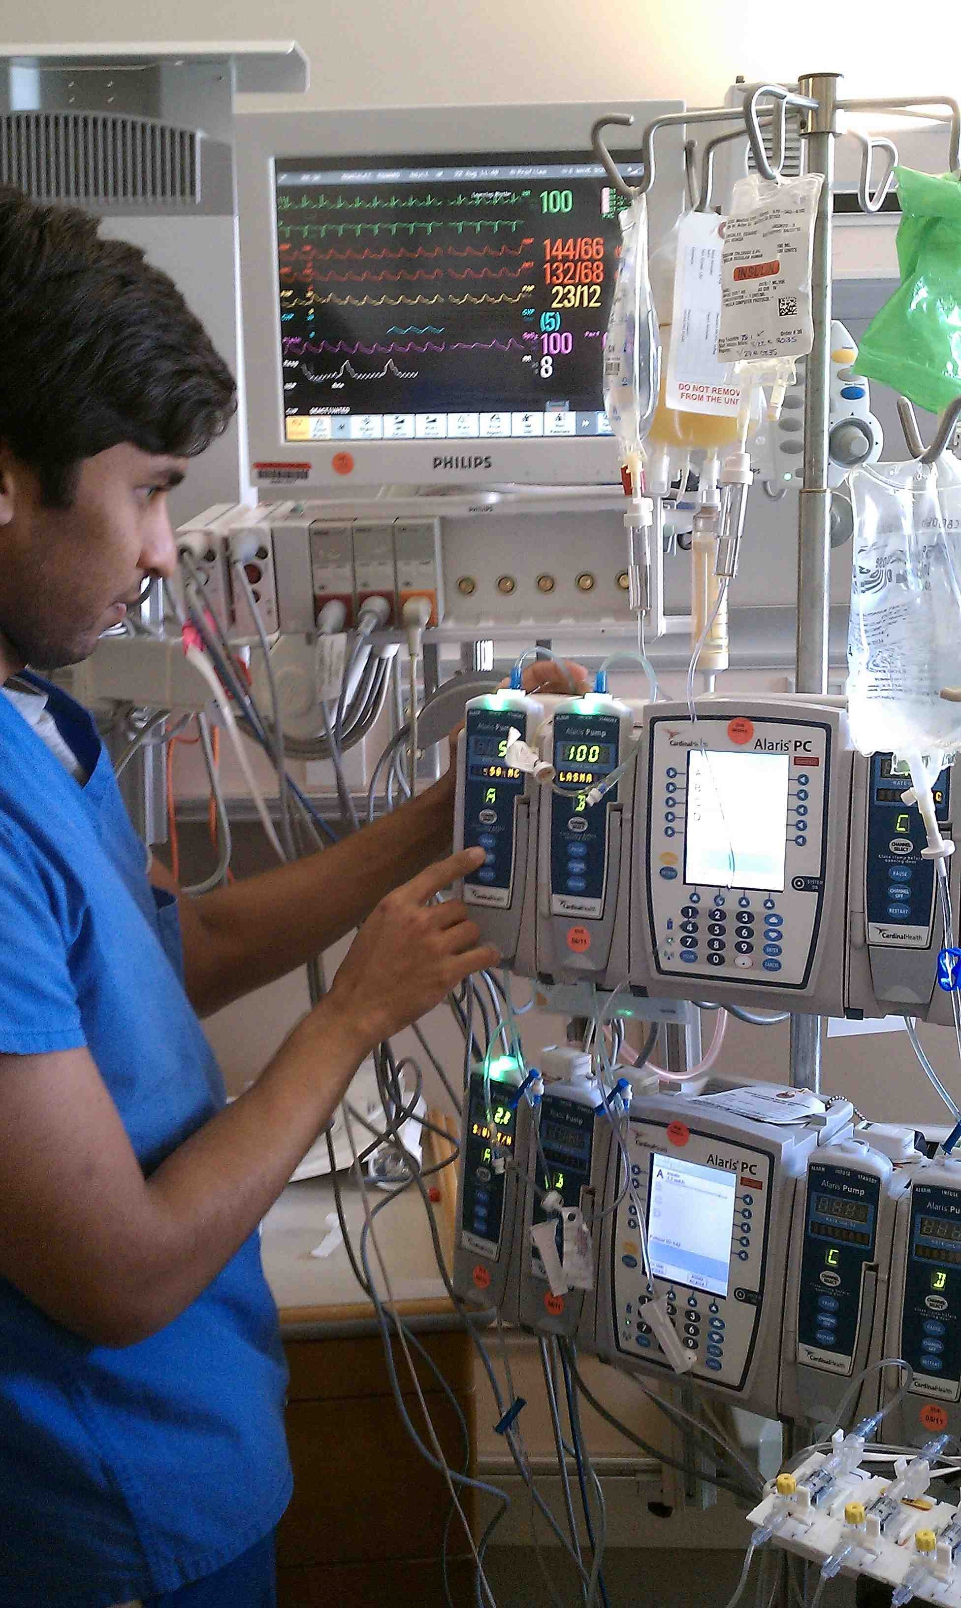
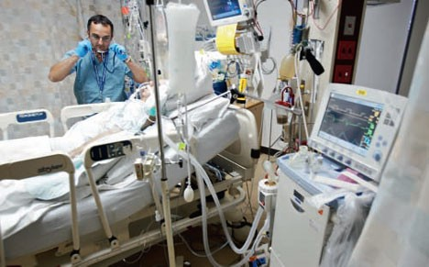
Real-time Monitoring at ICU
Arterial blood pressure
Central venous pressure (CVP)
Temperature
Heart rate
ECG
Drug dispensing measures

Slide 9






Healthcare Applications with Health Data Science
Diagnosis
Outcome
Treatment
Insurance
Drug discovery
Public health

Slide 10
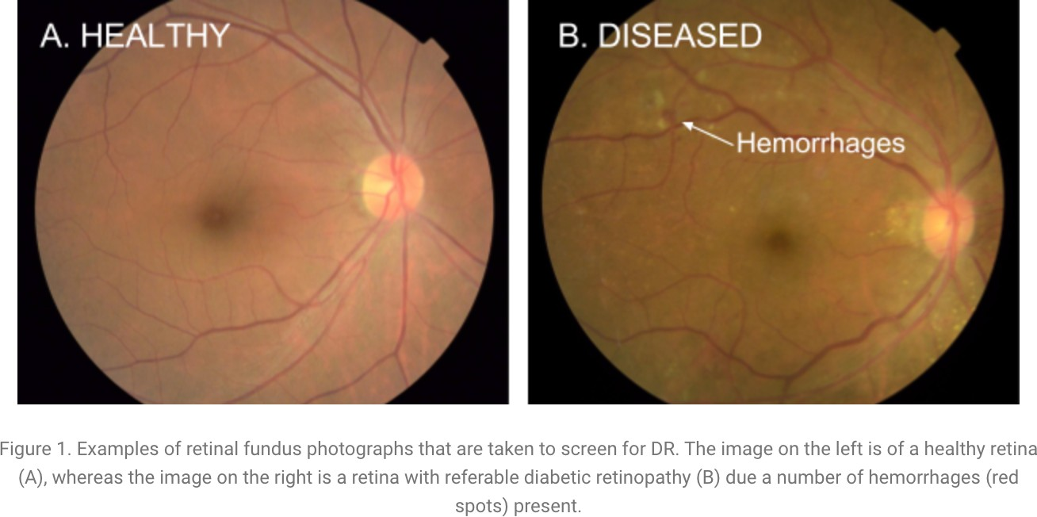
Diagnosis Applications
Medical imaging analysis
Early detection of diseases
Choi, Edward, Andy Schuetz, Walter F. Stewart, and Jimeng Sun. 2017. “Using Recurrent Neural Network Models for Early Detection of Heart Failure Onset.” Journal of the American Medical Informatics Association: JAMIA 24 (2): 361–70.
Triaging
Image credit: https://ai.googleblog.com/2016/11/deep-learning-for-detection-of-diabetic.html

Slide 11
Outcome Prediction
Readmission prediction
Length of stay prediction
Mortality prediction
Sepsis prediction

Slide 12

Treatment Recommendation
Drug drug interaction detection
Huang, K., C. Xiao, T. N. Hoang, L. M. Glass, and Jimeng Sun. 2019. “CASTER: Predicting Drug Interactions with Chemical Substructure Representation.” arXiv Preprint arXiv. https://arxiv.org/abs/1911.06446.
Treatment combination recommendation
Shang, Junyuan, Cao Xiao, Tengfei Ma, Hongyan Li, and Jimeng Sun. 2018. “GAMENet: Graph Augmented MEmory Networks for Recommending Medication Combination.” arXiv [cs.AI]. arXiv. http://arxiv.org/abs/1809.01852.
Zhang, Yutao, Robert Chen, Jie Tang, Walter F. Stewart, and Jimeng Sun. 2017. “LEAP: Learning to Prescribe Effective and Safe Treatment Combinations for Multimorbidity.” In Proceedings of the 23rd ACM SIGKDD International Conference on Knowledge Discovery and Data Mining, 1315–24. ACM.

Slide 13

Insurance Applications
Fraud detection
Cost estimation

Slide 14

Drug Discovery and Development
Molecule property prediction
Molecule generation
Fu, Tianfan, Cao Xiao, and Jimeng Sun. 2020. “CORE: Automatic Molecule Optimization Using Copy & Refine Strategy.” AAAI
Clinical trial recruitment
Biswal et al. 2020. “Doctor2Vec: Dynamic Doctor Representation Learning for Clinical Trial Recruitment.” AAAI
Gao et al. 2020. COMPOSE: Cross-Modal Pseudo-Siamese Network for Patient Trial Matching KDD

Slide 15
Public Health Applications
Epidemiology models
Predicting COVID19 cases at different locations
Predicting hospitalization
Predicting death

Slide 16


Why should we care machine learning?
Core dataset:
Baseline health exam
Clinical data derived from electronic health records (EHRs)
Healthcare claims
Laboratory data

Slide 17
Breakthroughs in Machine Learning
Major advances in ML & AI
Learning with high-dimensional features (e.g., regularization)
Semi-supervised and unsupervised learning
Modern deep learning techniques (e.g., convnets, variants of SGD)
Democratization of machine learning
High quality open-source software, such as Python’s scikit-learn, TensorFlow, Torch, Theano

Slide 18
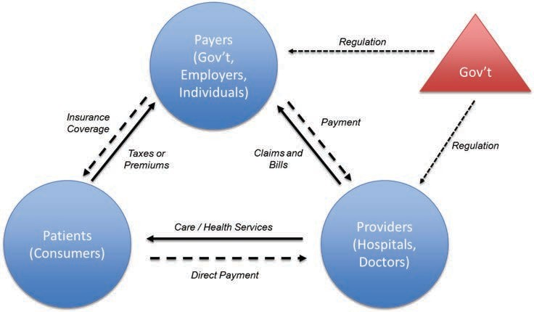
ML will Transform Every Aspect of Healthcare
The Stakeholders:

Slide 19
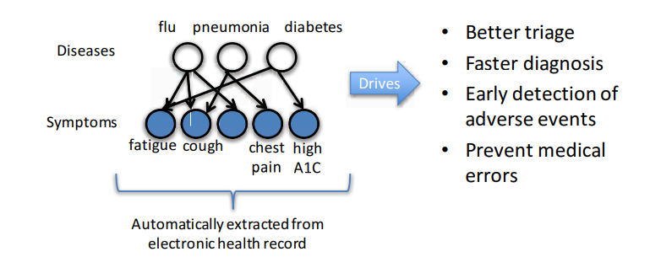
What will the ER of the Future be Like?
Behind-the scenes reasoning about the patient’s conditions (current and future)

Slide 20






US Healthcare: The COST Problem
US Healthcare spending in 2019
$3.6 trillion
Market cap of top 4 companies

Slide 21

US Healthcare Waste Per Year
$935 billion
Lack of care coordination,…
Preventable conditions, 6%
40% >
Healthcare provider errors, 12%
50 years budget
Unnecessary care,
Administrative inefficiency, 17%
Fraud
Healthcare provider errors Lack of care coordination
Unnecessary care
Fraud, 19%
Administrative inefficiency
Preventable conditions

Slide 22


Hope: Data Science – Low Cost, Better Quality
Lower cost
Early detection and prevention
E.g., heart failure onset prediction
Utilization analysis
to identify and remove waste
Better care
Inpatient care improvement
Sepsis detection
Home monitoring
Sleep monitoring at home

Slide 23
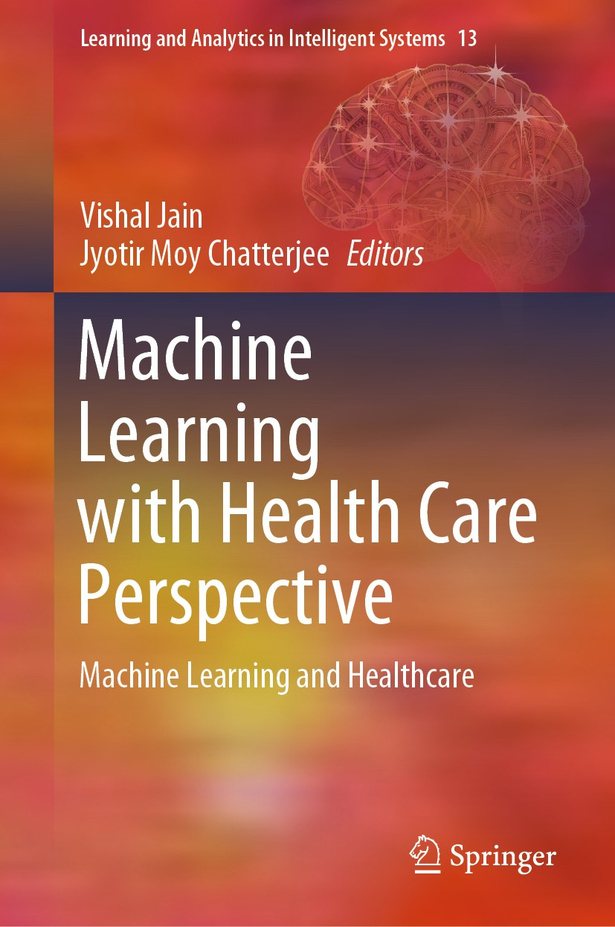
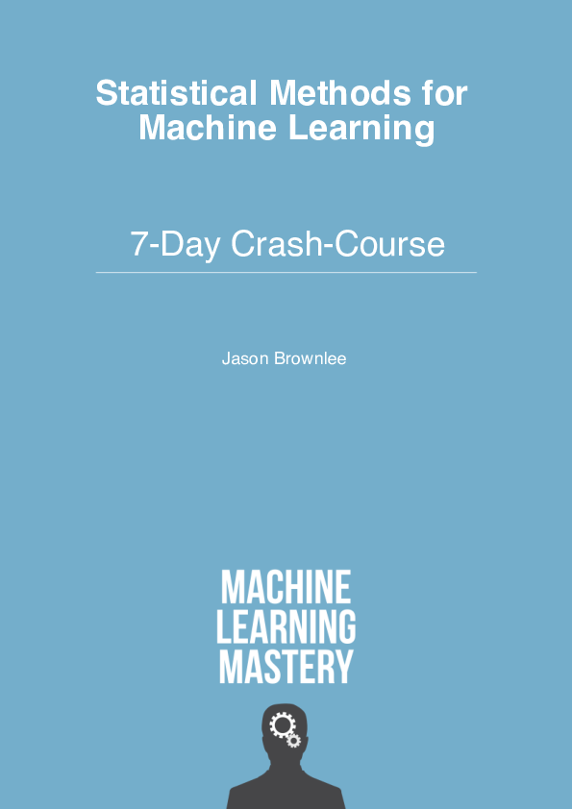
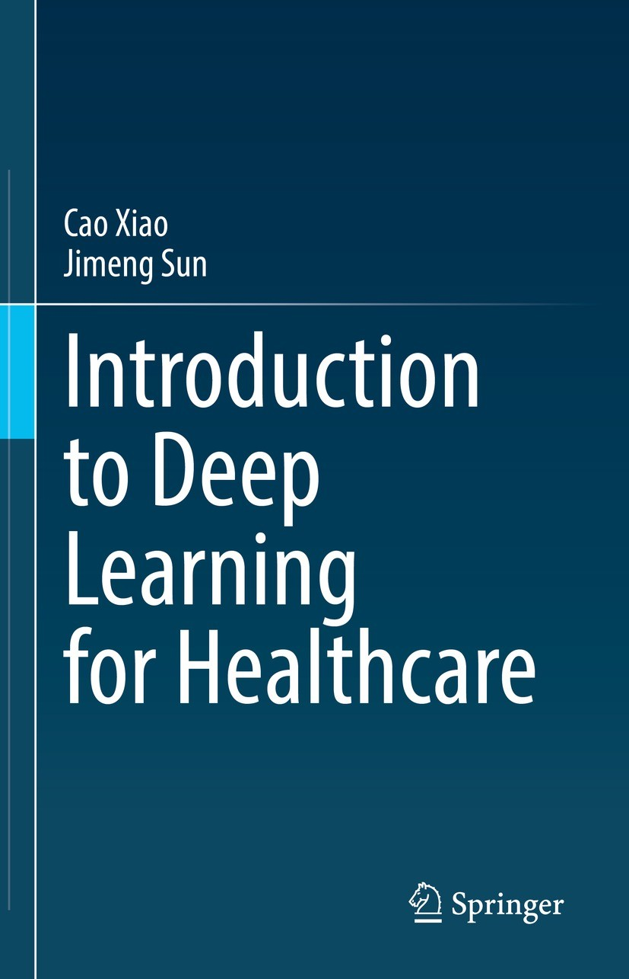
Recommended Books

Slide 24
References
An Introduction to Statistical Learning: with Applications in R/Python
Machine Learning with Health Care Perspective: Machine Learning and Healthcare
Introduction to Deep Learning for Healthcare
https://ocw.mit.edu/courses/6-s897-machine-learning-for-healthcare-spring-2019/
Deep Learning for Healthcare Specialization

