Slide 1
Foundations of Health Data Science (FHDS)
Lecture 2: Health Data
Md. Jubayer Hossain
Instructor
@cblast.du.ac.bd

Slide 2
Learning Objectives
Health data
Players in healthcare
Life cycle of healthcare data
Electronic Health Records (EHR)
Workflow of EHR

Slide 3
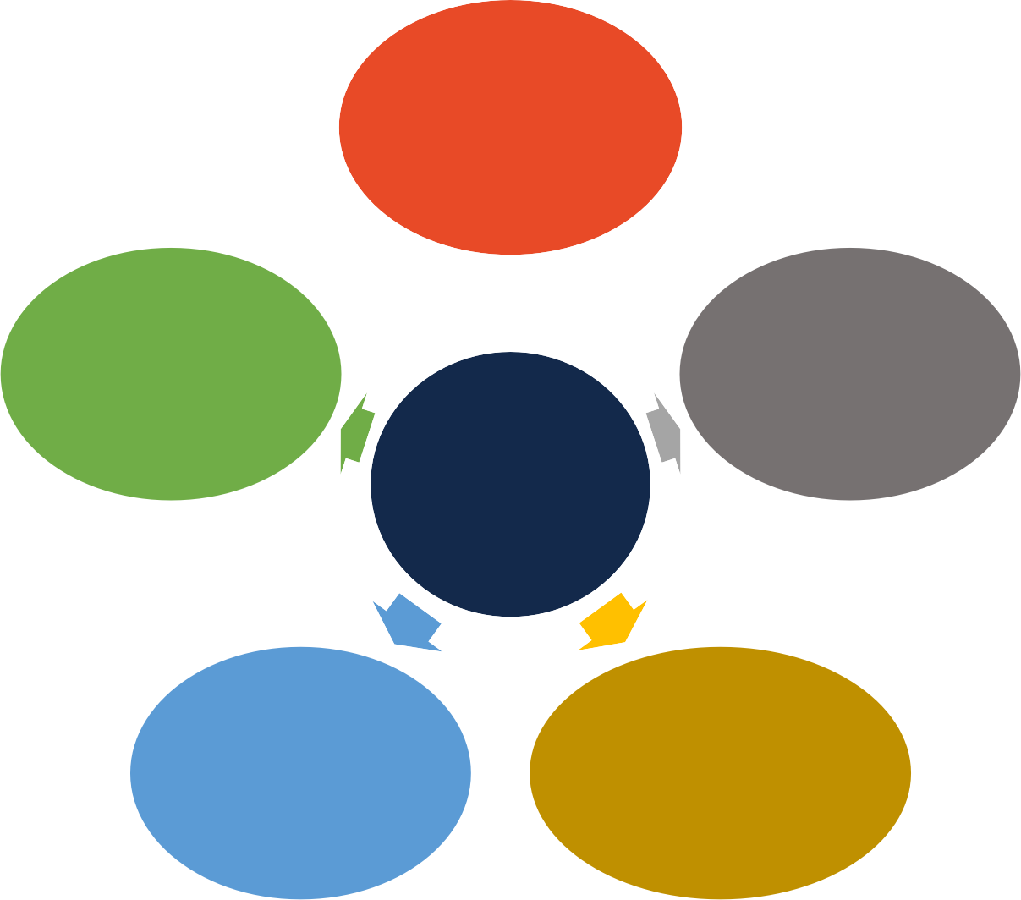
Players in Healthcare
Providers
Doctors, hospitals, clinic, pharmacy
Payers
Insurance companies, private companies
Researchers
clinicians, data scientist
Patients
Government
FDA, CDC, CMS
Pharmaceuticals
drug companies

Slide 4






Life Cycle of Healthcare Data
Pharmacy
Hospital
Pharmaceutical
Insurance co.
Patient
Government

Slide 5
Life Cycle of Healthcare Data
Electronic health records (EHR)
Pharmacy
Hospital
Pharmaceutical
Insurance co.
Medical claims
Patient
Government

Slide 6
Life cycle of Healthcare Data
Pharmacy claims
Pharmacy
Hospital
Pharmaceutical
Insurance co.
Patient
Government

Slide 7
Life Cycle of Healthcare Data
Clinical trials
Pharmacy
Hospital
Pharmaceutical
Insurance co.
Patient
Government

Slide 8

Life Cycle of Healthcare Data
Pharmacy
Hospital
data
Researcher
Pharmaceutical
Insurance co.
Patient
Medical literature
Government

Slide 9
Health Data
Electronic health records
Medical claims
Clinical notes
Medical literature
Continuous signals
Imaging data
Medical ontology
Clinical trial data
Drug discovery data

Slide 10
Adoption of EHR Systems among U.S. Hospitals
100
90
80
70
60
50
40
30
20
10
0
96
Basic EHR
94
95.9
85.2
83.8
75.5
71.9
Certified
59.4
EHR
44.4
27.6
15.6
9.4
12.2
2007 2008 2009 2010 2011 2012 2013 2014 2015 2016

Slide 11




What is in Electronic health record (HER)
Demographics
Medications
Clinical Notes and Reports
Continuous Monitoring Data
Multi-typed Medical Codes
Medical Images

Slide 12



Workflow of EHR Data
v1
v2
v3
v4
t1
t2a
t2b
t3
t4
time
Outpatient visit/encounter
Symptom, diagnosis, lab tests, medication prescriptions
Inpatient visit/encounter
Admission: chief complaints
Continuous monitoring data, imaging data
Discharge: discharge summary
(c)

Slide 13




















Longitudinal EHR data
Patient
Clinical Encounters
𝒆_{𝟏}
𝒆_{𝟐}
𝒆_{𝒕}
Chest Pain
Abdomin al Pain
Cough
Fever
Procedure
Diagnosis Medication
AcetaminophenBenzonatate
IV Fluid
Cardiac EKG

Slide 14
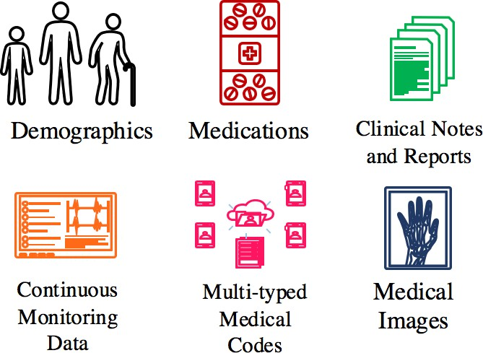
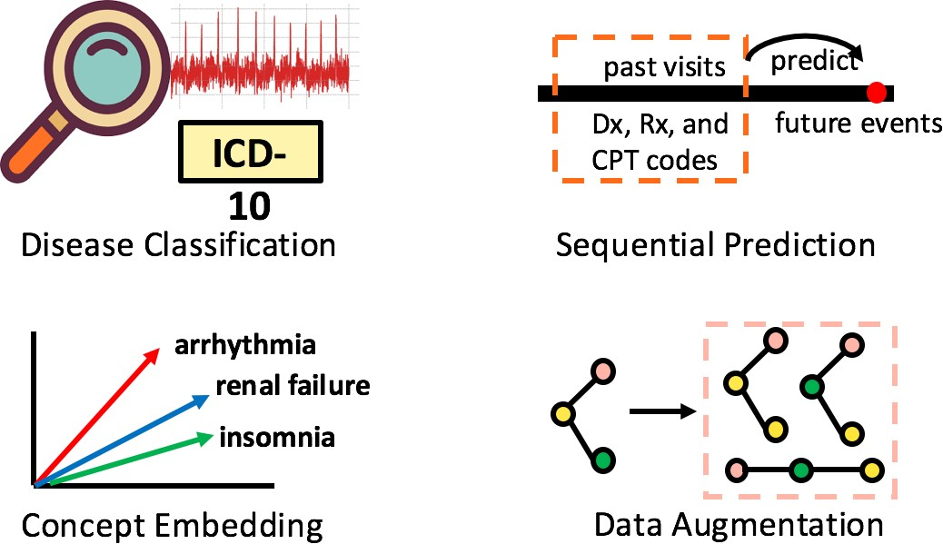
ML & DL as Effective Tools
EHR data
Embedding
End-Tasks
_{𝒛}1
_{𝒛}2
ML & DL models are effective tools for all phases of health data modeling.

Slide 15


Properties of EHR
Pros
Rich data types: structured + unstructured data
Longitudinal: multiple visits over time
Cons
Complex: multi-modality data
Siloed data: each hospital has its own EHR
Privacy concern: difficult to share/access

Slide 16
Clinical Notes
Free text documentation of patient status
Various types of notes
Admission
ED notes
Progress
Nursing
Radiology
ECG, Echocardiogram
Physician
Discharge summary
Respiratory
Social work

Slide 17
Clinical Notes - Template
Progress note (SOAP)
Subjective: what patient tells you
Objective: exam findings, labs
Assessment: diagnosis
Plan: treatment

Slide 18
Properties of Clinical Notes
Pros
Detailed: describes various info about patient status
Universal: clinical notes exist in all clinical encounters
Flexible: various information has been documented – symptoms, lab test
Cons
Unstructured: free text narrative can be difficult to process
Noisy: low documentation quality - acronym, typo
Sensitive: free text often contain protected health info (PHI)

Slide 19
Claims Data
Electronic transaction data between patients and healthcare providers.
Differ based on insurance types:
Medicare: national insurance program in the US
Commercial/private insurance

Slide 20
Claims Data - Medicare
Part A: Hospital insurance → inpatient visit
Part B: Medical insurance → physician service, outpatient visit, ambulance visits
Part C: Medicare advantage plan → capitation plan
Part D: Prescription drug

Slide 21
Claims Data – Commercial/Private
Medical
Inpatient: hospital visit, nursing facility, nursing home, hospice
Outpatient: Ambulatory visit, outpatient centers, facility fee
Professional: Doctor fee
Pharmacy
Prescription drug

Slide 22
Claims Data – Data Elements
Member info, date, place
Diagnosis: ICD
Procedure: HCPCS (CPT, other)
Drug: NDC
Financial information
Charge, payment, expenditure (total spending)

Slide 23
Properties of Claims
Pros
Large volume: plenty of claims data are available
Holistic view: all patient’s interactions with providers
Medication compliance: Every fill/refill of a prescription
Cons
Coding errors: Billing purpose only not detailed clinical documentations
Inaccurate data: imperfect reflection of actual patient status
Time lag: claims filing delay
Temporally limited: intrinsic point events, hard to track individual over time

Slide 24
Claims vs. EHR
Claims data | EHR data
Scope of data All transactions of patient provider interaction | Capture only the portion of care provided by a specific provider (hospital/clinic)
Medication data Medication filled | Medication prescription, not whether it is filled
Data richness Limited: structured codes – ICD, CPT, NDC | Rich: clinical notes, lab, vital, problem list, social history, imaging

Slide 25
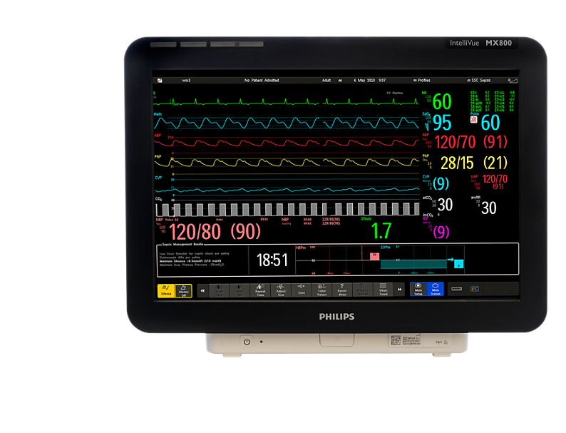
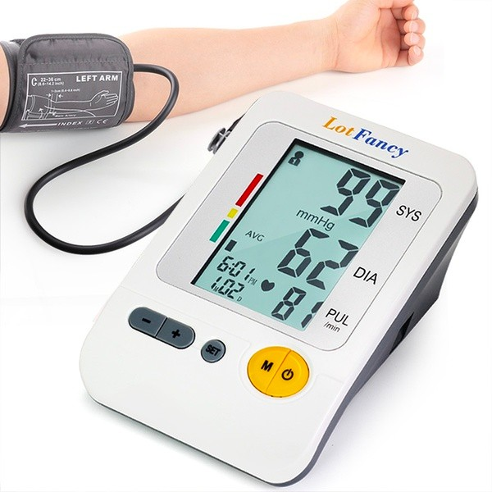

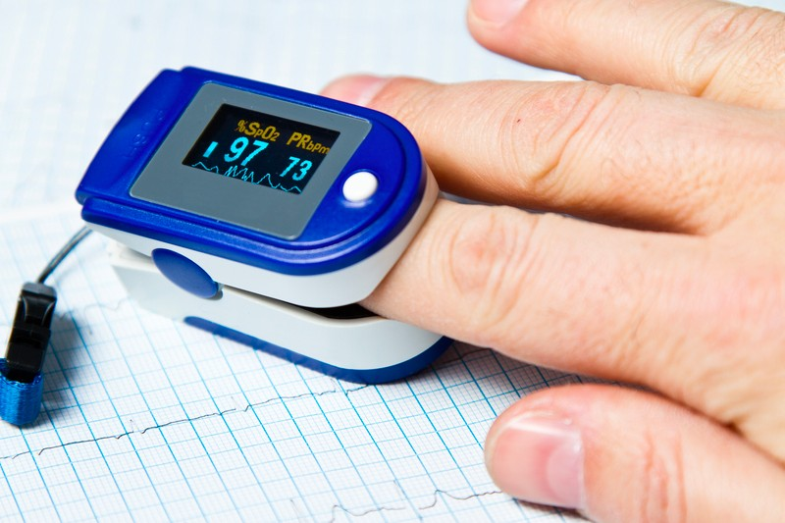
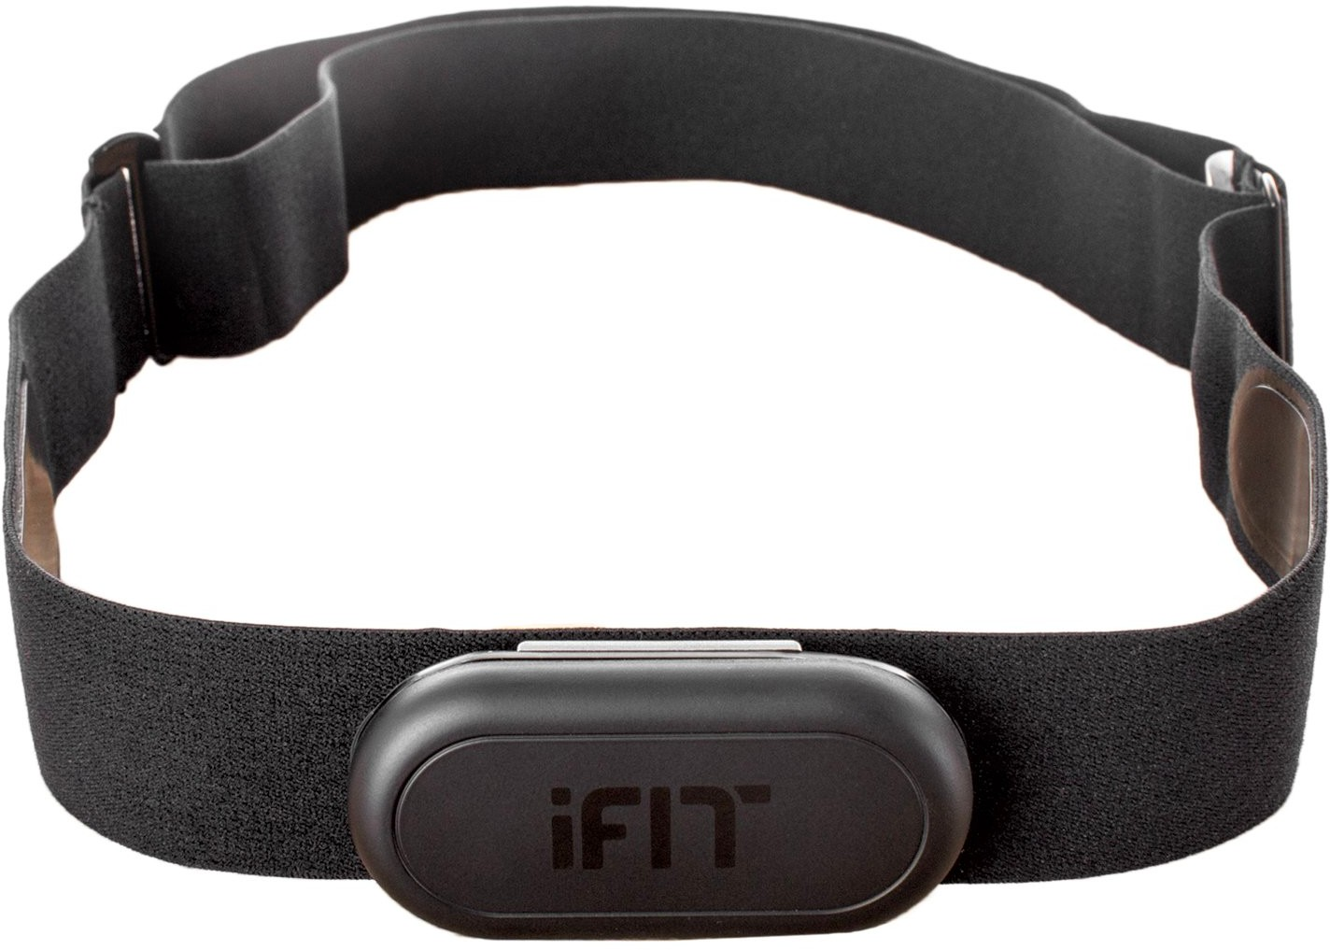
Continuous Signals
Continuous signals are commonly collected in hospitals
Important data for real-time clinical decision making
ECG monitoring
Oxygen saturation (SpO2)
Heart rate monitoring
Blood pressure
EEG

Slide 26
Properties of Continuous signals
Pros
Detailed data: continuous monitoring data
Objective measures: no human opinion or variations
Cons
Noisy: sensor placement, interference
Large volume: vast amount raw data need to be processed in real- time

Slide 27
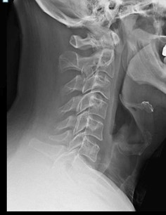
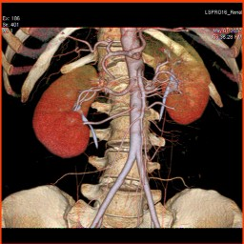
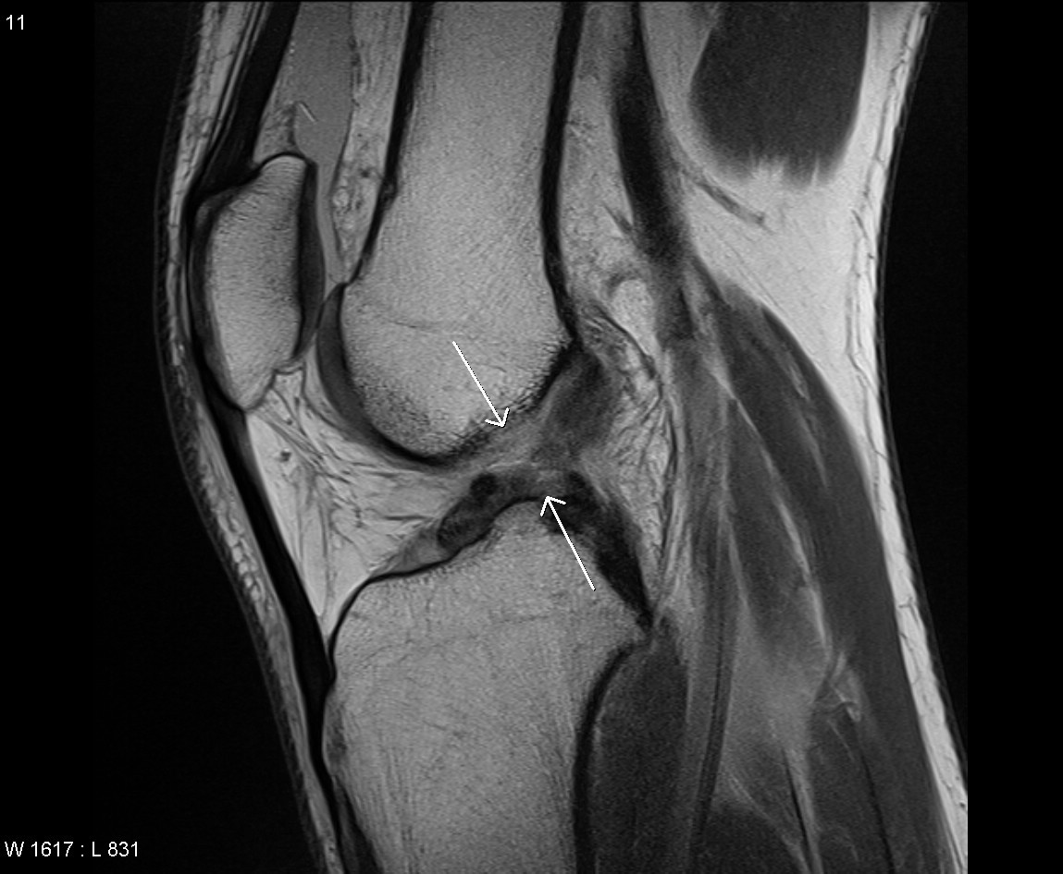
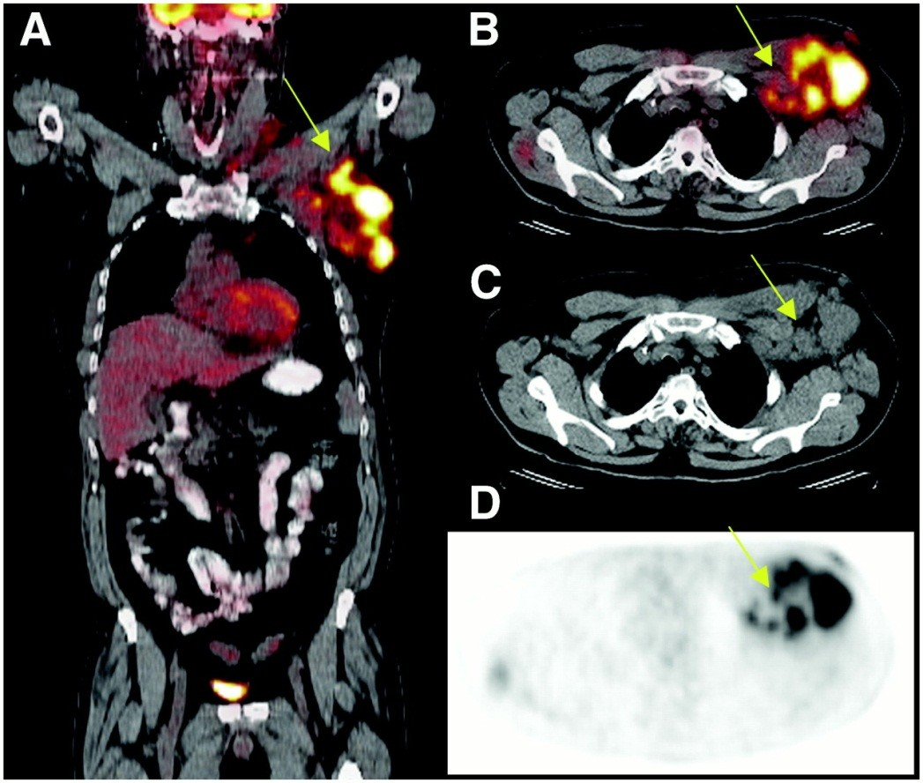
Imaging Data
Many different imaging data are available
X-ray
Computed tomography (CT)
magnetic resonance imaging (MRI)
positron emission tomography (PET-CT)
Storage size per image
Full body PET 9GB
CT Cardiac 36GB
fMRI 300GB
Size estimates
Imaging data in US 2014: 100 PB

Slide 28
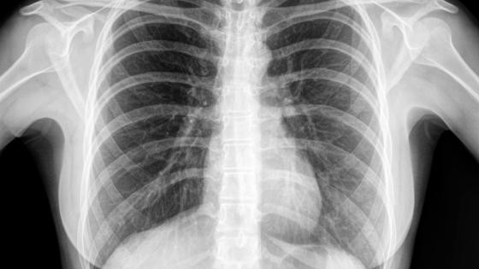
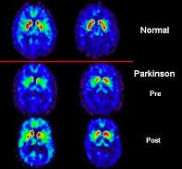
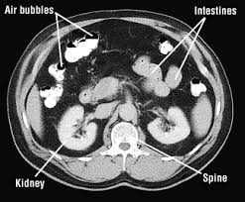
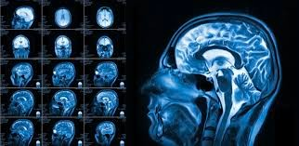
Quiz
Which types of imaging are they?
X-ray
Computed tomography (CT)
magnetic resonance imaging
positron emission tomography (PET-CT)
(a)
(d)
(b)
(c)

Slide 29
Properties of Imaging Data
Pros
Objective measures: no human opinion
Data standard: ensure generalizability of trained models
Detailed: high resolution
Cons
Label insufficiency: difficult to acquire high quality labels from experts
High dimensional: high resolution imaging data are difficulty to analyze

Slide 30


Medical Literature
Medical knowledge are documented in medical literature, such as publications and clinical guidelines
Text data
Medical literature search engine
Medline/PubMed data – medical publication abstract, author, journal, time
Clinical guideline database

Slide 31
Properties of Medical Literature
Pros
High quality: well written articles or documents
Comprehensive: covers diverse conditions
Cons
Difficult to parse: necessary expertise to locate and understand the relevant content
Not machine friendly: designed for human consumption which limited structured data and can be hard for machine to consume

Slide 32
Medical ontology
Medical ontology are knowledge graphs of different medical terminologies such as diseases, symptoms and treatments
Popular medical ontologies include
CPT for procedure codes
RxNORM for drug
SNOMED CT for general clinical terms
MESH for medical subject headings for literatures
ATC for drug

Slide 33
Properties of medical ontology
Pros
Machine readable: directed acyclic graphs
Easy to integrate it is easy to integrate ontology with other data sources such as EHR or claims
Cons
Limited coverage: The labor intensive effort to create
Noise: The error is difficult to control as the usage of ontology is often limited
Easily out of date: Due to labor intensive effort to maintain

Slide 34
Clinical Trial Data
Clinical trial is the process to test the efficacy and safety of a new drug
Data sources
Clinical trial protocols (text document)
Clinicaltrials.gov
including trial eligibility criteria
Recruitment networks between trials, investigators, patients
Safety reporting
FDA Adverse event database
Clinical trial management system (CTMS)

Slide 35
Properties of Trial Data
Pros
Important: valuable data for getting drug approved
Heterogeneous: both structured and unstructured, longitudinal data
Cons
Difficult to match: unstructured protocols need to map to structured patient records
Data integration: integration of heterogeneous data with variable quality

Slide 36


Drug Data
Existing drugs
Drugbank data
Chemical database for drug discovery
ChEMBL : large-scale bioactivity database for drug discovery
Zinc database: commercially available chemical compounds for virtual screening
QM9 dataset: quantum chemistry benchmark data for property prediction

Slide 37
Properties of Drug Data
Pros
Standard: data formats are standard
Free: many freely available (but not all)
Cons
Lack of 3D structure: 3D molecule data are limited
Latest novelty chemical data are lacking

Slide 38
References
An Introduction to Statistical Learning: with Applications in R/Python
Machine Learning with Health Care Perspective: Machine Learning and Healthcare
Introduction to Deep Learning for Healthcare
https://ocw.mit.edu/courses/6-s897-machine-learning-for-healthcare-spring-2019/
Deep Learning for Healthcare Specialization

