Slide 1
Foundations of Health Data Science (FHDS)
Lecture 4: Introduction to Health Care Data Analytics
Md. Jubayer Hossain
Instructor
@cblast.du.ac.bd

Slide 2
Learning Objectives
Categorize data into the different types
Define or apply common terms used in data analysis, such as sample, paired, histogram, population, correlation vs. causation, and descriptive
Determine whether data fits the definition of Big Data Summarize the challenges faced when working with Big Data

Slide 3
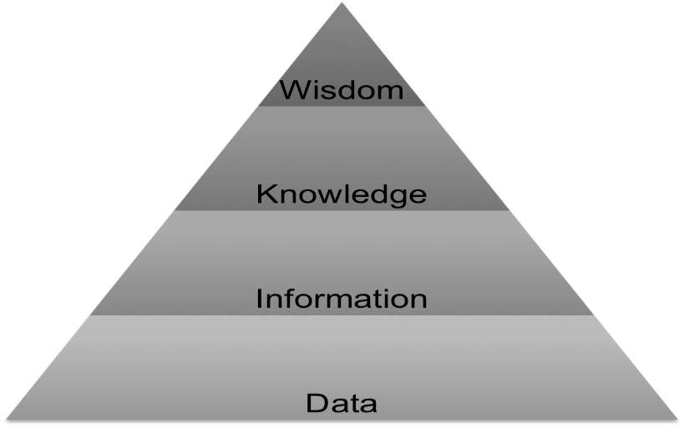
Data, Information, Knowledge, Wisdom Hierarchy
Data: symbols, facts, and measurements
Information: data processed to be useful; provides the “who, what, when, where” Knowledge: application of data and information; provides the “how”
Wisdom: evaluated understanding; provides the “why”
1.7 Figure: (Ackoff, R. 1989)

Slide 4
What is variable?
A data variable is "something that varies" or differs from person to person or group to group. Data variables are the items that we collect data about.
Examples for data variables are sex, age, weight, marital status, satisfaction rate, etc.

Slide 5
Why it is important to recognize the type of each data variable
When dealing with data, it is important to recognize the type of each data variable for the following reasons:
Summarizing data: describing a variable in mean with standard deviation or in frequency with percentage depends on the type of data variable.
Graphical presentation: choosing the proper graph to represent the data depends on the type of data variable.
Analyzing data: choosing the suitable statistical tests also depends on the type of data variables.

Slide 6
Types of Data in an EHR
Quantitative data (e.g., laboratory values)
Qualitative data (e.g., text-based documents and demographics)
Transactional data (e.g., a record of medication delivery)
(Murdoch & Detsky, 2013)

Slide 7
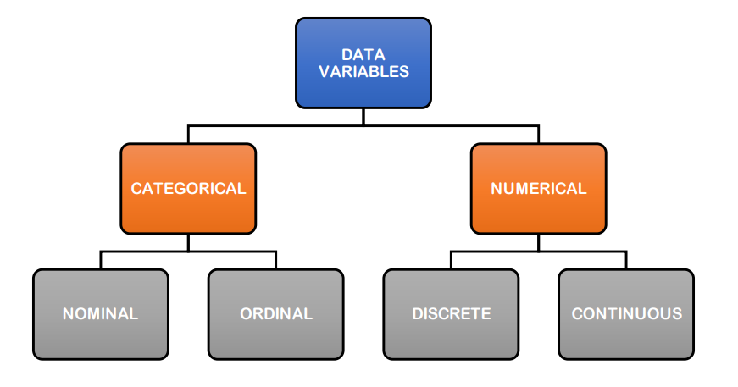
Types of Data variables

Slide 8
Categorical variables
They are also known as qualitative or nominal data; they have NO unit of measurement. Individuals are described as belonging to any of the categories of this variable.
Satisfaction status: (satisfied, neutral, not satisfied)
Sex: (female, male)
Colors: (red, green, blue, pink)
Nationality: (all countries)

Slide 9
Nominal variables
Nominal variables: those are categorical variables that have no intrinsic order.
Sex: (female, male), can also be presented as (male, female)
Blood groups: (A, B, AB, O) can also be presented as (A, B, O, AB) or any other order. Nationality: can be presented in any way; there is no order for the countries.

Slide 10
Ordinal variables
Ordinal variables: those are categorical variables that have an order, and that order has a meaning.
BMI status: (underweight, normal, overweight, obese, extremely obese)
Agreement level: (strongly disagree, disagree, undecided, agree, strongly agree)

Slide 11
Numerical variables
Those variables are either measured or counted, represented in numbers, and have a measurement unit.
Height (in cm)
Weight (in kg)
Blood glucose level (in mg/dL)
Number of kids in the family (4 kids, 2 kids, one kid, etc.)

Slide 12
Discrete variables
They take only integer numbers (no decimals) such as 0,1,2,3,4… They usually represent a count of something
Number of kids in a family.
Number of stents inserted into the coronaries.
Number of patient visits to the hospital.
The unit of measurement represents what we are counting ( as kid, stent, visit, respectively)

Slide 13
Continuous variables
They can take any real numerical value, including decimals (as 14.55, 48.8, 178.2). They involve measurement and have measurement units.
Weight (in kg)
Height (in cm)
Blood glucose level (in mg/dL)

Slide 14
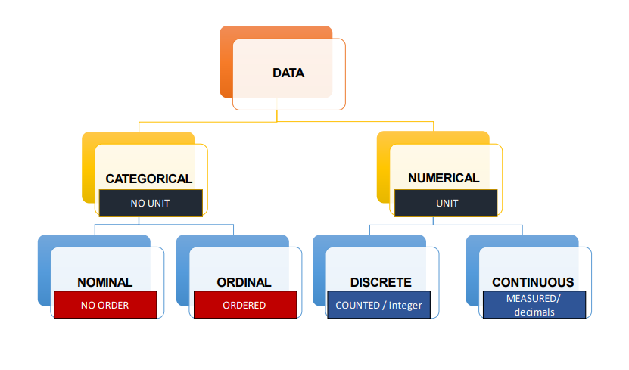
How to differentiate between types of data variables

Slide 15
Understanding the Data: Scales of Measure
Data come in many forms, and those forms determine what can or cannot be done with the data
For example, two patient names cannot be added together
Likewise, interpreting the relative distance between two measurements can only be done with certain kinds of data and not others
There are four scales: Nominal, ordinal, interval, and ratio

Slide 16
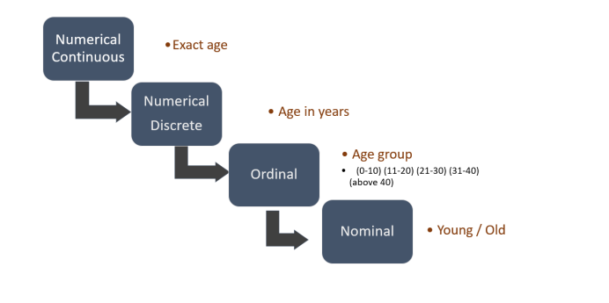
Understanding the Data: Scales of Measure
It is possible to change the type of data variable into another one, but only in one direction:
numerical continuous → numerical discrete → ordinal → nominal

Slide 17
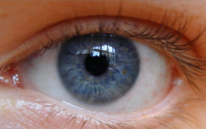
Scales of Measure: Nominal
From Latin
Names, labels, categories
Examples:
Patient names (John Doe, Maria Garcia)
Drug names (Ampicillin, Valium)
Eye color (blue, brown, green, gray)
Gender: male, female, unknown
Religious preference (Catholic, Jewish, none)
May be mapped to a number in a database
Example: brown eyes=1, blue eyes=2
Look Into My Eyes, 2009, CC BY-NC-SA 2.0

Slide 18


Scales of Measure: Ordinal
Includes all properties of Nominal (so Ordinal data all have a name of some sort)
Example: first, second, third
But intervals are not necessarily equal
CDC, 2010
Kehrer, 2009, CC BY-NC-SA 2.0

Slide 19
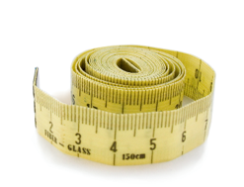
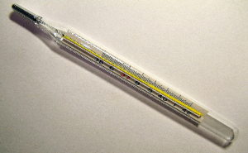
Scales of Measure: Interval and Ratio
Has equal intervals; Ratio also has absolute zero.
Examples: distance, length, temperature, weight
Includes properties of Nominal and Ordinal
May be grouped together in one category called “scale”
Lite, 2007, CC BY-NC-SA 2.0
Menchi, 2005, CC BY-NC-SA 3.0

Slide 20
Data Inconsistencies
Inconsistent naming conventions, such as “systolic blood pressure” versus “blood pressure, systolic”
Inconsistent definitions, such as how the date of admission is defined across departments;
Varying field lengths for the same data element, such as one system allowing a patient’s last name to be up to 50 characters while another system allows 25 characters
Varied data elements, such as M, F, or U for patient gender in one system while another system uses 1, 2, or 9 or Male, Female, or Unknown
("Managing a Data Dictionary", 2012)

Slide 21
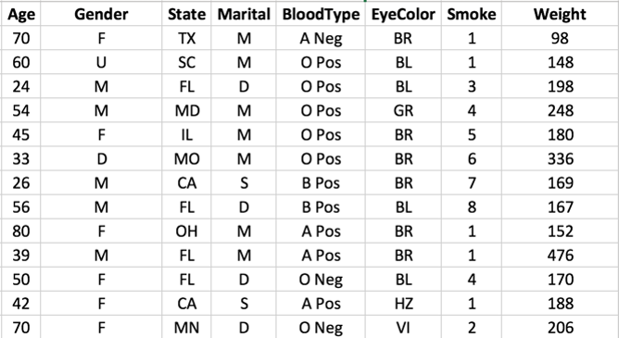
Data Dictionaries
The first step: obtain the data dictionary to understand your data
1.8 Figure: (Smith, K. 2016)

Slide 22
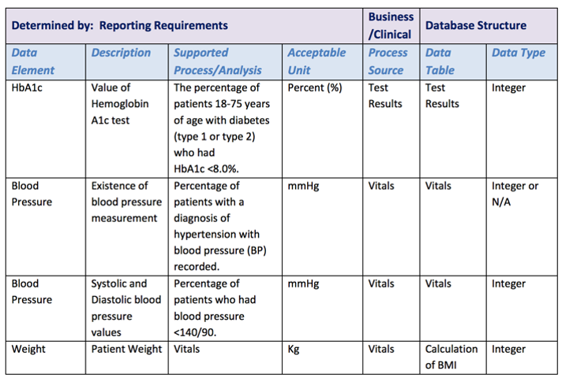
Data Dictionaries (Cont’d – 1)
A standard definition of data elements
Creates transparency
Enables analysts to report consistently and accurately
1.9 Figure: (HIMSS, 2014)

Slide 23
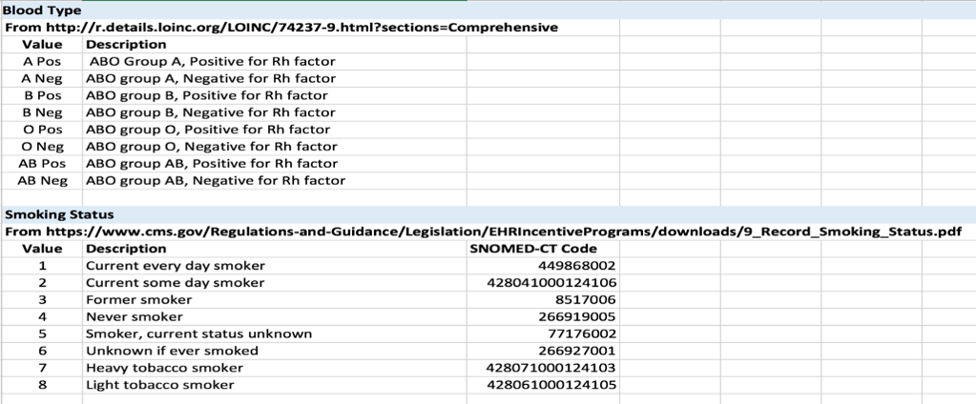
Data Dictionaries (Cont’d – 2)
Figure 1.10: (Smith, K. 2016)

Slide 24
Common Terms Used in Statistical Analysis
Population
Sample
Paired samples
Data set
Descriptive statistics
Frequency table
Histogram
Chi square
T-Test
Correlation vs. causation

Slide 25
Term: Population
A group of things that have something in common
Examples:
Patients in a particular hospital
Patients with a certain diagnosis
Patients with a particular attribute (gender, smoking status, age group)
Patients who had a certain surgical procedure in a given year by a specific surgeon

Slide 26
Term: Sample
A representative portion or subset of a group of things – part of a population
Example population: babies born in the United States in 2015
Example sample: a selection of those babies
Paired samples: before-and-after studies, or matched on one or more characteristics
Kernler, 2014, CC BY-NC-SA 4.0

Slide 27
Confidence Intervals
How well does a sample approximate the entire population?
Often set at 95%
The resulting intervals would bracket the true population parameter in approximately 95 % of the cases

Slide 28
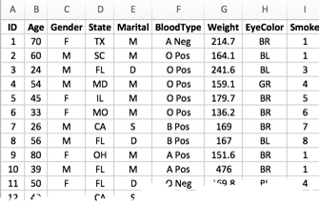
Data Set
A data set is a collection of data for a specific purpose. For this presentation, for example, the data set is a collection of 500 records that consists of age, gender, state of residence, marital status, blood type, weight, eye color, and smoking status.
1.11 Figure: (Smith, K. 2016)

Slide 29
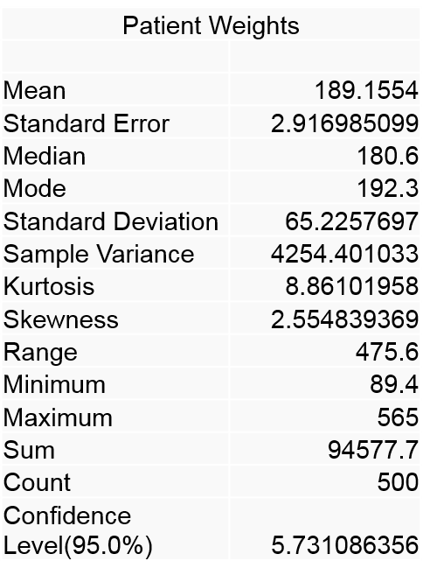
Descriptive Statistics
Basic overview of the data
Excel: Data → Data Analysis → Descriptive Statistics
Should be among the first analyses done on a set of data
Can identify some errors
Mean (average), number of records (count), range of values, maximum and minimum values
1.12 Figure: (Smith, K. 2016)

Slide 30
Correlation and Causation
Correlation: relationship between two things
Causation: one causes another
Correlation does not equal causation

Slide 31
The Potential of Big Data in Healthcare
Expand capacity to generate new knowledge
the effectiveness of treatments (Schneeweiss, 2014)
the prediction of outcomes (Schneeweiss, 2014)
Knowledge dissemination
Using analytics to combine EHR and genomic data to translate personalized medicine to clinical practice
Deliver information directly to patients and increase patient participation in their health care

Slide 32
What is Big Data?
Characteristics of big data:
Volume (i.e., the size of the dataset)
Variety (i.e., data from multiple repositories, domains, or types)
Velocity (i.e., rate of flow)
Variability (i.e., the change in other characteristics)
Traditional data architectures (such as typical relational databases) cannot handle this type of data
New architectures are required
(NIST Big Data, 2015)

Slide 33
Tools
Hadoop
Runs on clusters of hardware
MongoDB
Stores data using documents with fields
NoSQL utilities
("What is Hadoop?", 2016)

Slide 34
Requirements For Analytics for Learning Systems
A way to ensure that patient groups being compared are truly similar
Automated tools for analysis
Ability to rapidly run automated tools against new data
Software that can be used with little training and helps prevent errors in interpretation
Easily understood results

Slide 35
Challenges Facing Biomedical Big Data
Amount of information
Lack of organization
Lack of access to data and tools
Insufficient training in data science methods
("What is Big Data? | Data Science at NIH", 2015)

Slide 36
Lecture 4: Summary
Data come in many forms, and those forms determine what can or cannot be done with the data
Big data has the potential to advance healthcare
Analysis of big data requires tools like Hadoop and MongoDB
However, Biomedical Big Data faces many challenges

Slide 37
Lecture 4: Summary (Cont’d)
Analytics is the entire process of data collection, extraction, transformation, analysis, interpretation, and reporting
There are different types of data which determines what can or cannot be done with the data
There are various technologies or tools for working with different data types
Various challenges are faced when working with Big Data

Slide 38
Lecture 4 : References
Big Data Analytics: Descriptive Vs. Predictive Vs. Prescriptive - InformationWeek. (2014).InformationWeek. Retrieved 2 May 2016, from http://www.informationweek.com/big-data/big-data-analytics/big-data-analytics-descriptive-vs-predictive-vs-prescriptive/d/d-id/1113279
"The Definition Of Nominal Scale". Dictionary.com. N.p., 2017. Web. 7 Feb. 2017. http://www.dictionary.com/browse/nominal-scale
Descriptive Analytics - Gartner IT Glossary. (2015). Gartner IT Glossary. Retrieved 2 May 2016, from http://www.gartner.com/it-glossary/descriptive-analytics
Diagnostic Analytics - Gartner IT Glossary. (2015). Gartner IT Glossary. Retrieved 28 April 2016, from http://www.gartner.com/it-glossary/diagnostic-analytics
Escobar, G. J., Puopolo, K. M., Wi, S., Turk, B. J., Kuzniewicz, M. W., Walsh, E. M., ... & Draper, D. (2014). Stratification of risk of early-onset sepsis in newborns≥ 34 weeks’ gestation. Pediatrics, 133(1), 30-36. Retrieved 2/21/2016 from http://pediatrics.aappublications.org/content/pediatrics/133/1/30.full.pdf
Gartner Says Worldwide Enterprise IT Spending to Reach $2.7 Trillion in 2012. (October 17, 2011). Retrieved April 28, 2016, from http://www.gartner.com/newsroom/id/1824919
Health and Medicine Division. (September 6, 2012). Retrieved April 28, 2016, from http://www.nationalacademies.org/hmd/Reports/2012/Best-Care-at-Lower-Cost-The-Path-to-Continuously-Learning-Health-Care-in-America.aspx

Slide 39
Lecture 4: References (Cont’d – 1)
Health and Medicine Division. (n.d.). Retrieved April 28, 2016, from http://www.nationalacademies.org/hmd/Activities/Quality/LearningHealthCare.aspx
IBM (2013). Descriptive, predictive, prescriptive: Transforming asset and facilities management with analytics. Retrieved from http://www-01.ibm.com/common/ssi/cgi-bin/ssialias?infotype=SA&subtype=WH&htmlfid=TIW14162USEN.
Managing a Data Dictionary. (2012). Journal Of AHIMA, 83(1), 48-52. Retrieved from http://library.ahima.org/PB/DataDictionary#.WI9uCVMrJhE
Murdoch, T. & Detsky, A. (2013). The Inevitable Application of Big Data to Health Care.JAMA, 309(13), 1351. http://dx.doi.org/10.1001/jama.2013.393
National Institute of Standards and Technology,. (2015). NIST Big Data Interoperability Framework: Volume 1, Definitions. Retrieved from http://nvlpubs.nist.gov/nistpubs/SpecialPublications/NIST.SP.1500-1.pdf
NIST/SEMATECH e-Handbook of Statistical Methods. (n.d.). Retrieved May 02, 2016, from http://www.itl.nist.gov/div898/handbook/
Overview - Sepsis - Mayo Clinic. (2016). Mayoclinic.org. Retrieved 2 May 2016, from http://www.mayoclinic.org/diseases-conditions/sepsis/home/ovc-20169784

Slide 40
Lecture 2: References (Cont’d – 2)
Schneeweiss, S. (2014). Learning from big health care data. New England Journal of Medicine, 370(23), 2161-2163. http://www.nejm.org/doi/full/10.1056/NEJMp1401111#t=article
Shapira, G. (2016). The Seven Key Steps of Data Analysis. Oracle.com. Retrieved 28 April 2016, from http://www.oracle.com/us/corporate/profit/big-ideas/052313-gshapira-1951392.html
Six Steps Of An Analytics Project - Quality Assurance and Project Management. (2015). Quality Assurance and Project Management. Retrieved 2 May 2016, from http://itknowledgeexchange.techtarget.com/quality-assurance/six-steps-of-an-analytics-project/
What is Hadoop?. (2016). Sas.com. Retrieved 2 May 2016, from http://www.sas.com/en_my/insights/big-data/hadoop.html
What is Big Data? | Data Science at NIH. (2015). Datascience.nih.gov. Retrieved 2 May 2016, from http://datascience.nih.gov/bd2k/about/what
Charts, Tables and Figures
1.7 Figure: Ackoff, R. (1989). "From data to wisdom. Presidential address to ISGSR, June 1988.” Journal of Applied Systems Analysis 16(1): 3-9.
1.8 Figure: Smith, K. (2016). Synthetic Data Set. Used with permission from Kimberly Smith.
1.9 Figure: Health Information Management Systems Society (HIMSS). (2014). Clinical & Business Intelligence: An Analytics Executive Review Needs Assessment. Retrieved from http://www.himss.org/ResourceLibrary/genResourceDetailPDF.aspx?ItemNumber=34692

Slide 41
Lecture 4: References (Cont’d – 3)
Chart, Tables and Figures
1.10 Figure: Smith, K. (2016). Data Dictionaries. Used with permission from Kimberly Smith.
1.11 Figure: Smith, K. (2016). Data Set. Used with permission from Kimberly Smith.
1.12 Figure: Smith, K. (2016). Descriptive Statistics. Used with permission from Kimberly Smith.
Images
Slide 6: Look Into My Eyes. (2009). Girl`s blue eye [Online Image]. Retrieved 28 April 2016, from https://commons.wikimedia.org/wiki/File:Deep_Blue_eye.jpg
Slide 7: Kehrer, P. (2009). Win, Place, Show [Online Image]. Retrieved from https://www.flickr.com/photos/paulkehrer/3659279740
Slide 7: C. (2010, September 9). Growth Charts [Digital image]. Retrieved May 2, 2016, from http://www.cdc.gov/growthcharts/
Slide 8: Lite. (2007). Soft Ruler [Online Image]. Retrieved from https://commons.wikimedia.org/wiki/File:Soft_ruler.jpg
Slide 8: Menchi. (2005). Clinical thermometer 38.7 [Online Image]. Retrieved from https://commons.wikimedia.org/wiki/File:Clinical_thermometer_38.7.JPG#/media/File:Clinical_thermometer_38.7.JPG
Slide 15: Kernler, D. (2014). A visual representation of selecting a simple random sample [Online Image]. Retrieved from https://commons.wikimedia.org/wiki/File:Simple_random_sampling.PNG

