Slide 1
Foundations of Health Data Science (FHDS)
Lecture 5: Working with Data
Md. Jubayer Hossain
Instructor
@cblast.du.ac.bd

Slide 2
Learning Objectives
Describe reasons why data needs to be cleaned or modified before analysis
Demonstrate ability to identify and correct basic errors in data
Demonstrate ability to perform descriptive statistics
Demonstrate ability to use pivot tables
Describe the relationship between a database in a health IT system and data analysis tools

Slide 3
Reasons for Data Cleaning
Ensure accuracy: Identify and correct errors to improve the reliability of results
Enhance consistency: Standardize formats for consistent data representation
Minimize bias: Eliminate discrepancies to avoid skewed analysis outcomes

Slide 4
Identifying and Correcting Errors
Identifying Errors:
Reviewing outliers and anomalies
Utilizing data profiling tools
Correcting Errors:
Imputation techniques for missing data
Validating and cleansing data through various methods

Slide 5
Technologies and Tools
Common technologies and tools used for data analytics include:
Spreadsheet programs such as Microsoft Excel®
Statistical programs such as Python, R, SAS, SPSS, and Stata
Database management systems such as MySQL and Microsoft SQL Server® - can perform some basic analysis
Business intelligence applications such as Tableau®, QlikView®, IBM Cognos

Slide 6
Cleaning Data
Identify errors
Descriptive statistics
Categorical data
Use of pivot tables
Determine correct values or infer/impute
If uncorrectable delete the record
Work with a copy of your dataset and log all changes!

Slide 7
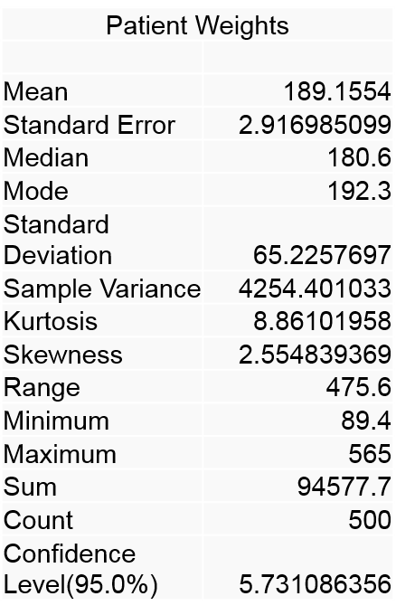
Data Cleaning – Continuous Data Descriptive Statistics
Generate descriptive statistics Data Analysis → Descriptive Statistics
2.1 Figure: (Smith, K. 2016)

Slide 8
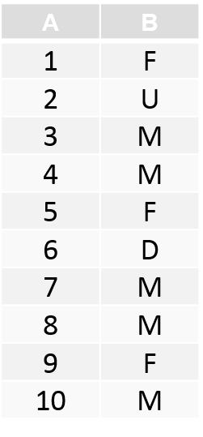
Data Cleaning – Categorical Data
COUNTIF function
=COUNTIF(range, criteria)
=COUNTIF($B$1:$B$10, “M”) - will give 5
=COUNTIF($B$1:$B$10, “F”) - will give 3
=COUNTIF($B$1:$B$10, “U”) - will give 1
Can identify some errors
2.2 Figure: (Smith, K. 2016)

Slide 9
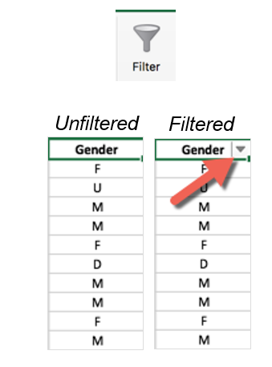
Filtering Records
Displays only those records that meet certain criteria
Click a cell in the column to be filtered
On the Data tab, click the Filter icon
2.3 Figure: (Smith, K. 2016)

Slide 10
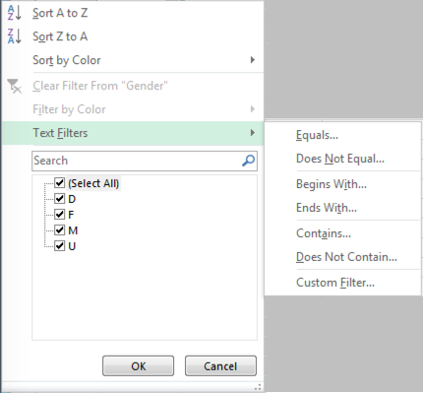
Filtering Records, continued
Dialog box displays all the values present in the column
Can check only values you are interested in – Excel will display only those records
2.4 Figure: (Smith, K. 2016)

Slide 11
Column Graph
Column graph shows individual weights
But doesn’t show us how many patients are in a particular weight category
2.5 Figure: (Smith, K. 2016)

Slide 12
Frequencies and Histograms
Frequency: “How many of X and Y are there?”
A frequency calculation gives how many times a particular value occurs
Can be shown as:
Frequency table
Histogram: a graph of the number of times values occur in a set of data

Slide 13
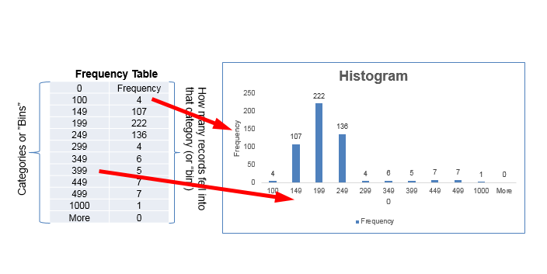
Example Frequency Table and Histogram
2.6 Figure: (Smith, K. 2016)

Slide 14
Example
How many patients are in each of the following weight categories (in pounds)?
< 100 300-349
100-149 350-399
150-199 400-499
200-249 500-1000
250-299 1000+

Slide 15
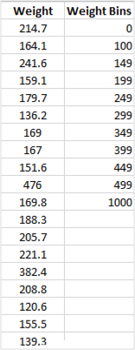
Set up the category bins
Add a column to your Excel spreadsheet with the bins that you want to use to categorize the patient weights
2.7 Figure: (Smith, K. 2016)

Slide 16
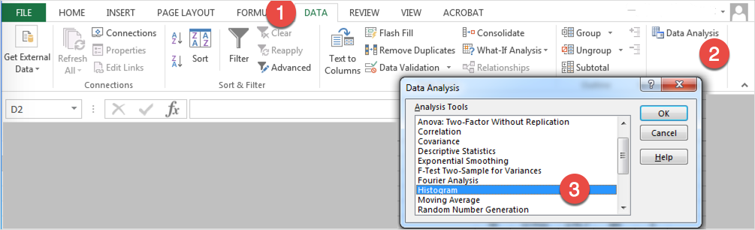
Creating a Frequency Table and Histogram
2.8 Figure: (Smith, K. 2016)

Slide 17
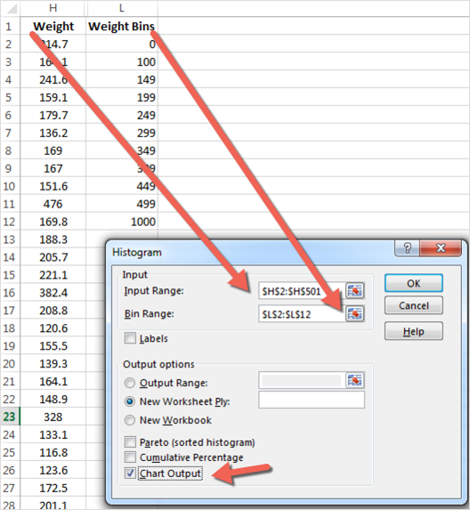
Creating a Frequency Table and Histogram
In the Input Range field, enter the range of cells that contain the weights
In the Bin Range field, enter the range of cells that contain the category bins that you created
Click Chart Output
1.9 Figure: (Smith, K. 2016)

Slide 18
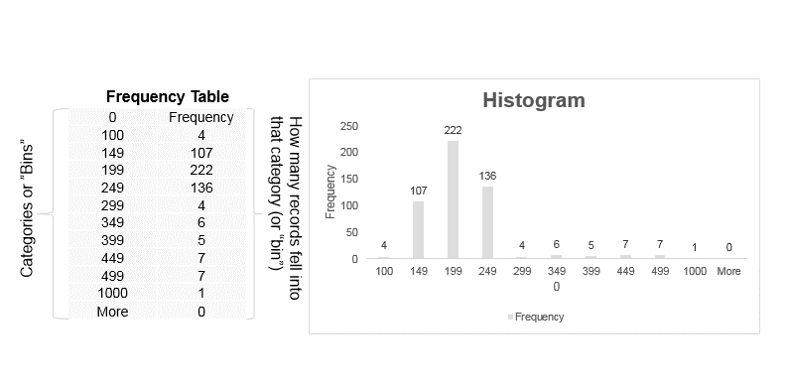
Frequency Table and Histogram Output
2.10 Figure: (Smith, K. 2016)

Slide 19
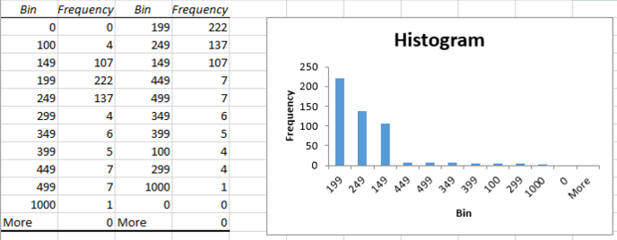
Sorted Histogram
2.11 Figure: (Smith, K. 2016)

Slide 20
Pivot Tables
Pivot tables are an Excel tool that let you summarize, analyze, and create different views of your data. You can arrange how the data is displayed.
Pivot tables are very useful for identifying trends or relationships among data in large datasets.
Use the laboratory exercise on pivot tables to explore data on hospital-acquired infections

Slide 21
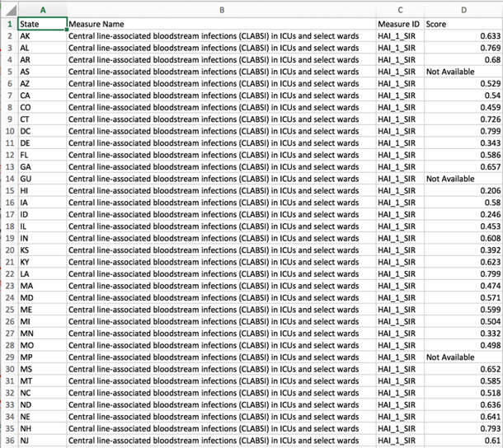
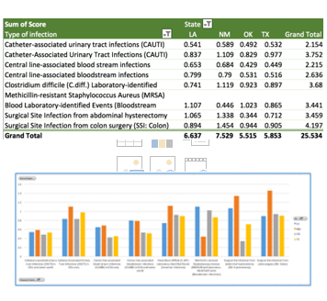
Example Pivot Table
2.13 Figure: (HealthData.gov, n.d.)
2.12 Figure: (HealthData.gov, n.d.)

Slide 22
Chi-Square Test
Are two categorical variables related?
Categorical variable examples:
Gender
Ethnicity
Age group (e.g. 40-49, 50-59)
Disease stage (I, II, III, IV)
Presence or absence of a disease

Slide 23
Lecture 3: Summary
Before you start doing any analysis, you must examine your data, identify any problems, and determine how to address them
We discussed descriptive statistics, pivot tables, histograms, frequency tables, and chi-square test
Pivot Tables describe the relationship between a database in an HIT system and data analysis tools

Slide 24
Lecture 5: References
References
Load the Analysis ToolPak. (n.d.). Retrieved May 03, 2016, from https://support.office.com/en-us/article/Load-the-Analysis-ToolPak-305c260e-224f-4739-9777-2d86f1a5bd89
Charts, Tables, and Figures
2.1 – 2.11 Figure: Smith, K. (2016). Used with permission from author.
2.12 – 2.13 Figure: Healthcare Associated Infections - State | HealthData.gov. (n.d.). Retrieved May 03, 2016, from http://www.healthdata.gov/dataset/healthcare-associated-infections-state

