Slide 1
Foundations of Health Data Science (FHDS)
Lecture 7: Secondary Use of Clinical Data
Md. Jubayer Hossain
Instructor
@cblast.du.ac.bd

Slide 2
Learning Objectives
Describe the secondary uses of clinical data, including EHRs
Discuss the limitations and challenges of re-using clinical data
Conduct a data re-use analyses for health care quality measurement utilizing a sample data set (Exercise)

Slide 3
Limitations and Challenges for Re-Using Clinical Data
Caveats for re-use of clinical data
Overcoming the caveats
Need for interoperability

Slide 4
Caveats for Re-Use of Clinical Data
Operational clinical data may be
Inaccurate
Incomplete
Of unknown provenance
Of insufficient granularity
There are many idiosyncrasies

Slide 5
Inaccurate
Documentation not always a top priority
Four known national leaders assessed use of data for studies on treatment of hypertension and found that data was:
Missing
Erroneous
Un-interpretable
Inconsistent
Inaccessible in text notes

Slide 6
Incomplete
Not every diagnosis is recorded at every visit
Absence of evidence is not always evidence of absence – censoring
Makes simple tasks challenging
Undermines ability to automate quality measures
Under-reported based on under-capture of data due to variation in clinical workflow and documentation practices
Correct when present but often missing in primary care EHRs

Slide 7
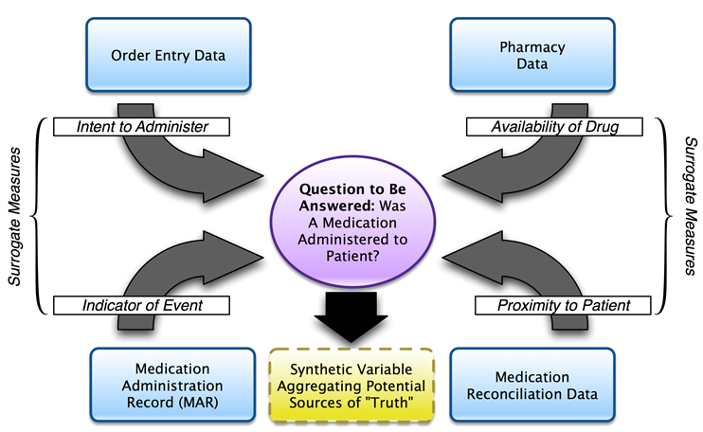
Of Unknown Provenance and Insufficient Granularity
Provenance
Where data came from
Example on slide
Granularity:
Diagnostic codes assigned for billing purposes may be generalized per requirements
Provenance – knowing where your data come from (Seiler, 2011)

Slide 8
Idiosyncrasies of Clinical Data
“Left censoring” – Early part of data may be missing
“Right censoring” – Data source may not cover long enough time interval
Data might not be captured from other clinical or non-clinical settings
Bias in testing or treatment
Institutional or personal variation in practice or documentation styles
Inconsistent use of coding or standards

Slide 9
Overcoming the Caveats: Recommendations for EHR Data Use
Assessing and using data
Adaptation of “best evidence” approaches to use of operational data
Need for standards and interoperability
Appropriate use of informatics expertise

Slide 10
Focus on Interoperability
ONC for Health IT developed interoperability road map for 10-year path forward
Emerging approaches include standard application programming interface (API)
Need for both documents and discrete data
Fast Healthcare Interoperability Resources (FHIR) – http://wiki.hl7.org/index.php?title=FHIR_for_Clinical_Users

Slide 11
Clinical Data Research Networks
HMO Research Network – facilitates clinical research
http://www.hcsrn.org/en/
FDA Mini-Sentinel Network – safety surveillance of medications
https://www.sentinelinitiative.org/
PCORnet – www.pcornet.org
Clinical data research networks (CDRNs)
Common data model for subset of data

Slide 12
Lecture 7 – Summary
There are a number of caveats for re-use of clinical data
Understanding and using best practices may allow overcoming the caveats
Efforts of overcome challenges include a focus on interoperability and leveraging clinical data research networks

Slide 13
Lecture 7 – Summary
There are plentiful opportunities for secondary use or re-use of clinical data
We must be cognizant of caveats of using operational clinical data
We must implement best practices for using such data
We need consensus on approaches to standards and interoperability and leveraging clinical data research networks

Slide 14
Lecture 7 – References
Anonymous (2014). Connecting Health and Care for the Nation: A Shared Nationwide Interoperability Roadmap Version 1.0. Washington, DC, Department of Health and Human Services. http://www.healthit.gov/policy-researchers-implementers/interoperability
Barkhuysen, P, deGrauw, W, et al. (2014). Is the quality of data in an electronic medical record sufficient for assessing the quality of primary care? Journal of the American Medical Informatics Association. 21: 692-698.
Bayley, KB, Belnap, T, et al. (2013). Challenges in using electronic health record data for CER: experience of four learning organizations. Medical Care. 51: S80-S86.
Collins, FS, Hudson, KL, et al. (2014). PCORnet: turning a dream into reality. Journal of the American Medical Informatics Association. 21: 576-577.
deLusignan, S and vanWeel, C (2005). The use of routinely collected computer data for research in primary care: opportunities and challenges. Family Practice. 23: 253-263.
Fleurence, RL, Curtis, LH, et al. (2014). Launching PCORnet, a national patient-centered clinical research network. Journal of the American Medical Informatics Association. 21: 578-582.

Slide 15
Lecture 7 – References
Hersh, WR, Cimino, JJ, et al. (2013). Recommendations for the use of operational electronic health record data in comparative effectiveness research. eGEMs (Generating Evidence & Methods to improve patient outcomes). 1: 14. http://repository.academyhealth.org/egems/vol1/iss1/14/
Hersh, WR, Weiner, MG, et al. (2013). Caveats for the use of operational electronic health record data in comparative effectiveness research. Medical Care. 51(Suppl 3): S30-S37.
Miller, DR, Safford, MM, et al. (2004). Who has diabetes? Best estimates of diabetes prevalence in the Department of Veterans Affairs based on computerized patient data. Diabetes Care. 27(Suppl 2): B10-21.
Parsons, A, McCullough, C, et al. (2012). Validity of electronic health record-derived quality measurement for performance monitoring. Journal of the American Medical Informatics Association. 19: 604-609.
Richesson, RL, Rusincovitch, SA, et al. (2013). A comparison of phenotype definitions for diabetes mellitus. Journal of the American Medical Informatics Association. 20(e2): e319-e326.

Slide 16
Lecture 7 – References
Seiler, KP, Bodycombe, NE, et al. (2011). Master data management: getting your house in order. Combinatorial Chemistry & High Throughput Screening. 14: 749-756.
Wei, WQ, Leibson, CL, et al. (2013). The absence of longitudinal data limits the accuracy of high-throughput clinical phenotyping for identifying type 2 diabetes mellitus subjects. International Journal of Medical Informatics. 82: 239-247.
Zhang, Z and Sun, J (2010). Interval censoring. Statistical Methods in Medical Research. 19: 53-70.

