Slide 1
Foundations of Health Data Science (FHDS)
Lecture 10: Machine Learning in Healthcare
Md. Jubayer Hossain
Instructor
@cblast.du.ac.bd

Slide 2
Learning Objectives
Describe the major tasks for which machine learning is used
Compare and contrast the major approaches for machine learning
Notes:
The learning objectives for this unit, Machine Learning and Natural Language Processing, are to:
Describe the major tasks for which machine learning is used
Compare and contrast the major approaches for machine learning
Describe the major tasks for which natural language processing is used
And discuss the major approaches and challenges for processing clinical narratives

Slide 3
Machine Learning
Definitions
Tasks
Approaches
Steps
Tools
Notes:
In this lecture, we will begin by talking about definitions of machine learning.
Then we will describe tasks for which machine learning is used.
This will be followed by discussion of the approaches to machine learning, followed by the steps in the process and the tools employed.

Slide 4
Machine Learning
Definitions
Tasks
Approaches
Steps
Tools
Notes:
In this lecture, we will begin by talking about definitions of machine learning.
Then we will describe tasks for which machine learning is used.
This will be followed by discussion of the approaches to machine learning, followed by the steps in the process and the tools employed.

Slide 5
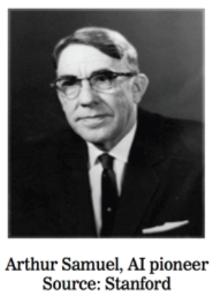
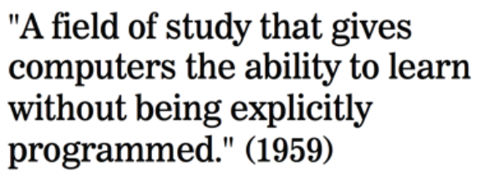
What is Machine Learning?

Slide 6
What is Machine Learning?
One definition: “Machine learning is the semi-automatic extraction of knowledge from data.”
Knowledge from data: Starts with a question that might be answerable using data
Automatic extraction: A computer provides the insight
Semi-automatic: Requires many smart decisions by a human

Slide 7
Machine Learning Definitions - 1
Machine learning is the field of computer science that studies how computers learn from data (Deo, 2015)
Derived from
Mathematics/statistics: Learning relationships from data
Computer science: Emphasis on efficient algorithms, especially those involving large amounts of data
Notes:
There are many definitions of machine learning, but it is commonly described as the field of computer science that studies how computers learn from data. Machine learning is derived from mathematics and statistics - where relationships are learned from data, and from computer science - where there is emphasis on efficient algorithms, especially those involving large amounts of data.

Slide 8
Machine Learning Definitions - 2
Major types of learning
Supervised: Learn to predict a known output
Learns from training data
Evaluated on test data
To avoid “over fitting”
Unsupervised: find naturally occurring patterns or groupings within data
Notes:
Often when we talk about machine learning, we talk about different types of learning.
In supervised learning, machine learning algorithms learn to predict a known output that they learn from training data and have their effectiveness evaluated on test data. The use of training and test data is done to avoid over fitting the training data. For further reading on the concept of overfitting, see the reference slides at the end of this presentation.
In unsupervised machine learning, we aim to find naturally occurring patterns or groupings within the data.

Slide 9
Statistical Learning vs. Machine Learning
Is there any difference between Statistical Learning and Machine Learning?
Statistical Learning: Statistical learning is about models usually developed through human decisions/inputs, which are generally interpretable.
Machine Learning: Machine learning is somewhat or fully automated (although human input is inevitable), which are generally less or not interpretable.

Slide 10
Statistical Learning vs. Machine Learning
Another notable difference between statistical learning and machine learning is the intended application:
Machine Learning is more geared towards predicting on outcome
Statistical learning is more about describing and decision making.

Slide 11
What is Statistical Learning
“It is one thing to estimate the probability of rain and another thing to decide whether it’s worth carrying an umbrella” –Frank Harrel

Slide 12
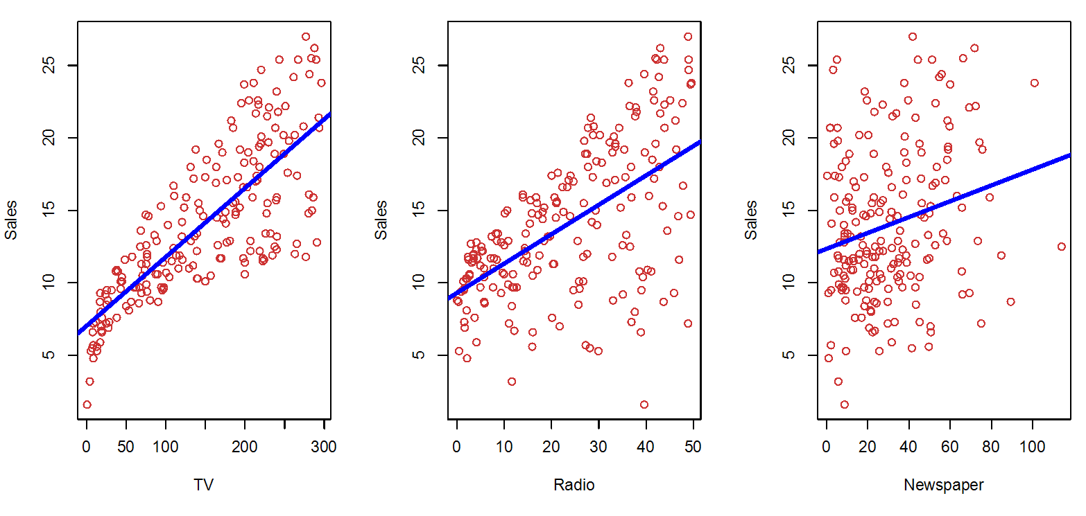
Association between Sales and Advertising Dollars
Figure: The Advertising data set. The plot displays sales, in thousands of units, as a function of TV, radio, and newspaper budgets, in thousands of dollars, for 200 different markets. In each plot we show the simple least squares fit of sales to that variable, as described in Chapter 3. In other words, each blue line represents a simple model that can be used to predict sales using TV, radio, and newspaper, respectively.

Slide 13
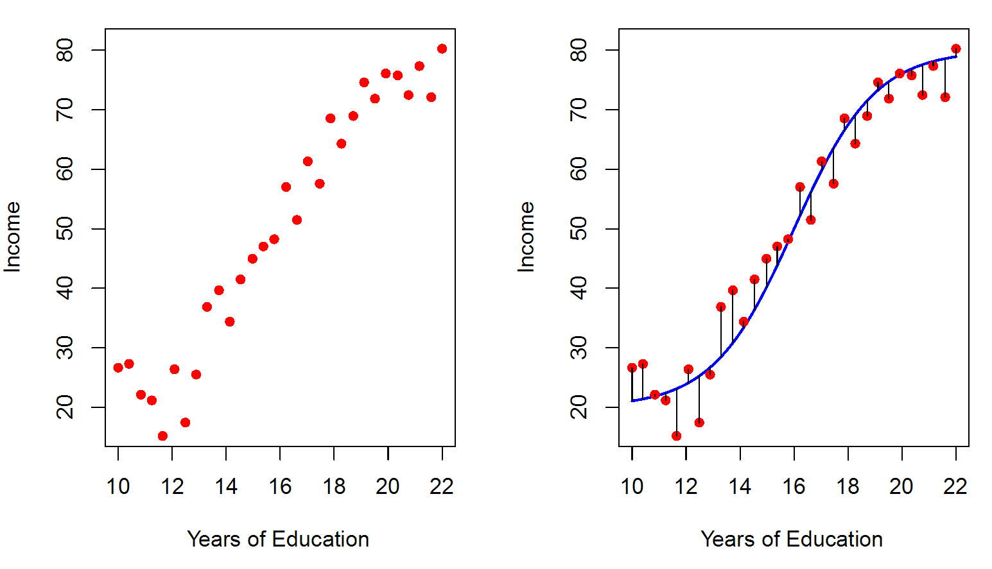
Predicting Income using Years of Education
The red dots are the observed values of income (in tens of thousand dollars)
The years of education for 30 simulated individuals
Individual | Years of Education | Income
1 | 10 | 15
2 | 16 | 55
3 | 20 | 70
Simulated data for 30 individuals
Figure: Relationship between years of education and income

Slide 14
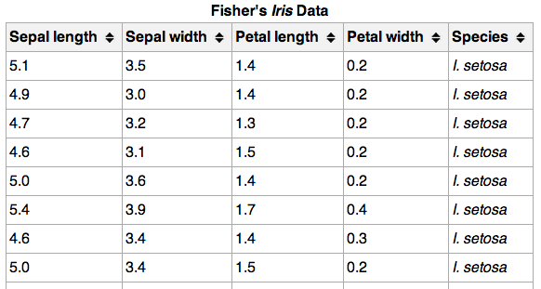
Machine Learning Terminology
}
150 observations
(n = 150)
{
Feature matrix “X” has n rows and p columns
Response “y” is a vector with length n
{
Response/target
4 features (p = 4)

Slide 15
Machine Learning Terminology
Observations are also known as: samples, examples, instances, records
Features are also known as: predictors, independent variables, inputs, regressors, covariates, attributes
Response is also known as: outcome, label, target, dependent variable
Regression problems have a continuous response. Classification problems have a categorical response. The type of supervised learning problem has nothing to do with the features!

Slide 16
Input and Output Variables
Outcome Variables (Dependent): The ones that we are interested to predict.
Income
Sales
Input Variables(Independent): The ones that we use to predict the outcome of interest.
TV, Radio, Newspaper
Years of Education

Slide 17
Example 1 - Input and Output Variables
Figure: The Advertising data set. The plot displays sales, in thousands of units, as a function of TV, radio, and newspaper budgets, in thousands of dollars, for 200 different markets. In each plot we show the simple least squares fit of sales to that variable, as described in Chapter 3. In other words, each blue line represents a simple model that can be used to predict sales using TV, radio, and newspaper, respectively.

Slide 18
Example 2 - Input and Output Variables
The red dots are the observed values of income (in tens of thousand dollars)
The years of education for 30 simulated individuals
Individual | Years of Education | Income
1 | 10 | 15
2 | 16 | 55
3 | 20 | 70
Simulated data for 30 individuals
Figure: Relationship between years of education and income

Slide 19
Input and Output Variables Notations
In general, we denote the outcome variable as Y
And the predictor variables as X1, X2, … and so on.

Slide 20
Mathematical Formulation of Relationship between Input and Output Variables
The observed outcome/response variable Y and different predictors X1, X2,… Xp
The functional relationship between them is expressed as
Y = f(x) + e
Here, f is an unknown function of the input variables, and the e is the random error term.

Slide 21
Types of Machine Learning
Unsupervised Learning
Evaluation Metrics
Supervised Learning

Slide 22
Supervised Learning
Supervised learning (aka “predictive modeling”):
Predict an outcome based on input data
Example: predict whether an email is spam or ham
Goal is “generalization”

Slide 23
Supervised Learning
There are two categories of supervised learning:
Regression
Outcome we are trying to predict is continuous
Examples: price, blood pressure
Classification
Outcome we are trying to predict is categorical (values in a finite set)
Examples: spam/ham, cancer class of tissue sample

Slide 24
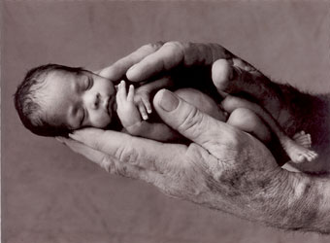
Regression or Classification?
Problem: Children born prematurely are at high risk of developing infections, many of which are not detected until after the baby is sick
Goal: Detect subtle patterns in the data that predicts infection before it occurs
Data: 16 vital signs such as heart rate, respiration rate, blood pressure, etc…
Impact: Model can predict the onset of infection 24 hours before the traditional symptoms of infection appear
Image: http://www.babycaretips4u.com/wp-content/uploads/2014/03/premature-baby.jpg;
Case Study: http://www.amazon.com/Big-Data-Revolution-Transform-Think/dp/0544002695

Slide 25
How does Supervised Learning Work?
How does supervised learning “work”?
Train a machine learning model using labeled data
“Labeled data” is data with a response variable
“Machine learning model” learns the relationship between the features and the response
Make predictions on new data for which the response is unknown
The primary goal of supervised learning is to build a model that “generalizes”: It accurately predicts the future rather than the past!

Slide 26
Supervised Learning Examples
Aiming to predict diagnosis, e.g.,
Interpretation of electrocardiogram
Detection of abnormalities on chest x-ray
Estimating risk, e.g., Framingham Risk Score (Kengne, 2014)
Predicting risk of coronary heart disease
Being extended to look at newer available risk factors, e.g., genomic variants
Notes:
Let's look at some examples of supervised learning. A common application of supervised learning has the aim of predicting a clinical diagnosis from a training data set. For example, we might process the waves of an electrocardiogram in an effort to interpret them with the goal of learning to make a diagnosis.
Another relatively common supervised learning task is the detection of abnormalities on a chest x-ray.
A more specific example of supervised learning is the estimation of risk that comes from large data sets such as the Framingham Heart Study. The risk score from the Framingham study aims to predict the risk of coronary heart disease for an individual.
As new types of data become available, the risk score models can be extended to include these new types of data, such as variants in the human genome.

Slide 27
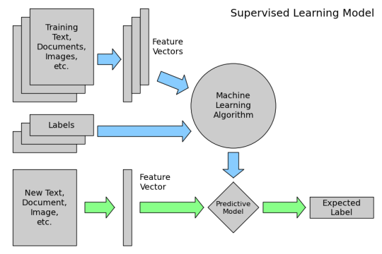
How does Supervised Learning Work?
How does supervised learning “work”?

Slide 28
Unsupervised Learning
Unsupervised learning:
Extracting structure from data
Example: segment grocery store shoppers into “clusters” that exhibit similar behaviors
Goal is “representation”

Slide 29
Unsupervised Learning
Common types of unsupervised learning:
Clustering: group “similar” data points together
Dimensionality Reduction: reduce the dimensionality of a dataset by extracting features that capture most of the variance in the data

Slide 30
Unsupervised Learning
Unsupervised learning example: Coin clustering
Observations: Coins
Features: Size and mass
Response: There isn’t one (no hand-labeling required!)
Perform unsupervised learning
Cluster the coins based on “similarity”
You’re done!
Sometimes, unsupervised learning is used as a “preprocessing” step for supervised learning. (How?)

Slide 31
Unsupervised Learning Examples
Discovery of new attributes associated with diagnosis, treatment, or prognosis of disease
Example is genome-wide association studies (GWAS), where goal is to identify genome variants associated with disease (Atanasovska, 2015)
Forms basis for Precision Medicine Initiative (IOM, 2011; Collins, 2015)
Notes:
What about examples of unsupervised learning? A common use of unsupervised learning is the discovery of new attributes that may be associated with clinical questions such as diagnosis, treatment, or prognosis of disease.
An example of unsupervised learning is the genome-wide association study or GWAS (gee-wass), where the goal is to identify genome variants that might be associated with a particular disease. These types of investigations form the basis of precision medicine, where the goal is to identify causes and factors associated with a disease more precisely and develop more targeted treatments.

Slide 32
Tasks of Machine Learning
Classification: Predict class from a one or more elements of data
Regression: Predict numerical value from data
Clustering: Group items together
Density estimation: Find statistical values
Dimensionality reduction: Reduce many to few features
Notes:
There are a number of different tasks for which we use machine learning. One of the most common is classification, where we aim to predict the class from one or more elements of data.
There is also regression, where we aim to predict a numerical value from the data.
Another type of task is clustering, where we try to group various items together.
There is also density estimation, where we attempt to determine how well the data fit a model statistically.
Finally, there is dimensionality reduction, where we aim to take data sets of many dimensions and reduce them to fewer features for simplification or computational efficiency.

Slide 33
Approaches to Classification
k-Nearest Neighbors (kNN): Aim to find category having “closest” number of attributes
Naïve Bayes: Derive conditional probabilities that classify into categories
Support vector machines (SVMs): For binary classification, draw “line” that separates one category from others
Decision trees: Develop set of rules that classify into categories
Notes:
There are a number of approaches used in machine learning for classification. Some of the most common algorithms are listed here and are described in a general sense. There is a great deal of mathematics that underlie all of them, but we can understand them by looking at what they attempt to do overall.
One common approach is k-nearest neighbors or kNN, where we aim to find categories by determining the closest number of attributes as calculated via a distance measure. We then attempt to classify the data into categories by how closely they fit within each category.
Another approach is called Naïve Bayes. This uses Bayes’ Theorem, and we attempt to derive conditional probabilities that classify according to categories.
Another common approach is support vector machines or SVMs. These are used for binary classification and we attempt to model a line through the data that separates one category from the other using vector mathematics.
Finally, there are decision trees, where we attempt to develop a set of rules that enable us to work through a decision tree to classify elements into categories.

Slide 34
Approaches to Regression
Linear regression: Classic approach of predicting numerical value from data
Some techniques improve upon basic algorithm: locally weighted, ridge, and lasso
Logistic regression aims to classify into binary categories
Notes:
There are likewise a number of different approaches to regression.
Linear regression is a classical approach of predicting a numerical value from a set of data. There are various techniques that improve upon the basic algorithm of linear regression, such as locally weighted, ridge, and lasso techniques.
Another type of regression is logistic regression that's really more of a classification, in which we aim to classify data into binary categories.

Slide 35
Steps in Machine Learning
Collect data
Prepare input data – wrangle, clean
Analyze input data
(If supervised) Train algorithm
Test algorithm
Use algorithm
Notes:
What are the steps that we take in using machine learning? We begin by collecting the data, collecting the kind of data that we want to use for machine learning purposes.
We then have to prepare the input data in a way that it can be used by machine learning algorithms. This is sometimes called data wrangling, where we transform the data into formats that can be used for machine learning.
We also may need to clean the data because the source from which it comes may have other types of data in it and we want to clean the data so it can be used for input into our machine learning algorithms.
Next, we analyze the input data. If we are using supervised methods, we next train the algorithm using the kinds of supervised learning methods that we've already seen.
We then test the algorithm with test data that is different from the training data so we can determine if the algorithm is generalizable and not over-fitted.
Finally, we actually make use of the algorithm for the task for which we were planning to use it.

Slide 36









Predictive Modeling Pipeline
1.
Prediction Target
6. Performance Evaluation
2.
Cohort
Construction
5.
Predictive Model
3.
Feature
Construction
4.
Feature Selection

Slide 37
Important Concepts and Tools for Modern Machine Learning - 1
Big Data: Growing quantity of data defined by 4 Vs (Ward, 2014; Reed, 2015)
Volume: Sheer quantity continues to grow
Variety: Data of varying types, e.g., in medicine not only structured data but text, images, waves, video, etc.
Velocity: Generated increasingly quickly
Veracity: How do we know we can trust it?
Notes:
There are some other important concepts and tools for modern machine learning. We often hear the term Big Data. This is referring to the growing quantity of data that is available, although it is not just about the amount of data.
Big Data is defined usually by the 4 V’s. The first V is volume, and the sheer quantity continues to grow.
The next V is variety, meaning that we have many varying types of data, especially in medicine. This includes not only structured data, such as lab tests and prescriptions, but other types of data such as text, images, waves, video, and more.
Big Data is also characterized by velocity, in that it is generated continuously and comes at us quickly.
Finally, there is the issue of veracity, as we have to know that we can trust the data source.

Slide 38
Important Concepts and Tools for Modern Machine Learning - 2
MapReduce computing: Framework for distributing computer processing across many different machines, without dependency across machines
Hadoop: Open-source software framework for running MapReduce and other algorithms across machines on a network
Cloud/Web services: Computing infrastructure on Internet that can be used and purchased incrementally
Notes:
There are some other important concepts and tools in modern machine learning. One is MapReduce computing. MapReduce provides a framework for distributing computer processing across many different computers, including those across the Internet. This process is done so there is no dependency of the processing on one machine from another. This enables us to do processing in parallel on many different machines.
Hadoop is an open source software framework that allows the running of MapReduce and other algorithms that are widely distributed across computer networks, including those across the Internet.
We also may hear about cloud or web services, where there is a computing infrastructure on the Internet that can be used and purchased incrementally.

Slide 39
Lecture 10 – Summary
Machine learning is the field of computer science that studies how computers learn from data
The major types of machine learning are supervised and unsupervised learning
The major tasks of machine learning are classification, regression, clustering, density estimation, and dimensionality reduction
Notes:
This concludes lecture a of machine learning and natural language processing. In summarizing this lecture, we learned:
Machine learning is the field of computer science that studies how computers learn from data.
The major types of machine learning are supervised and unsupervised learning.
The major tasks of machine learning are classification, regression, clustering, density estimation, and dimensionality reduction.

Slide 40
Lecture 10 –References
Anonymous (2011). Toward Precision Medicine: Building a Knowledge Network for Biomedical Research and a New Taxonomy of Disease. Washington, DC, National Academies Press.
Brownlee, J. (2016, March 21). Overfitting and Underfitting Machine Learning Algorithms. Retrieved June 18, 2016, from http://machinelearningmastery.com/overfitting-and-underfitting-with-machine-learning-algorithms/
Cai, E. (2014, March 19). Machine Ling Lesson of the Day - Overfitting and Underfitting. Retrieved June 18, 2016, from https://chemicalstatistician.wordpress.com/2014/03/19/machine-learning-lesson-of-the-day-overfitting-and-underfitting/
Deo, RC (2015). Machine learning in medicine. Circulation. 132: 1920-1930.
Notes:
No Audio.

Slide 41
Lecture 10 –References
Collins, FS and Varmus, H (2015). A new initiative on precision medicine. New England Journal of Medicine. 372: 793-795.
Kengne, AP, Masconi, K, et al. (2014). Risk predictive modelling for diabetes and cardiovascular disease. Critical Reviews in Clinical Laboratory Sciences. 51: 1-12.
Atanasovska, B, Kumar, K, et al. (2015). GWAS as a driver of gene discovery in cardiometabolic diseases. Trends in Endocrinology and Metabolism. 26: 722-732.
Reed, DA and Dongarra, J (2015). Exascale computing and big data. Communications of the ACM. 58(7): 56-68.
Ward, JS and Barker, A (2014). Undefined by data: a survey of big data definitions. Databases (cs.DB), http://arxiv.org/abs/1309.5821
Notes:
No Audio.

