Slide 1
FOUNDATIONS OF HEALTH DATA SCIENCE
Course Overview
Md. Jubayer Hossain
cBLAST, University of Dhaka
https://hossainlab.github.io/

Slide 2
Center for Health Data Science (HeaDS)
The mission of the Center is to strengthen health data science within the Faculty:
Active and visible hub for Health Data Science
Providing data science support for researchers at SUND
Courses, workshops and training environments to improve data science skills
Support a network of researchers and educators
Notes:
Before starting the day, I would like to spend 2 minutes to introduce you to the Center for Health Data Science (HeaDS)

Slide 3

WHAT IS DATA SCIENCE?

Slide 4
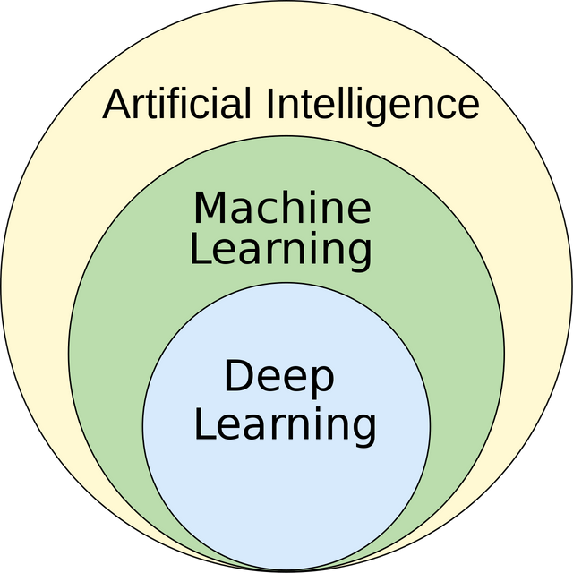
WHAT DO THE WORDS MEAN?
Machine Learning:
"Technologies and algorithms that enable systems to identify patterns, make decisions, and improve themselves through experience and data" [1]
Machine learning is methodology.
Currently our most successful way of achieving AI
1. https://ai.engineering.columbia.edu/ai-vs-machine-learning/
Notes:
ML is more about development of tools that enable computer to do these human-like performances
DS is more about everything related to data

