Slide 1

Final Year Project Proposal
Academic year 2025-26 Batch - A13

Slide 2

Project Title :
An Explainable Multi-Agent Framework for Patient-Centric Medical Report Understanding and Recommendation
Team Members | Roll Number
Ch.Venkata Lakshmi Vardhan | AV.EN.U4AIE22006
Venkata Chiranjeevi Segu | AV.EN.U4AIE22036
A.Venkata Sai Harshendra | AV.EN.U4AIE22059
Team Mentor : Dr. Sathya Rajendra Singh .R

Slide 3
About Our Previous Project & Paper
Paper Title: Multi-Modal Few-Shot Anomaly Detection in Medical Imaging using Meta-Learning and Vision-Language Models
Conference: 1st International Conference on Advanced Trends in Engineering and Emerging Technologies (ICATEET-2026)
Submission Status:
Article submitted during previous academic semester
Underwent peer-review process
Accepted for presentation and We have gave presentation also & Currently waiting for Approval.
Evidence Provided:
Official confirmation email from conference organizers(In below Page)
Paper ID (AI-041)

Slide 4
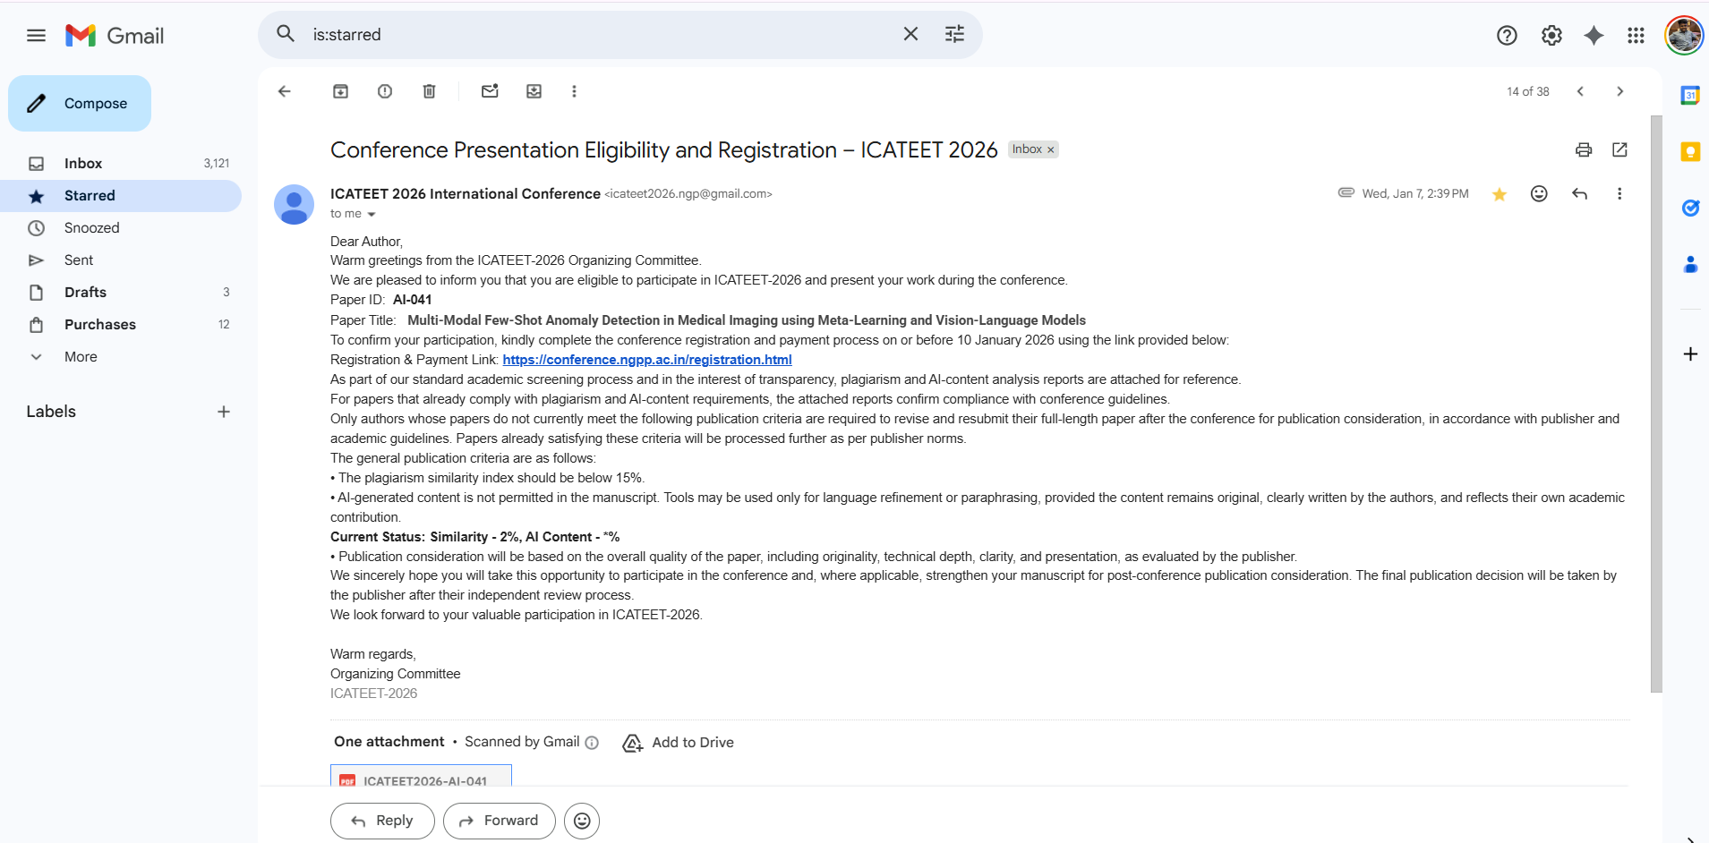
About Our Previous Project & Paper

Slide 5
The Problem & Our Solution
The Challenge: Patients receive medical reports that are difficult to understand due to complex terminology and lack of clear, patient-focused explanations.
Our Goal: To enable patients to understand their medical reports clearly and safely before consulting a healthcare professional.
Our Solution: An explainable multi-agent AI system that analyzes real medical reports and provides patient-centric disease explanations with justified, non-diagnostic recommendations.

Slide 6
Introduction
Medical reports are primarily written for clinicians and often contain complex terminology that limits patient understanding.
Existing AI approaches mainly focus on summarization and do not guarantee meaningful patient comprehension.
Summarization ≠ Understanding There is no system that explicitly models disease explanation and patient-safe recommendations using a structured, explainable, and verifiable AI framework.
Single-model systems lack transparency and fail to separate explanation, reasoning, and recommendation generation.
Patient-centric healthcare requires interpretable, safe, and trustworthy AI systems that support—not replace—doctors.
This project proposes an explainable multi-agent AI framework to transform medical reports into clear disease explanations and justified recommendations for patients.

Slide 7
Datasets
Dataset | Modality / Content | Purpose in Project
MIMIC-III (public, de-identified clinical dataset from PhysioNet). | Textual clinical data, primarily discharge summaries and related medical notes. | • Used as real-world input to evaluate the system’s ability to explain medical reports and generate safe, justified recommendations for patients.
MIMIC-III Discharge Summaries
20 real cases used
ICD diagnosis context integrated

Slide 8
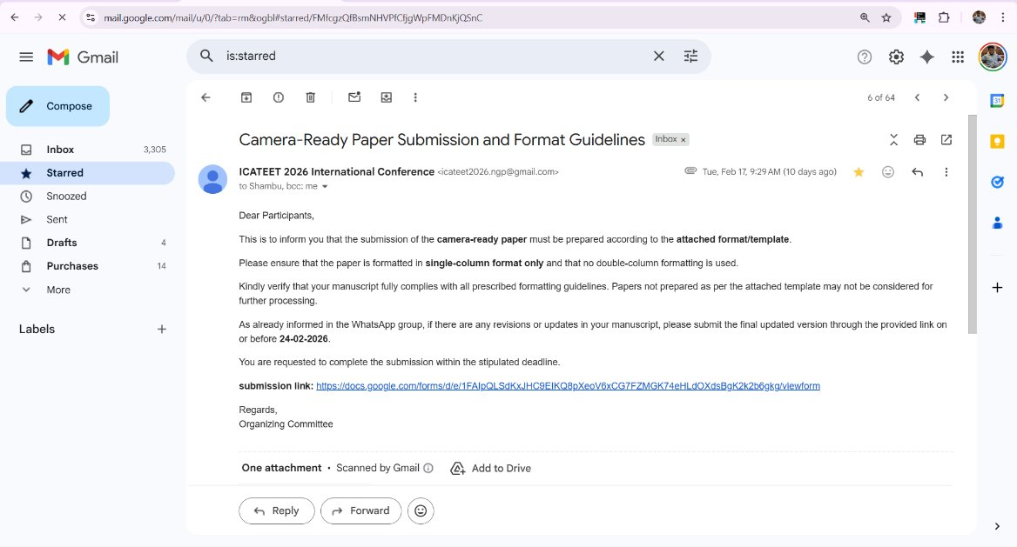
Cuurent Status of Paper​
https://drive.google.com/file/d/1era1AFO4LZJbRnPwYR7FepaF9u69FSI0/view?usp=sharing

Slide 9
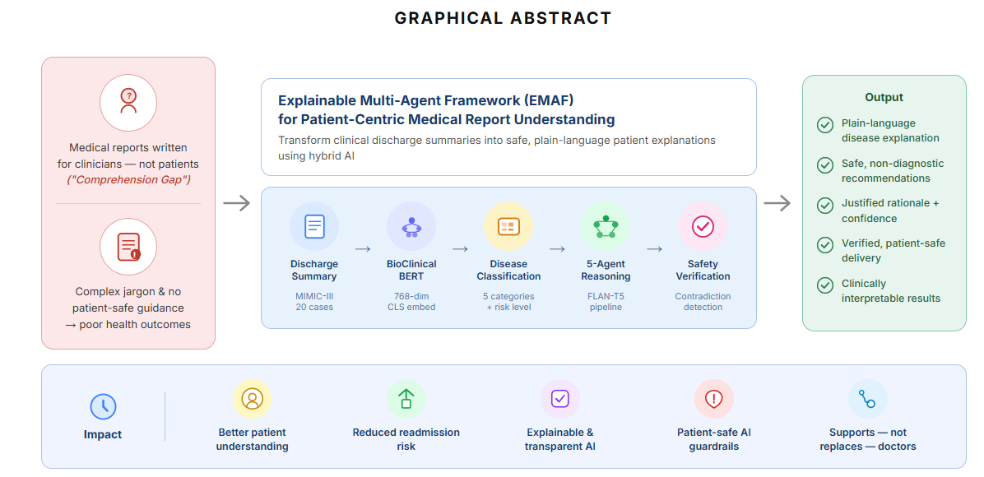

Slide 10
Literature Survey
Title | Authors | Methodology | Key Results | Research Gap
Summarizing Medical Documents with Pretrained Transformers (EMNLP 2020) | Zhang et al. | Transformer-based abstractive summarization for clinical notes | Improved clinical summarization quality | Focus only on summarization; no risk modeling, no patient-safe recommendation
BioClinicalBERT: Clinical Language Model Pretrained on MIMIC-III (2019) | Alsentzer et al. | BERT pretrained on MIMIC-III clinical notes | Strong performance on clinical classification tasks | No patient explanation; no reasoning layer; not generative
ClinicalBERT for ICD Code Prediction (ACL Clinical NLP 2019) | Huang et al. | Fine-tuned BERT for ICD multi-label classification | Improved readability scores | No explainability; no safety validation; purely predictive

Slide 11
Literature Survey
Large Language Models Encode Clinical Knowledge (Nature 2023, Med-PaLM) | Singhal et al. | Instruction-tuned LLM for medical QA | High clinical QA performance | Monolithic model; lacks structured guardrails; no modular safety verification
Multiagent AI Systems in Health Care (NIH, 2024) | Borkowski & Ben-Ari | Conceptual multi-agent healthcare framework | Describes future architecture possibilities | Conceptual only; no real implementation; no patient readability evaluation
Simplifying Clinical Text for Patients (NAACL 2021) | Devaraj et al. | Text simplification for patient readability | Improved readability scores | Simplification ≠ structured reasoning; no risk modeling; no recommendation layer

Slide 12
Key Novel Contributions
Disease explanation as a first-class output, not an afterthought
Separation of explanation and recommendation reasoning
Justification and limitation-aware recommendations
Ethical, dataset-driven deployment using real clinical data

Slide 13
Proposed Solution
Hybrid Multi-Agent System with:
Clinical grounding (BioClinicalBERT)
Structured classification
Instruction-controlled reasoning (FLAN-T5)
Safety verification layer

Slide 14
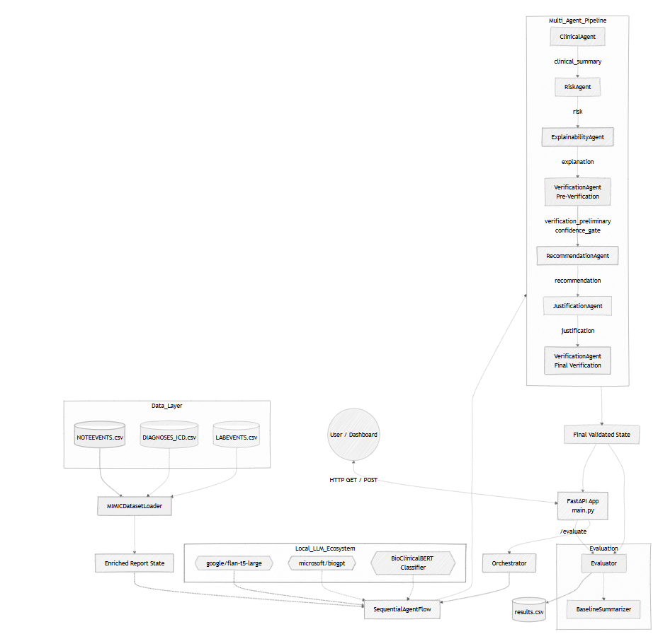
Architecture Diagram
Raw Report ↓ BioClinicalBERT ↓ Classification Head ↓ Risk Agent ↓ Explainability Agent ↓ Recommendation Agent ↓ Justification Agent ↓ Verification Agent

Slide 15
Process Flow
Clinical Classification Layer (BioClinicalBERT)
Model: BioClinicalBERT (MIMIC-III trained)
Process:
Discharge Summary → Tokenization
CLS embedding extraction (768-dim representation)
Linear Classification Head
Softmax Output → Disease Category
Categories:
Cardiovascular, Respiratory, Endocrine, Infectious, Neurological
Purpose: Convert unstructured clinical text into structured disease signals.

Slide 16
Process Flow
Multi-Agent Reasoning Layer (FLAN-T5)
Risk Agent
Assigns Low / Medium / High risk with structured reasoning.
Explainability Agent
Translates clinical findings into simple patient-friendly language.
Recommendation Agent
Generates safe, non-diagnostic next steps.
Justification Agent
Explains rationale + confidence + limitations.
Verification Agent
Detects contradictions and unsafe outputs.

Slide 17
Metrics We Use:
Clinical Classification Performance(Model: BioClinicalBERT + Linear Head):
Precision, Recall, F1 Score
Purpose: Measures disease category prediction accuracy.
Readability & Summarization Quality
Original FKGL, Agent FKGL, Length Reduction
Purpose: Shows improved patient readability without excessive compression.
Information Preservation
QA-Based Accuracy, Information Coverage
Purpose :Demonstrates preservation of key diagnoses and findings compared to baseline single-prompt system.

Slide 18
Key Contributions
Hybrid architecture
Domain-grounded classification
Multi-agent safety design
Quantitative validation
Reproducible pipeline

Slide 19
Conclusion
Developed a hybrid clinical–reasoning architecture combining BioClinicalBERT and FLAN-T5.
Achieved improved readability of medical reports while preserving essential clinical information.
Generated patient-safe, non-diagnostic recommendations through structured guardrails.
Demonstrated measurable clinical classification performance using supervised evaluation (Precision / Recall / F1).
Designed a modular and interpretable multi-agent framework enabling safety validation and component-level evaluation.
The system bridges the gap between clinical language complexity and patient understanding, while maintaining safety and quantitative validation.

Slide 20
References
https://aclanthology.org/2020.emnlp-main.449/
https://arxiv.org/abs/1904.05342
https://aclanthology.org/W19-1909/
https://www.nature.com/articles/s41586-023-06291-2
https://pmc.ncbi.nlm.nih.gov/articles/PMC12360800/
https://aclanthology.org/2021.naacl-main.371/

Slide 21

THANK YOU

