Slide 1
SUSTAINOVATION - 2025 Track: Clean Water PROJECT: AquaSathi
AI-Powered Water Quality Advisor for Elderly & Specially-Abled
TEAM LEADER: DABBETI CHIRANJEVI TEAM MEMBER: MATETI REETHUSRI

Slide 2
The Problem Statement
Elderly and specially-abled individuals face challenges in accessing clean drinking water.
Manual water testing is complex and inaccessible.
Unawareness about filter condition and unsafe water usage is widespread.
Leads to severe health risks, especially in rural and underserved areas.

Slide 3
Our Solution – AquaSathi
An AI-powered assistant to assess and advise on water quality using simple input.
Voice-based and text-based suggestions for ease of use.
No hardware dependency – works standalone via browser/app.
Stores logs and provides filter change alerts.

Slide 4
How It Works
Step 1: User inputs basic water parameters – TDS, pH, Turbidity.
Step 2: ML model predicts if water is safe/unsafe.
Step 3: System advises – Boil, Use Filter, Replace Cartridge, etc.
Step 4: Voice alerts for elderly users + visual UI for accessibility.

Slide 5
Features at a Glance
✔ Manual or file-based data input.
✔ AI/ML classification of water safety.
✔ Accessibility-first design with large UI, voice prompts.
✔ PWA-compatible lightweight web interface.
✔ Historical tracking and alerts for filter change.

Slide 6
Machine Learning Component
Dataset: WHO + Kaggle water quality datasets.
Algorithm: Logistic Regression + Random Forest for comparison.
Features: pH, TDS, turbidity, temperature.
Accuracy: ~90% in cross-validation.
Supports real-time prediction on low-end systems.

Slide 7
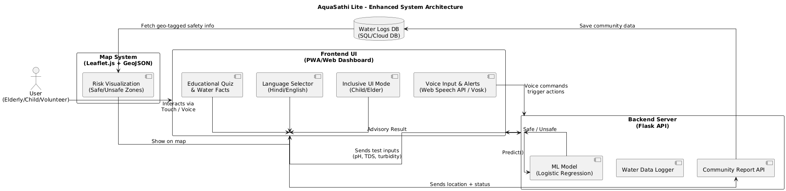
AquaSathi System Architecture

Slide 8
Technology Stack
Frontend: HTML, CSS, Bootstrap, JavaScript.
Backend: Python, Flask (REST APIs).
ML: Scikit-learn, Pandas, NumPy.
Voice Alerts: Web Speech API integration.
Database: SQLite / Firebase (optional).
Deployment: Render / Vercel / GitHub Pages.

Slide 9
Future Enhancements
IoT Integration: ESP32 + TDS/pH sensors.
Community dashboard for collective water safety alerts.
Multilingual voice guidance for better inclusivity.
Filter lifespan prediction using advanced ML.
Android version for mobile accessibility.

Slide 10
Future Enhancements
Voice command interaction for elderly and low-literacy users.
Crowdsourced water safety map using community inputs.
Inclusive UI mode for children and elderly (simplified, visual, audio).
Gamified educational module for kids: clean water awareness.
Multilingual support: English + Hindi interface.

Slide 11
1.Voice Command Feature
Allows users to interact using phrases like 'Check water quality'.
Built using Python SpeechRecognition and Vosk for offline use.
Improves accessibility for visually impaired or elderly users.
Also supports audio feedback (text-to-speech).

Slide 12
2.Crowdsourced Water Safety Map
Each user's water quality result is tagged with location data.
Map visualizes Safe / Unsafe zones using Leaflet.js.
Encourages community involvement in real-time water reporting.
Helps NGOs or health officials spot potential contamination clusters.

Slide 13
3.Inclusive UI Mode
Child/Elder toggle simplifies the interface.
Larger icons, minimal steps, visual and audio guidance.
Voice prompts help non-tech users complete actions.
Accessible on mobile, tablet, and desktops.

Slide 14
4.Educational & Gamified Mode
Includes interactive water safety quiz for children.
Animated facts and tips about water pollution and health.
Promotes awareness among younger users.
Easy to embed within the existing web interface.

Slide 15
5.Multilingual Support
Supports English and Hindi – toggle option in UI.
Simplified translations for action buttons and alerts.
Important for rural adoption and inclusive communication.
Scalable to add more languages in future versions.

Slide 16
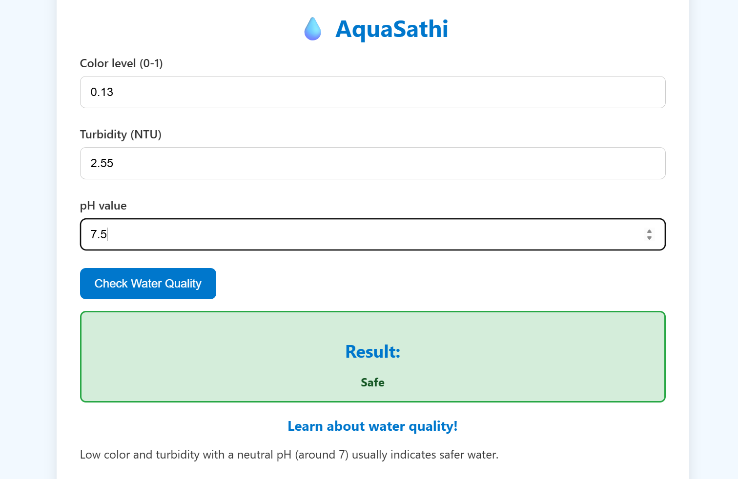
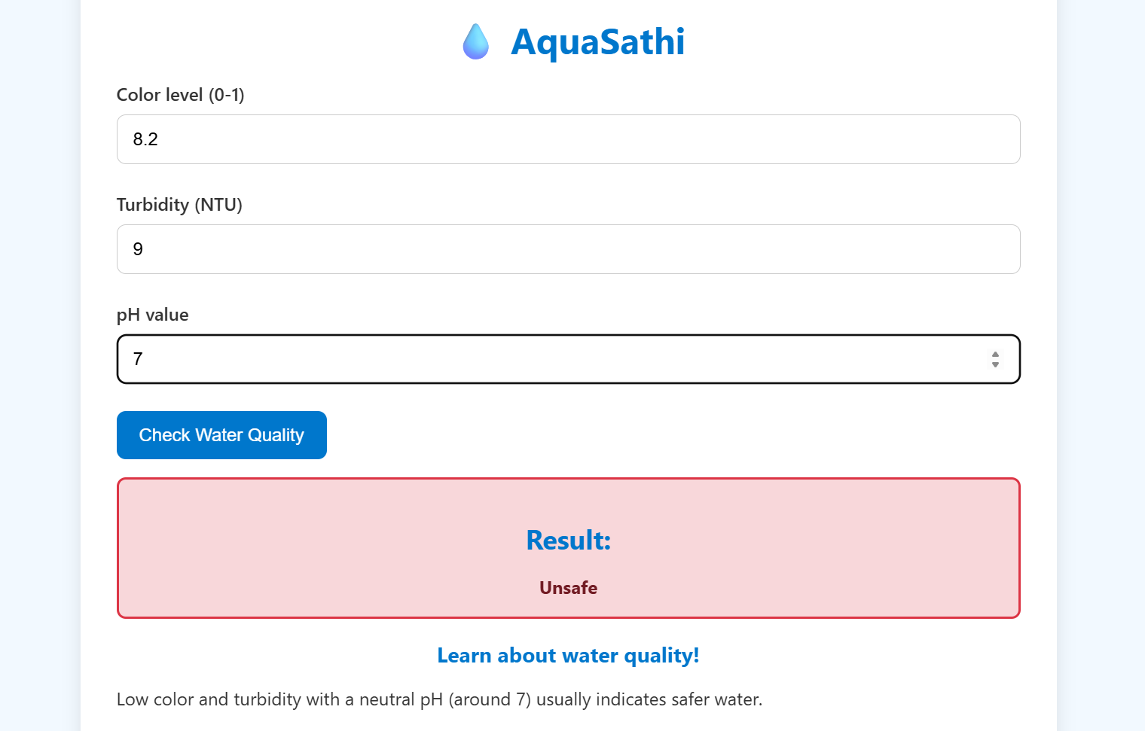
SAMPLE UI

Slide 17
Real-World Impact
Empowers vulnerable groups to monitor water independently.
Prevents chronic exposure to unsafe water.
Enhances trust in existing purifier infrastructure.
Can be deployed in rural health centers and smart villages.
Bridges the tech gap in water safety awareness.

Slide 18
Thank You
Project: AquaSathi – AI-Powered Water Advisor.
Email: chiranjevidabbeti@gmail.com
GitHub : https://github.com/chiranjevi123/AquaSathi.git.

