Slide 1
Poisson Cluster Process: Bridging the Gap Between PPP and 3GPP HetNet Models
Harpreet S. Dhillon, Ph.D.
Joint work with Chiranjib Saha and Mehrnaz Afshang
Wireless @ Virginia Tech
Blacksburg, VA

Slide 2













HetNet: Different Components
Small cell
Serving Link
Pico BS
Macro cell
User
Macro BS
HetNet with different BSs and coverage regions

Slide 3


PPP Model of HetNets
BSs of different tiers (macro and small cells) and users are modeled as homogeneous Poisson point process (PPP) over .
The statistics of at the origin is computed.
Due to stationarity, this result is used to characterize coverage probability of a typical user of the network.
Point for SBS
Point for Macro BS
A Two-tier Baseline HetNet Model

Slide 4

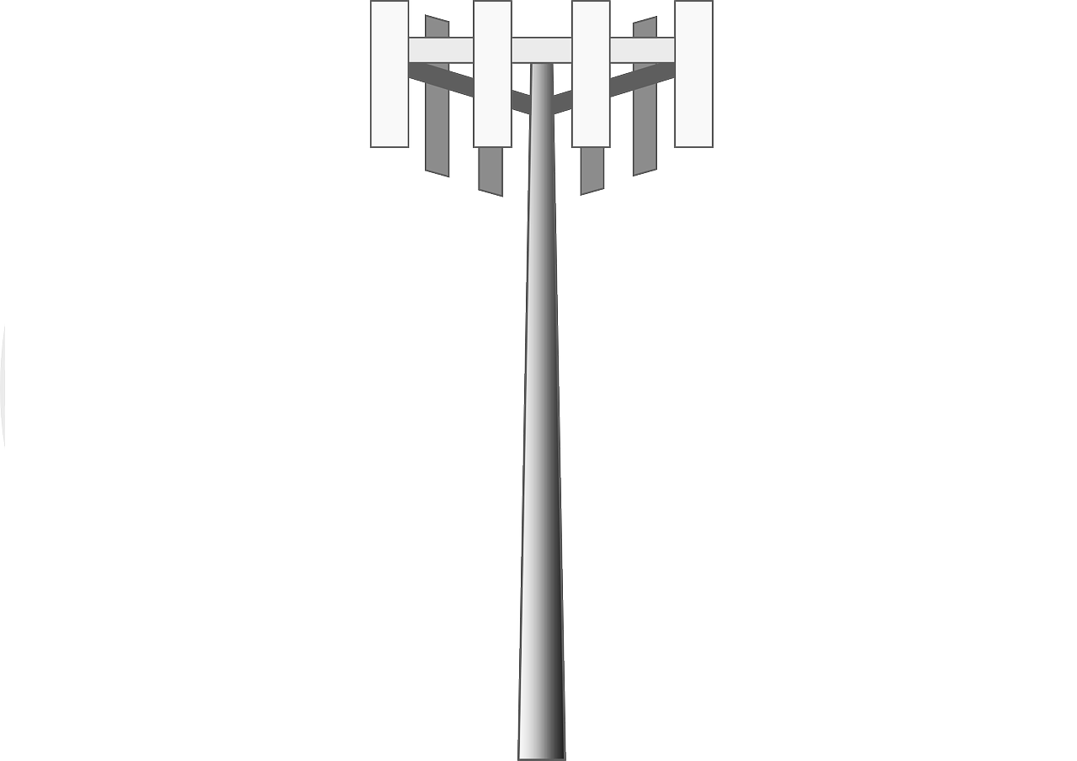


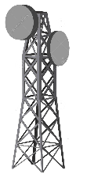





PPP Model: How far from actual HetNet?
Macro BS
Pico BS
Users in residential complex
User Hotspot
Femto BS
A Simple Illustration of HetNet

Slide 5
PPP Model: How far from actual HetNet?
Key components missing in the baseline PP model:
Non-uniformity in user distribution:
Modeling all users as an independent PPP is not realistic.
Fraction of users form spatial clusters (Hotspots), e.g. users in public places and residential areas.
Correlation between small cell BS (SBS) and user location:
Operators deploy pico BSs at higher density at user hotspot.
Users install their own femto BSs.
Inter and Intra BS-tier Dependence: *
BS locations are not necessarily independent.
Site planning for deploying BSs introduces correlation in BS locations.
* N. Deng, W. Zhou, and M. Haenggi, “Heterogeneous cellular network models with dependence,” IEEE JSAC, 2015.

Slide 6

3GPP Models: User Distribution
3GPP considers different configurations of SBSs and users in HetNet simulation model.
Users “uniform” across macro cells
Users “non-uniform” across macro cells
Users forming clusters within a disc
User Configurations in 3GPP HetNet Model

Slide 7

3GPP Model: SBS Distribution
SBSs deployed at higher density at certain areas (indoor models)
SBSs deployed randomly or under some site planning.
SBSs at the center of user hotspot.
SBS Configurations in 3GPP HetNet Model

Slide 8

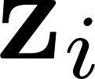

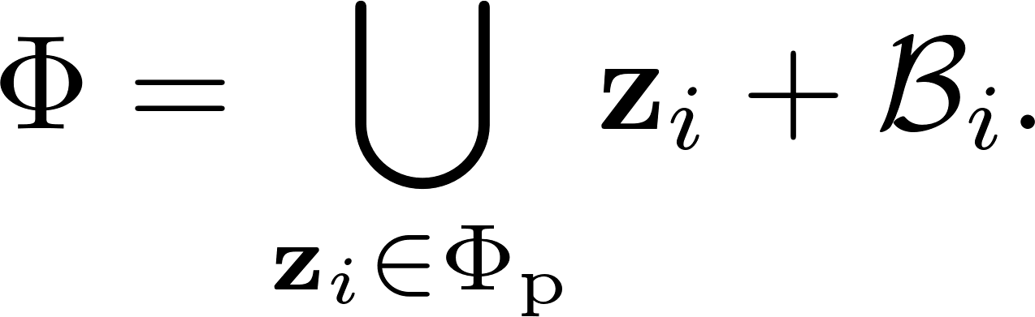


How can PCP enhance HetNet Model?
Poisson Cluster Process (PCP) is more appropriate abstraction for user and BS distributions considered by 3GPP.
Definition: Poisson Cluster Process (PCP)
A PCP is generated from a PPP called the Parent PPP, by replacing each point by a finite offspring point process where each point is independently and identically distributed around origin.
Definition: Matern Cluster Process
Each point in is uniformly distributed inside disc of radius centered at origin.
Matern Cluster Process: An example of PCP

Slide 9
PCP Based HetNet Models
New HetNet models with combination of PPP and PCP have closer resemblance to 3GPP HetNet models.
Model 1: Users PPP, BSs PPP (Baseline)
Model 3: Users PCP, BSs PCP
Model 2: Users PCP, BSs PPP
Model 4: Users PPP, BSs PCP

Slide 10
Unified HetNet Model: PCP meets PPP
We consider K tier HetNet with two sets of BS PPs:
K₁ BS tiers are modeled as independent PPPs.
K₂ BS tiers are modeled as independent PCPs.
User Distribution:
Users can be independent PPP.
Users can be a PCP correlated with the BS distribution.
For this setup, we derive coverage probability.
Models 1-4 appear as special cases of this unified framework.

Slide 11
User Association: Max SIR and Max Power
Two types of cell association are considered.
Max Power: Connect to the BS providing maximum average received power.
Contact and Nearest distance distributions of PCP and PPP are the key components of analysis*.
Max SIR: Connect to the BS providing maximum instantaneous SIR (assuming interference limited network).
The analysis is well-known for the Baseline model **.
We generalize this approach to enable coverage analysis for the proposed Unified Model.
* M. Afshang, C. Saha, and H. S. Dhillon, “Nearest-Neighbor and Contact Distance Distributions for Thomas Cluster Process”, IEEE Wireless Commun. Letters, 2016.
** H. S. Dhillon, R. K. Ganti, F. Baccelli, and J. G. Andrews, “Modeling and analysis of K-tier downlink heterogeneous cellular networks,” IEEE Journal on Sel. Areas in Commun., 2012.

Slide 12



Construction of 0th tier
If the users are PCP, the user PP is correlated with one BS PPP .
Correlation can be handled by constructing the 0th tier ( ).
If users are clustered around which is a PPP, is only the BS of at cluster center (z) of the typical user.
If users same parent PPP of which is a PCP, is the set of BSs in belonging to the same cluster center (z) of the typical user.

Slide 13


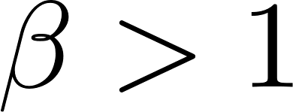

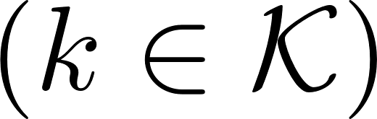
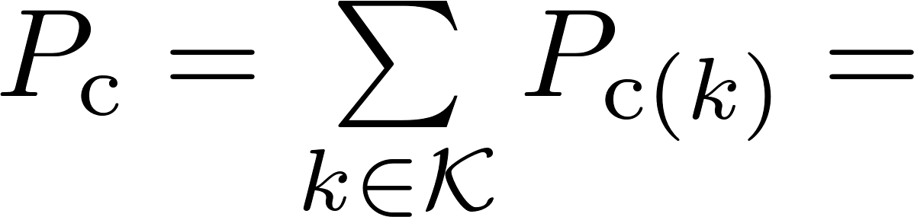
Coverage Probability
Coverage probability, or equivalently CCDF of SIR , is:
For , can be expressed as sum of probability that serving BS belongs to .
where is the interference from all BSs in .

Slide 14
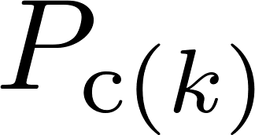
Coverage Probability
By Rayleigh fading assumption
Taking expectation with respect to fading
: Per-tier Coverage

Slide 15
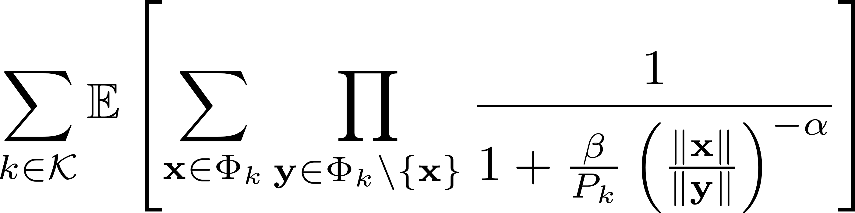
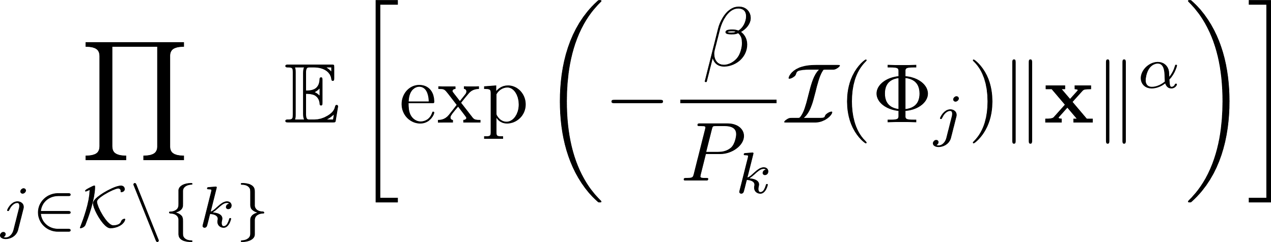
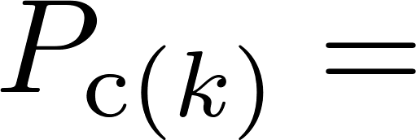

Coverage Probability
This term belongs to a general family of functional over point processes called sum-product functional.
Can be expressed in terms of probability generating functional (PGFL) of .

Slide 16

Sum-Product Functional
Definition
We define Sum-product functional of a point process can be defined as:
where and are measurable.
There are more general versions of Sum-product functional *.
There will be different expressions of the sum-product functional depending on .
* U. Schilcher, S. Toumpis, M. Haenggi, A. Crismani, G. Brandner and C. Bettstetter, “Interference Functionals in Poisson Networks," in IEEE Trans. Inf. Theory, Jan. 2016.

Slide 17

Sum product functional
We require sum-product functional of when:
The third case occurs when the users are modeled as PCP having same parent PPP as that of some PCP distributed BS tier.
Has to be evaluated separately as is a finite PP.
Case 1:
is PPP
Campbell-Mecke Theorem can be applied to evaluate sum-product functional.
Case 2:
is PCP
Case 3:

Slide 18
Sum product functional: PPP
Lemma 1:
The sum product functional of when is a PPP can be expressed as follows:
where is the mean measure of , denotes the PGFL of .
H. S. Dhillon, R. K. Ganti, F. Baccelli, and J. G. Andrews, “Modeling and analysis of K-tier downlink heterogeneous cellular networks,” IEEE JSAC, 2012.

Slide 19
Sum product functional: PCP
In PCP, selecting a point from x implies selecting a tuple (x, z), where z is the cluster center of x.
Lemma 2:
The sum product functional of when is a PCP can be expressed as follows:
with
denotes PGFL of with respect to its reduced Palm distribution.

Slide 20
Sum product functional: A special Case
Conditioning on the number of offspring points is the key to the analysis of sum product functional of finite PP , i.e., BSs in belonging to the same cluster center of the typical user.
Lemma 3:
The sum product functional of when is a cluster of a randomly chosen point
of can be expressed as follows:

Slide 21
Results: Model 1 Vs. Model 2
Increasing cluster radius: 20:10:40
In Model 2, the coverage probability decreases as cluster radius increases and shifts towards that of Model 1.

Slide 22
Results: Models 1,3 and 4
Increasing cluster radius: 20:10:40
Increasing cluster radius: 20:10:40
Increasing cluster radius has a conflicting effect on coverage probability of Model 3 and 4: coverage probability of Model 4 increases whereas that of Model 3 decreases.

Slide 23
Conclusive Remarks
We propose a unified framework for modeling K-tier HetNet.
Derived coverage probability for this model under max-SIR connectivity.
Sum-product functionals for PCP and finite point processes were derived as key components of analysis.
Special cases of the Model closely resemble BS and user configurations in 3GPP simulations of HetNet.
Future Directions:
Rate analysis
Incorporation of shadowing and general channel models
Extension to uplink
Developing unified framework for Max-power association
Modeling spatial separation of BSs *
* M. Afshang and H. S. Dhillon, “Spatial modeling of device-to-device networks: Poisson cluster process meets Poisson
hole process,” in Proc., IEEE Asilomar, Nov. 2015,

Slide 24
Relevant Publications
M. Afshang, H. S. Dhillon, “Poisson Cluster Process Based Analysis of HetNets with Correlated User and Base Station Locations”, submitted, Available online: arxiv.org/abs/1612.07285
C. Saha, M. Afshang, H. S. Dhillon, “Enriched K-Tier HetNet Model to Enable the Analysis of User-Centric Small Cell Deployments”, IEEE Trans. on Wireless Commun., 2017.
M. Afshang, C. Saha, and H. S. Dhillon, “Nearest-Neighbor and Contact Distance Distributions for Thomas Cluster Process”, IEEE Wireless Commun. Letters, 2016.
M. Afshang, H. S. Dhillon, and P. H. J. Chong , “Modeling and Analysis of Clustered Device-to-Device Networks” IEEE Trans. on Wireless Commun., 2016.
M. Afshang, H. S. Dhillon, and P. H. J. Chong, “Fundamentals of Cluster-Centric Content Placement in Cache-Enabled Device-to-Device Networks ” IEEE Trans. on Commun.,2016.

Slide 25
Thank You for Your Attention
Harpreet S. Dhillon, Ph.D.
Wireless@VT, Bradley Department of ECE
Virginia Tech, Blacksburg, VA
http://www.dhillon.ece.vt.edu

Slide 26
Coverage Probability
By assumption
By Rayleigh assumption
Sum product functional is the key to the derivation of coverage

Slide 27
Sum product functional: A special Case
In order to model the correlation between user and BS, the sum product functional of the cluster within which user is located should be handled separately.
Lemma 3:
The sum product functional of when is a cluster of a randomly chosen point
of can be expressed as follows:

