Slide 1
Indoor Scene Classification
Intro to Computer Vision : Final Project presentation
By - Chirantan Ghosh

Slide 2
Overview
Indoor Scene Classification: Problem
Additional Background
Data
Methodology
Results

Slide 3
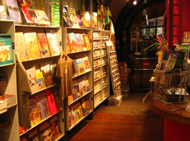
What do we mean by indoor scene classification?
Given an image taken indoors, how do we identify the type of location?
This is a hard problem { even for humans!

Slide 4
A More Formal Definition
An indoor scene is the abstract of various semantic cues which include multiple objects of which classes are open-set and contextual relationships between them." - Li et al, 2019
Given a set of images X, learn mapping f : X -> Y , Y = {0,1}^n
Example: You see an image that contains a bookshelf. Is it in a library, a home office, a living room, a restaurant? How do we know by looking at a picture?

Slide 5
Why should we care about indoor scene classification?
Autonomous navigation
Localization of criminal activity
Understanding user behavior in different physical settings
Advertising and marketing

Slide 6
What has been done?
Szummer & Picard, 1998, kNN + MSAR
Payne & Singh, 2005, Benchmarking, Data Requirements
Quattoni & Torralba, 2009 (CVPR09), Dataset, ElasticNet, Multiclass
And then come CNNs!

Slide 7
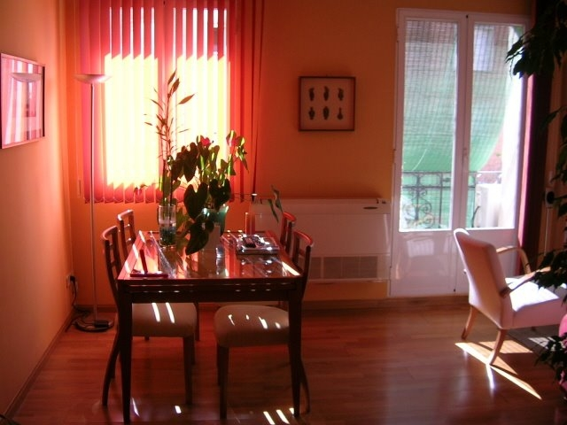
Data: CVPR09
The CVPR09 dataset contains 67 Indoor categories with a total of 15620 images.
The number of images varies across categories, with at least 100 images per category in .jpeg format.

Slide 8
Methodology: An Architectural Comparison
Six (6) ImageNet architectures on GPU configurations

Slide 9
Methodology: Network Architectures
ResNet50
ResNet101
DenseNet121
DenseNet169
InceptionV3
InceptionResnetV2

Slide 10
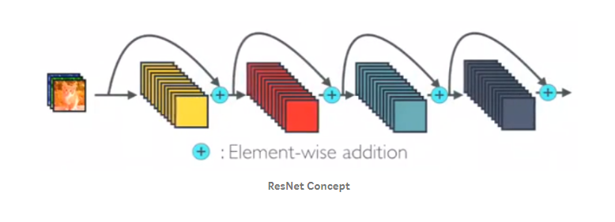
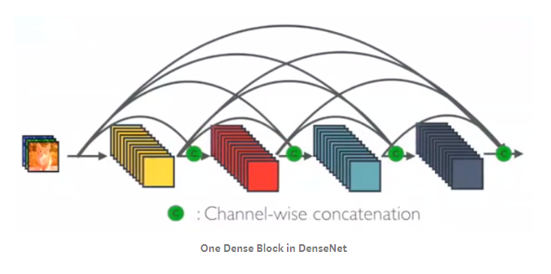
ResNet Vs DenseNet

Slide 11
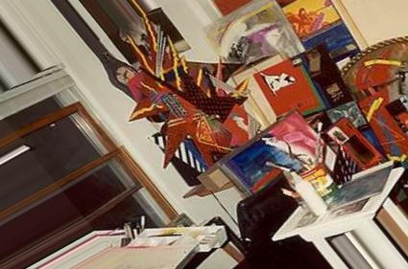
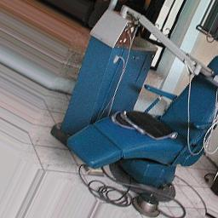
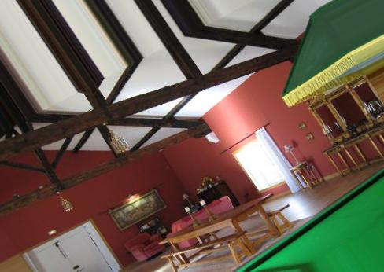
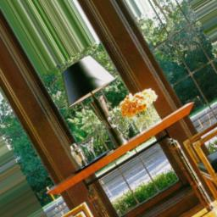
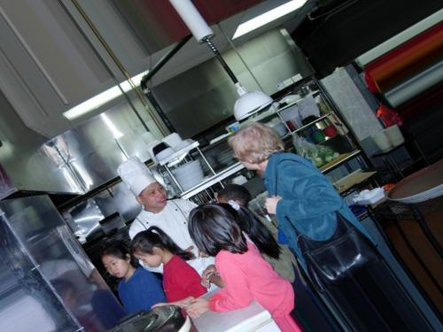
Data Augmentation

Slide 12
Quantitative Results
Model | Epochs | Training Acc | Validation Acc | Time Per Epoch
DenseNet121 | 133 | 0.9457 | 0.4641 | 226
ResNet101 | 109 | 0.9100 | 0.0326 | 245
Resnet50 | 150 | 0.8828 | 0.0392 | 248
InceptionV3 | 232 | 0.9062 | 0.5022 | 241
DenseNet169 | 110 | 0.9562 | 0.5137 | 242
InceptionResnetV2 | 112 | 0.9432 | 0.5213 | 240

Slide 13
Qualitative Results
Architecture | Actual Category | Predicted category | No. of Correct Predictions | No. of Wrong Predictions | Total No. of Category
Resnet50 | All | Diff types | 1 | 5 | 6
Resnet101 | same | Diff. types | 0 | 6 | 6
InceptionV3 | same | Diff. types | 2 | 4 | 6
Densenet121 | same | Diff. types | 5 | 1 | 6
Densenet169 | same | Diff types | 4 | 2 | 6
InceptionResnetV2 | same | Diff. types | 6 | 0 | 6

Slide 14
What is going on with the Validation Accuracy?
A few different things: Keras' default methodology for splitting into training and validation sets was used. It uses user-specified proportion to split dataset based on ordering (i.e., user specifies 90% of data as training, 10% as validation, ) the validation set contains the `last' 10% of the dataset. Depending on how the data is loaded (sequentially by category here), the validation set may contain only a small fraction of the total number of classes or categories.
The ResNet models are drastically overfitting. This has to do with layer `freezing’ i.e., specifying certain layers that should not be updated when training.
ResNet models are known to overfit in certain problem spaces, and the recommended solution is to freeze the batch normalization layer.
This was not done in this case, as the comparison was among common out-of-the-box models.
Experimenting with freezing different layers of each out-of-the-box model is a natural next step for this project.

Slide 15
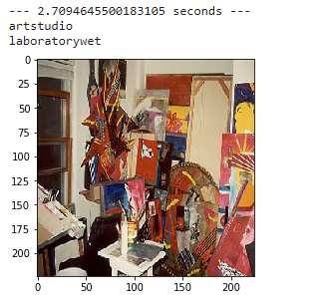
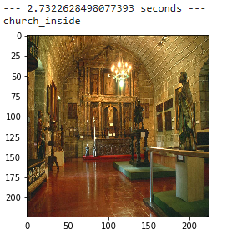
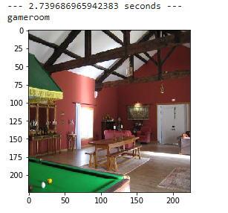
Results

Slide 16
Conclusion
Among all the ImageNet architectures, used for the comparison purpose on this dataset, InceptionResnetV2 has performed the best followed by DenseNet169 and InceptionV3.
It seems that the number of layers in the architecture has a correlation with its performance.
The model with highest number of layers, i.e. InceptionResnetV2 has performed the best.

