Slide 1









Bangalore Institute Of Technology R Road, V V Pura Bengaluru-560004
www.bit-Bangalore.edu.in
Department of Electronics and Telecommunication Engineering
VI Semester Major PROJECT WORK Phase-1 (22BTE685)
New Synopsis Presentation Feb-May 2026
On
Real Time Vision-Based Precision Landing of UAV in GPS-Limited Environments
Presented by
Presented on – Date:- 09/05/2026
FULL NAME | USN
AMRUTH M KASHYAP | 1BI23ET004
CHIRANTH B M | 1BI23ET012
NIHAL S JAMAKHANDI | 1BI23ET039
PRAJWAL S | 1BI23ET043

Slide 2
VISION OF THE DEPARTMENT
Empower every student to be Creative and Productive in the field of Electronics and Telecommunication Engineering by imparting excellent Technical Education and inculcating Human Values.
MISSION OF THE DEPARTMENT
To make our Students acquaint with the Global requirements such as Problem Solving Skills, Cultural Sensitivity, Ethical Behaviour and Social Responsibility.
To Motivate our Students to pursue Higher Education and engage in continuous up-gradation of their Professional Skills.
To encourage students to develop Communication Skills, Professional Values, and Positive Attitude that in turn leads to fostering Leadership Qualities.

Slide 3

CONTENTS
Abstract
Introduction
Literature Survey
Problem statement
Objectives of the project
System Design and Methodology
Block diagram
Hardware and Software Requirements
Expected results
Application of the project
Paper References

Slide 4
ABSTRACT
The growing deployment of UAVs in time-critical applications demands robust autonomous landing capability independent of GNSS availability. This project presents the design, implementation, and experimental evaluation of a real-time vision-based precision landing system for a quadcopter UAV operating in GPS-limited environments. The proposed architecture integrates the open-source Pixhawk 2.4.8 flight controller with an OpenMV H7 machine-vision camera that autonomously detects and tracks a nested AprilTag fiducial marker affixed to the landing pad. Angular offset data computed onboard the camera is transmitted as MAVLink LANDING_TARGET messages to the flight controller, which executes a closed-loop descent using its built-in Extended Kalman Filter and PID stabilisation loops. Experimental results demonstrate a mean landing deviation of approximately 9 to 12 cm across outdoor, semi-outdoor, and indoor environments.

Slide 5

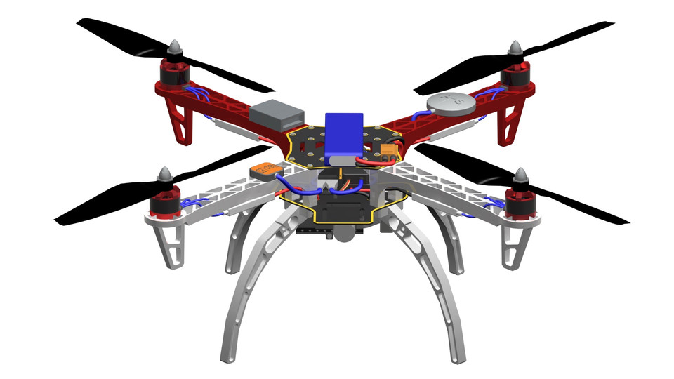
INTRODUCTION
Drones or usually called as Unmanned Aerial Vehicles (UAVs), commonly known as drones used in applications such as surveillance, package delivery, cinematography, and industrial inspection. One of the most critical phases of drone operation is landing, as inaccurate or unstable landing can cause damage to the drone and the equipment it carries. Conventional landing methods rely mainly on GPS, which may suffer from signal degradation, positional errors, or complete unavailability in indoor and obstructed environments.
This project focuses on designing and developing a quadcopter drone capable of stable flight and autonomous precision landing using a vision-based system. A camera module is used to detect a visual landing marker and provide positional information to the flight controller, enabling accurate and controlled landing. The system aims to improve landing accuracy, enhance safety, and provide a reliable and cost-effective solution for autonomous UAV operations.

Slide 6
LITERATURE REVIEW
Ref No. | Methodology Used | Objectives | Merits | Remarks
[1] | Vision-Based Precision Landing: Uses OpenMV camera, AprilTag detection, and Pixhawk flight controller. Offset angles and distance are calculated from camera images and used to guide landing. | To develop a low-cost autonomous precision landing system for quadcopters using computer vision. | Cost-Effective: Low-cost implementation. Accurate: Centimeter-level landing accuracy. | Works well in controlled environments; accuracy depends on lighting and marker visibility.
[2] | A three-stage vision-based system uses vision and motion sensors for approach guidance, final-phase backup, and post-landing verification. | To improve UAV landing accuracy and reliability in GPS-degraded or denied environments. | 1. Reliability: Robust system with backup mechanisms and verification stage. | System complexity and hardware requirements are higher compared to basic landing systems.
[3] | A-Star-Guided Potential Field (AGPF): Algorithm combining global path planning and local obstacle avoidance for UAV navigation. | To generate optimal and smooth UAV paths while avoiding obstacles in dynamic environments. | 1. Smooth Trajectory: Produces smoother paths. | Focuses on navigation and path planning rather than landing; useful as an extension to autonomous UAV systems.

Slide 7
PROBLEM STATEMENT
GPS-only landing guidance exhibits lateral errors of one to three metres under nominal conditions and fails entirely in GPS-denied environments. Commercial precision landing solutions that meet sub-decimetre accuracy requirements are either prohibitively expensive or tightly integrated into proprietary drone platforms that resist independent sensor integration. There is therefore a clear engineering requirement for a cost-effective, open-architecture precision landing system that combines affordable machine-vision hardware with established open-source autopilot firmware to achieve centimetre-level landing accuracy independent of GNSS availability.

Slide 8

OBJECTIVE OF THE PROJECT
Design a quadcopter UAV precision landing system with vision-based control that achieves centimetre-level landing accuracy on a designated pad independent of GNSS availability.
Integrate an OpenMV H7 camera for AprilTag detection and angular offset computation, with a Pixhawk 2.4.8 flight controller configured for closed-loop precision descent via MAVLink LANDING_TARGET messages.
Enable stable precision landing in Stabilize, Loiter, and Auto flight modes across outdoor, semi-outdoor, and indoor environments with varying GPS signal quality.

Slide 9
METHODOLOGY
Component | Approach
Flight Controller | Pixhawk 2.4.8 with ArduCopter 4.0.7 firmware
Vision System | OpenMV H7 camera with AprilTag36h11 detection
Communication | MAVLink LANDING_TARGET messages via SERIAL4 UART
State Estimation | Extended Kalman Filter (EKF2) sensor fusion
Control Strategy | Cascaded PID control for attitude and position
Performance Validation | Landing deviation testing across outdoor, indoor, GPS-denied environments

Slide 10
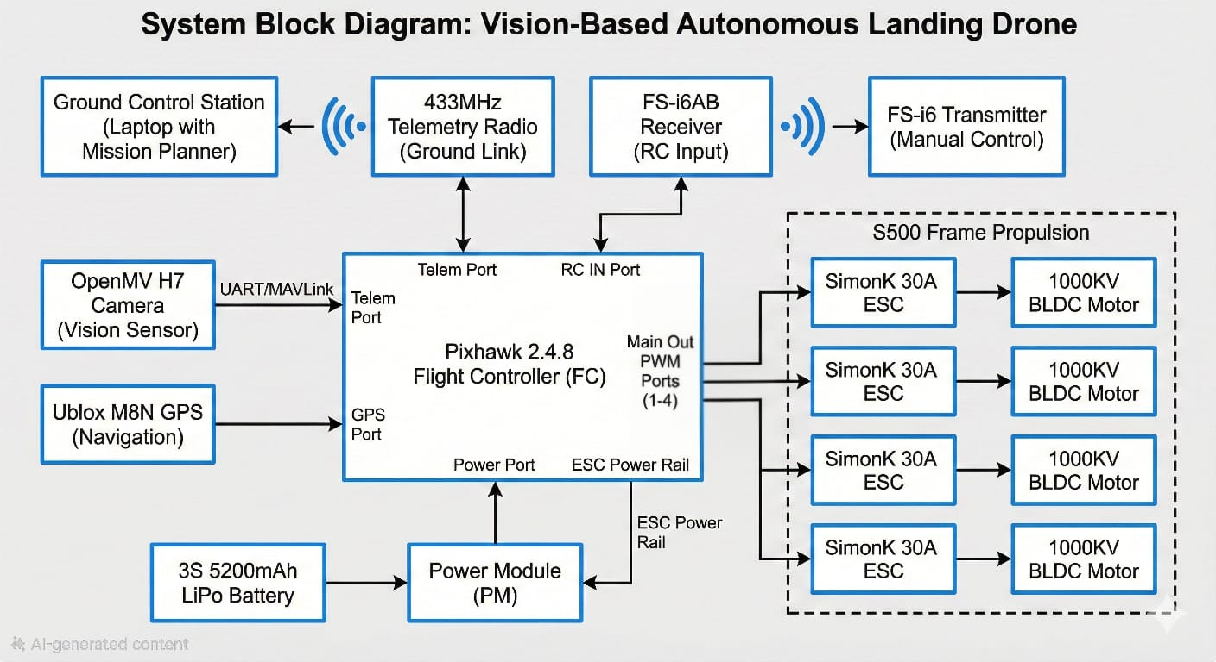
BLOCK DIAGRAM

Slide 11
START
Initialize UAV, sensors, and AprilTag marker
OpenMV H7 detects AprilTag marker
Compute angular offsets (angle_x, angle_y)
Transmit MAVLink LANDING_TARGET
message to Pixhawk
EKF2 fuses vision + IMU data
PID controller generates motor commands
Send PWM signals to ESCs
UAV adjusts position and descends
Update position estimate
Marker
centered?
Continue descent
Yes
No
Touchdown
(Precision Landing Complete)

Slide 12
HARDWARE AND SOFTWARE REQUIREMENTS
Hardware
Pixhawk 2.4.8 Flight Controller
OpenMV H7 Camera
A2212 1000KV Brushless Motors
S500 Quadcopter Frame
Electronic Speed Controllers (ESCs)
FlySky FS-i6 Transmitter/Receiver
3S LiPo Battery 5200mAh
GPS M8N Module with Compass
433MHz Telemetry Radio
Software
ArduCopter Firmware
MicroPython (OpenMV)
MAVLink Protocol
AprilTag Library

Slide 13
EXPECTED RESULTS
Mean landing deviation of less than 12 cm across environments
Reliable AprilTag detection at 40-400 cm range
Stable precision landing in GPS-denied indoor environments
Successful MAVLink integration at 30 fps update rate
All failsafe protocols validated and operational
PID-stabilised closed-loop descent confirmed

Slide 14
APPLICATION OF THE PROJECT
Precision delivery of medical supplies and commercial packages to confined landing pads.
Infrastructure inspection on narrow platforms atop wind turbines and transmission towers.
Post-disaster search-and-rescue operations in GPS-degraded environments.
Autonomous landing in warehouses, underground facilities, and urban canyon environments.

Slide 15

PAPER REFERENCES
[1] Rizqy Ilmi Naufal, Nyoman Karna, and Soo Young Shin,
“Vision-Based Autonomous Landing System for Quadcopter Drone Using OpenMV,”
2022 13th International Conference on Information and Communication Technology Convergence (ICTC), IEEE, 2022.
[2] Meng Xu, “Visual Recognition-Assisted Precision Landing for UAVs in GPS-Degraded Environments: Approach Guidance, Backup End-Phase Recognition, and Post-Landing Verification,”
2025 International Conference on Aerospace Information Perception and Intelligent Processing (AIPIP), IEEE, 2025.
[3] Jaewan Choi and Younghoon Choi,
“Path Planning for Unmanned Aerial Vehicle: A-Star-Guided Potential Field Method,”
Drones, vol. 9, MDPI, 2025.

Slide 16


