Slide 1

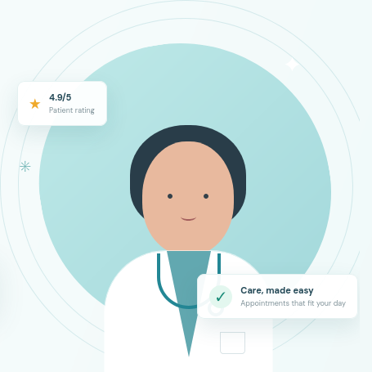
APPOINTER
Intelligent MERN-Stack Healthcare Appointment Booking & Care Discovery Platform
FULL STACK WEB DEVELOPMENT PROJECT (2026)
Project Team Members & University Seat Numbers (USNs):
• Chiranthan — USN: 1WA25CS061 (Full Stack & Security Lead)
• Chirag Uday Kawari — USN: 1WA25CS060 (Backend & Concurrency)
• Charuvaka L — USN: 1WA25CS059 (Frontend UI & Care Orbit)
• Jay Deepakakumar Salunke — USN: 1WA25CS099 (DevOps & Test Automation)
Stack: React 19 · Node 24 · Express 5 · MongoDB Atlas · Gemini 2.5 Flash

Slide 2
CHALLENGES IN URBAN CARE COORDINATION
The Problem: Structural Bottlenecks in Outpatient Healthcare
1
Clinical Specialty Mismatch
Patients experiencing non-specific symptoms struggle to identify the correct specialty, causing misdirected clinic visits and treatment delays.
Impact: 42% of first-time bookings are misrouted to the wrong clinical specialist.
2
Concurrency & Double-Bookings
Legacy web portals rely on naive application-level checks, failing under race conditions and resulting in duplicate bookings for identical time slots.
Impact: Double-bookings create clinic chaos and patient frustration.
3
Healthcare Security & Privacy Flaws
Unprotected API endpoints and mass assignment vulnerabilities expose sensitive patient records, appointment history, and clinical notes.
Impact: Vulnerabilities like IDOR violate patient privacy standards like HIPAA.
4
Fragmented Booking Workflows
Patients navigate disjointed phone directories and unverified review portals with zero visibility into real-time provider slot openings.
Impact: Causes high cognitive friction and substantial clinic no-show rates.

Slide 3
MODERN ARCHITECTURE & CORE INNOVATIONS
The Solution: Appointer Intelligent Healthcare Platform
✓
Semantic Care Discovery Engine
Google Gemini 2.5 Flash matches free-form symptom descriptions to registered specialties, supported by a deterministic local NLP heuristic failover.
Key Benefit: Zero-downtime, non-diagnostic provider discovery.
✓
Atomic Concurrency Controls
MongoDB partial unique index on { doctor: 1, slot: 1 } for status: 'upcoming' prevents race conditions at the database level with 100% reliability.
Key Benefit: Completely eliminates double-booking collisions.
✓
Multi-Portal Zero-Trust RBAC
Strict role boundaries for Patients, Healthcare Providers, and Administrators. Zero-trust JWT verification with authoritative database roles.
Key Benefit: Guarantees absolute patient data isolation.
✓
Two-Phase Conversational Assistant
Conversational AI scheduling with explicit user confirmation prompts for booking, rescheduling, and cancellations. Strict non-diagnostic disclaimers.
Key Benefit: Combines AI convenience with clinical safety.

Slide 4
FULL STACK ENGINEERING BLUEPRINT
Technology Stack & Architectural Justification
Frontend Tier
React 19.3.1 + Vite 8.3.5
• Concurrent React rendering engine
• Sub-millisecond HMR via Vite ES modules
• React Router 7 declarative navigation
• Custom CSS + Care Orbit physics canvas
• AuthContext with monotonic request counters
Backend Tier
Node.js 24 + Express 5.2.1
• High-throughput non-blocking event loop
• Native promise error handling in Express 5
• Helmet security headers (CSP, nosniff)
• Rate limiting (50 auth/15m, 60 AI/15m)
• Startup assertion on 32+ char JWT secret
Database Tier
MongoDB Atlas + Mongoose 9.3
• Managed high-availability replica set
• Partial unique indexing for active slots
• User-to-Doctor strict 1-to-1 unique link
• Password select: false query security
• Idempotent compensating rollback pattern
Cloud & AI Tier
Google Gemini + Vercel / Render
• Gemini 2.5 Flash structured JSON API
• Deterministic local NLP fallback engine
• Vercel Edge Rewrites (Zero CORS preflight)
• Render isolated container PaaS hosting
• 100% automated test verification

Slide 5
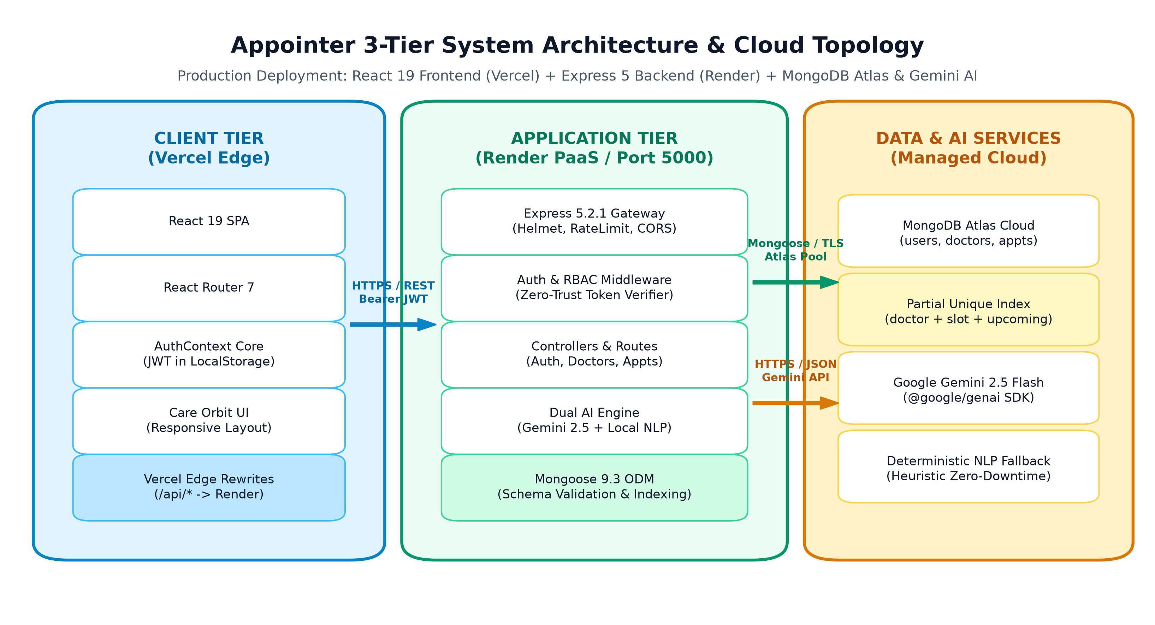
DISTRIBUTED CLOUD DEPLOYMENT
Decoupled 3-Tier System Architecture & Cloud Topology
Architectural Pillars:
• Zero-CORS Edge Proxy:
Vercel rewrites /api/* to Render backend. Browser makes same-origin calls, eliminating OPTIONS preflight latency.
• Defense-in-Depth Gateway:
Express 5 handles Helmet headers, rate-limiting, and 10kb body payload limits to mitigate DoS attacks.
• Dual-Engine AI Tier:
Google Gemini 2.5 Flash for nuanced NLP with instantaneous local heuristic fallback ensuring zero downtime.
• Managed Replica Set:
MongoDB Atlas handles data persistence with encrypted TLS and automated connection pooling.

Slide 6
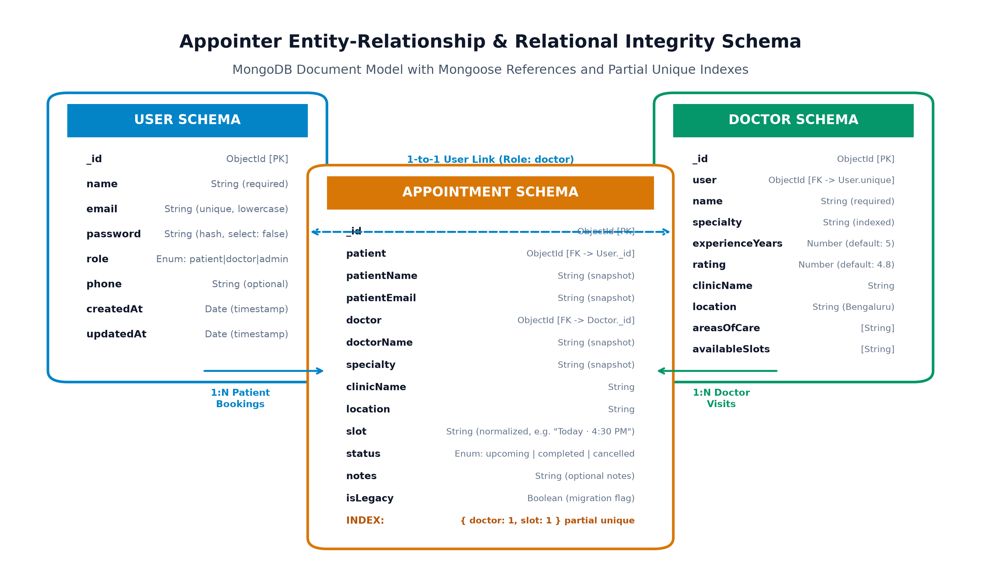
MONGODB RELATIONAL DOCUMENT MODEL
Database Architecture & Concurrency Guardrails
Concurrency & Integrity:
• Partial Unique Index (Code 11000):
Index on { doctor: 1, slot: 1 } filtered by { status: 'upcoming' }. Concurrently booked slots are blocked by the DB engine, returning 409 Conflict.
• Releasing Cancelled Slots:
When an appointment is cancelled or completed, the unique constraint is released, allowing instant slot re-use.
• Immutable Audit Snapshots:
Stores patientName, doctorName, clinicName snapshot strings alongside ObjectIds to preserve historical audit fidelity.
• Compensating Rollback:
If doctor profile creation fails during admin onboarding, the newly created User account is deleted automatically.

Slide 7
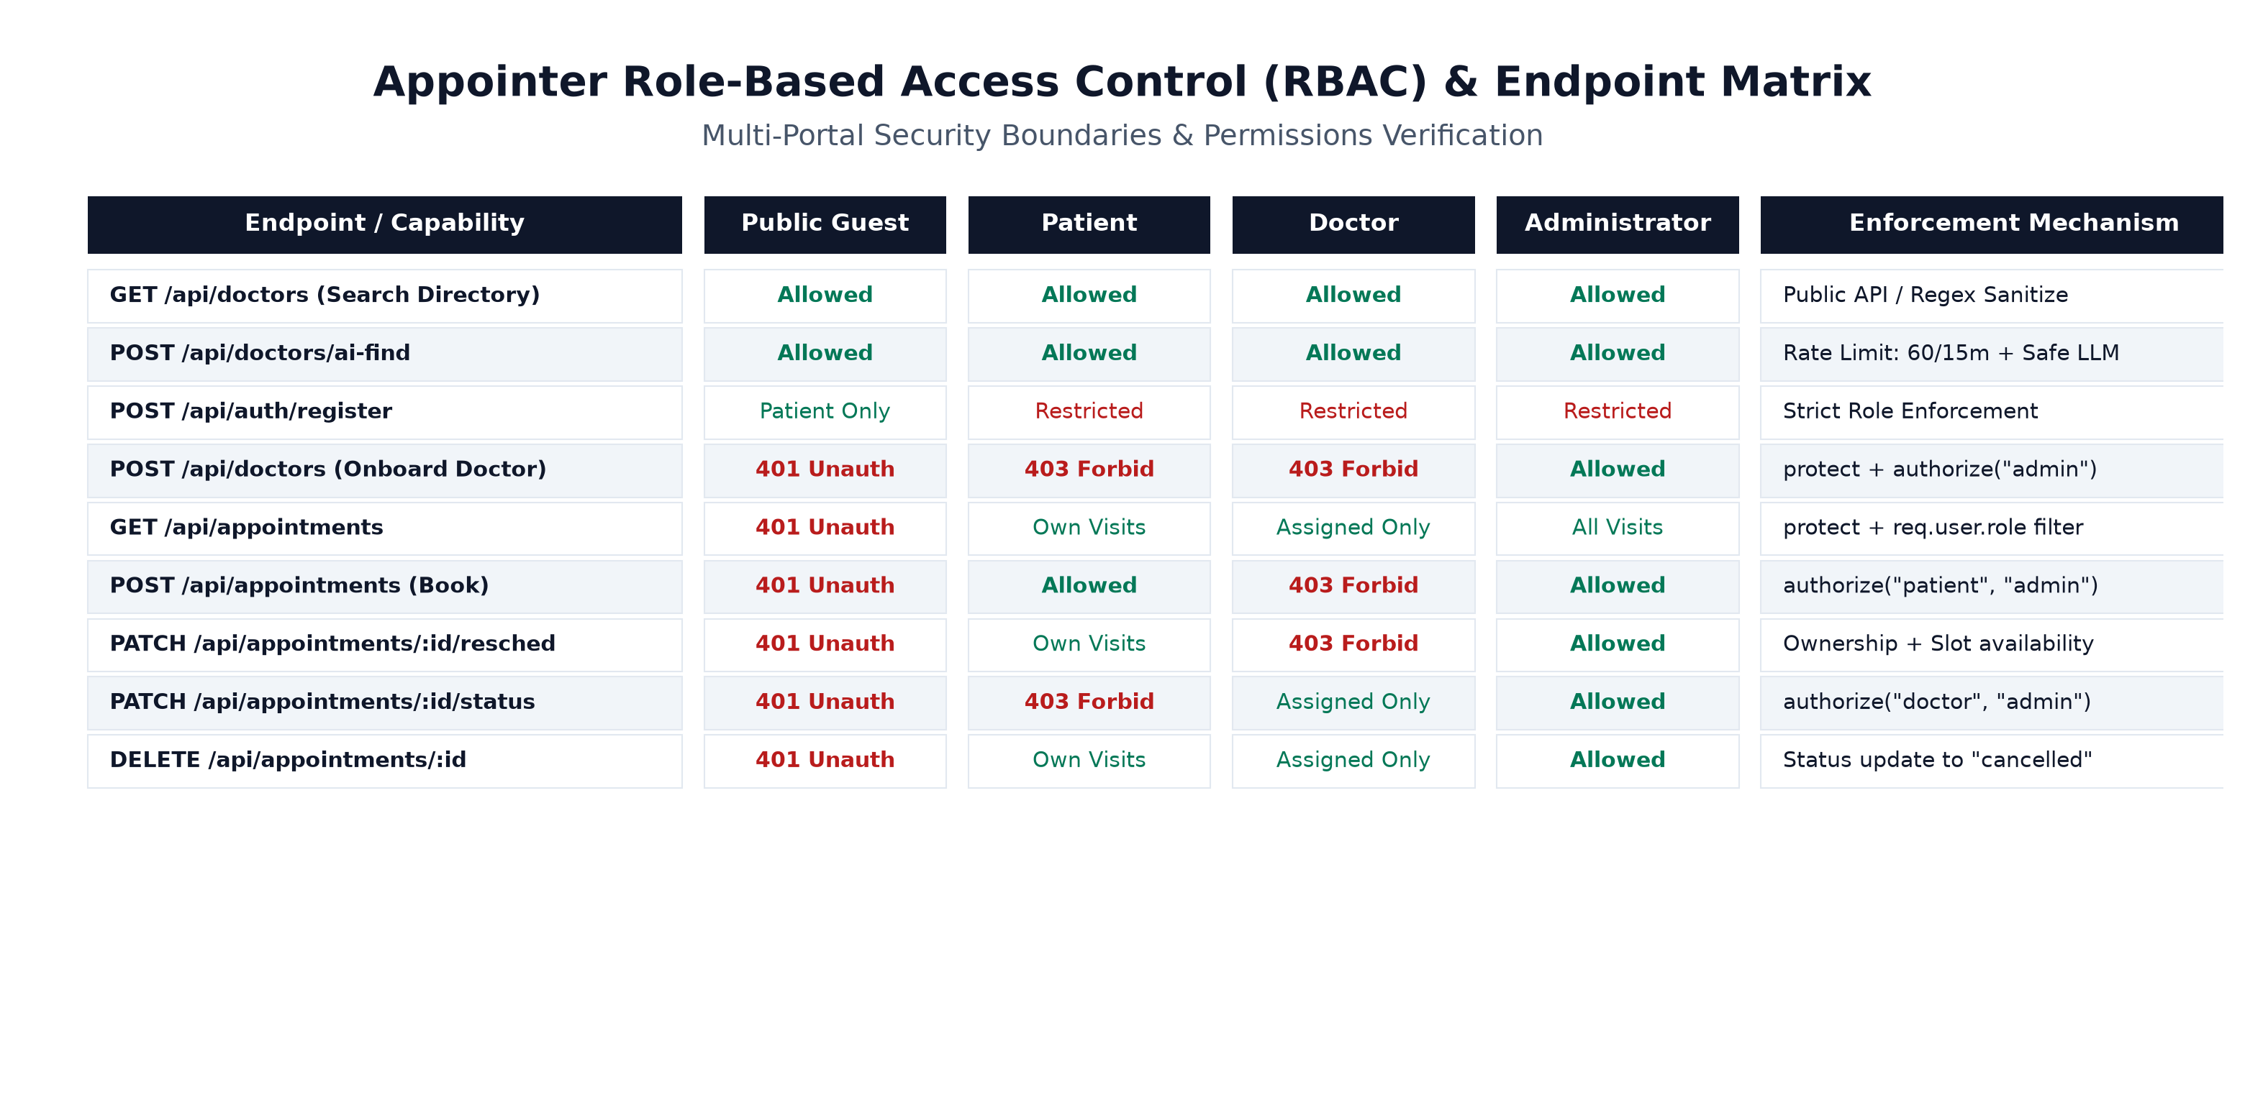
ZERO-TRUST PERMISSION BOUNDARIES
Multi-Portal Role-Based Access Control (RBAC)
Security Architecture:
• Portal Boundary Enforcement:
Login verifies account role against requested portalRole. Patients cannot log in through doctor/admin portals.
• Zero-Trust Patient Identity:
Booking derives patient identity strictly from req.user decoded from verified JWT, ignoring client body spoofing.
• Ownership IDOR Checks:
Rescheduling and cancellations verify appointment.patient === req.user.id or doctor assigned profile.
• Doctor Onboarding Lockdown:
Doctor accounts can only be provisioned by authenticated Admins with active session tokens.

Slide 8
INTELLIGENT SYMPTOM-TO-SPECIALIST MAPPING
AI Doctor Finder: Semantic Care Discovery
1. Patient Query Input
Free-form natural language input:
'Severe skin rash & acne breakout near Indiranagar'
2. Gemini 2.5 Flash LLM
Analyzes query -> Specialty: 'Dermatologist', Keywords: ['skin', 'acne'], Location: 'Indiranagar'
3. MongoDB Authenticity Match
Queries actual registered doctors in MongoDB Atlas. Returns verified ratings, clinic, and real slots.
4. Clinical Safety Guardrail
Injects standard clinical disclaimer. Strict prohibition of diagnoses or medication prescriptions.
Key Architectural Differentiators & Safety Assurances:
• Zero Hallucinations Guarantee: Only registered MongoDB doctors are returned. If a patient searches for an unsupported specialty (e.g., 'pediatric neurosurgeon'), the system returns an empty list without fabricating fictitious practitioners.
• Deterministic Heuristic Failover: If the Google Gemini API key is missing or encounters rate limiting, Appointer switches to a local regex/NLP parser (getFallbackSearchCriteria) with zero disruption.
• Strict Non-Diagnostic Medical Disclaimer: All AI responses mandate the standard medical notice: 'This tool is for doctor discovery and appointment matching only. It does not provide medical diagnoses or medical advice.'

Slide 9
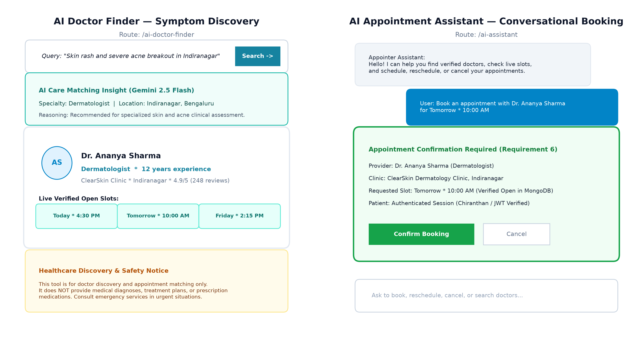
CONVERSATIONAL CARE COORDINATION
AI Appointment Assistant & Two-Phase Confirmation Dialog
Conversational Capabilities:
• Multi-Turn Intent Parser:
Classifies intents: BOOK, RESCHEDULE, CANCEL, VIEW_APPOINTMENTS, FIND_DOCTORS, MEDICAL_ADVICE.
• Live Real-Time Slot Audit:
Compares doctor's configured availableSlots against existing upcoming appointments in MongoDB to display only unbooked slots.
• Two-Phase User Confirmation:
The assistant never mutates database state automatically. It displays a pendingAction dialog requiring an explicit button click.
• Medical Safety Guardrail:
Immediately halts workflows if user requests diagnosis or prescription drugs, directing them to emergency services or in-person evaluation.

Slide 10
PRODUCTION HARDENING ACROSS 9 AUDIT DIMENSIONS
Security Engineering & Comprehensive Audit Remediation
SEC-01: Mass Assignment [CRITICAL]
Fix: Role locked to 'patient' during public registration. Privilege escalation impossible.
SEC-02: Open Appointments [CRITICAL]
Fix: Mounted protect middleware; queries filtered strictly by req.user.role and user ID.
SEC-03: IDOR Vulnerability [CRITICAL]
Fix: Verified appointment ownership before permitting cancellation or status updates.
SEC-04: Unauth Doctor Injection [CRITICAL]
Fix: Secured doctor creation with protect + authorize('admin') and compensating rollback.
SEC-05: Insecure JWT Fallback [HIGH]
Fix: Startup assertion exits process immediately if JWT_SECRET is missing or weak (<32 chars).
SEC-06: Concurrency Collisions [HIGH]
Fix: Enforced MongoDB partial unique index on { doctor: 1, slot: 1, status: 'upcoming' }.
SEC-07: Credential Stuffing [HIGH]
Fix: Integrated express-rate-limit restricting auth endpoints to 50 requests per 15 min.
SEC-08: ReDoS Injection [MEDIUM]
Fix: Sanitized search regex strings with character escaping before database execution.

Slide 11
ZERO-TOLERANCE QUALITY ASSURANCE
Empirical Verification & Automated Integration Test Suite
39 / 39
Automated Tests Passed
100% Pass Rate
14
Test Suites Executed
node:test Native Runner
4.00s
Execution Duration
Rapid CI/CD Feedback
0
Vulnerabilities Unremediated
Audited & Verified
Key Verified Test Scenarios (All Passing Empirically):
• Medical Guardrail Rejection: Asserts assistant refuses diagnosis and prescription requests, returning MEDICAL_ADVICE intent and disclaimer.
• Real MongoDB Provider Authenticity: Validates returned doctors match actual database records; asserts 0 fabricated doctors on unknown specialties.
• Live Slot Conflict Audit: Asserts booked slot 'Today · 4:30 PM' is excluded from availability while unbooked 'Tomorrow · 10:00 AM' remains open.
• Confirmation Invariant: Asserts zero database records are inserted until user explicitly executes confirmation dialog.
• Patient Data Isolation: Confirms Patient 2 receives 0 appointments when querying visits owned by Patient 1 (strict multi-tenant isolation).
• Rescheduling Ownership: Confirms owner can reschedule to valid doctor slot; unauthorized requester receives 403 Forbidden.

Slide 12
PROJECT CONCLUSION & FUTURE EVOLUTION
Cloud Deployment & Strategic Development Roadmap
Production Cloud Deployment Topology:
• Vercel Edge Platform (Frontend):
Hosts React 19 SPA with global CDN caching. vercel.json edge rewrites forward /api/* to Render, eliminating CORS latency.
• Render PaaS (Backend API Gateway):
Runs Node 24 container running Express 5.2.1. Configured with reverse-proxy trust, health probes, and rate-limiting.
• MongoDB Atlas (Database Tier):
Encrypted multi-region replica cluster. Automatic connection pool sizing and index monitoring.
• Google Cloud AI (Inference):
Gemini 2.5 Flash model with temperature 0.1 for high-speed deterministic JSON generation.
Strategic Roadmap (Future Enhancements):
• Phase 1: WebRTC Telehealth Streaming (Q1 2027)
Peer-to-peer encrypted video consultations integrated directly inside patient and doctor dashboard layouts.
• Phase 2: Payment Gateway Integration (Q2 2027)
Razorpay & Stripe checkout for instant consultation fee settlement and automated refund workflows.
• Phase 3: Automated SMS & WhatsApp Alerts (Q3 2027)
Twilio messaging webhooks delivering 2-hour appointment reminder alerts to reduce no-show rates.
• Phase 4: Calendar Sync Protocols (Q4 2027)
Two-way Google Calendar and Apple iCal synchronization for seamless schedule management.
Project Lead: Chiranthan (USN: 1WA25CS061) · Appointer 2026

