Slide 1
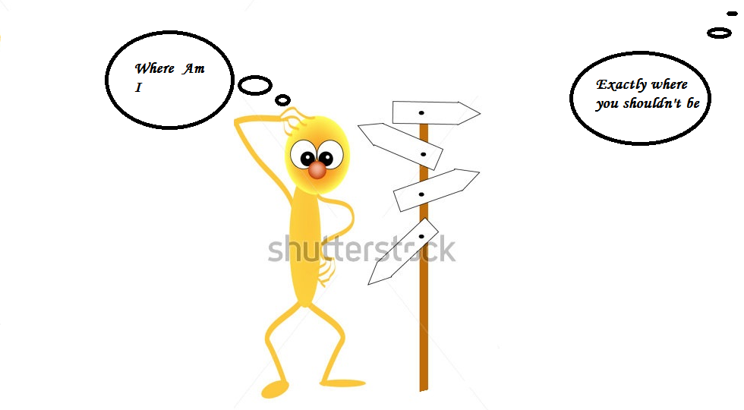
Confusion while coming to a new place
Signboard not clear
Lack of identification

Slide 2
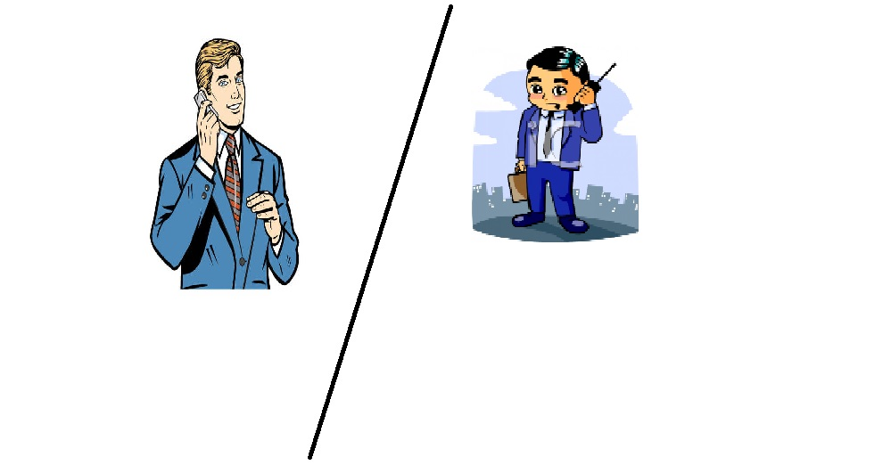
Some times is too irritating for a person to explain for the same cause.

Slide 3
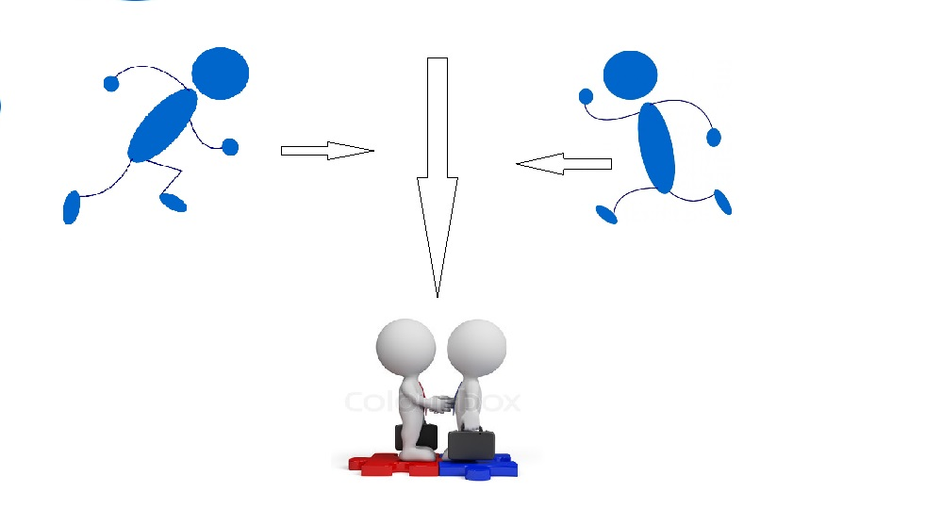
Easier to find
Manage to meet the right person

