Slide 1
Interactive Sales Dashboard – Task 3
Created by: Chiranthana J
Internship: Data Analyst – Visualization Task
Tool Used: Power BI
Dataset: sales_data_sample.csv (Kaggle)

Slide 2
Dashboard Contains
4 KPI Cards:
Total Sales
Total Orders
Total Customers
Average Sales per Order
1 Line Chart: Monthly Sales Trend
1 Bar Chart: Sales by Product Line
3 Interactive Slicers:
Product Line
Country
Order Date (range filter)

Slide 3
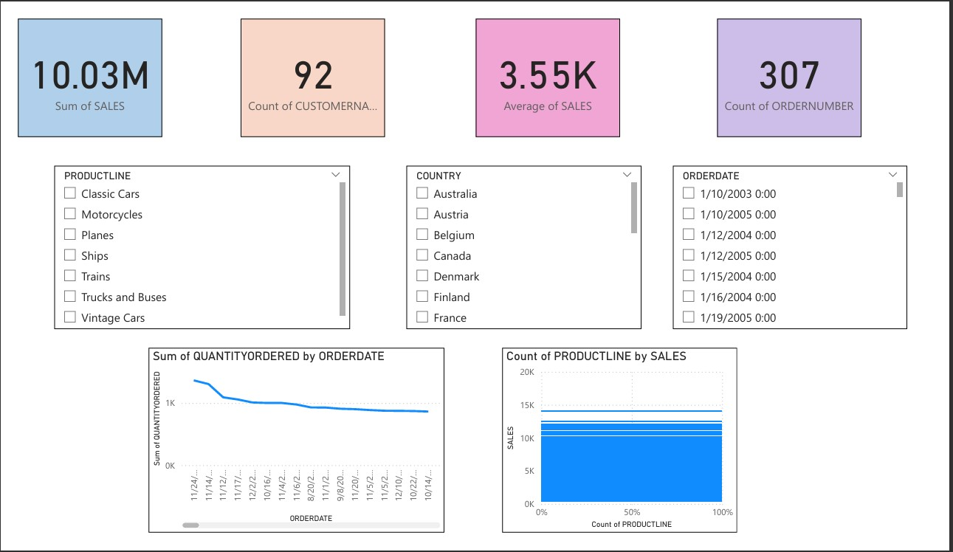
VISUALIZATION :

Slide 4
Insights Derived from the Dashboard :
Classic Cars category leads in total sales.
Monthly sales show a spike during Q3 and Q4.
Shipped orders dominate performance.
A few key customers account for high revenue.
The dashboard enables filtering by product line, region, and time period for tailored analysis.

Slide 5
Conclusion & Personal Learning
Built a clean, interactive dashboard for stakeholders.
Gained hands-on experience using slicers, cards, and charts.
Learned how to turn raw data into visual insights.
Practiced design consistency and layout clarity.
Ready to apply these skills to real-world business analysis.

