Slide 1
Forex Analysis
Team Members :
Ashutosh Gajankush
Chiranth HD
Ilesh Patel
Smruthi Karinatte
Notes:
Introduce Title of the paper
Introduce Group
Discuss Agenda

Slide 2
NEED FOR FOREX ANAYSIS:
Foreign exchange markets are considered to be the most liquid market of all
The forex market is the backbone of international trade and global investing
How this Works?
Data Source : searched different websites like investin.com, quandall.com for data
User inputs the date to get information from the past exchange rates
Data visualization for easy understanding
Libraries : Flask, EasyGUI, Numpy, Pandas, Matplotlib
2
Notes:
--how continental airlines transformed itself using BI
--rose to the position of best from worst by incorporating BI in their organization
--invested only abt $30M ---
--Realized $500M in cost savings in areas such as marketing, fraud detection, demand forecasting, tracking and improved data center management
--ROI > 1000%
--CA has proven to be best example to say real time BI is critical to accomplish business strategy and get maximum benefits out of business.
--using real time tech, CA is moving from first to favorite airline

Slide 3
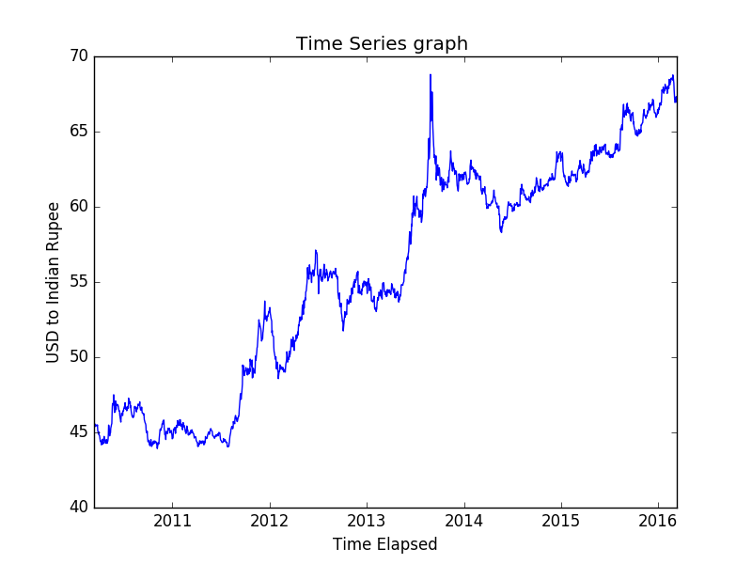
Analysis of a Particular Currency for a Specified Time Range
Our third Data Analysis shows the fluctuation in prices of the particular currency pair over a selected range of years As you see in the figure 3 the x-axis shows the rate of one currency compared to the other over the period of a selected range.

Slide 4
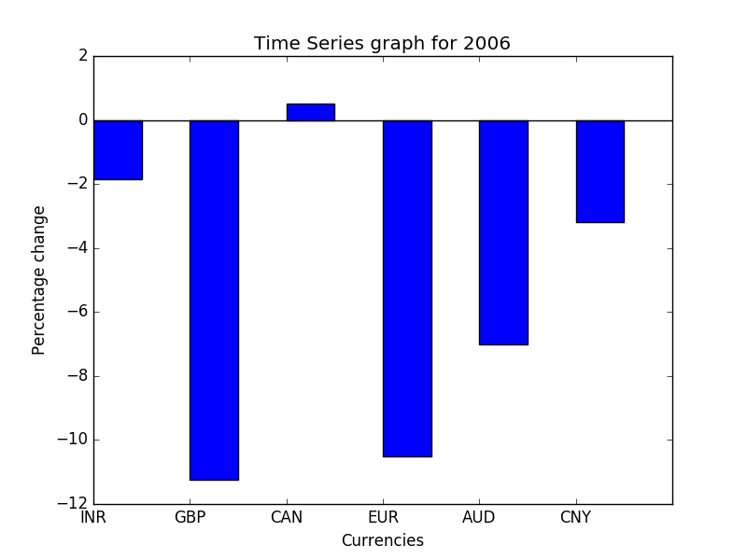
Change in Value of Currency (Percentage) for Selected Year
Our First Data Analysis shows the fluctuation in prices of the currency pairs over a particular year. As you see in the figure 1 the x-axis shows the rate of one currency compared to the other over the period of a selected year

Slide 5
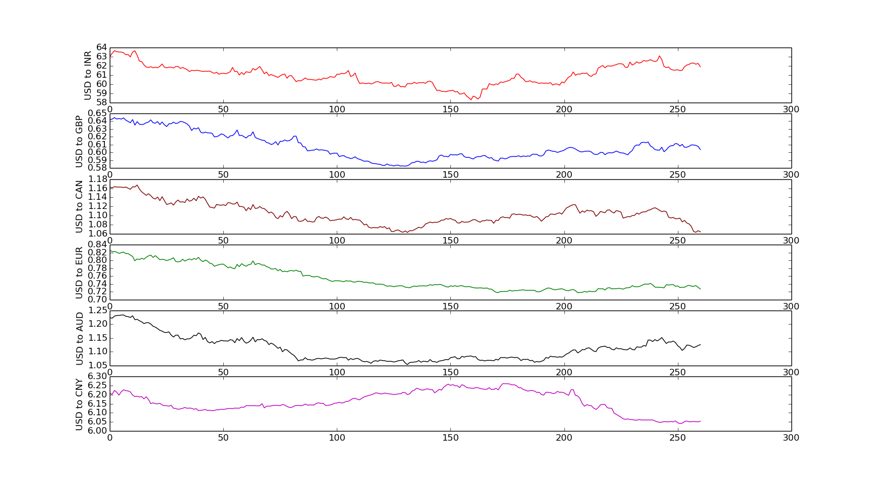
Consolidated Analysis of all the Currencies on Annual Basis
Our Second Data Analysis shows the fluctuation in prices of the currency pairs over the range of years. As you see in the figure 2 it shows the consolidated view. The x-axis shows the rate of one currency compared to the other over the period years.

Slide 6
Flask
Main program saves the plots in the Static folder
Display of graphs on localserver using Flask
Standard HTML Page stored in the templates folder
This HTML accesses the images from the Static folder
Auto refresh for 10 seconds

Slide 7
THANK YOU
7

