Slide 1
LearnIt Learn Anything Anywhere
Presented by:
Chirayu Akshaybhai Joshi

Slide 2
Outline
What is LearnIt?
Why LearnIt?
How I designed and built LearnIt?
References

Slide 3
Motivation
Technical geek
Used YouTube for learning (Telusko)
Then took course on Udemy
Found live streaming feature missing in Udemy

Slide 4
What is LearnIt?
Unique Study Platform
Learn from mentors in real time
Teach anyone in real time
Upload courses

Slide 5
Project Goal
To create an online platform for learning and teaching
Live learning for better learning experience
Interactive online class

Slide 6
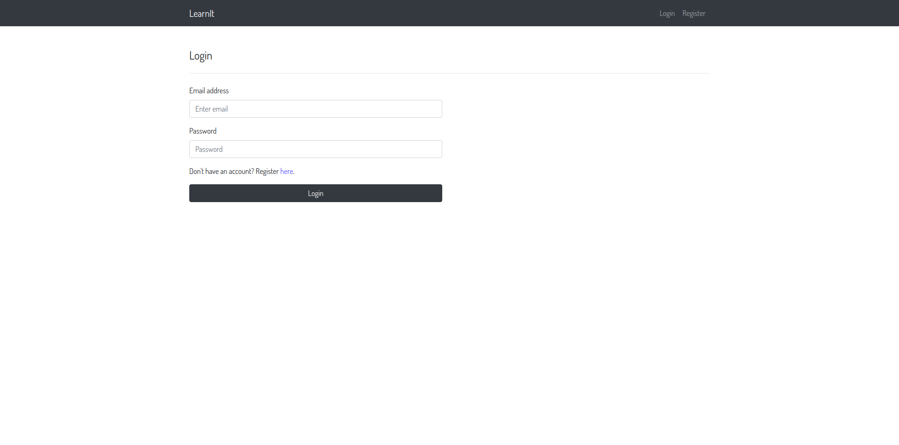
Project Description
Login page

Slide 7
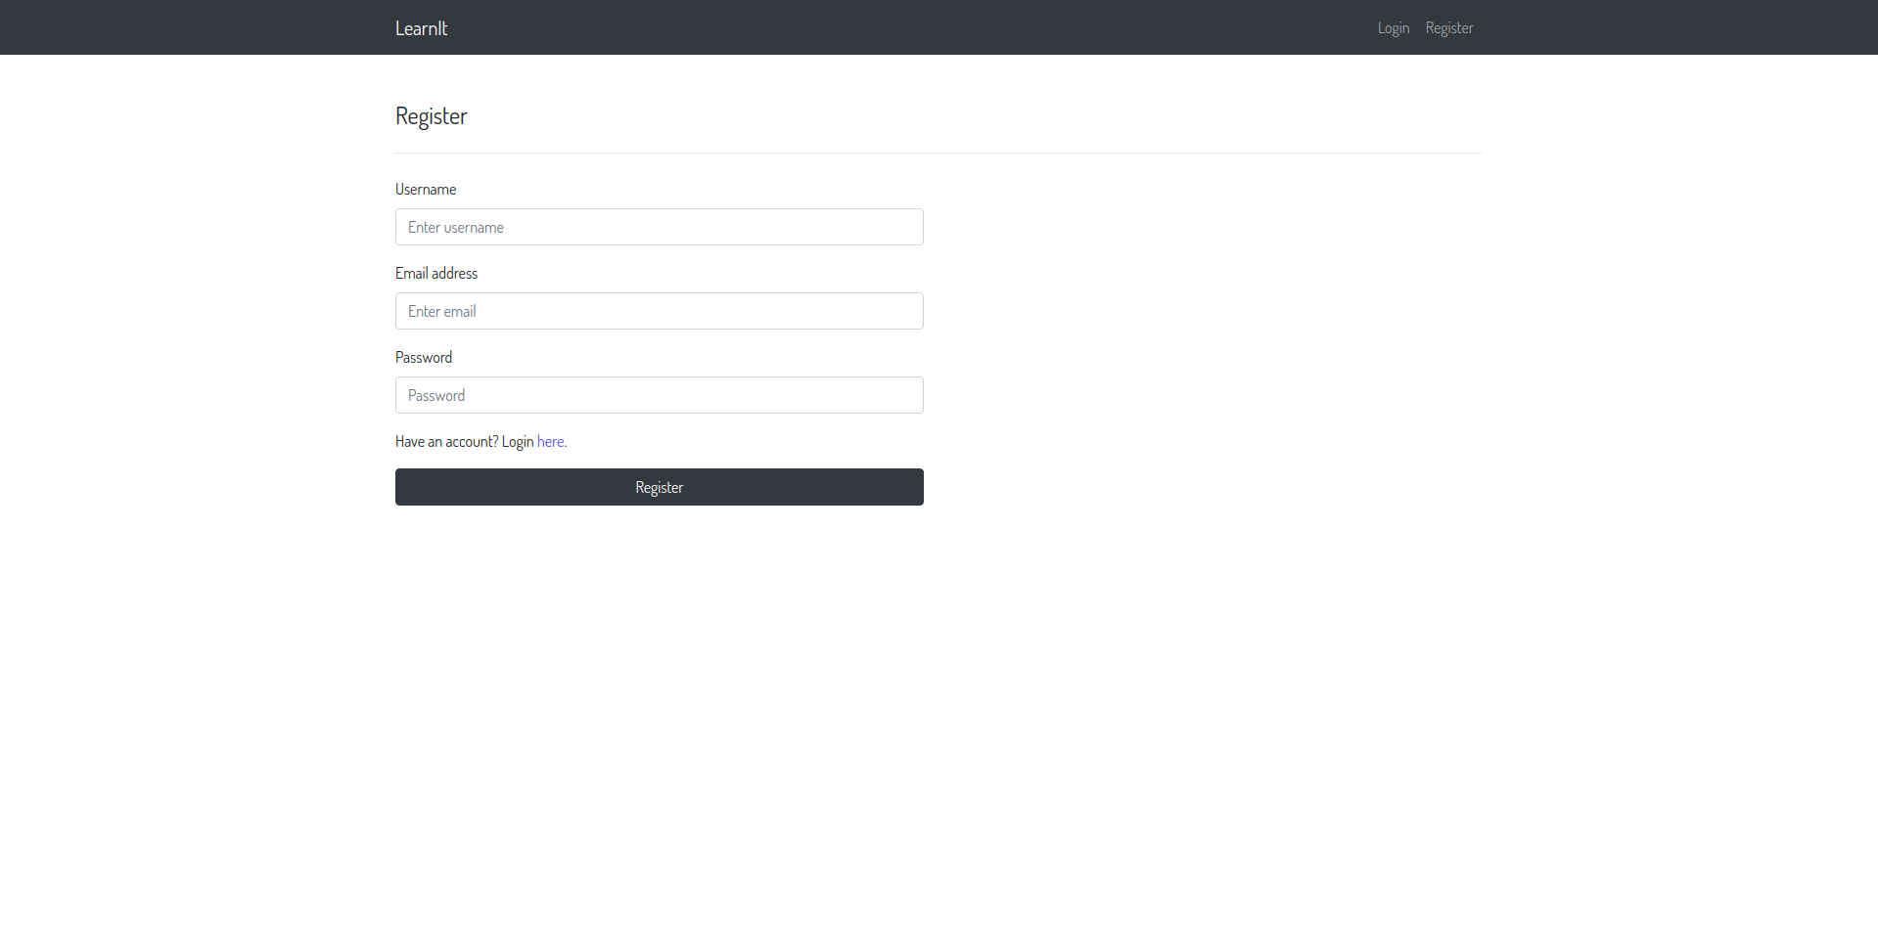
Registration page

Slide 8
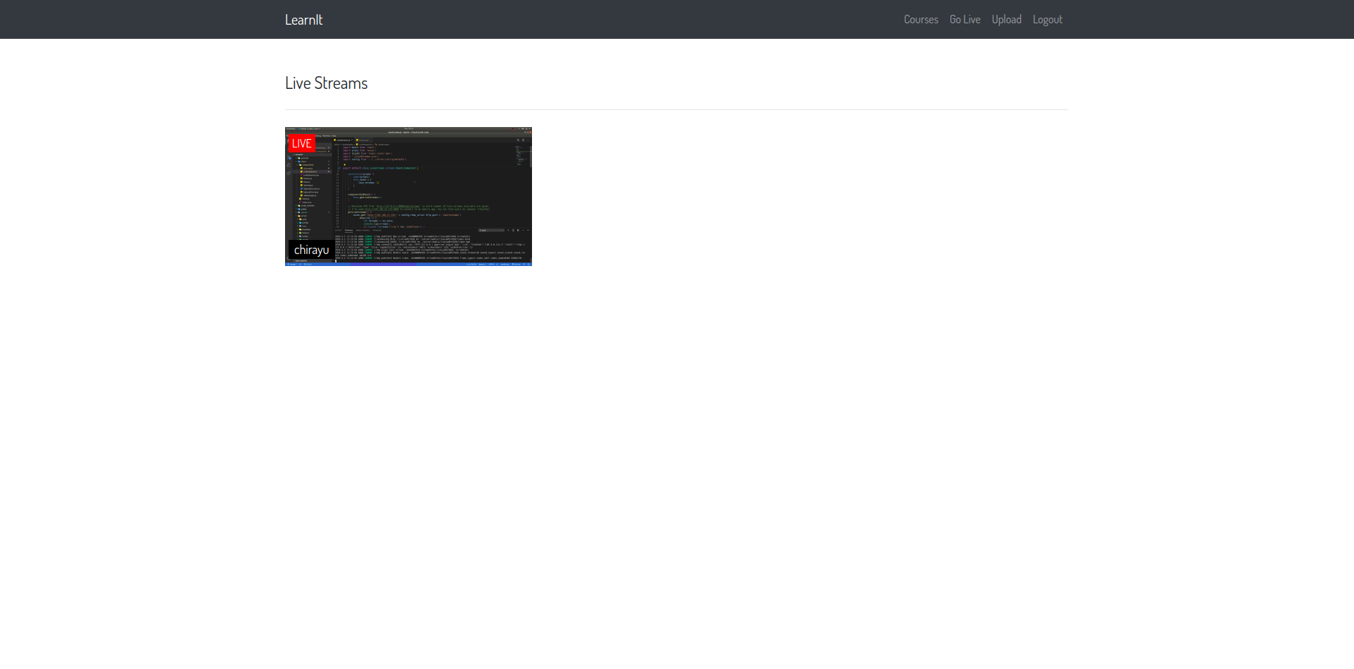
Home page

Slide 9
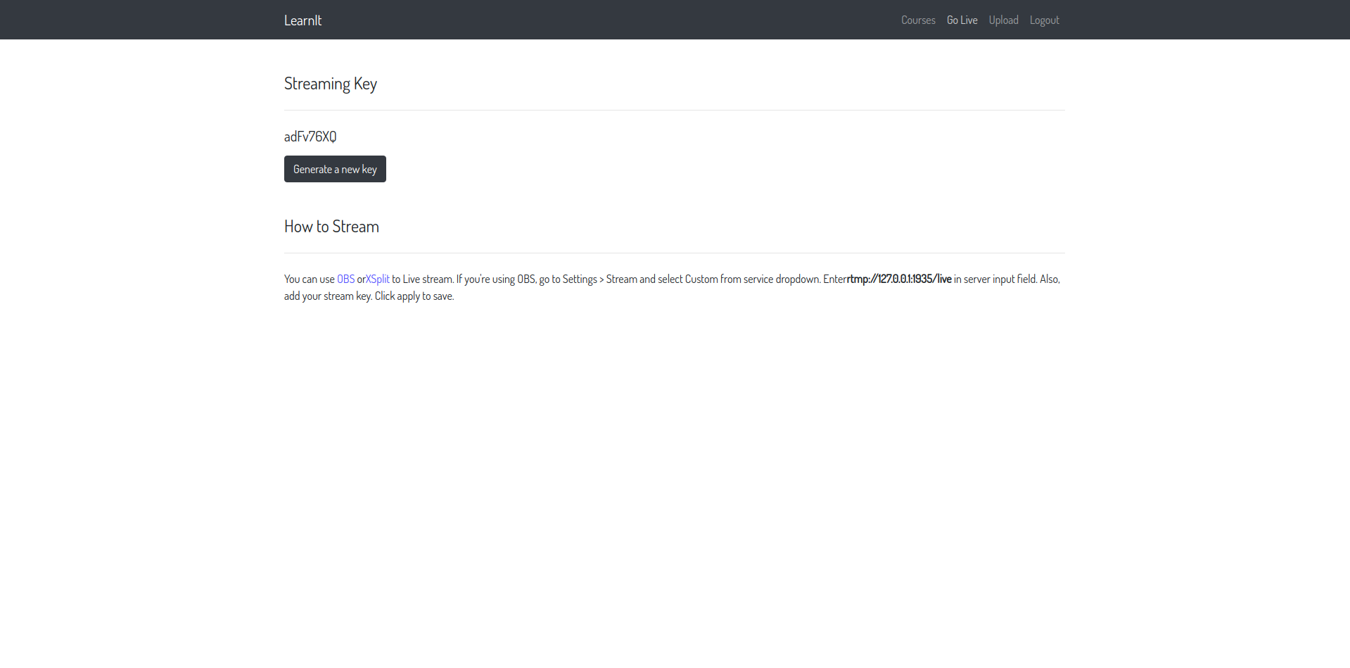
Go Live page

Slide 10
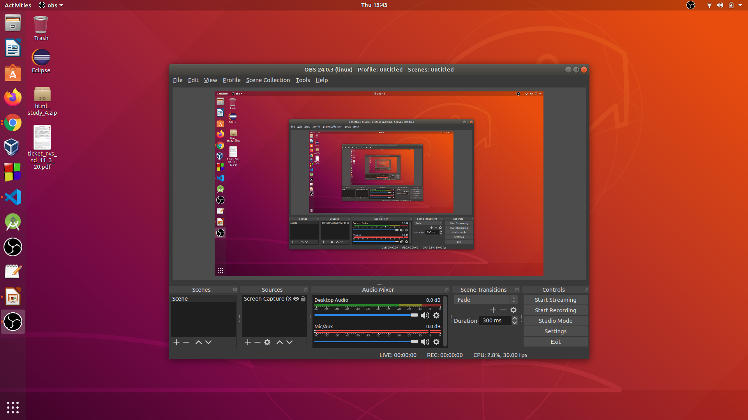
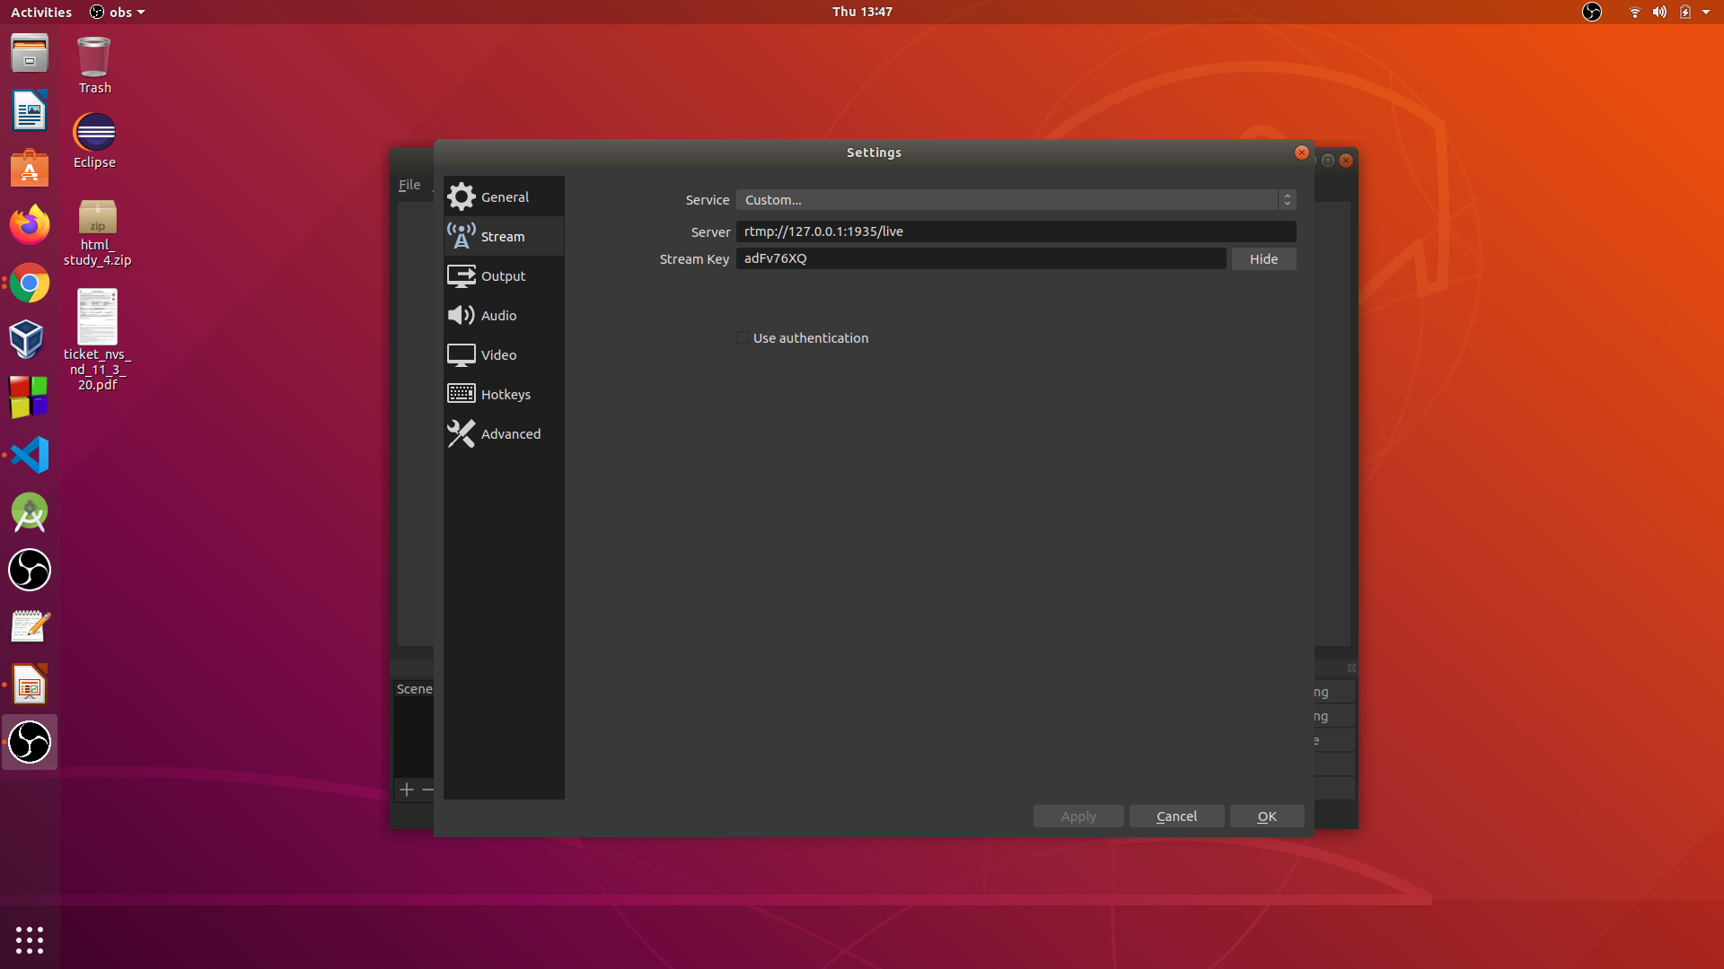
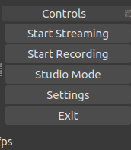

Slide 11
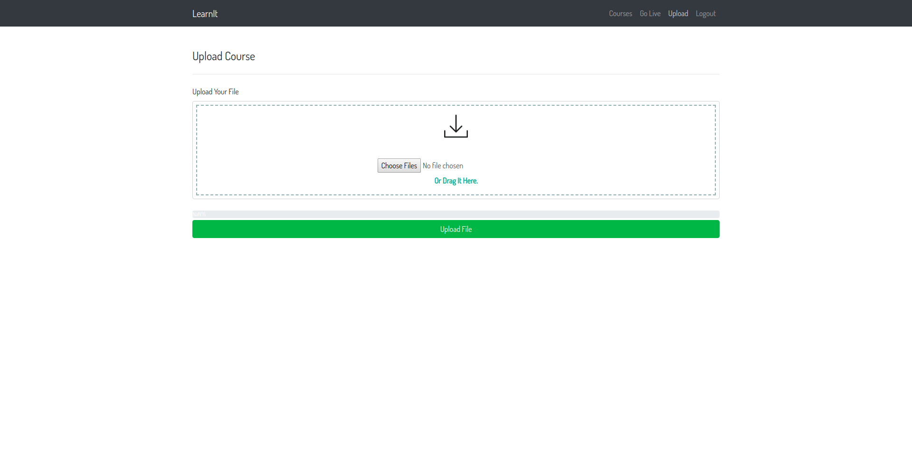
Upload Course page

Slide 12
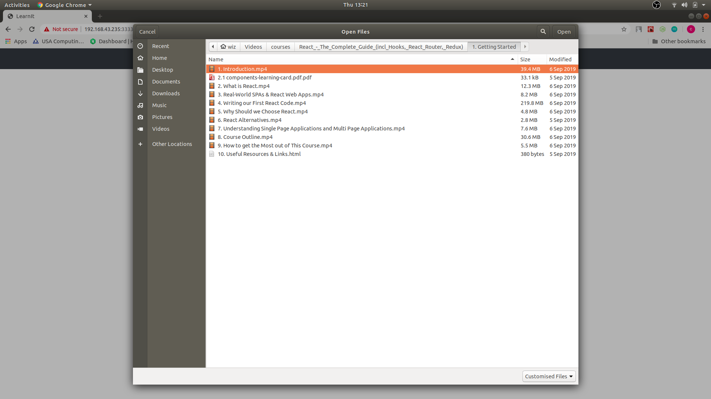
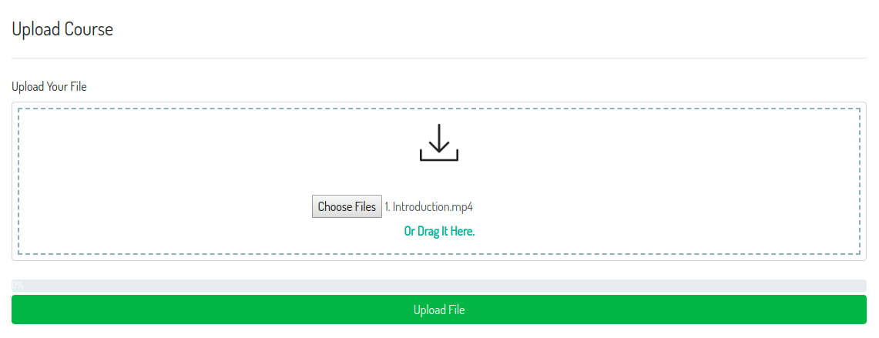
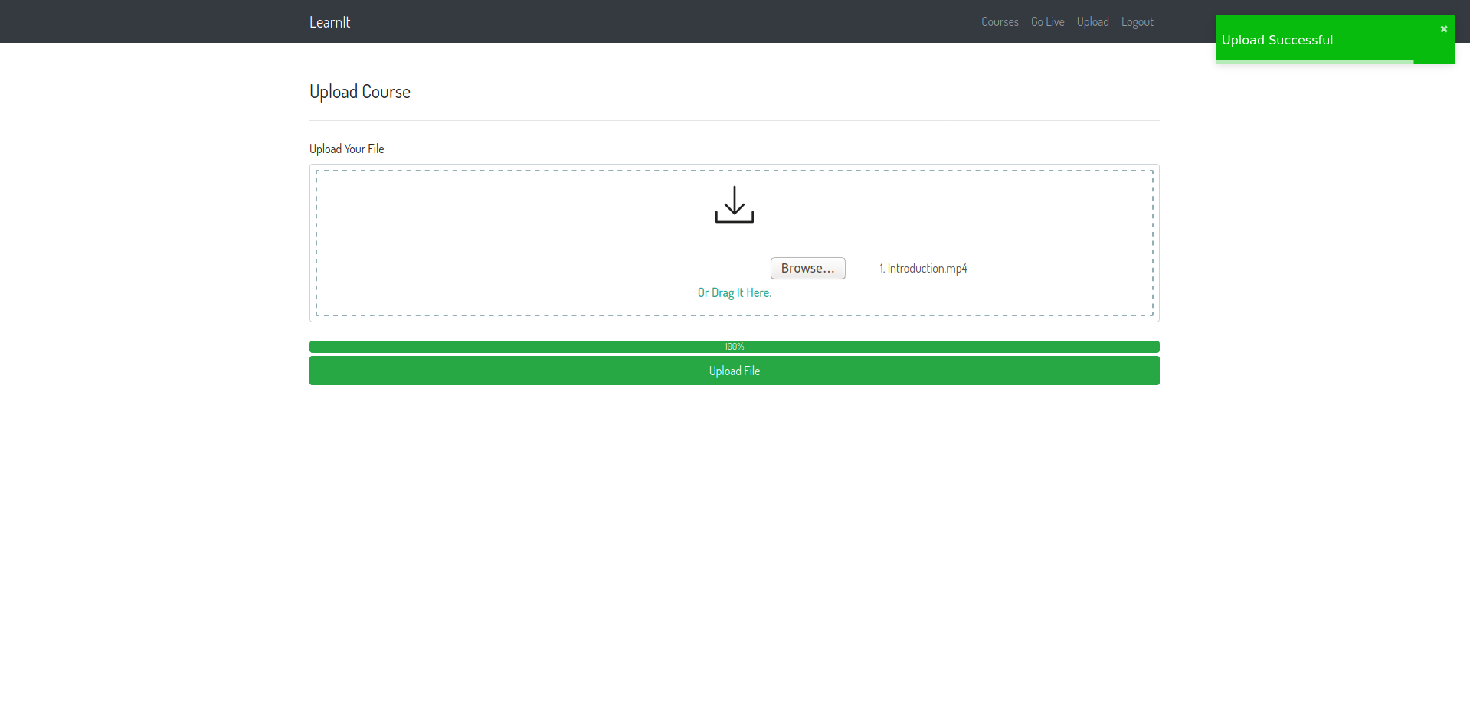
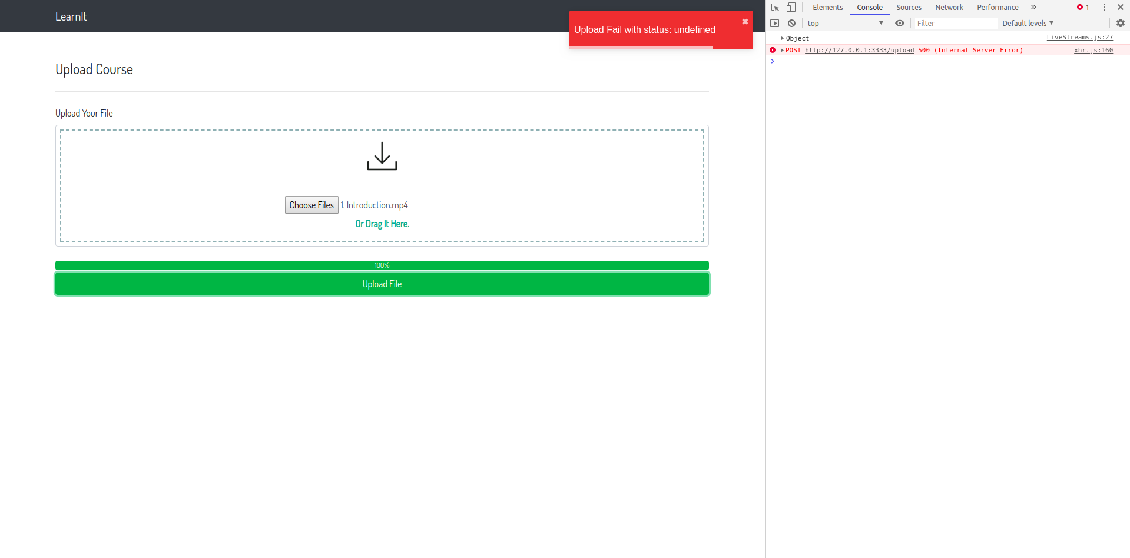

Slide 13
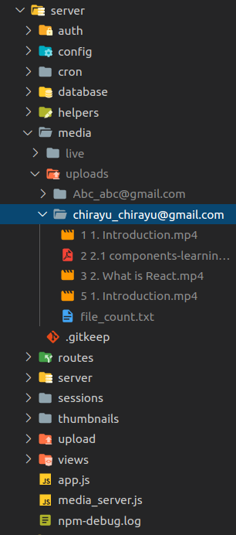
Server side storage

Slide 14
Flow Chart
Login Page
Registration
Page
Home Page
Courses
Go Live
Upload
Logout
Watch courses
Get Streaming Key
Upload Courses
Logout

Slide 15
Limitations
High speed internet required
Media encoder for webapp required
Server with high processing power required

Slide 16
Frameworks, Packages, Libraries, Tools used
For WebApp:
Front-end: ReactJS, axios, video.js, react-router-dom, react-toastify, reactstrap
Background: NodeJS, Express.js, passport.js, Node Media Server, FFMPEG, fs, multer
Tools: OBS Studio
For Mobile App:
Android Studio, Java

Slide 17
Scope of the project
In university, college, schools, coaching institutes, etc
Online educational platform
Online problem solving platform

Slide 18
Learning outcome
I learned some of the trending frameworks like ReactJS and NodeJS
I learned about different protocols like RTMP and RTSP
I learned about HLS, nginx server
I learned how to connect Frontend with Backend using HTTP requests

Slide 19
Further Planning
Imporvement in UI/UX
Chat option when live streaming is on
Watch the uploaded course by user
Live stream from mobile device
Access control of users
Monetization

Slide 20
Courses referred
React – The Complete Guide (incl Hooks, React Router, Redux)
Javascript Essentials
NodeJS – The Complete Guide (incl MVC, REST APIs, GraphQL)

Slide 21
References
https://www.youtube.com/watch?v=qY4XCkTqONw&feature=emb_title
https://github.com/
https://stackoverflow.com/

Slide 22
Github Repository
For project contribution, management and commit history, visit my open source project on github by visiting below link. And don’t forget to star the project ;-)
https://github.com/chirayu-joshi/learnIt

Slide 23
Thank you...

