Slide 1
Week – 6
In the week – 6 I have started working on the Android development part of the same project . In that I have implemented following things:-
Role-Based Access Control (RBAC)
Implemented a secure dual-login architecture that strictly separates Contractor (Admin) and Builder roles, ensuring users only access features relevant to their permission level.
Dedicated Builder Onboarding Flow
Developed specialized Sign-Up and Login interfaces exclusively for Builders, featuring custom form validation and real-time error handling to streamline the registration process.
Context-Aware User Experience
Designed a dynamic UI that visually adapts (e.g., distinct color themes for Builders) based on the selected role, reducing user error and clearly distinguishing user workspaces.

Slide 2
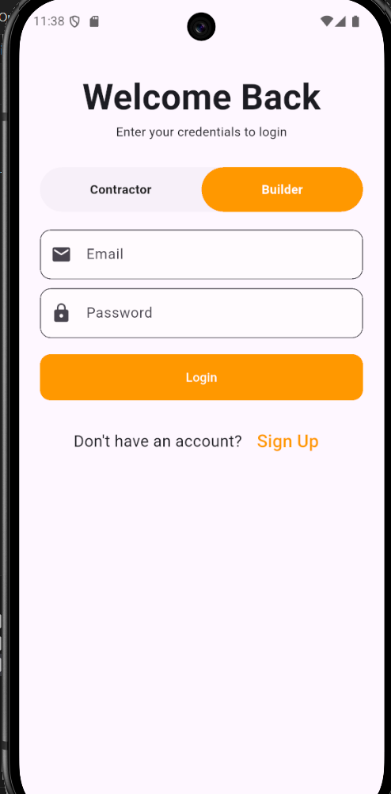
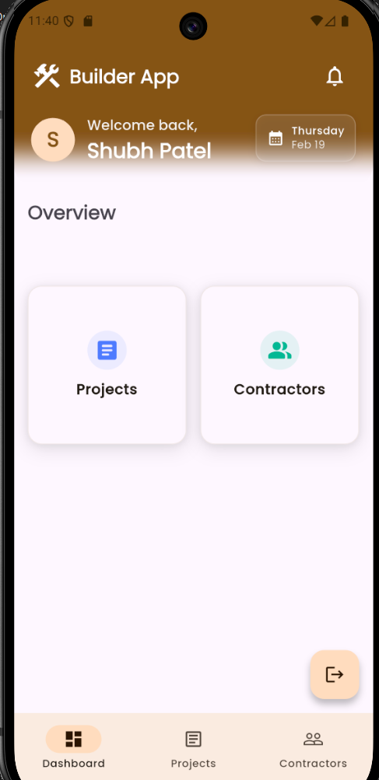

Slide 3
Week - 6
Transitioned from active project development on the LIMA ERP project to specialized technical research.
Conducted a comprehensive study of OpenTelemetry (OTel) as a framework for system observability and performance monitoring.
Researched the Three Pillars of Observability: Traces (request flow), Metrics (performance data), and Logs (system events).
Explored the OpenTelemetry Collector architecture to understand how data is received, processed, and exported to backend monitoring tools.

Slide 4
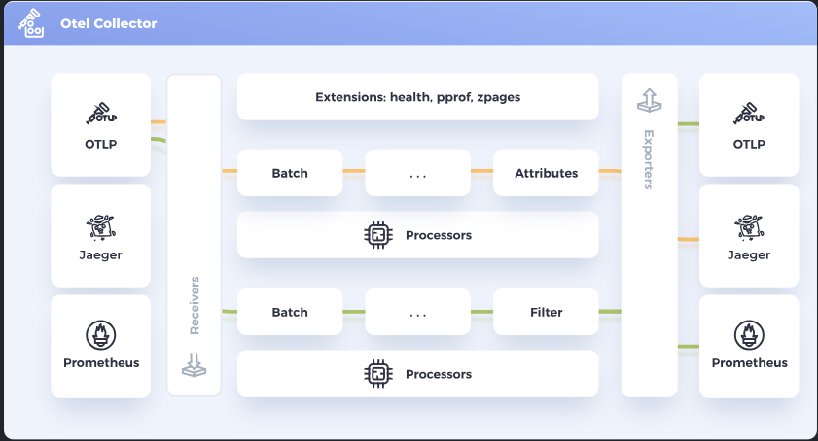
.
The Three Pillars of Observability
Traces: Understanding how to track the path of a single request across multiple services (e.g., from a React frontend to a Node.js controller).
Metrics: Learning to measure system health through quantitative data like response latency and error rates.
Logs: Researching structured logging to improve debugging efficiency in complex environments.

Slide 5
Week – 7
Shifted focus to Agentic AI by researching LangGraph to build a stateful chatbot for the LIMA ERP project.
Studied the core concepts of Stateful Graphs, including Nodes (functional steps) and Edges (conditional logic paths).
Analyzed how Agentic Workflows differ from traditional linear chains by allowing for cycles and self-correction.
Explored State Management using TypedDict to share information like conversation history and tool outputs across different parts of the bot.
Researched Persistence and Checkpointers to enable the chatbot to remember user interactions across multiple sessions.
Studied Conditional Edges, which allow the agent to dynamically decide whether to call a tool or respond directly to the user.
Investigated Human-in-the-Loop patterns to incorporate manual approval steps for sensitive database operations within the ERP.
Evaluated the integration of LangGraph with existing backend services to treat the LIMA database as a searchable tool for the AI.

