Slide 1
Analyzing NYPD shooing incidents dataset 2006-2020
Created by Chirayu Parikh University of Colorado – Boulder Data Science (DTSA 5301) Assignment

Slide 2
NYPD Shooting Incidents Dataset
Publicly available dataset in CSV format: https://data.cityofnewyork.us/api/views/833y-fsy8/rows.csv?accessType=DOWNLOAD
Data is collected from Jan 2006 to Dec 2020
Includes fields such as Data and time of the incident, Borough, perpetrators and victims sex and racial details
Other details such as location (lat and long coordinates) are not required for our analysis
Analysis does using R Markdown with visualization and a model to predict victim's race with the most occurrences in the data set

Slide 3
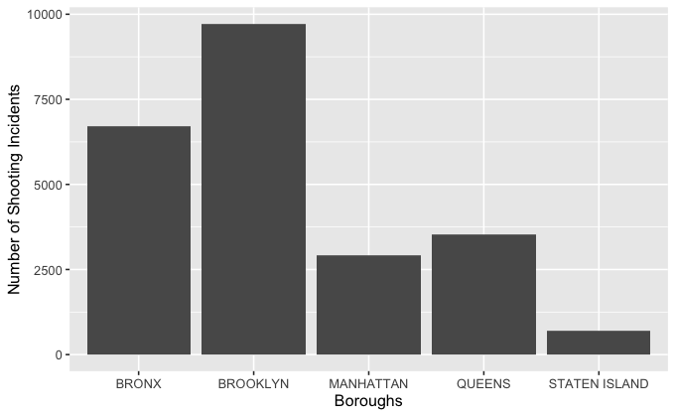
Number of shooting Incidents per borough
Brooklyn has the highest number of incidents follows by Bornx
As expected Staten Island is the lowest

Slide 4
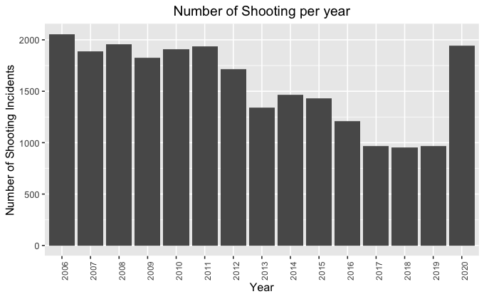
Yearly break down of shooting incidents in NYC from 2006 to 2020
In general we see a downward trend in the number of shooting incidents
Big Spike in 2020

Slide 5
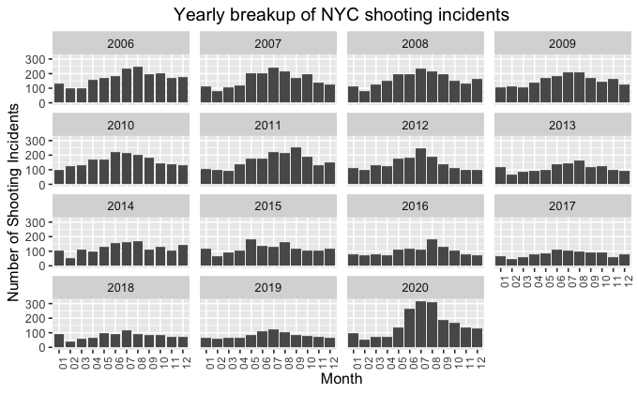
Closer look at the 2020 Spike
A close look at monthly number per year shows June, July and August had the higest number of incidents
This possibly co-insides with the killing of Geroge Floyd and the riots that followed in the aftermath

Slide 6
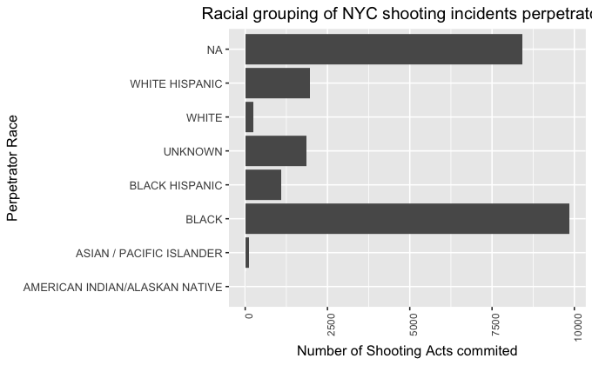
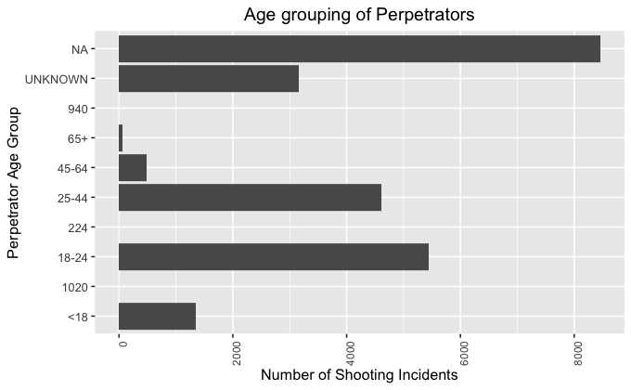
Some missing data points for perpetrators
We see some ‘NA’ for some data point relating to perpetrators
Probably because information about the perpetrator is still not yet known
For example, if there was a shooting event and by the time it was reported the perpetrator(s) could have fled the scene
We can see this in perpetrator’s Age and Race field

Slide 7
Using Naive Model to do a simple prediction
Predict victim's race with the most occurrences in the data set
Create a train and test datasets
First we run the model on train dataset
We then use the test dataset to find the accuracy of the model
In our analysis we found the model accuracy was 71 percent
There is a scope of improvement

Slide 8
Concluding thoughts
The data gives an overall “Big Picture” view of the shooting incidents in NYC
This needs to be combined with other datasets (i.e. socio-economic, etc) to get specific trends and patterns on shootings
Location data was not used, since it’s out of scope for this analysis
Brooklyn has the highest number of incidents followed by Bronx
In general a downward trend, expect for a spike in 2020
Spike possibly related to aftermath of George Floyd killing and riots that followed
The Naive Model used for prediction is not accurate and a better model should be explored

Slide 9
Resources
Dataset in CSV format: https://data.cityofnewyork.us/api/views/833y-fsy8/rows.csv?accessType=DOWNLOAD
Project GitHub link: https://github.com/chirayuparikh/CU_DS_Files

