Slide 1
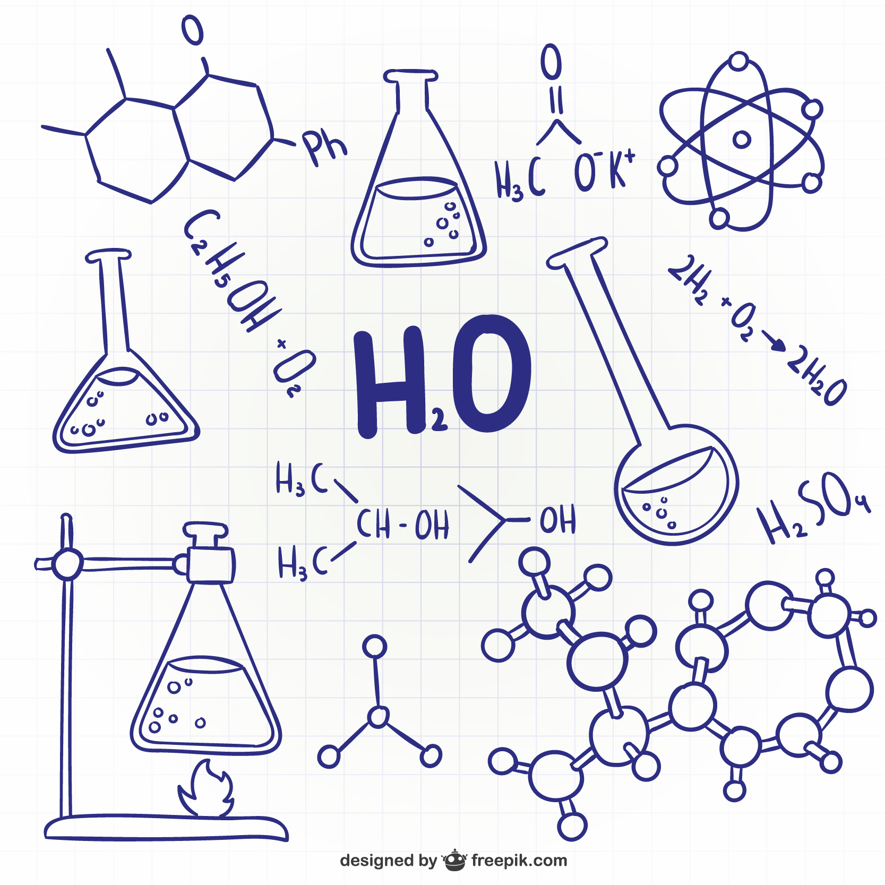
Predicting Chemical Solubility with Data Mining
A journey into predicting solubility using data mining techniques

Slide 2
Explore chemical solubility through data mining
Motivation
Dataset acquisition, expansion, and additional attributes with RDKit
Key steps: preprocessing, exploratory data analysis, regression, and classification.
Conclusion

Slide 3
Motivation
Are Chemists stuck waiting months for slow, expensive, and unreliable solubility tests to hold back vital research?
Can Chemists truly untangle the scientific puzzle of how complex molecules dance with different solvents?
Is predicting the fate of countless compounds just a guessing game due to limited and scattered data?

Slide 4
Data Collection
From where we get the data?
Open-access database called "BigSolDB"
RDKit library

Slide 5
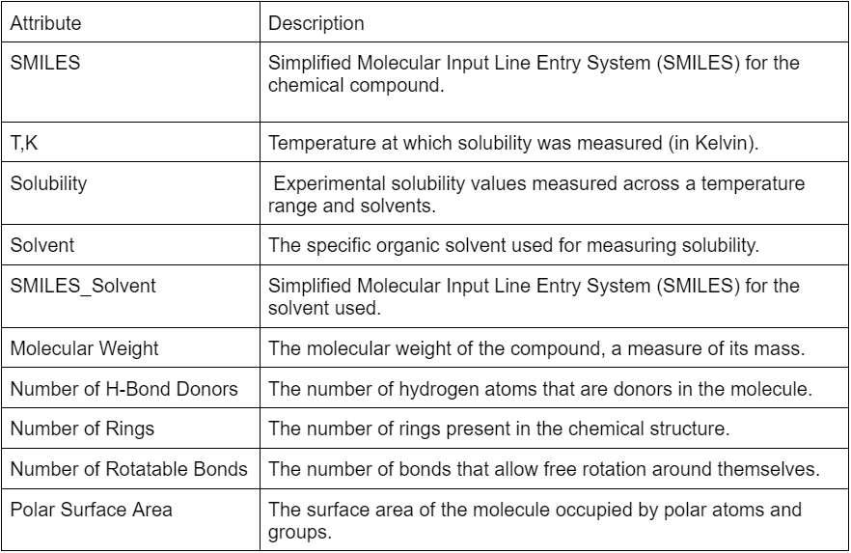
Attributes Definition

Slide 6
Cleaning and preprocessing impact on dataset size
Missing values | Duplicates | Invalid Smile code
2.87% | 670 rows | 3

Slide 7
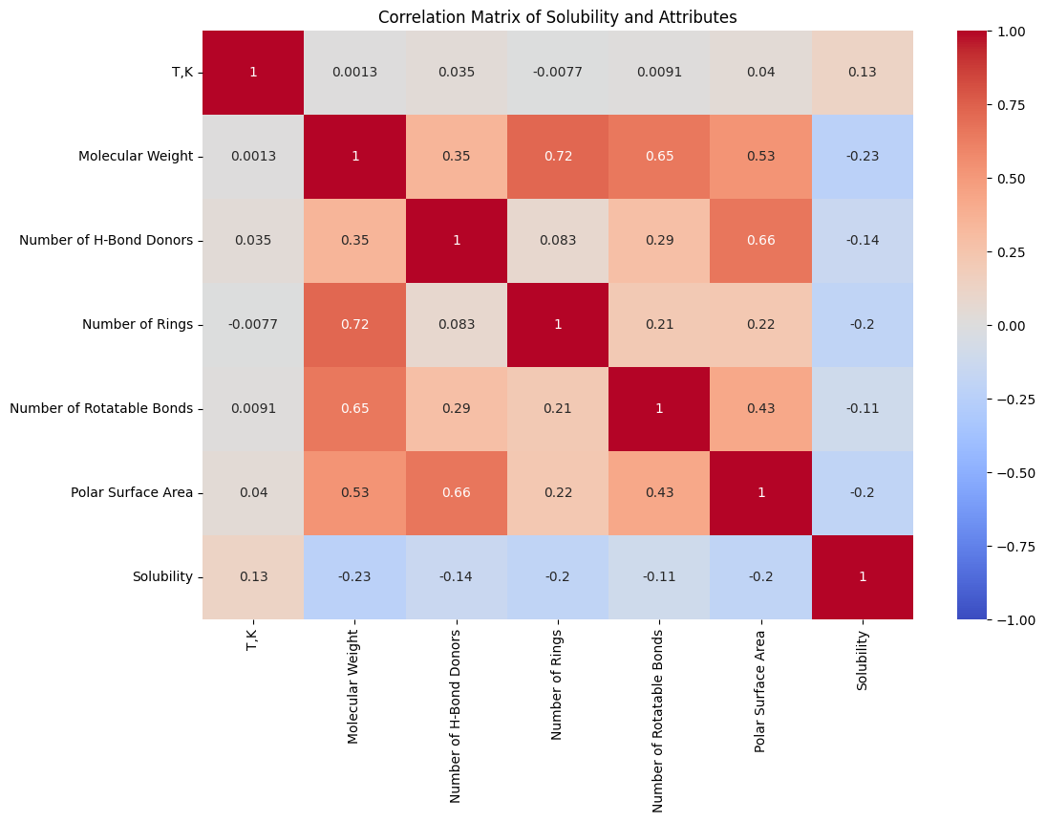
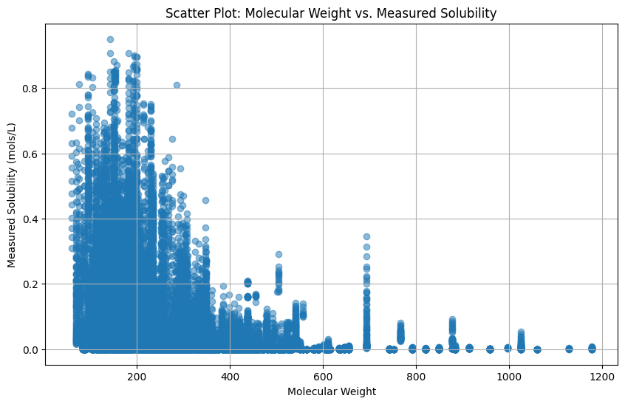
Exploratory Data Analysis

Slide 8
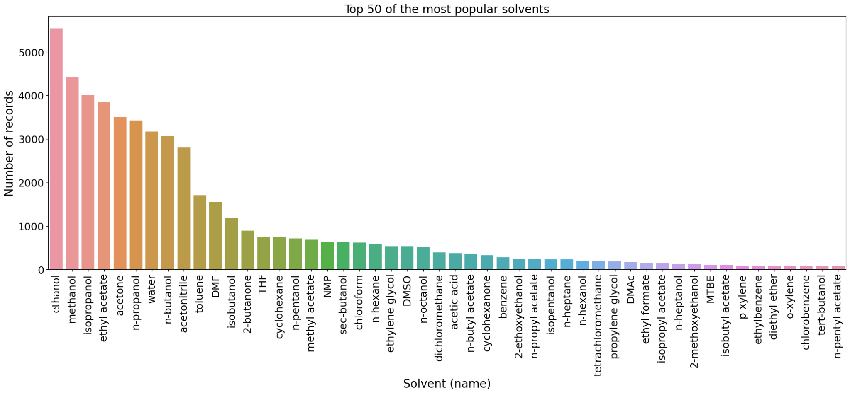
Exploratory Data Analysis

Slide 9
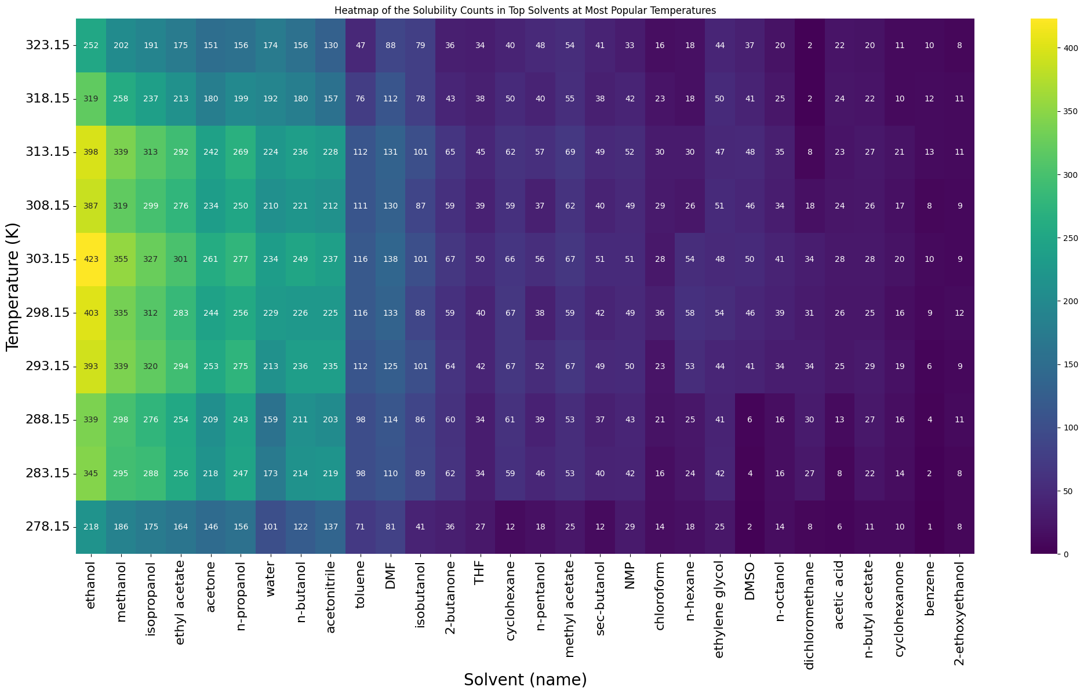
Exploratory Data Analysis

Slide 10
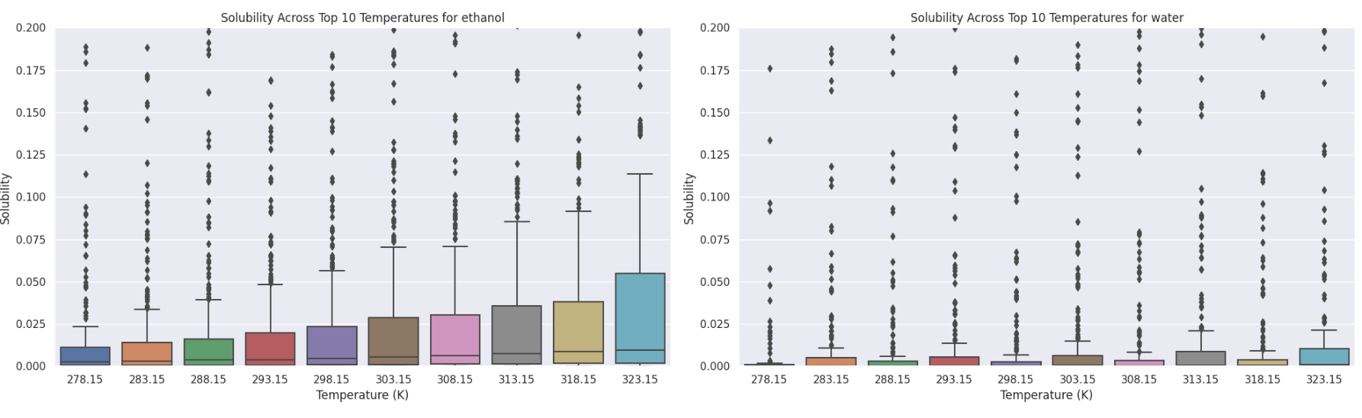
Exploratory Data Analysis

Slide 11
Why not omitting outliers?
Risk of Data Loss:
Simple removal of outliers would result in an almost empty dataset.
Meaningful Contributions:
The outliers hold meaningful information that contributes significantly to the dataset.
Essential for Analysis:
Retaining outliers is essential for conducting a comprehensive and insightful analysis.

Slide 12
Machine Learning Approaches
Regression Approach
Classification Approach

Slide 13
Regression Approach
Model evaluation:
Method evaluation
Stratified 5-Fold Cross-Validation
Evaluation metrics:
EVS
MSE
MAE
R2

Slide 14
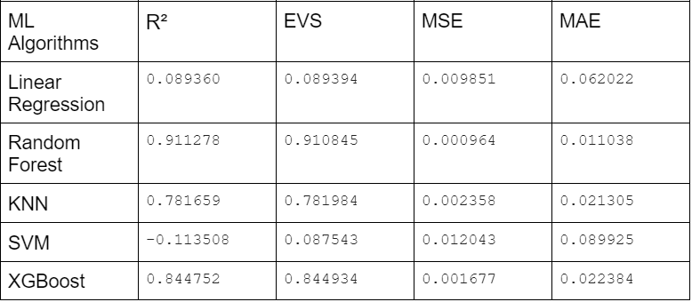
Performance of different machine learning algorithms

Slide 15
Classification Approach
Model evaluation:
Stratified 5-Fold Cross-Validation and Stratified Shuffle Split .
Why One Hot Encoding ?
machine learning algorithms:
Random Forest
k-Nearest Neighbors
Artificial Neural Network
XGBoost

Slide 16
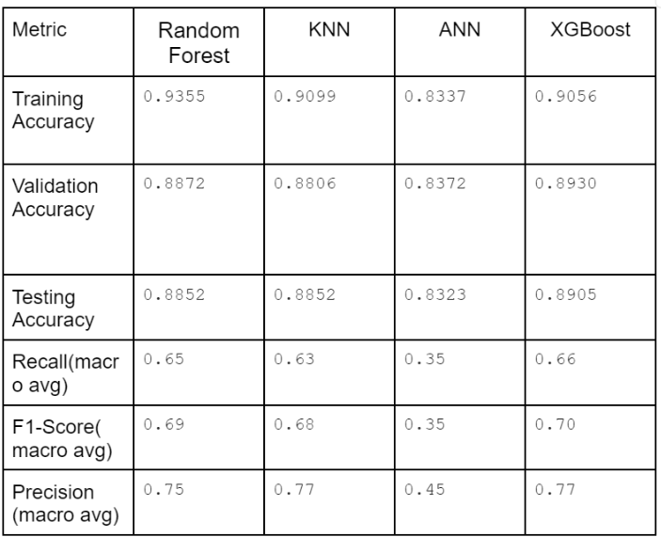
Performances of different machine learning algorithms
With Stratified Shuffle Split XGBoost appears to be the model that best fits the data .

Slide 17
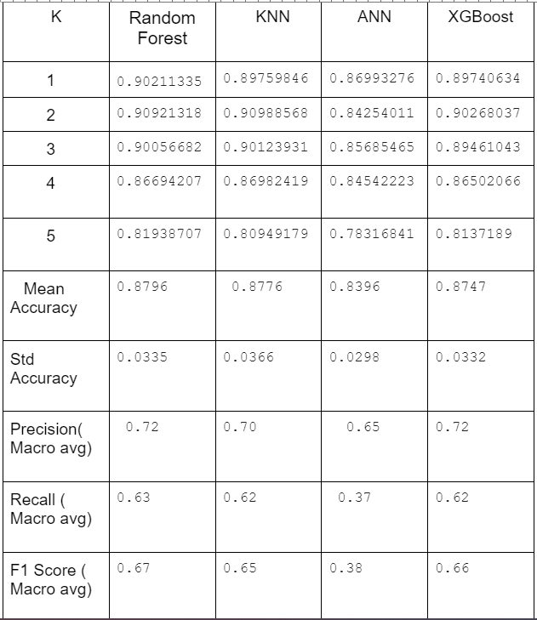
With Stratified 5-Fold Cross-Validation Random Forest appears to be the model that best fits the data overall

Slide 18
Potential Impact
Chemistry:
Accelerated Drug Discovery: Optimal bioavailability for faster drug development. exp:Pfizer
Improved Chemical Processes: Enhanced efficiency, reduced waste, and cost savings.
Agriculture:
Optimized practices, improved crop yields, and minimized environmental impact.
Food Science:
Guided food formulations, improved stability, and optimized extraction processes.
Exp:Nestlé,Kraft Heinz, Danone
Environmental Science: :
Informed environmental cleanup, risk assessment, and remediation technologies.

Slide 19
Conclusion
The project's predictive capabilities offer broad applications in drug discovery, chemical processes, and various industries, addressing solubility challenges and contributing to advancements in science and technology.

Slide 20

WANT BIG IMPACT? USE OUR Solubility prediction MODEL.

Slide 21
Thank you

