Slide 1
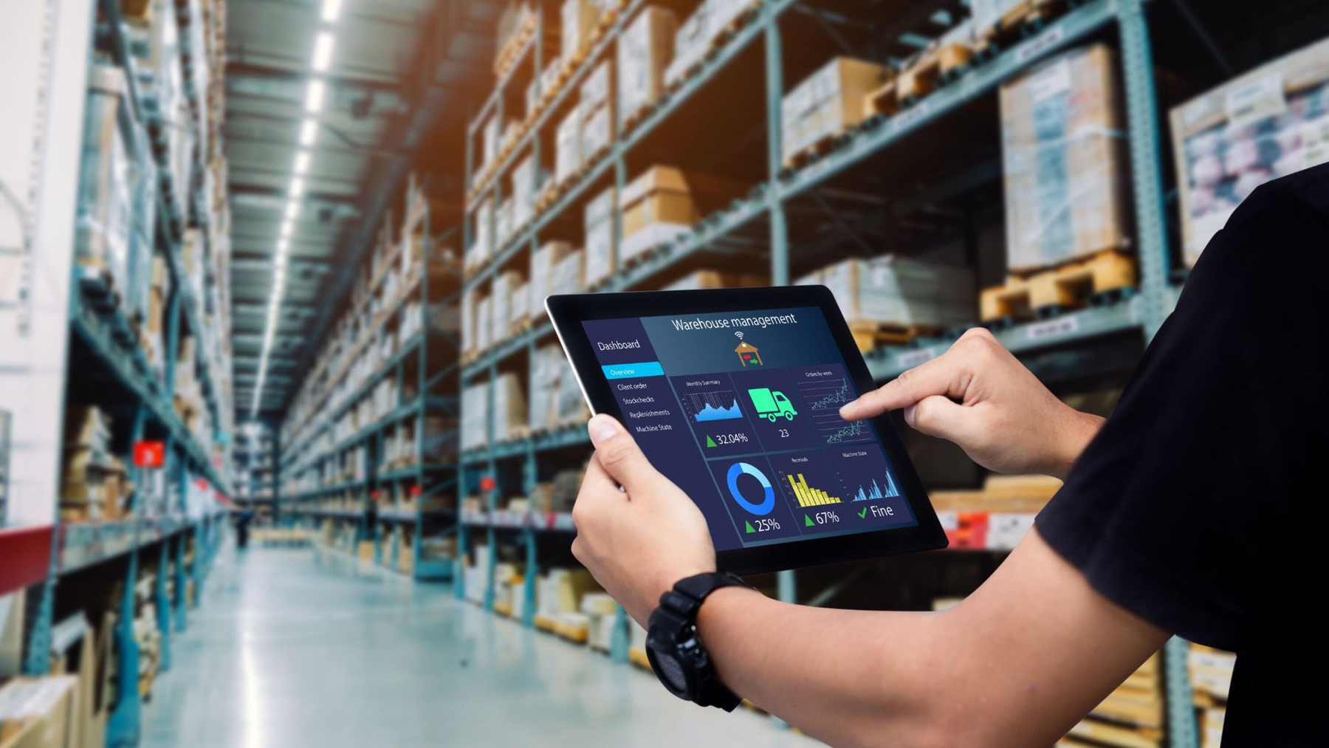

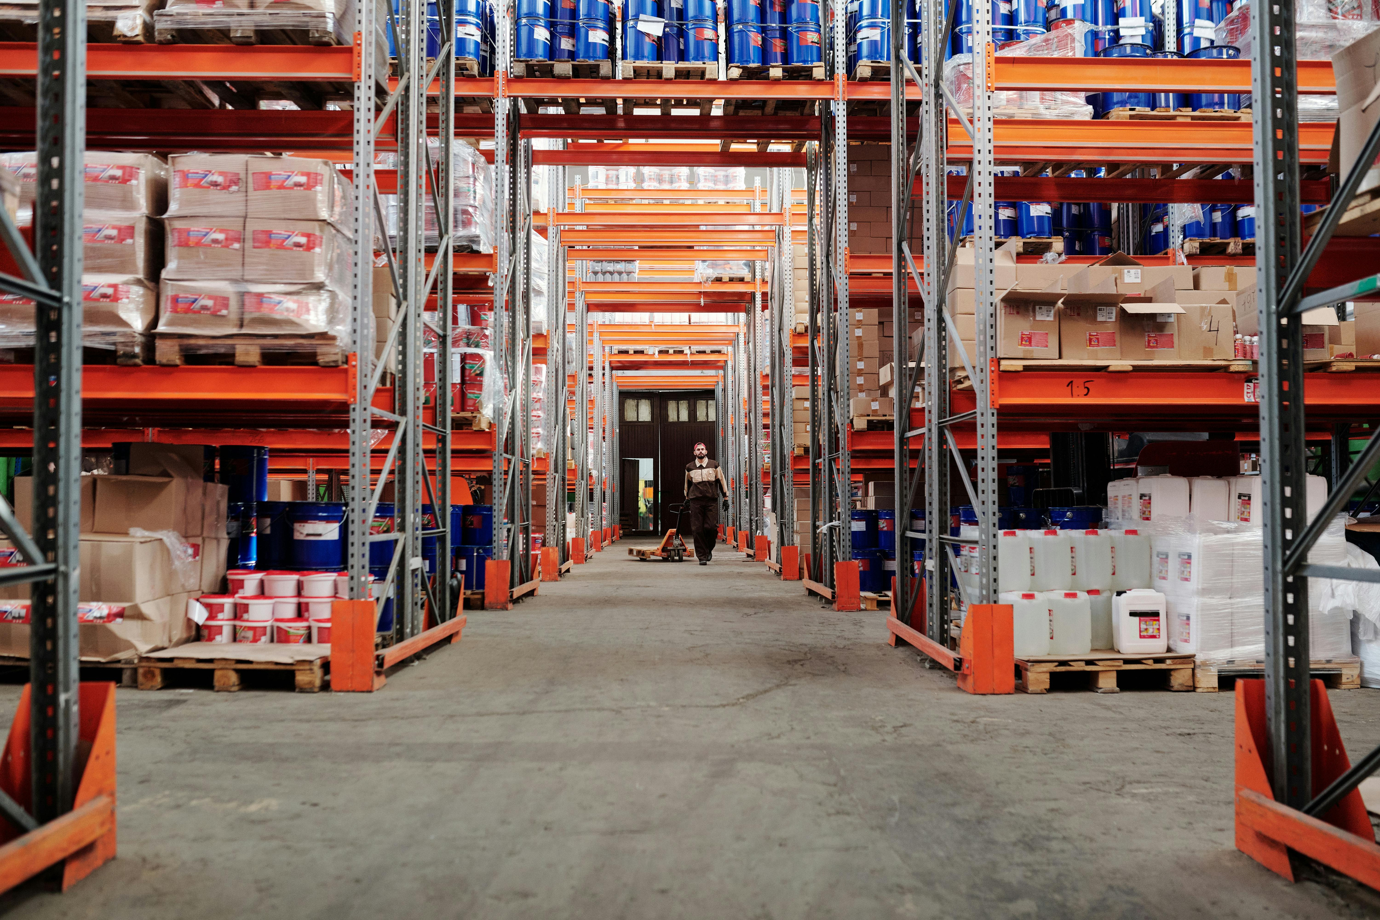

INTELLIGENT
PROCUREMENT
AI AGENT
An AI agent that flags late and risky purchase orders, built on simulated SAP data
OCTOBER 2026
PRESENTED BY: SHYRINE OURARI
Notes:
Introduce yourself and the goal in one sentence: a prototype agent that finds risky purchase orders, explains why, recommends actions and lets people approve the sensitive ones. Everything SAP-related is simulated. Say it upfront.

Slide 2

SAP & AGENTIC AI
FUNDAMENTALS
Agentic AI works toward a goal: it plans the steps, calls tools, looks at the results and acts, within limits set by people.
Rule-based automation: fixed if-then rules. Predictable, but rigid.
Traditional ML: predicts a score, but takes no action.
Chatbot: answers questions, then waits for the next one.
SAP & SAP BTP
Joule & AI agents
How agents reach SAP
  S/4HANA is the ERP core: purchase orders, suppliers, goods receipts and stock.
SAP BTP extends and connects it with integration, APIs, data and AI services.
Generative AI hub (SAP AI Core on BTP) gives governed access to LLMs.
  Joule is SAP's AI copilot inside SAP apps.
Joule Agents handle multi-step work across processes.
Joule Studio (SAP Build) is where custom agents are built, with a human in the loop.
  Data and actions: S/4HANA APIs, for example Purchase Order (OData V4).
Connectivity: BTP destinations and the Cloud Connector.
Process: each API becomes a tool, and approvals and logs stay in the flow.
Notes:
About 2 minutes. Rules are predictable but rigid, ML only predicts, a chatbot only answers; an agent investigates with tools and acts, which is why it needs guardrails, approvals and logging. Joule Studio is where an SAP customer would build such an agent. In this prototype SAP is simulated: the mock tools have the shape of these APIs. Sources: docs/SAP_AND_AGENTIC_AI.md.

Slide 3

THE BUSINESS PROBLEM
68 open purchase orders, 6 of them already overdue. Buyers can't check every order every day.
Late deliveries by supplier category
Share of the 1,607 closed orders delivered after the promised date (synthetic data)
30.5% of deliveries arrive late
9 of 25 suppliers are on time less than 70% of the time
5 of 20 materials below safety stock
Notes:
Frame it from the buyer's view: which orders do I look at first, and why? Delays concentrate on a few suppliers and on electronics; stock is already short for some materials. The numbers come from the synthetic data (seed 42, as of 2026-10-12), designed with realistic patterns.

Slide 4


PROPOSED SOLUTION
Detect and prioritize
Screen all 68 open purchase orders.
Combine business rules and supplier late-rate statistics to assess delay risk.
Rank orders by risk, urgency, material criticality and financial exposure
.
Investigate and explain
Use 4 read tools to retrieve order, stock, supplier and alternative-source information.
Generate evidence-based explanations and draft supplier emails with an LLM.
Use 3 action tools to execute permitted actions or request approval.
Act within limits
Automatically send permitted reminders.
Route higher-impact actions for approval: Procurement Manager up to €10,000; Director above €10,000.
Record decisions and actions in an audit log.
Notes:
One sentence per step. The deterministic core (business rules + the supplier's historical late rate) decides the numbers, the agent orchestrates tools, the LLM only writes text, and people keep the authority for sensitive actions. Every step lands in an append-only audit log.

Slide 5

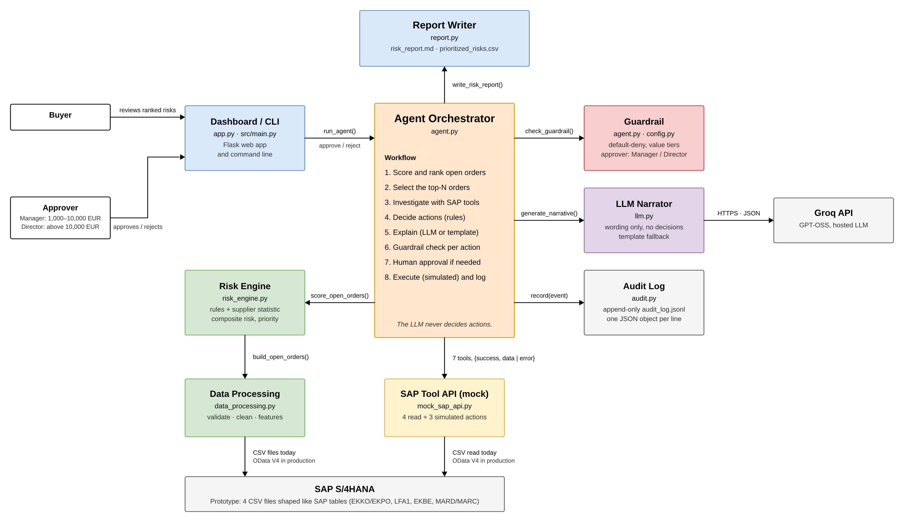
ARCHITECTURE
Notes:
Walk it from the user to SAP. The buyer and the approver use the Flask web app or the CLI. The orchestrator runs the 8-step workflow and calls the risk engine (45% overdue, 30% rules, 25% supplier late rate), the guardrail, the LLM narrator, the audit log and the report writer. SAP data comes in through the mock SAP tool API. In production that API would call the S/4HANA OData V4 APIs through SAP BTP (destinations, Cloud Connector), the LLM would go through the generative AI hub, and approvals would move to SAP Build Process Automation. There is no model to host: the scoring is plain rules and one statistic.

Slide 6

DATA SCIENCE APPROACH
Method
Test ROC-AUC on 350 later orders
Question: which open orders are likely to arrive late, and which matter most?
Data: 1,607 past orders, 30.5% delivered late. 12 bad orders removed, each with a reason.
Statistic: How often each supplier was late before, using only past deliveries.
Rules: stock below safety stock (+40), stock runs out before delivery (+35), supplier on time under 70% (+25).
ML tested: Logistic Regression and Random Forest, trained on older orders, tested on 350 newer ones
Risk score: 45% overdue, 30% rules, 25% supplier late rate.
Why I kept it simple
The ML model did not beat the supplier late rate on this test period (0.659 vs 0.676). Over 10 other generated datasets it was ahead by only 0.025 on average. That is not worth the extra complexity, so the prototype uses the statistic, which anyone can recompute and explain.
Notes:
Say it clearly: I tried machine learning and measured it honestly. With a temporal split and time-series cross-validation, the Logistic Regression reached 0.659 test ROC-AUC; the supplier late rate alone reached 0.676, and even the generator's true probability only reaches 0.703, delays here are mostly random draws. Over 10 other generated datasets the model was ahead by only 0.025 on average. The brief asks for a simple, well-explained solution, so the risk score uses business rules and that one statistic. With real SAP history and richer features (lead time, plant, season) I would test a model again.

Slide 7


Prototype Demo
Notes:
Switch to the web app and follow the brief step by step: data quality on the Overview; the risk ranking (priority is not risk: PO 4500000342 is Medium but ranks 3rd); investigate PO 4500000337 (overdue, stock below safety stock, supplier late 64% of the time); the reminder is automatic, the supplier replacement waits for the Director; reject it with a reason; show the audit log. If the live demo fails, play the recorded 3-minute video from its own file.

Slide 8
KEY LEARNINGS
SAP Ecosystem: Understanding how S/4HANA, BTP, OData APIs, and Joule fit together.
From PoC to Production: Identifying the requirements for real SAP integration, monitoring, and governance.
Business-Driven AI: Translating procurement needs and constraints into an intelligent solution.
Notes:
Close with the learnings, they are the personal part. Everything under 'Next steps' is future work, not implemented. Invite questions; presentation/DEMO_SCRIPT.md has prepared answers (why no ML, where the weights come from, what the LLM decides).

