Slide 1
Early Warning of Pitcher Arm Injuries from
Pitch-Tracking Time Series (MLB Statcast)
2026.MM.DD
[Presenter name]

Slide 2
Motivation
Why pitcher injury matters
Pitcher injuries keep rising
  MLB pitcher IL placements: 212 (2005) → 485 (2024); IL days 13,666 → 32,257 (AP, 2024)
  Elbow-related IL days roughly tripled: 3,940 → 12,185
The cost is large
  2015–2025: 1,122 pitchers, 2,365 shoulder/elbow IL placements, about $3.33B in lost salary; 68.3% from elbow injuries (Dillon et al., OJSM)
Why it matters
  Once a pitcher is on the IL, the damage is already done
  If warning signs are caught early → adjust rest days, manage workload, give rest

Slide 3
Motivation
Injury risk is a time series
Each pitcher has his own normal
  Velocity, velocity variability, release point per appearance
  Trend: league-wide "velocity revolution" (velocity rises every season)
  Seasonality: velocity tends to rise later in the season
  Exogenous drivers: rest days, recent pitch counts (7/14/28 days), ACWR, temperature
If we can forecast a pitcher's normal, deviations become warnings
Connects to our course
  ARIMA / ARIMAX, EWMA, anomaly detection on residuals
Per-appearance pitch series
Forecast the pitcher's own normal
Residual anomaly = early warning
Rest / workload adjustment

Slide 4
Related work
(1) Velocity as an injury signal
Study | Research Focus | Methodology | Important Contribution | Limitation
Prodromo et al. (2016) | Pitch characteristics before Tommy John surgery (UCLR) vs. age-matched controls | Case-control, conditional logistic regression | Higher fastball velocity before surgery; velocity is a significant variable | Compares pitcher vs. pitcher with season averages; cannot tell when change happens
Mayo et al. (2021) | Trends in the last 15 games before UCLR (223 pitchers) | Mann-Kendall trend test | Four-seam velocity fell ~0.1 mph/game (tau = −0.657, P < .001); spin rate fell ~5 rpm/game | No healthy controls; no alert rule
Mastroianni et al. (2026) | Pitch metrics before IL vs. healthy baseline | Linear mixed models with personal baseline | Last 5 appearances: velocity drops (P = .019), horizontal release variability rises (P = .005) | Retrospective comparison; no online, updating detection

Slide 5
Related work
(2) Detection methods and workload
Study | Research Focus | Methodology | Important Contribution | Limitation
Ozaki (Master's thesis, AUT) | Detecting deviation before UCLR (46 pitchers, 2016–2024) | Autoencoder anomaly detection on 40 features | Deviation grew 2.7× near surgery; code and matched controls (45 pairs) are public | Healthy pitchers also flagged (73% vs. 66%); intentionally ignores time order
Bright et al. (2026) | Injury-risk screening from broadcast video | Time-aware ML with irregular-interval correction | Personal baseline + interval weighting improves prediction | Uses video estimates, not measured tracking data
Slowik et al. (2021) | Workload and upper-extremity injury in college pitchers (n = 17) | ACWR with ROC threshold | ACWR change beyond ±33% → 8.3× next-week injury risk | Tiny sample, wide CI (1.8–54.1); 3-week chronic window

Slide 6
Research Background
Limitations of Previous Studies and Novelty (1)
Limitations of Previous Studies
  Most studies compare injured vs. healthy pitchers with season averages; within-pitcher change over time is rarely modeled.
  Injury signals should be read against each pitcher's own time series.
  Pre-injury trends were tested, but never turned into an alert rule; false alarms on healthy pitchers were not counted.
  We need an early-warning system evaluated by lead time and false alarms.
  The one anomaly-detection study avoided time-series models, fearing they absorb slow decline into the baseline.
Novelty of the Proposed Method
  Pitcher-specific time-series baseline: forecast each pitcher's expected velocity, flag residuals
  Performance + workload together: velocity, variability, release + rest days, 7/14/28-day counts, ACWR
  Interpretable early-warning evaluation on open data: lead time, false alarms, healthy controls

Slide 7
Research Background
Limitations of Previous Studies and Novelty (2)
Season averages
injured vs. healthy
Retrospective test
no alert rule
Injury noticed
after IL
Current
practice
Per-appearance
time series per pitcher
ARIMAX / EWMA
residual
Early warning
→ adjust workload in time
Proposed

Slide 8
Dataset: MLB Statcast (2021–2026)
Dataset
Sources
  Pitch data: Baseball Savant Statcast, pitch-by-pitch
  Injury labels: MLB official API transactions (IL placement date, body part)
  Temperature: MLB API game weather, filled with Open-Meteo if needed
Data info
  Period: 2021–2026 regular seasons
  Size: ~4,500 pitches/day, ~700K pitches/season; ~250 arm-injury events/season
  Frequency: pitches aggregated per appearance; starters every ~5 days, irregular
  Key variables: velocity, release side/height, extension, spin rate, pitch type, pitcher, date, game ID
  Exogenous: rest days, 7/14/28-day pitch counts, temperature, month, starter vs. reliever
Research suitability: long, open, pitch-level series linked to real injury labels, so warnings can be tested against what actually happened.

Slide 9
Dataset: MLB Statcast (2021–2026)
Unit of analysis and variables
Group | Variable | Definition
Performance | Velocity | Mean & max fastball velocity per appearance
 | Velocity variability | SD of fastball velocity per appearance
 | Release point | Mean & SD of horizontal / vertical release
 | Auxiliary | Spin rate, extension, in-game velocity decay slope
Workload | Rest days | Days since last appearance
 | Recent load | 7/14/28-day cumulative pitches
 | ACWR | 7-day ÷ 28-day average load
  Unit: pitcher × appearance; time axis = appearance index, rest days as a separate variable
  Injury event: IL placement for an arm-related reason
  IL records are used only for evaluation, never for training

Slide 10
Injury early warning
Approaches (1)
Approach: early warning as time-series anomaly detection
  Learn each pitcher's normal level from his past appearances; score how far the current appearance deviates
Research questions
    RQ1. Do velocity, its variability, and release point move away from a pitcher's own normal in the last few appearances before injury?
    RQ2. How early and how accurately can the residual (actual − forecast velocity) detect injury?
    RQ3. Do workload indicators (rest days, 7/14/28-day pitch counts) improve alert performance?
    RQ4. Does signal strength differ for starters vs. relievers and hard throwers vs. others?
Alert success
  Alert raised within the last K appearances before IL placement (K = 5 candidate, following Mastroianni et al.)

Slide 11
Injury early warning
Approaches (2)
Model Selection
  Baseline 1: Random score (chance level)
  Baseline 2: Simple rule (velocity drops X mph below season average)
  Baseline 3: Workload rule (ACWR outside ±33%)
  Model 4: EWMA (cumulative detection of gradual standardized velocity drop)
  Model 5: ARIMAX (expected velocity given rest days, temperature, ballpark; anomaly = residual)
  Model 6: Multivariate (MEWMA, Isolation Forest): velocity + variability + release + workload
  (Optional) LSTM autoencoder
Evaluation
  Time-ordered split: train 2021–2024, validation 2025 (alert threshold), test 2026
  Subgroups: hard throwers vs. others, starters vs. relievers
Task | Metric
Velocity prediction | MAE, RMSE
Injury detection | F1
Classification | AUROC, AUPRC
Early warning | Lead time (+ false alarms on healthy pitchers)

Slide 12
Injury early warning
Approaches (3): framework
Input data
Statcast pitches
+ MLB IL transactions
+ weather
Appearance series
Per-pitcher velocity, variability, release point, by appearance index
Models
Rules · EWMA · ARIMAX
MEWMA / Isolation Forest
Output
Anomaly score →
Injury warning
+ lead time
Exogenous X: rest days · 7/14/28-day pitch counts · ACWR · temperature · month · starter/reliever

Slide 13
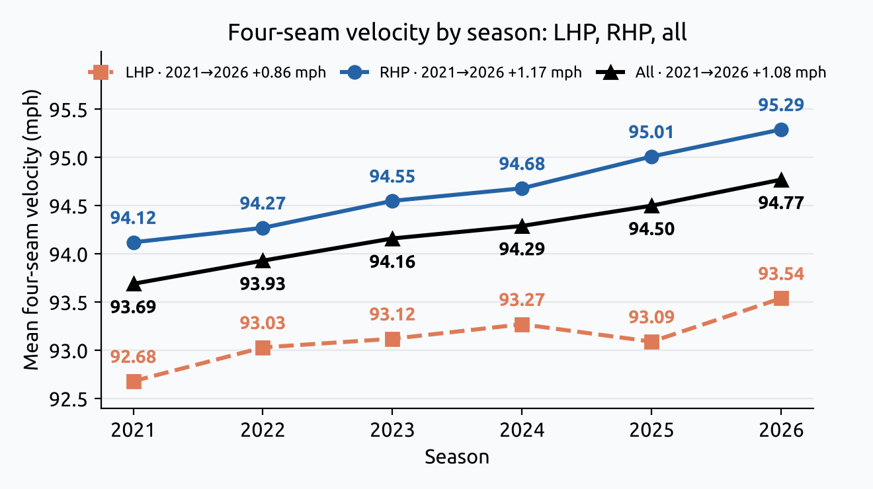
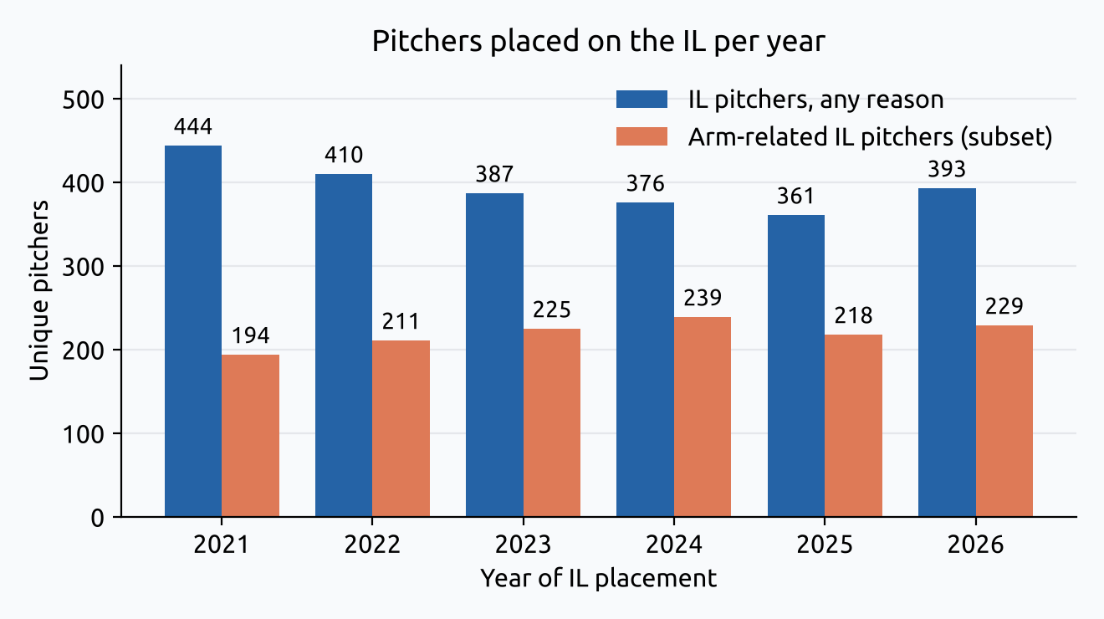
EDA of the dataset
Exploratory Data Analysis (1)
Annual four-seam velocity (left) and IL pitchers per year (right), 2021–2026 (own analysis)
  Upward trend: league four-seam velocity 93.69 → 94.77 mph (+1.08) in 2021–2026; RHP +1.17, LHP +0.86 → need a pitcher-specific, detrended baseline
  Arm injuries are a large share: arm-related IL pitchers 194–239 per year, about 44% (2021) → 58–64% (2023–2026) of all IL pitchers

Slide 14
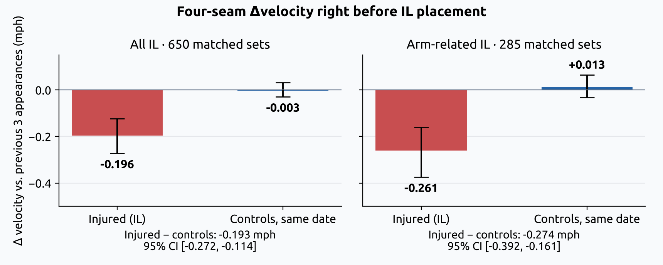
EDA of the dataset
Exploratory Data Analysis (2)
Four-seam Δvelocity right before IL: injured vs. controls at the same date (bootstrap 2,000×)
  Δvelocity = last appearance vs. average of previous 3 appearances
  All IL: −0.196 mph vs. controls −0.003 → difference −0.193 [95% CI −0.272, −0.114]
  Arm-related IL: −0.261 mph vs. controls +0.013 → difference −0.274 [95% CI −0.392, −0.161] → a measurable pre-injury velocity drop

Slide 15
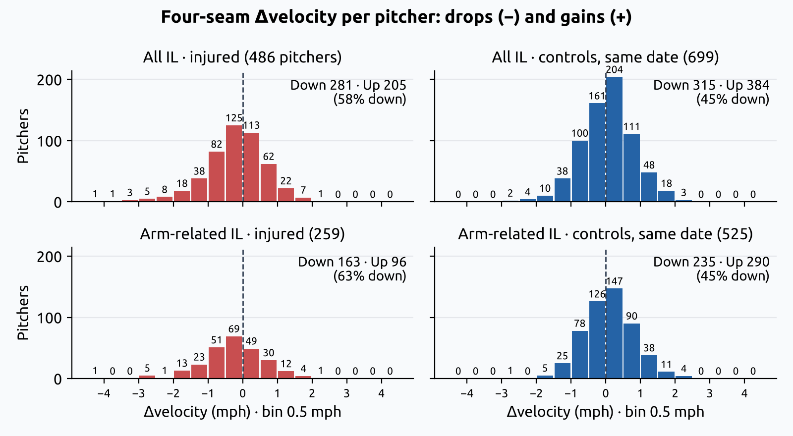
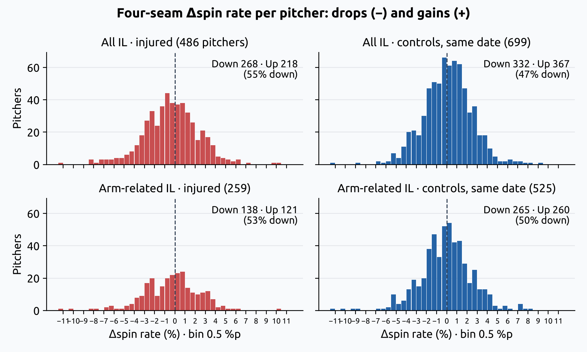
EDA of the dataset
Exploratory Data Analysis (3)
Distribution of four-seam Δvelocity (left) and Δspin rate (right): IL vs. controls (own analysis)
  Velocity: arm-related IL 163 down / 96 up (63% down) vs. controls 235 / 290 (45% down)
  Spin rate: arm-related IL 138 / 121 (53% down) vs. controls 265 / 260 (50% down) → weak signal, auxiliary only
  Distributions overlap heavily: a single-feature threshold will cause many false alarms → combine velocity, variability, release, and workload; evaluate false alarms

Slide 16
Expected Contributions
Expected Contributions
Individualized Modeling
Anomaly detection against each pitcher's own velocity level
Temporal Pattern Analysis
How velocity changes and how long anomalies persist before injury
Workload Integration
Rest days and ACWR as exogenous drivers
Early Injury Detection
Test whether warnings come before IL, with lead time and false-alarm rate

