Slide 1
Early Warning of Pitcher Arm Injuries
from Pitch-Tracking Time Series
MLB Statcast, 2021–2026 regular seasons
2026.10.27
Department of Data Science
Soyeon Kim · Minseo Jeong · Donghan Kang · Minseok Choi

Slide 2
Contents
Outline
01
Background Problem statement, injury trends, why time series
p. 3–4
02
Related work Studies in four topics, limitations, our novelty
p. 5–8
03
Data MLB Statcast 2021–2026, unit of analysis, variables
p. 9–10
04
Method Research questions, framework, split · models · metrics
p. 11–13
05
EDA Velocity trend, injury sites, pre-IL velocity and spin
p. 14–18

Slide 3
Background
Background
Related work
Data
Method
EDA
Problem statement: what and why
Goal Detect departures from a pitcher's own normal in per-appearance velocity, velocity variability, and release point, and raise a warning before an arm-injury IL placement
MLB pitcher injuries, 2005 vs 2024 (AP)
  IL placements 212 → 485, IL days 13,666 → 32,257; elbow-injury IL days roughly tripled (3,940 → 12,185)
  Shoulder and elbow injuries, 2015–2025: 1,122 pitchers, 2,365 IL placements, about $3.33B in lost salary (Dillon et al., OJSM)
  Once a pitcher is on the IL, the loss has already happened. The real question is not who is at risk but when to rest him
  Catching early signs lets teams adjust rest days, manage workload, or give rest

Slide 4
Background
Background
Related work
Data
Method
EDA
Why this is a time-series problem
Autocorrelation
The signal is defined only as a deviation from the pitcher's own past
Shuffle the order of appearances and the signal disappears
So we can forecast the next value from the past and monitor the residual
Trend
The 'velocity revolution' keeps raising league four-seam velocity
93.69 → 94.77 mph (2021→2026): +1.08, up every single season
A component that must be removed before judging a pitcher's anomaly
Seasonality
Velocity is higher later in the season than early on
2025: April 94.18 → June 94.61 mph, then flat; 2024 has the same shape (94.04 → 94.40)
Injuries themselves also tend to cluster in certain parts of the season
Exogenous variables
Rest days (days since the last appearance)
Pitches thrown in the last 7 / 14 / 28 days, ACWR (acute : chronic workload)
Separate velocity changes explained by rest and workload from injury signals

Slide 5
Related work
Background
Related work
Data
Method
EDA
(1) Velocity–injury link · normal vs. pre-injury
Study | Data · method | Key result | Limitation (vs. ours)
Topic 1. Studies supporting the premise that velocity is linked to injury
Prodromo et al. (2016) | UCLR pitchers vs. age-matched controls (2002–2015) Case-control, conditional logistic regression | Higher velocity in the season before surgery; mean fastball velocity was significant | Compares pitchers with season averages → cannot tell when change happens
Topic 2. Studies comparing a pitcher's normal with the pre-injury period
Mastroianni et al. (2026) | 78 UCL-surgery pitchers vs. 156 matched controls Within-pitcher change | Gradual velocity drop over the last 5 appearances (P = .019); larger horizontal release variability (P = .005) | Retrospective; no AUC or lead time reported
Ozaki (2026, MS thesis) | 46 UCLR pitchers (2016–2024) Autoencoder anomaly detection | Anomaly grew 2.7× closer to injury; code and 45 matched pairs released | Healthy pitchers also flagged (73% vs. 66%); time order ignored on purpose

Slide 6
Related work
Background
Related work
Data
Method
EDA
(2) Time-series methods · exogenous variables
Study | Data · method | Key result | Limitation (vs. ours)
Topic 3. Studies using time-series methods
Mayo et al. (2021) | Last 15 games before UCLR, 223 pitchers Mann-Kendall trend test | Four-seam velocity fell ~0.1 mph per game (tau = −0.657, P < .001); spin fell ~5 rpm per game | No healthy controls; no alert rule
Bright et al. (2026) | 3D pose from broadcast video Screened 7,348 pitchers | AUC 0.811 for Tommy John surgery, 0.825 for severe arm injury | Video estimates; point-in-time screening, not a per-pitcher time-series alert
Topic 4. Studies on exogenous variables
Slowik et al. (2021) | 17 college pitchers ACWR with a ROC-chosen cutoff | ACWR change beyond ±33% → 8.3× next-week injury risk | Small sample (95% CI 1.8–54.1); 3-week chronic window

Slide 7
Related work
Background
Related work
Data
Method
EDA
Limitations of previous studies
Limitation 1
Limitation 2
Limitation 3
Injured vs. healthy pitchers compared with season averages
Trend tests only: no alert rule, no false-alarm count
Appearances treated as independent or averaged over a season (autocorrelation ignored)
What is needed
What is needed
What is needed
Read change against each pitcher's own time series
An alert system judged by lead time and false alarms
A time-series model that forecasts the next appearance from past ones and monitors the residual

Slide 8
Related work
Background
Related work
Data
Method
EDA
Novelty of our approach
Core idea a per-pitcher time-series baseline; monitor the gap (residual) between actual velocity and the velocity forecast from his own past
1. Multivariate time series on open data
2. Evaluating a real alert system, not just a test
Performance velocity · variability · release
How early? days before the IL placement
Workload rest days · pitch counts · ACWR
How often wrong? false-alarm rate
Uses only public Statcast and MLB records → reproducible results
None of the studies we reviewed reports both lead time and false-alarm rate

Slide 9
Data
Background
Related work
Data
Method
EDA
Dataset: MLB Statcast (2021–2026)
Sources
  Pitch data: Baseball Savant Statcast, pitch by pitch
  Injury labels: MLB official API transactions (IL placement date, body part)
  Temperature: MLB API game weather, filled with Open-Meteo if needed
Data info
Item | Description
Period | 2021–2026 regular seasons (6), after the 2017 velocity redefinition and 2020 Hawk-Eye switch
Size | ~4.38M pitches · 855–909 pitchers per season · 3,340 IL placements (1,683 arm-related)
Frequency | Pitches aggregated per pitcher × appearance (irregular spacing)
Key variables | Velocity, release side / height, extension, spin rate, pitch type, pitcher, date, game ID
Exogenous | Rest days, 7 / 14 / 28-day pitch counts, ACWR
  Suitability: a long, open, pitch-level series linked to real injury labels, so warnings can be checked against what actually happened

Slide 10
Data
Background
Related work
Data
Method
EDA
Unit of analysis and variables
Group | Variable | Definition
Performance | Velocity | Mean & max fastball velocity per appearance
 | Velocity variability | SD of fastball velocity per appearance
 | Release point | Mean & SD of horizontal / vertical release
 | Auxiliary | Spin rate, extension, in-game velocity decay slope
Workload | Rest days | Days since the last appearance
 | Recent load | Cumulative pitches over 7 / 14 / 28 days
 | ACWR | 7-day ÷ 28-day average load
  Unit: pitcher × appearance; time axis = appearance index, rest days as a separate variable
  Injury event: IL placement for an arm-related reason
  IL records are used only for evaluation, never for training

Slide 11
Method
Background
Related work
Data
Method
EDA
Research questions
RQ1
How early and how accurately can the residual (actual − velocity forecast from the pitcher's own past) detect an arm-injury IL placement?
RQ2
In the last few appearances before injury, do velocity, its variability, and release point move away from the pitcher's own normal?
RQ3
Do workload indicators such as rest days and 7 / 14 / 28-day pitch counts improve alert performance?
RQ4
Does the strength of the warning signal differ between hard throwers and other pitchers?

Slide 12
Method
Background
Related work
Data
Method
EDA
Framework
Input data
Statcast pitches
+ MLB IL records
Appearance series
Per-pitcher velocity, variability, release point by appearance index
Models
Rules · EWMA · ARIMAX
MEWMA · ML comparison
Output
Anomaly score →
injury warning
+ lead time
Exogenous X: rest days · 7 / 14 / 28-day pitch counts · ACWR
Alert success alert within the last 3 appearances (~21 days) before IL; 2 and 5 also tested, fixed on validation

Slide 13
Method
Background
Related work
Data
Method
EDA
Data split · models · evaluation
Time-ordered split
Train 2021–2024
Valid. 2025 (threshold)
Test 2026
Models
Evaluation metrics
Type | Model | Description
Baselines | 1. Random score | Chance level
 | 2. Simple rule | Alert when velocity drops X mph below normal
 | 3. Workload rule | Alert when ACWR moves beyond ±33%
Time series | 4. EWMA | Cumulative detection of a gradual standardized drop
 | 5. ARIMAX | Residual vs. expected velocity given rest days and pitch counts
Extra check | 6. ML methods | Compared on the same terms with methods that ignore time order
Extension | 7. MEWMA | Monitors velocity, variability, release together (multivariate)
Question | Metric
Accuracy | Recall and precision with ≤ 1 false alarm per pitcher-season (main: F1)
False alarms | False alarms per pitcher-season, alert rate in controls
Lead time | Days from first alert to IL placement (median, distribution)
Overall | Appearance-level AUPRC
Reference | Velocity forecast error: MAE, RMSE

Slide 14
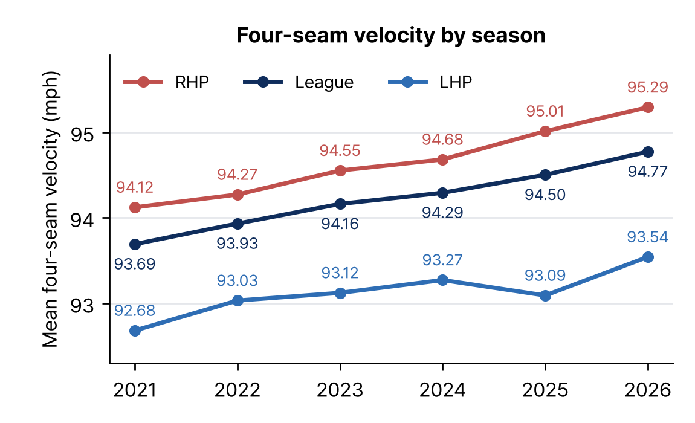
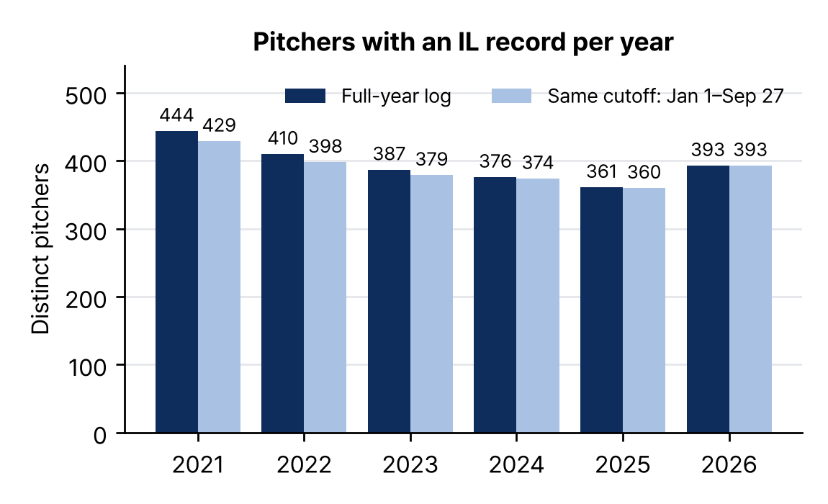
Exploratory Data Analysis
Background
Related work
Data
Method
EDA
(1) League velocity trend and IL volume
Four-seam velocity by season (pitch-weighted, left) and distinct pitchers with an IL record (right), 2021–2026
  League four-seam velocity rose six seasons in a row: 93.69 → 94.77 mph (+1.08) → we need a detrended, per-pitcher baseline
  360–444 pitchers per year had an IL record; the 2026 log ends Sep 27, so we also compare on the same cutoff (volume only, not an injury rate)

Slide 15
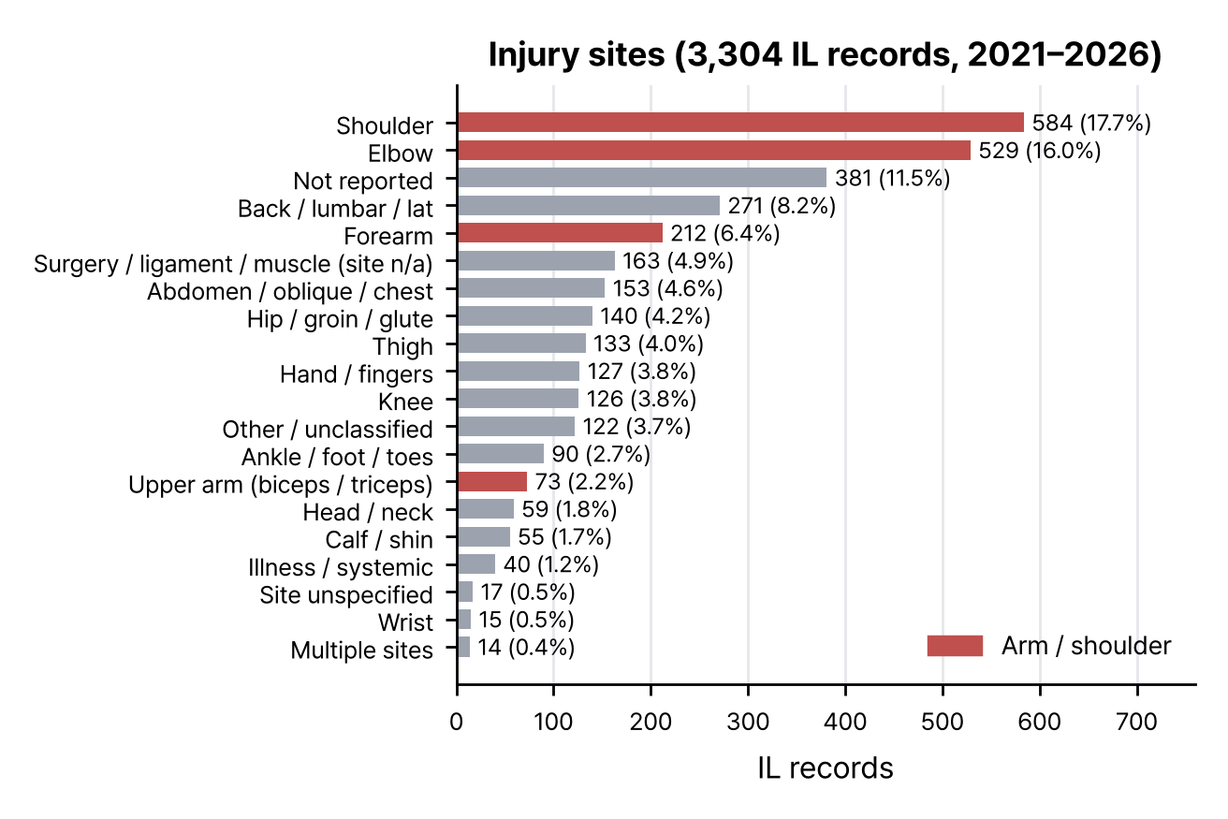
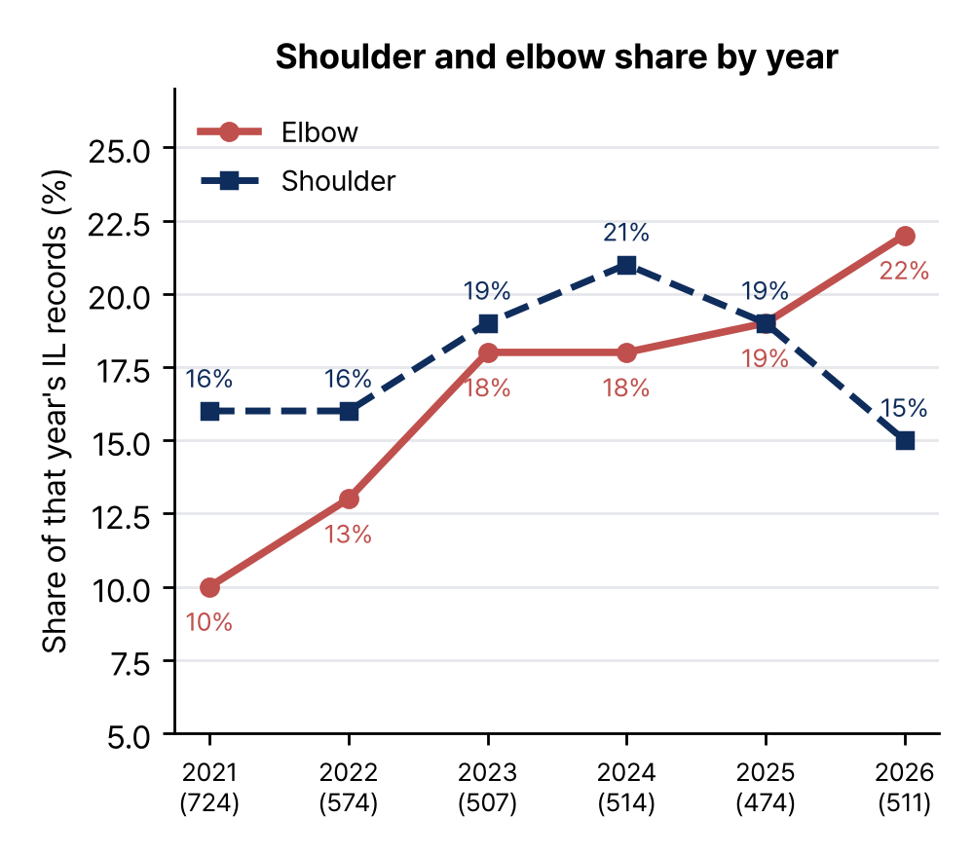
Exploratory Data Analysis
Background
Related work
Data
Method
EDA
(2) Injury sites
  Shoulder 17.7%, elbow 16.0%, forearm 6.4%: arm sites lead (denominator: IL records, not pitchers)
  Elbow share rose from 10% (2021) to 22% (2026) → arm-related IL is our main event

Slide 16
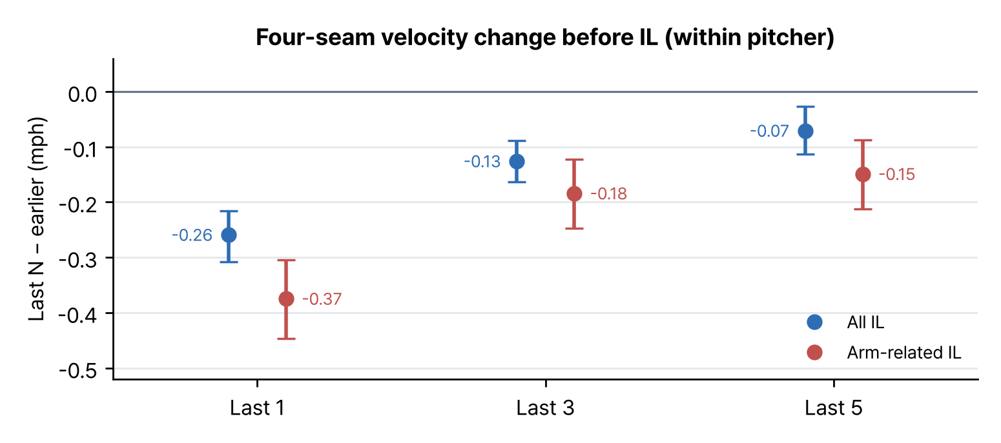
Exploratory Data Analysis
Background
Related work
Data
Method
EDA
(3) Velocity right before IL placement
IL events | All IL | Arm-related
Last 1 | 1,479 | 663
Last 3 | 1,066 | 460
Last 5 | 786 | 329
Within the same pitcher's current IL segment: mean of last N appearances − mean of earlier ones (dot: difference, line: 95% CI, 2,000 pitcher-cluster bootstraps)
  This is a within-pitcher comparison, not a comparison with healthy pitchers
  The drop is largest in the last appearance (all −0.26, arm −0.37 mph) and shrinks as N grows; arm-related IL drops more in every window
  The drop is concentrated right before IL → a short alert window (last 3, checked with 2 and 5)

Slide 17
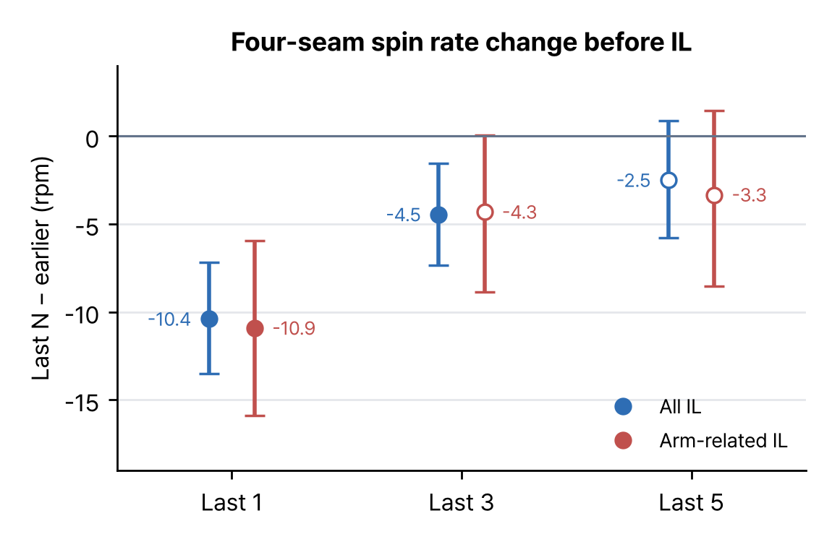
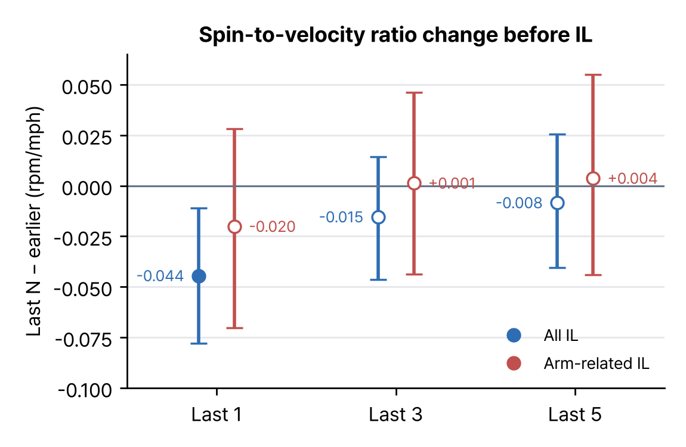
Exploratory Data Analysis
Background
Related work
Data
Method
EDA
(4) Spin rate and spin-to-velocity ratio before IL
Last N − earlier appearances (within pitcher). Filled dot = 95% CI excludes 0; open dot = includes 0
  Spin rate: about −10 rpm in the last appearance (all −10.4, arm −10.9); over the last 5 the 95% CI includes 0
  Spin-to-velocity ratio: only the last appearance for all IL is below 0 (−0.045); for arm-related IL every window includes 0

Slide 18
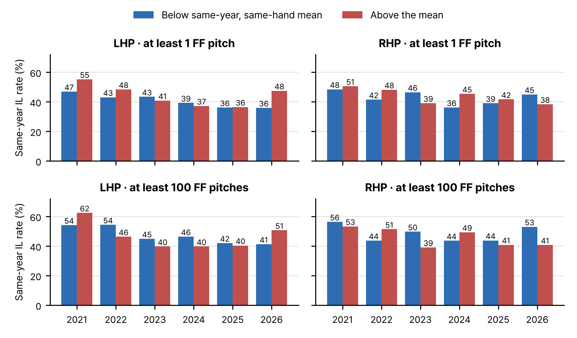
Exploratory Data Analysis
Background
Related work
Data
Method
EDA
(5) Same-year IL rate by velocity group
  Compares groups of pitchers: faster or slower than the mean for that year and throwing hand
  The faster group is higher in 12 of 24 year × group cells; no consistent direction
Same-year IL rate for pitchers above (red) and below (blue) the same-year, same-hand mean

Slide 19
Thank you
Q & A
Department of Data Science
Soyeon Kim · Minseo Jeong · Donghan Kang · Minseok Choi

