Slide 1
INTRODUCTION
Vehicular Ad Hoc Networks (VANETs) are a subset of Mobile Ad Hoc Networks (MANETs) designed for vehicular communication.
Main objectives: Enhance road safety, traffic efficiency, and provide infotainment services.

Slide 2
UNDERSTANDING VANET
Key communication types:
V2V: Vehicles exchanging data directly.
V2I: Vehicles communicating with roadside units (RSUs) or cloud servers.
V2X: Interaction with pedestrians, cyclists, and other smart city infrastructure.

Slide 3
DATASETS
simulates Denial-of-Service (DoS) attacks in a Vehicular Ad-Hoc Network (VANET) environment.
Goal: model realistic vehicular communication under both normal and malicious conditions to enable the development and evaluation of Intrusion Detection Systems (IDS).
COLLECTED DATA: based on the below parameters 1) Different Attack Types
2) Different Time Windows 3) Different Packet Rate

Slide 4
DATASETS
Folder Naming Convention: cs-dy-mz-n
Component | Meaning
Cs | Case study/cooperative safety scenario
Dx | X= 3,4… depending on Ddos type
My | Y=0,1,2,3,4 Scenario variation of BMS
n | Number of vehicles, here 30/40/50

Slide 5
DATASETS: File Types
1) Dataset_pkt_x: Individual Packet-level data
sendtime
rcvtime
senderID
messageID
position
speed
heading
ddostype
msgtype
2) Dataset_timewin_x: Aggregated features per time window
received packets
IAT_Mean
IAT_Std
IAT_Max
IAT_Min
received_addresses
max_pkt_from_sameID
has_attacker

Slide 6
DATASETS: File Types
3) Dataset_truth: Ground truth data for attacker positions or IDs
4) Dataset_timewinsum: Summary stats per window 5) Dataset_pktsum: Summarized packet data

Slide 7
Model Used
Used ML Model to predict Attack: Random Forest (Mainly) and XGBoost
Advantage | Benefit in Use Case
Handles high-dimensional data | VANET data has many features
Robust to noise | Irregular or tampered BSM’s wouldn’t confuse the whole model
Feature importance ranking | Helps understand which features matter most
Low overfitting | Better generalization than a single decision tree

Slide 8
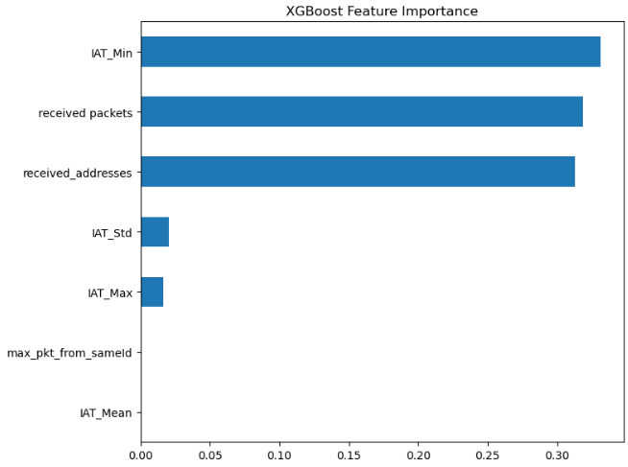
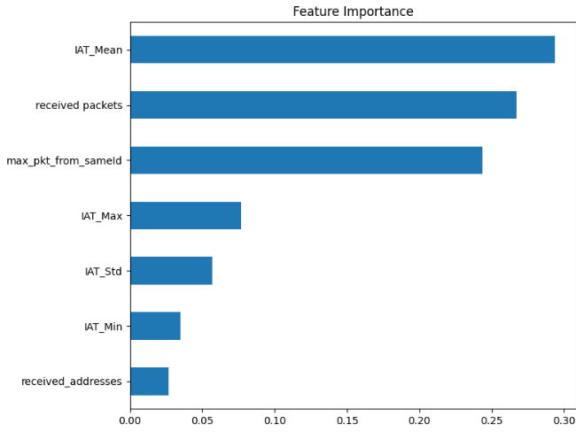
Findings and Analysis
Random Forest: ranks features based on how consistently and effectively data is split across multiple trees
XGBoost: Captures subtle timings irregularities and address diversity under attack scenarios

Slide 9
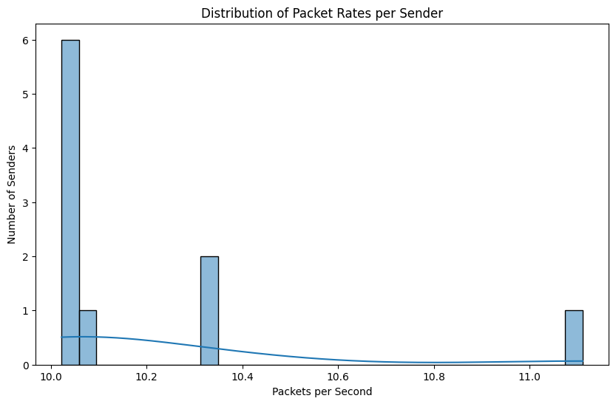
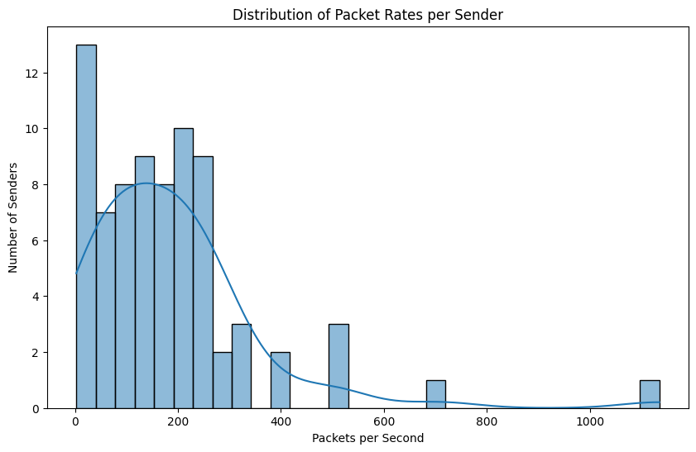
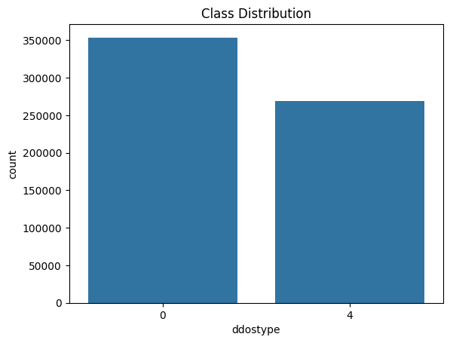
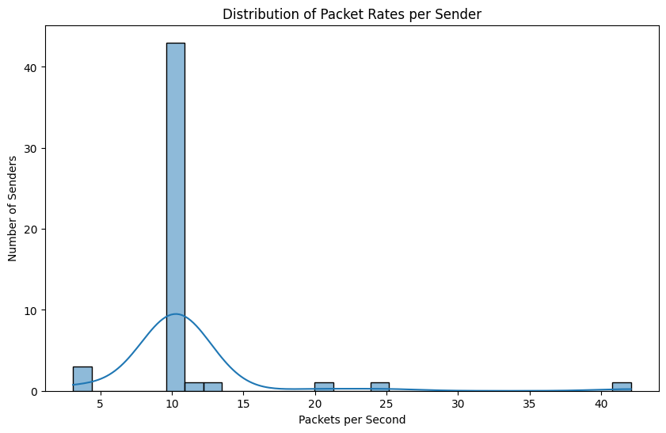
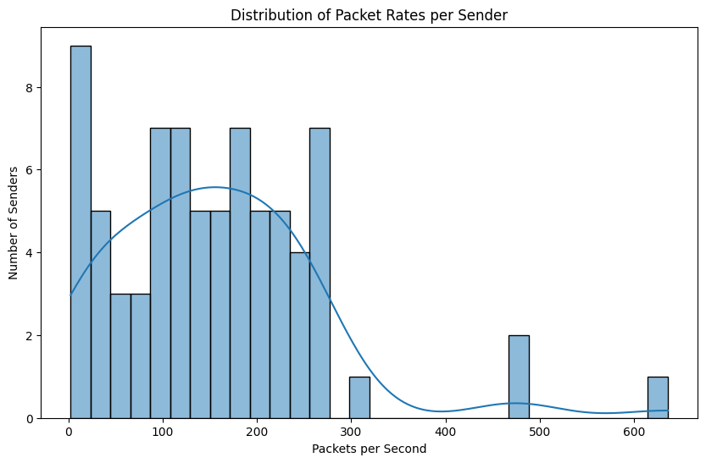
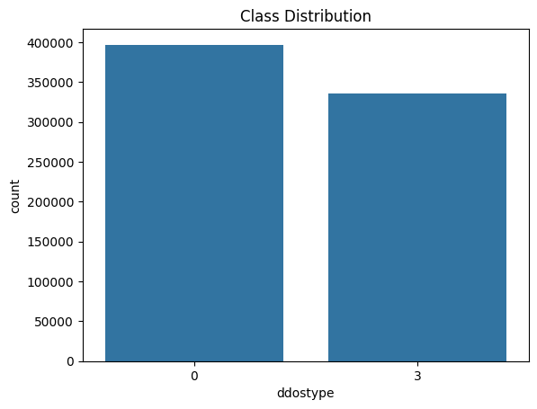
Distribution of Packet Rate per sender

Slide 10
Analysis
1) Single File – High Packet count
- Low uniform sender behavior - low-rate, stealthy DoS attack 2) All Packet Sizes:
Mixed behaviour: multiple time windows and scenarios
Low rate and high rate attack patterns
- Captures heterogeneity across senders:

Slide 11
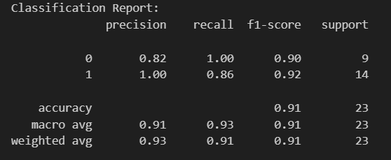
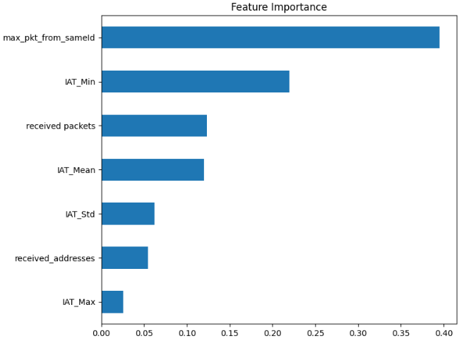
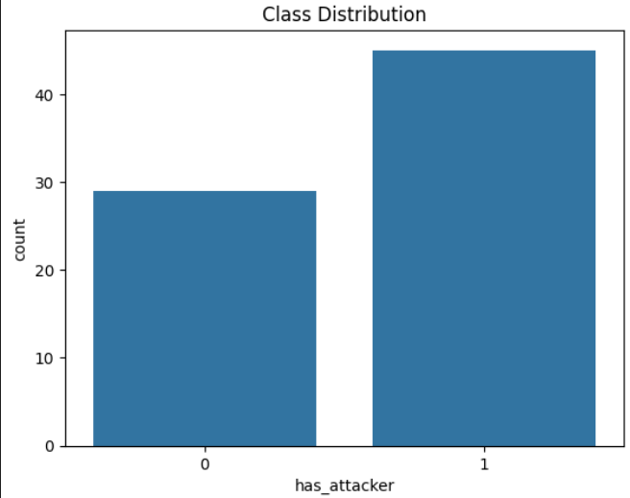
Feature shifts across dataset scales
For a single dataset file:

Slide 12
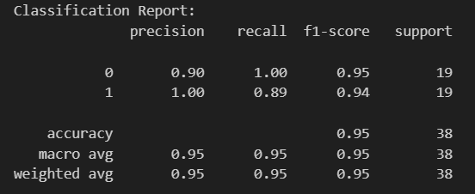
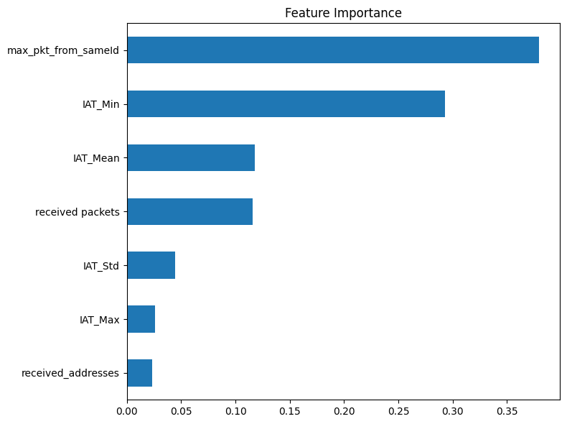
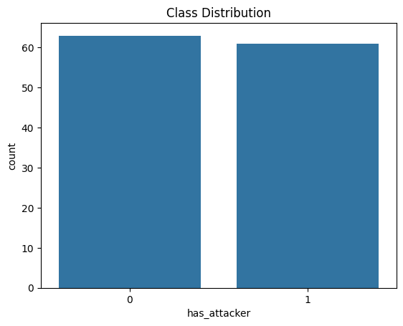
Feature shifts across dataset scales
For MULTIPLE dataset file:

Slide 13
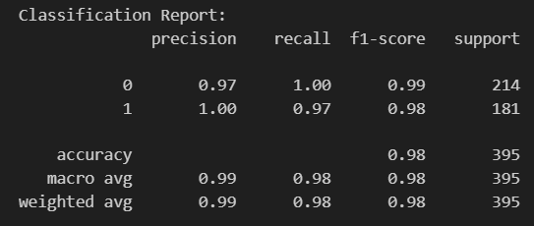
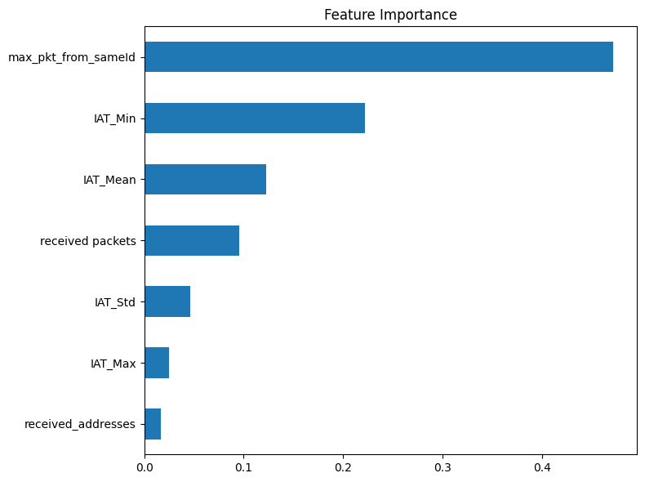
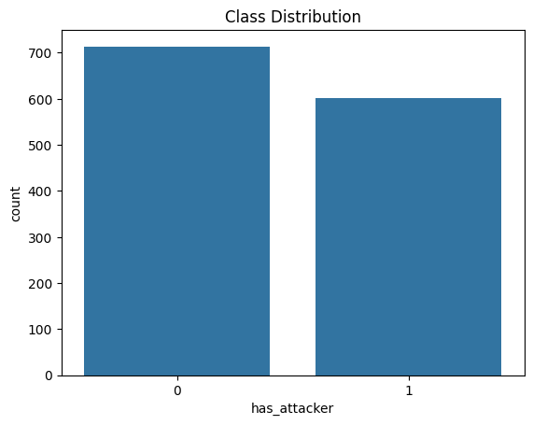
Feature shifts across dataset scales
For ALL dataset file:

Slide 14
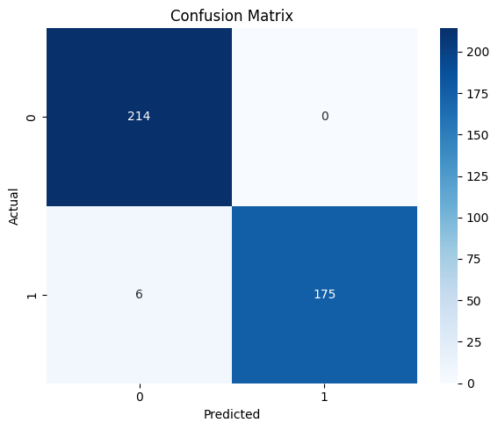
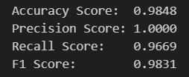
Individual attack classification
Model is able to classify the attacks with high accuracy and precision.

Slide 15
Interpretations and Hypothesis
1) Increasing Data Diversity Reveals Generalizable Features:
- Small dataset shows localized patterns - More fields: Richer attack behaviors 2) Mean Features Are Sensitive to Sample Size:
- IAT_Mean: Central tendency measure, stable in small windows - Sample grows: extremes (min/max IATs)and frequency based patterns are more robust and informative - IAT_Mean captures worst-case scenarios (bursty attacks)
3) Packet Flooding Signatures Become Clearer at Scale: - In real-world Dos, an attacker overwhelms by sending many packets from 1 identity - Pattern emerger strongly in larger aggregates.

Slide 16
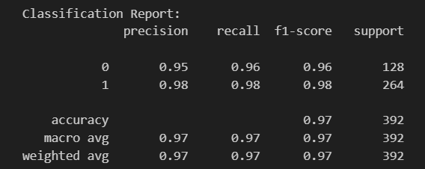
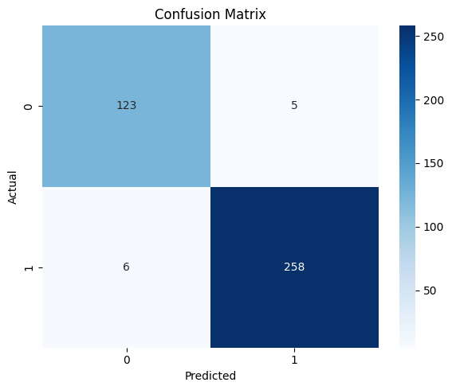
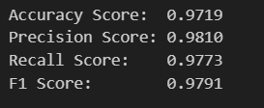
Mix Attacks

Slide 17
THANK YOU !

