Slide 1

FAQ Extraction
based on Transformer and BERT
Xinrong Liang
Sicheng Pan

Slide 2
FAQ Extraction
- intro
TEXT
Seq2Seq model become more and more popular
Encoder
Decoder
文本

Slide 3
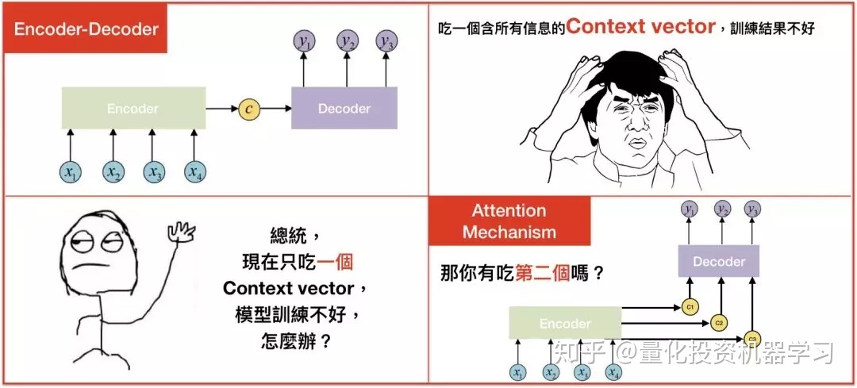
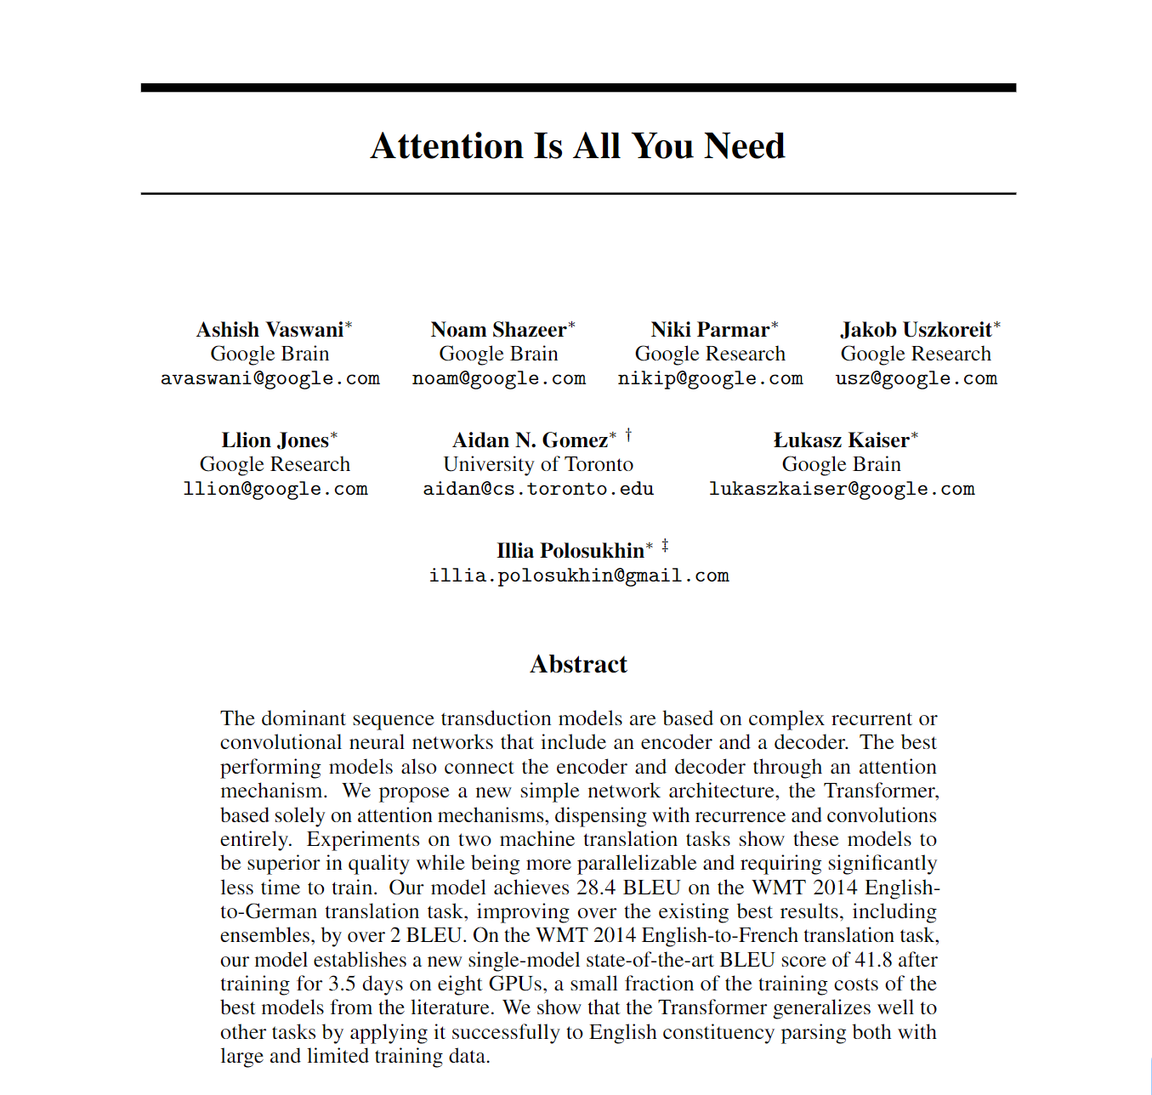
FAQ Extraction
- intro
From CNN/RNN to Transformer

Slide 4
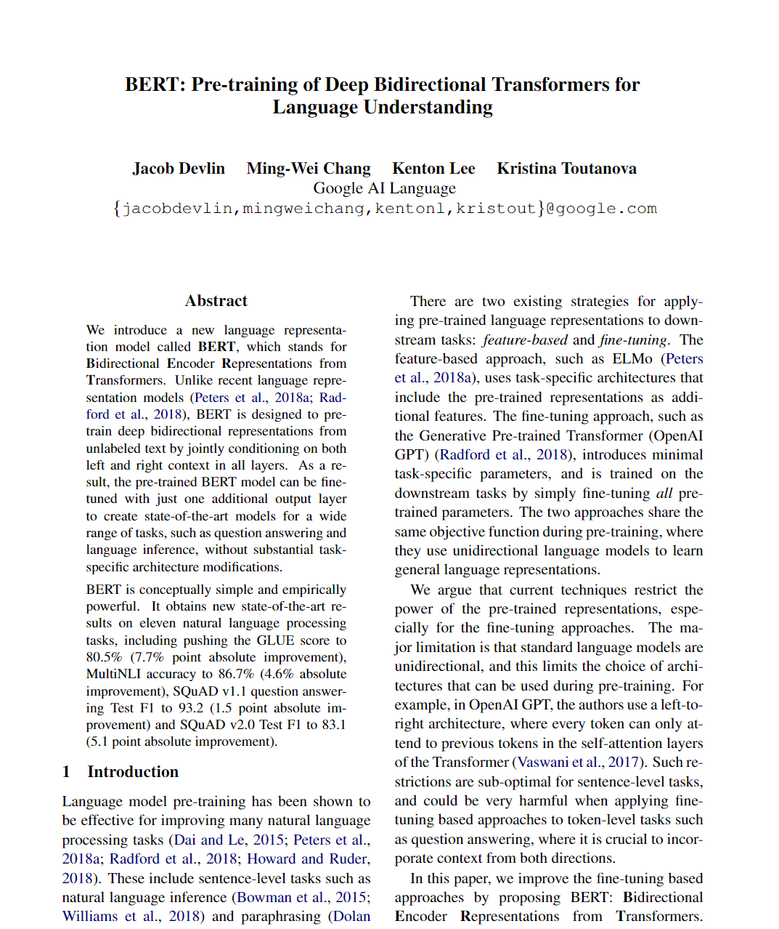
FAQ Extraction
- intro
From CNN/RNN to Transformer

Slide 5
FAQ Extraction
- intro
BERT: Pretrained model can be used to fine-tuning specific model to apply NLP tech to smaller application scenario

Slide 6
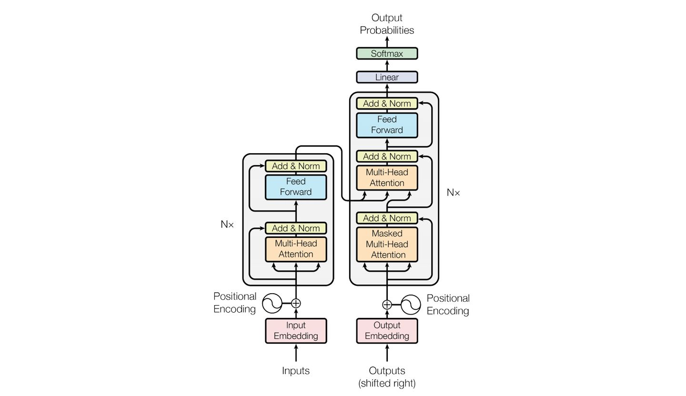
FAQ Extraction
- details
Transformer principle: Attention is all you need

Slide 7
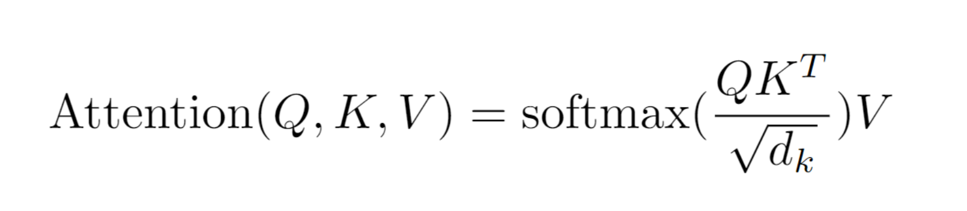
FAQ Extraction
- details
Transformer principle: Attention is all you need

Slide 8
FAQ Extraction
- details
python run_qa.py \
--model_name_or_path bert-base-uncased \
--dataset_name squad \
--do_train \
--do_eval \
--per_device_train_batch_size 12 \
--learning_rate 3e-5 \
--num_train_epochs 2 \
--max_seq_length 384 \
--doc_stride 128 \
--output_dir /tmp/debug_squad/
module transformers
easy to use in production environment

Slide 9
FAQ Extraction
- details
chinese-roberta-wwm
中文预训练模型
Whole word masking

Slide 10
FAQ Extraction
- details
Structure
Question generation
Answer extraction

Slide 11
FAQ Extraction
- details
Structure
Question generation
Pre-trained model: NEZHA-base-wwm
Pre-train data: Sogou QA Single question
Answer extraction
Pre-trained model: chinese-roberta-wwm

Slide 12
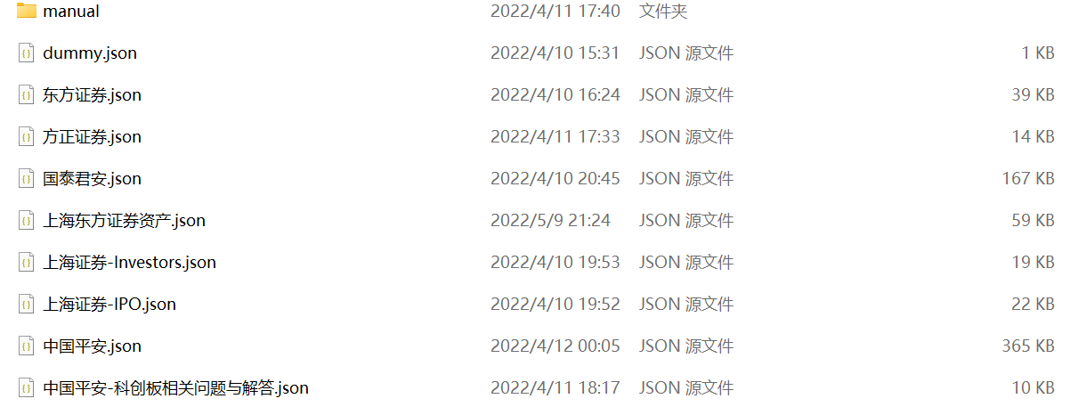
FAQ Extraction
- our work
Collect train & test data
Unified data format

Slide 13
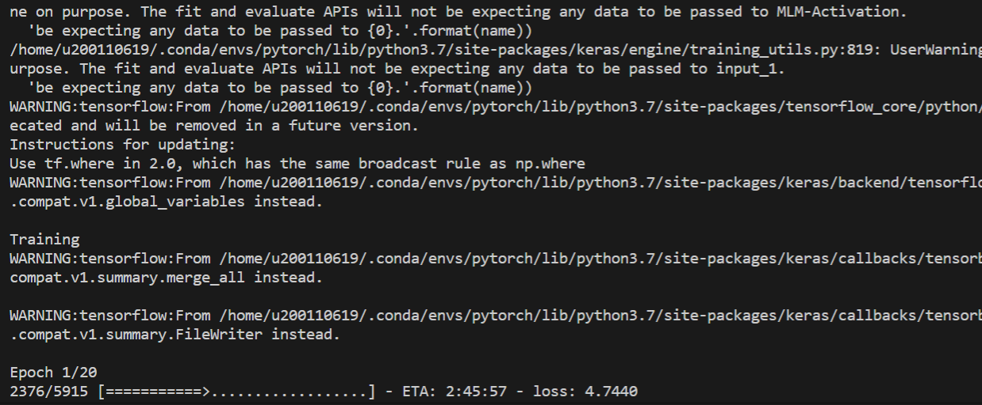
FAQ Extraction
- our work
result

Slide 14
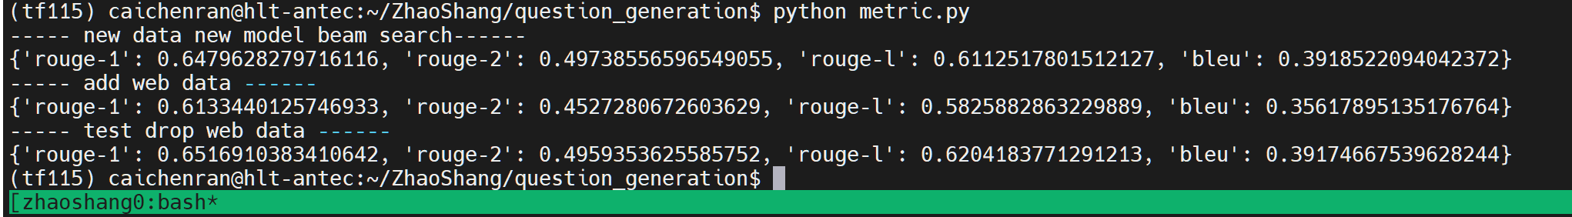
FAQ Extraction
- our work
result

Slide 15
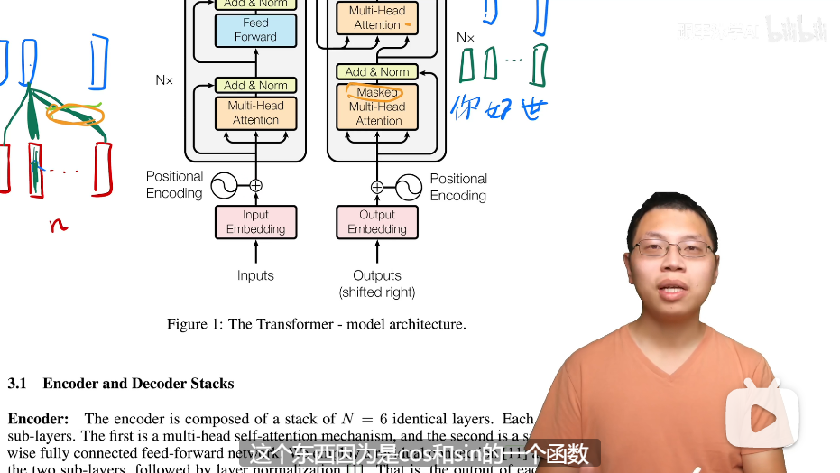
FAQ Extraction
- our work
Study principles of Transformer, BERT…

Slide 16
FAQ Extraction
- after
Further study
Try to adjust the parameters
Apply to production environment
Optimize inferential model

