Slide 1
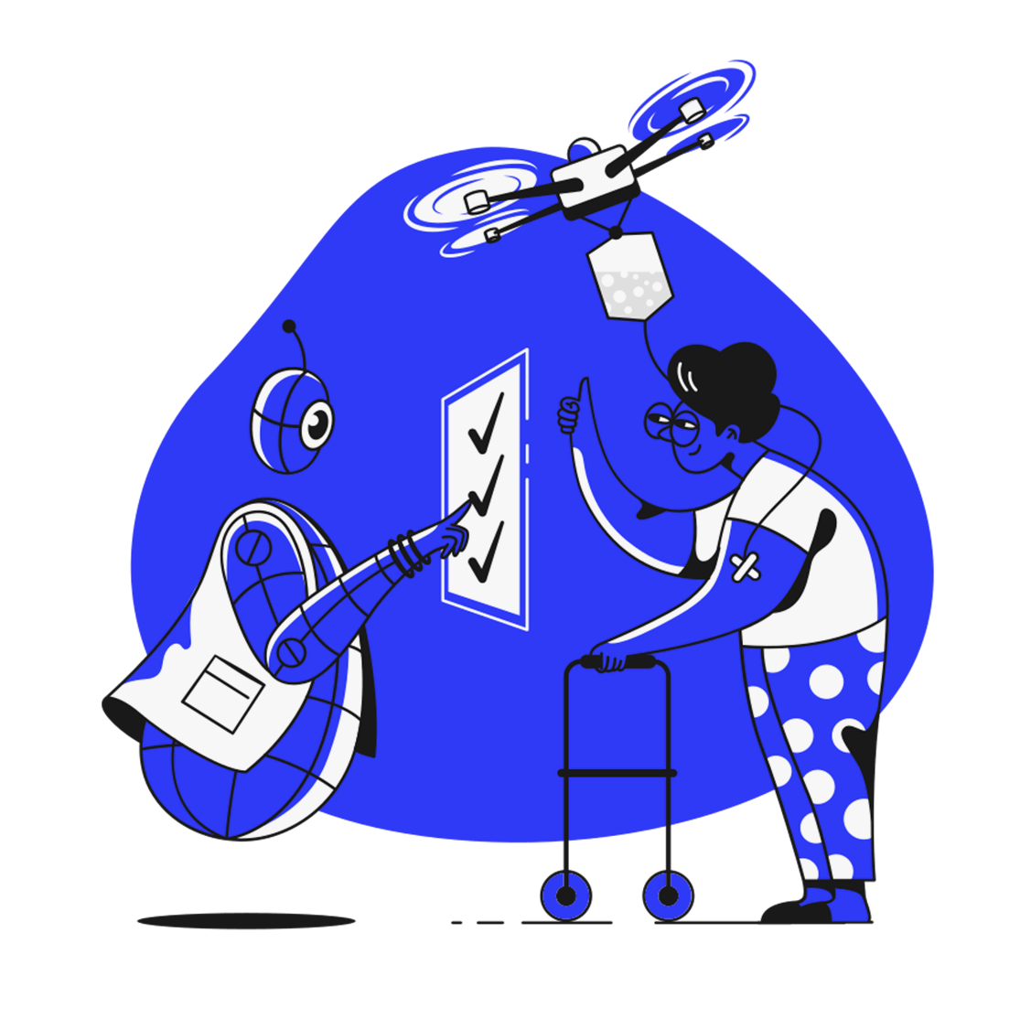


The Chiron
Network
A decentralized AI ecosystem leveraging blockchain technology to allow users to contibute computational resources, medical data and
monetory relief directly to those in need.
Contribute
Check your Symptoms

Slide 2

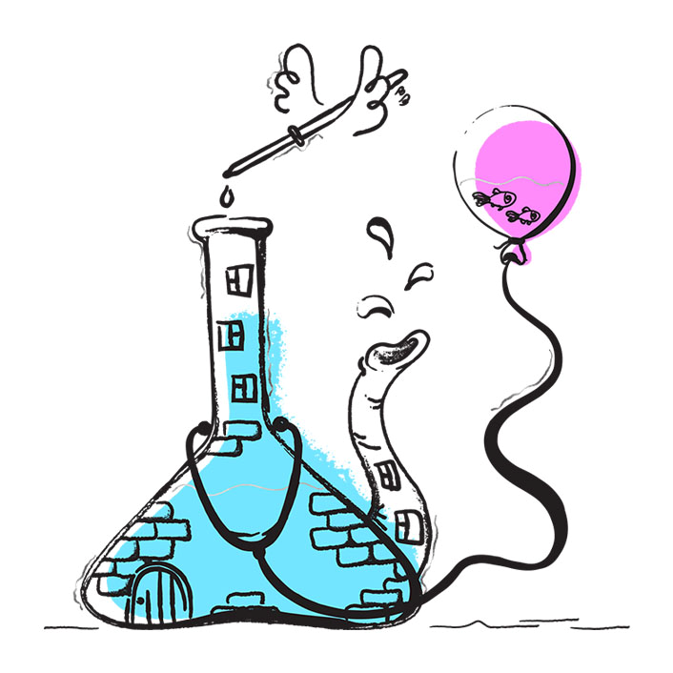
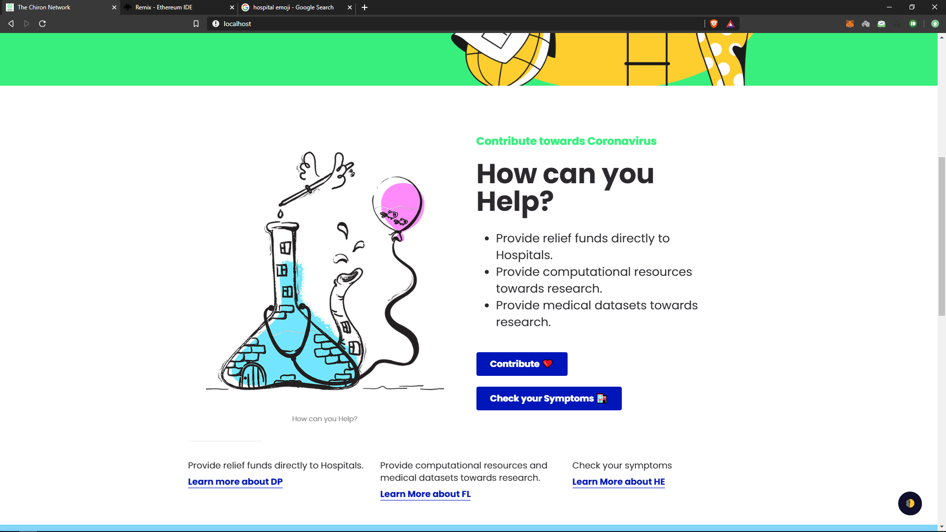

Slide 3
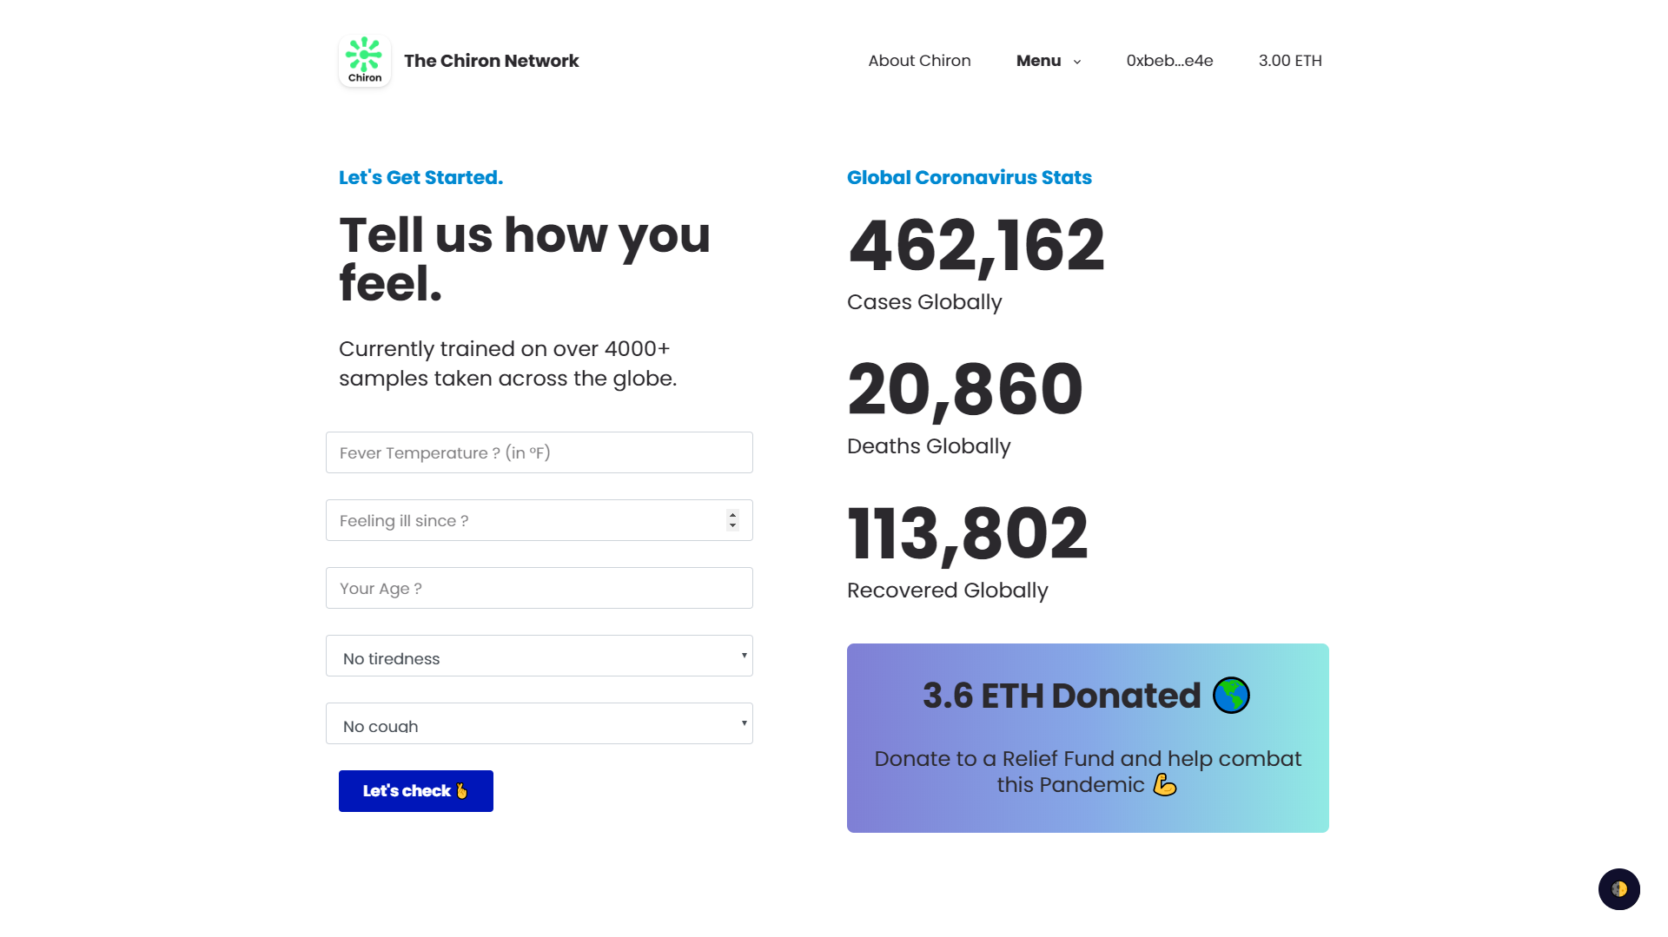

Slide 4
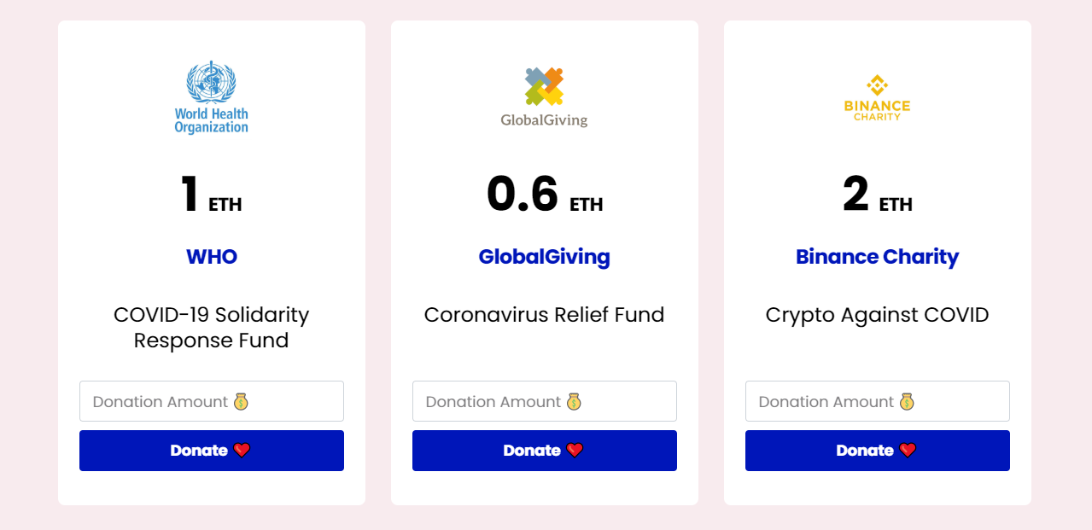
Available Funds

