Slide 1
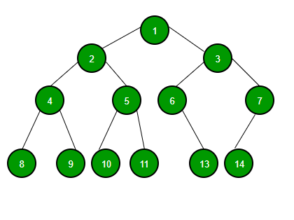
Binary Tree
Binary Tree can have 2 children for each element.
Right Child
Left Child

Slide 2
Types of Binary Tree
Full Binary Tree
Perfect Binary Tree
Complete Binary Tree
Degenerate or Pathological Tree
Balanced Binary Tree
Skewed Binary Tree

Slide 3
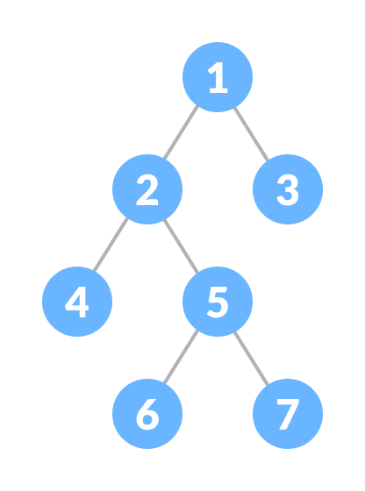
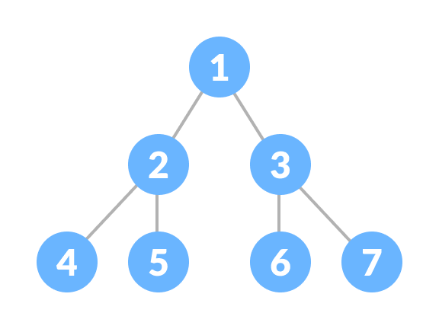
Full Binary Tree
Perfect Binary Tree
Every parent node/internal node has either two or no children
Every internal node has exactly two child nodes and all the leaf nodes are at the same level.

Slide 4
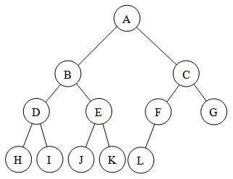
Complete Binary Tree
Completely filled at every level possible except at last.
The filling of the leaf node must start from the leftmost side.
It is not mandatory that the last leaf node must have the right sibling.

Slide 5
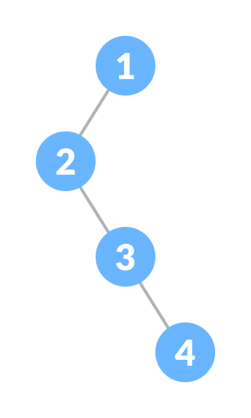
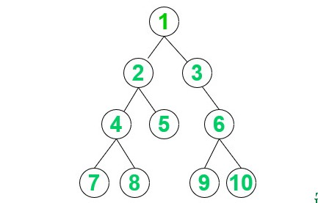
Degenerate Binary Tree
Balanced Binary Tree
Tree having a single child either left or right.
Every internal node has exactly two child nodes and all the leaf nodes are at the same level.

Slide 6
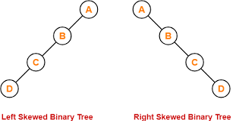
Skewed Binary Tree
Tree is either dominated by the left nodes or the right nodes.
Types:
Right Skewed Binary Tree
Left Skewed Binary Tree

Slide 7
Binary Search Tree
Binary Search Tree can have 2 children for each element.
The left subtree of a node contains only nodes with keys lesser than the node’s key.
The right subtree of a node contains only nodes with keys greater than the node’s key.

Slide 8
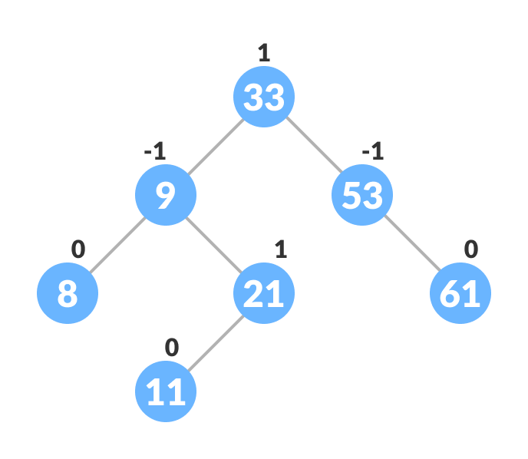
AVL Tree
AVL tree is a self-balancing binary search tree in which each node maintains extra information called a balance factor whose value is either -1, 0 or +1.
AVL tree got its name after its inventor Georgy Adelson-Velsky and Landis.
Balance Factor = (Height of Left Subtree - Height of Right Subtree) or (Height of Right Subtree - Height of Left Subtree)

Slide 9
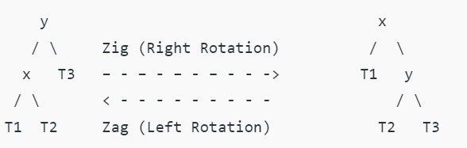
Splay Tree
Splay tree is a self-balancing binary search tree
whenever an element is looked up in the tree, the splay tree reorganizes to move that element to the root of the tree, without breaking the binary search tree invariant. - Splaying

Slide 10
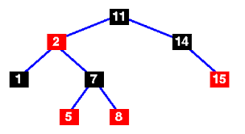
Red Black Tree
Red Black Tree is a self-balancing binary search tree
Points to Noted:
Every node has a color either red or black.
The root of the tree is always black.
There are no two adjacent red nodes (A red node cannot have a red parent or red child).
Every path from a node (including root) to any of its descendants' NULL nodes has the same number of black nodes.
All leaf nodes are black nodes.

Slide 11
Basis for Comparison | Binary Tree | Binary Search Tree
Definition | A Binary Tree is a non-linear data structure in which a node can have 0, 1 or 2 nodes. Individually, each node consists of a left pointer, right pointer and data element. | A Binary Search Tree is an organized binary tree with a structured organization of nodes. Each subtree must also be of that particular structure.
Structure | There is no required organization structure of the nodes in the tree. | The values of left subtree of a particular node should be lesser than that node and the right subtree values should be greater.
Operations Performed | The operations that can be performed are deletion, insertion and traversal | As these are sorted binary trees, they are used for fast and efficient binary search, insertion and deletion.
Types | There are several types. Most common ones are the Complete Binary Tree, Full Binary Tree, Perfect Binary Tree, Degenerate Binary Tree, Balanced Binary Tree and Skewed Tree | The most popular ones are AVL Trees, Splay Trees, Tango Trees, T-Trees.

Slide 12
Heap (Binary Heap) Heap data structure is a complete binary tree

Slide 13
Complete Binary Tree
Completely filled at every level possible except at last.
The filling of the leaf node must start from the leftmost side.
It is not mandatory that the last leaf node must have the right sibling.

Slide 14
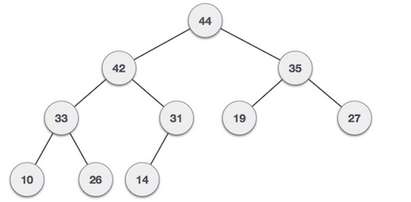
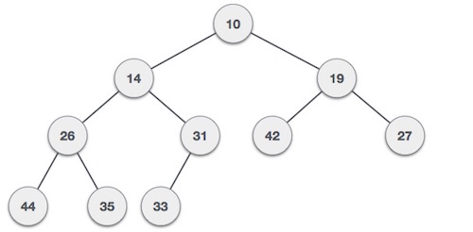
Heap Types
Max Heap
Min Heap
Where the value of the root node is greater than or equal to either of its children.
Where the value of the root node is less than or equal to either of its children.
Heap Operations - Heapify
Heapify is the process of creating a heap data structure from a binary tree.
It is used to create a Min-Heap or a Max-Heap.

Slide 15
Heap Data Structure Applications
Heap is used while implementing a priority queue.
Dijkstra's Algorithm
Heap Sort

