Slide 1
VOICE ASSISTANT SYSTEM
Underthe Guidance Of,
Mr.P.DURGA PRASAD
Submitted By,
CH.VAMSHI (4511-18-733-107)

Slide 2
CONTENTS
1. ABSTRACT
2. INTRODUCTION
3. EXISTING SYSTEM & DISADVANATGES
4. PROPOSED SYSTEM & ADVANTAGES
5. BLOCK DIAGRAM
6. SYSTEM REQUIREMENTES
7.HARDWARE REQUIREMENTES
8.MODULES
9.UML DIAGRAMS
10. OUTPUT SCREENS
11. CONCLUSION
12. FUTURE ENHANCEMENT
13. REFERENCES

Slide 3
1.ABSTRACT
The Most famous application of iPhone is “SIRI” and Google that is “GoogleVoice Search”. But this Application mostly works with Internet Connections.
But our Proposed System has capability to work with and without Internet Connectivity.
System takes the user input in form of voice or text and process it and returns the output in various forms like action to be performed or the search result is dictated to the end user.

Slide 4
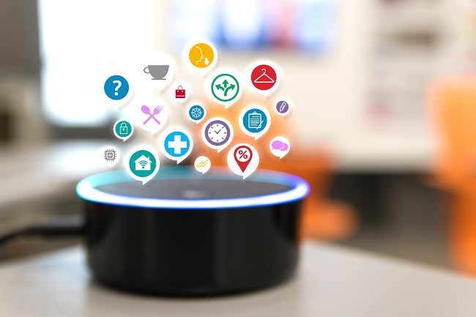
2.INTRODUCTION
A voice assistant is a digital assistant that uses voice recognition, language processing algorithms, and voice synthesis to listen to specific voice commands and return relevant information or perform specific functions as requested by the user.
Types Of Voice Assistant:
1.Task Oriented Voice Assistant.
2.Knowledge Oriented Voice Assistant.

Slide 5
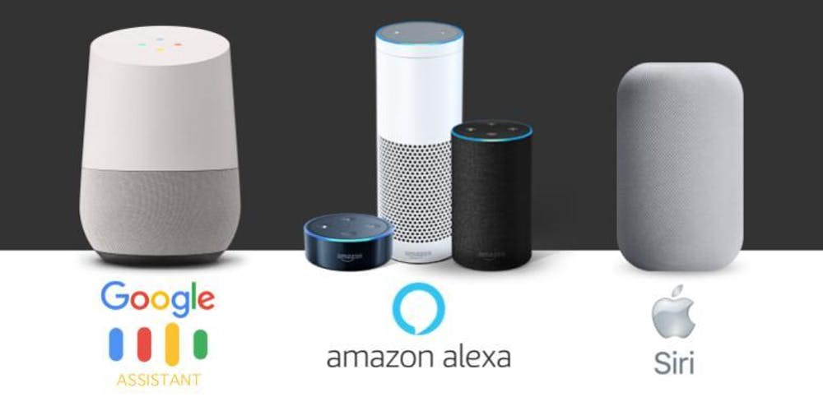
3.EXISTING SYSTEM
The Most famous application of iPhone is “SIRI” which helps the end user to communicate end user mobile with voice and it also responds to the voice commandsof the user.
Same kind of application is also developed by the Google that is “GoogleVoice Search” which is used for in Android Phones. But this Application mostly works with Internet Connections

Slide 6
DISADVANTAGES
The Most famous application of iPhone is “SIRI” and Google developed “GoogleVoice Search” are more power consuming applications.
The Cost and Infrastructure is more.
And this Application mostly works with Internet Connections.

Slide 7
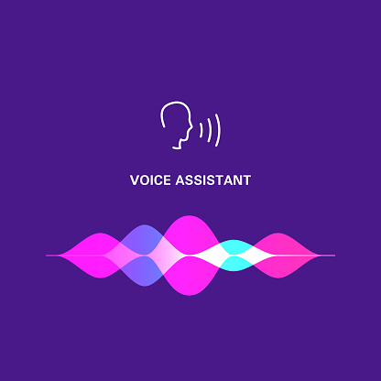
4.PROPOSED SYSTEM
Assistant System is a Concept of artificial Intelligence.
It is Combination of
Automatic SpeechRecognition.
Artificial Intelligence.
Natural Language Processing.
Inter Process Communication.

Slide 8
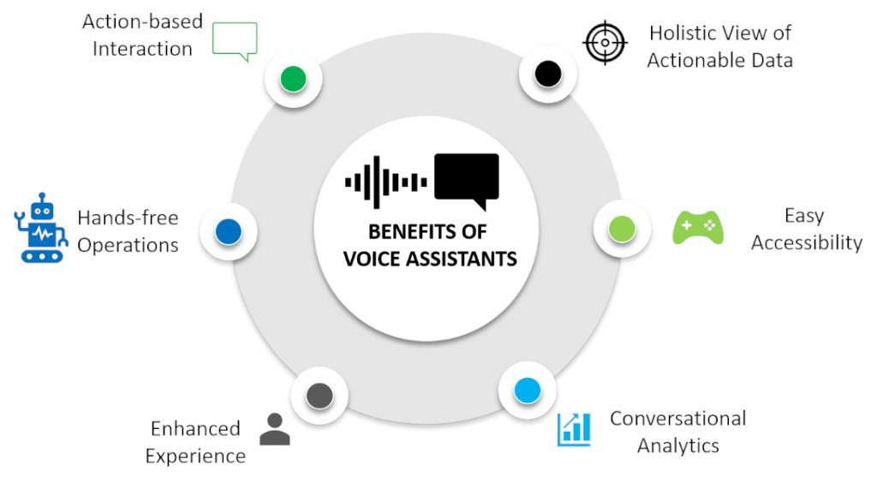
ADVANATAGES
This Application works with and without Internet Connection.
This Application Consist Most Efficiency and Saftey

Slide 9
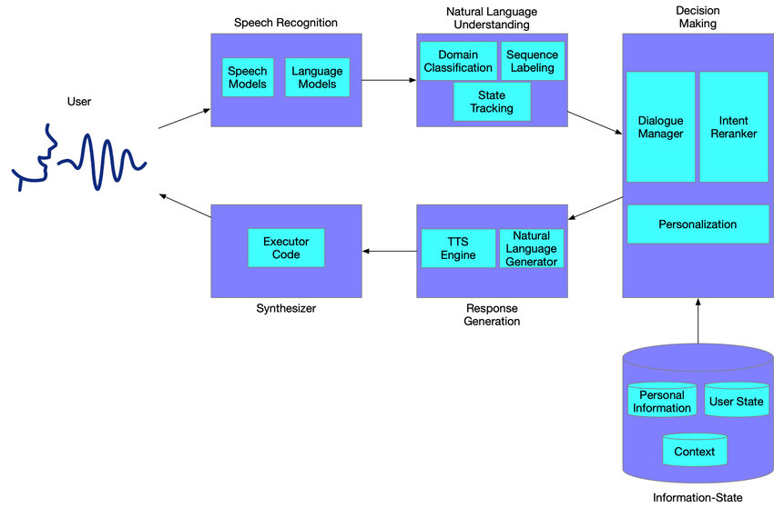
5.BLOCK DIAGRAM

Slide 10
6.SYSTEM REQUIREMENTS
OPERATING SYSTEM : Windows11
CODING LANGAUGE : Python
7.HARDWARE REQUIREMENTS
PROCESSOR : 2.70 GHz
RAM : 4 GB
MINIMUM HARD DISK : 320 GB

Slide 11
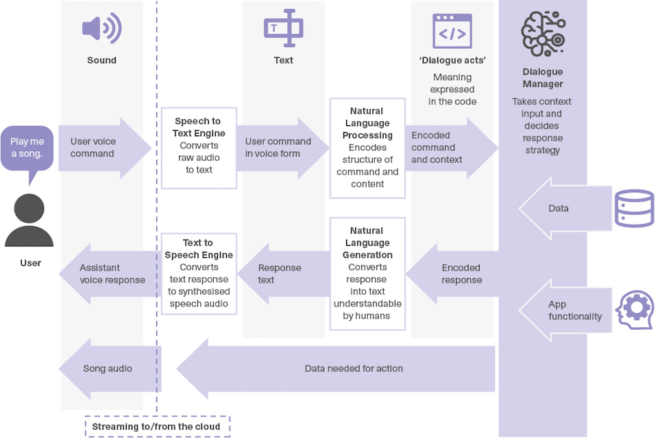
8.MODULES
Working Layers :
1.Speech To Text Layer
2.Text Analysis Layer
3.Interpret Command Layer
4.Text To Speech Layer

Slide 12
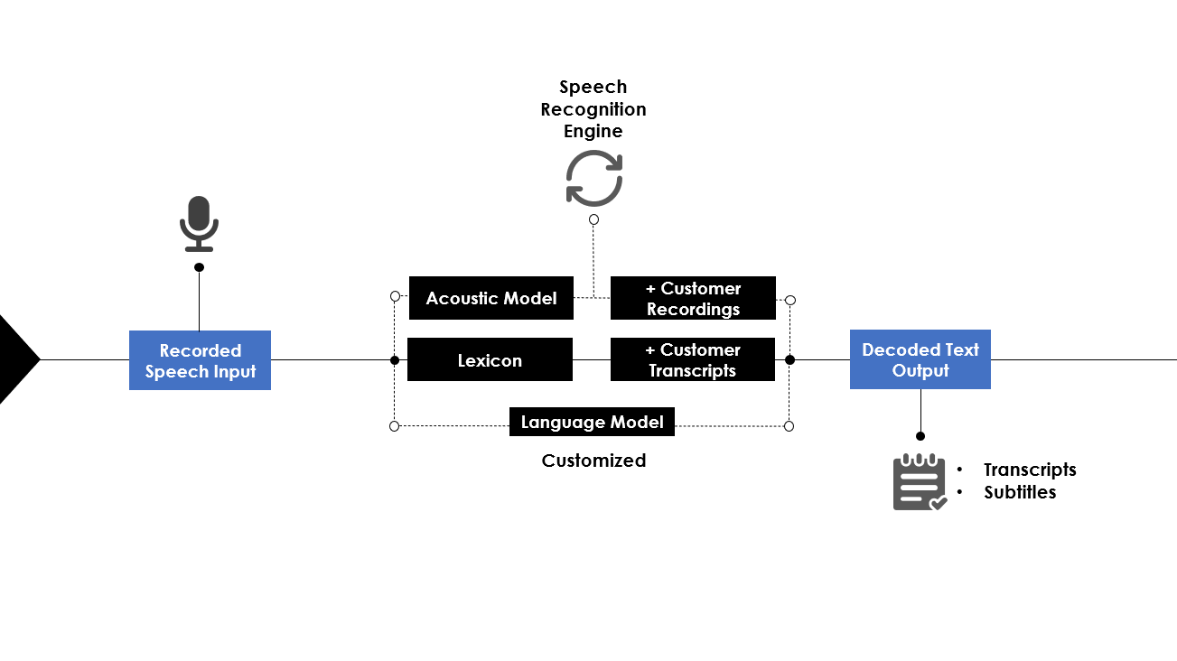
1.Speech To Text Layer (STT):
Our voice is in the form of singals when reaches to microphone , it pickup that signals.
This audio can be covert into text using Speech To Text(STT) process.
This Can be achieved by using the speech recognition library.
It involves the Accoustic Analysis which is combination of acoustic model,pronunciation model,language model.

Slide 13
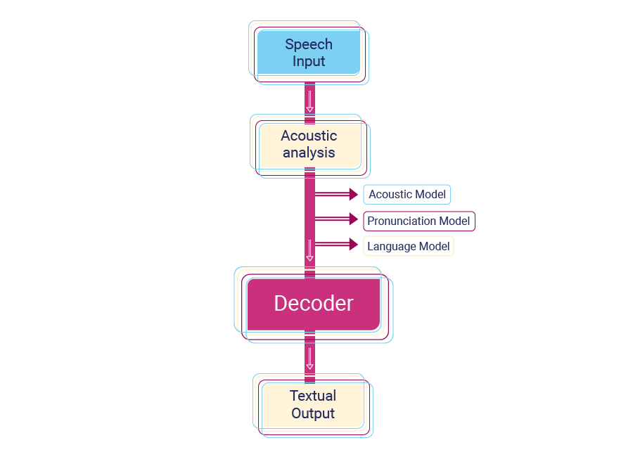
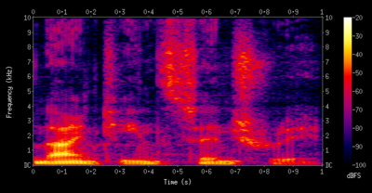
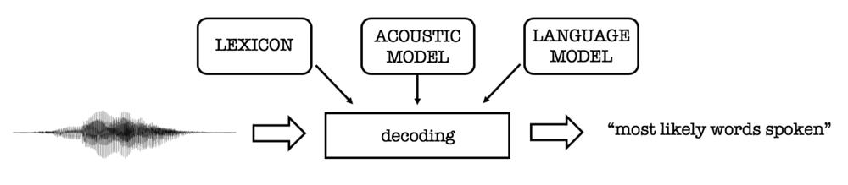

Slide 14
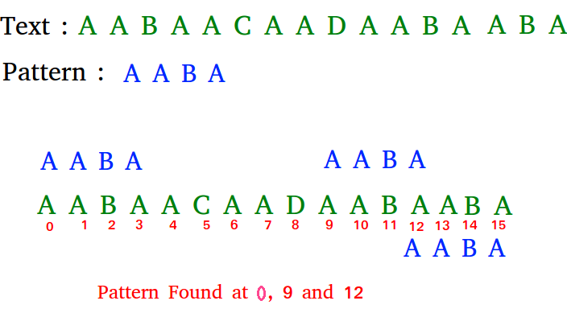
2.Text Analysis:
The total sentence can be divided into individual words.
Ex: what is capital of India.
capital India
These words can using Pattern searching algorithm to search in Internet Database(ecosystem).

Slide 15
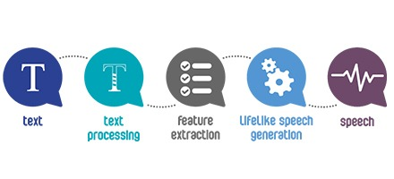
3.Interpret Commands Layer:
Using Webrowser Library it is working as database and find the solutions.
It findout all the Related information which belong to task.
In that it takes the Most times used give as output.
4.Text To Speech Layer (TTS):
What is Output get by Data base it is text form and covert into speech.
This can be achieved by using the pyttsx3 library.

Slide 16
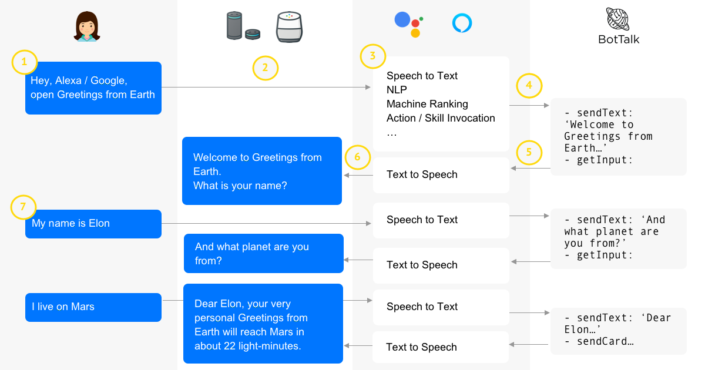

Slide 17

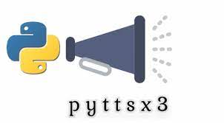


Technical Library Requirements:
Speech Recognition
Pyttsx3
Wikipedia
Pyaudio
Wolframalpha
Tkinter
Webrowser
Beautifullsoup

Slide 18
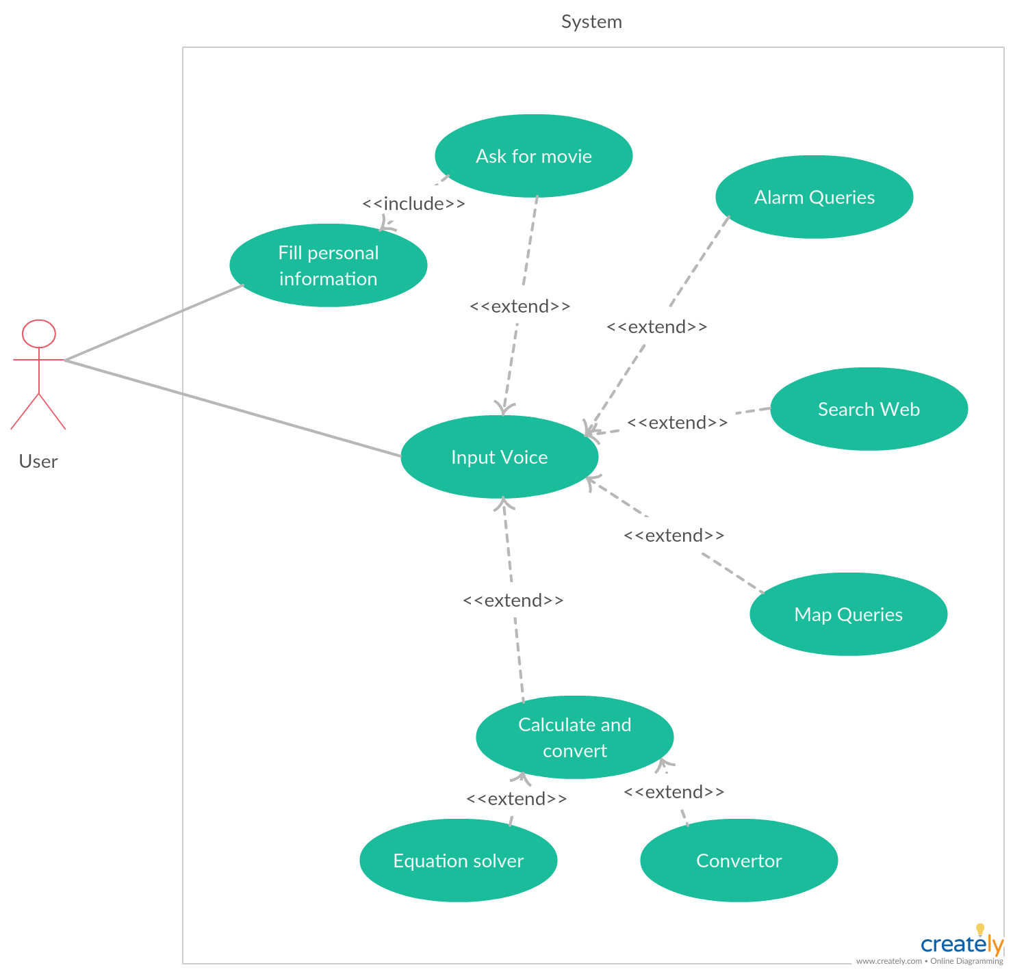
9.UML DIAGRAMS

Slide 19
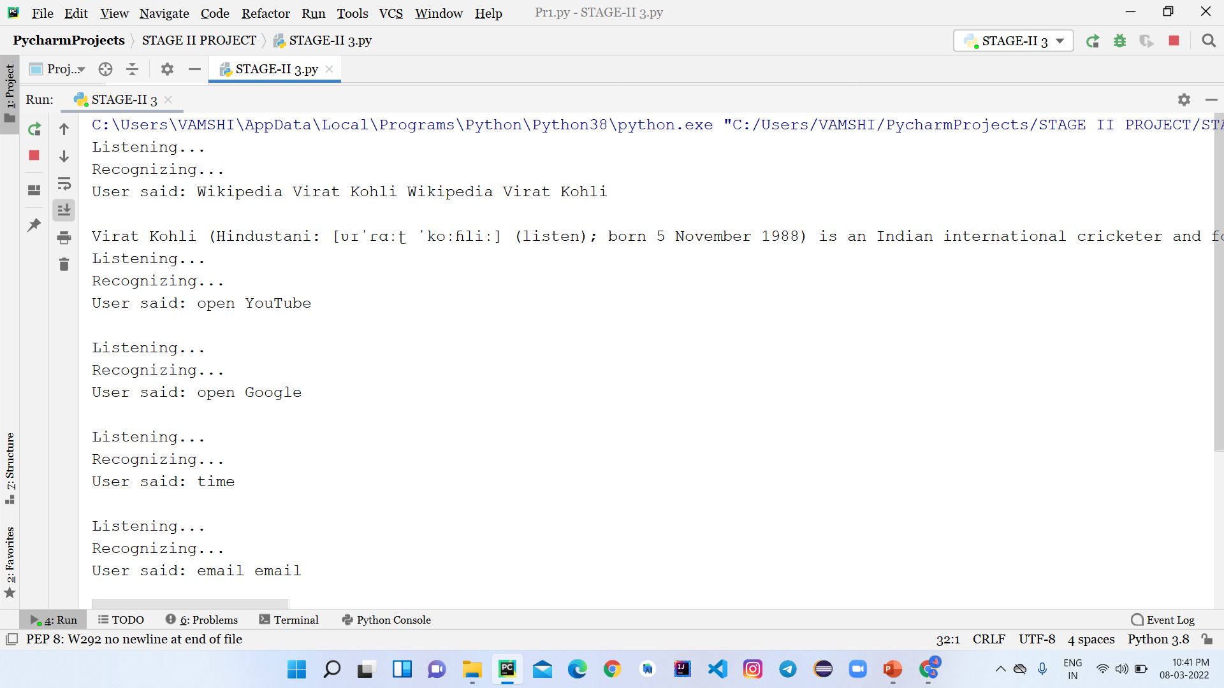
10.OUTPUT SCREEN

Slide 20
11.CONCLUSION
This is how simple it is to build your own voice assistant.
You can add many more features such as play your favorite songs, give weather details, open email application, compose emails, restart your system, etc.
You can integrate this application into your phone or tablet as well.
Have fun exploring and developing your own Alexa/Siri/Cortana.

Slide 21
12.FUTURE ENHANCEMENT
The virtual assistants which are currently available are fast and responsive but we still have to go a long way.
The understanding and reliability of the current systems need to be improved a lot.
The assistants available nowadays are still not reliable in critical scenarios.
The future of these assistants will have the virtual assistants incorporated with Artificial
Intelligence which includes Machine Learning, Neural Networks, etc.

Slide 22
13.REFERENCES
Nil Goksel-Canbek Mehmet Emin Mutlu, “On the track of Artificial Intelligence: Learning with Intelligent Personal Assistant” International Journal of Human Sciences.
Sutar Shekhar, P. Sameer, Kamad Neha, Prof. Devkate Laxman, " An Intelligent Voice Assistant Using Android Platform", March 2015, IJARCSMS, ISSN: 232 7782
VINAY SAGAR, KUSUMA SM, "Home Automation Using Internet of Things", June-2015, IRJET, e-ISSN: 2395 -0056.
“Speech recognition with flat direct models,” IEEE Journal of Selected Topics in Signal Processing, 2010.
Rishabh Shah, Siddhant Lahoti, Prof. Lavanya. K, “An Intelligent Chatbot using Natural Language Processing”. International Journal of Engineering Research, Vol. 6, pp. 281-286, 1 May 2017.

Slide 23
THANK YOU

