Slide 1
Buffers
In Node.js
By -Devansh Shukla

Slide 2
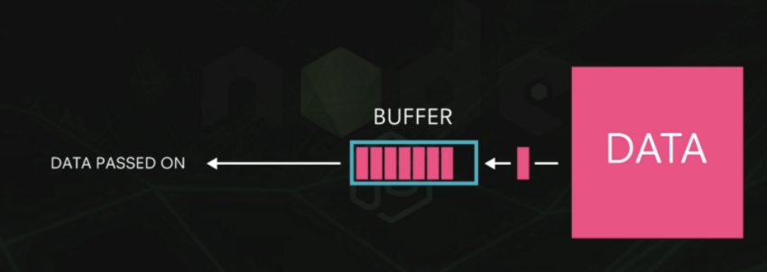
What Are Buffers ?
The Buffer class in Node.js is designed to handle raw binary data. Each buffer corresponds to some raw memory allocated outside V8.
Buffers act somewhat like arrays of integers, but aren't resizable and have a whole bunch of methods specifically for binary data.
The integers in a buffer each represent a byte and so are limited to values from 0 to 255 inclusive. When using console.log() to print the Buffer instance, you'll get a chain of values in hexadecimal values.

Slide 3
Why Buffers ?
Pure JavaScript, while great with unicode-encoded strings, does not handle straight binary data very well.
This is fine on the browser, where most data is in the form of strings.
However, Node.js servers have to also deal with TCP streams and reading and writing to the filesystem, both of which make it necessary to deal with purely binary streams of data.
Pure JavaScript is great with Unicode encoded strings, but it does not handle binary data very well

Slide 4
Some Methods to perform the operations on Buffer:
No Method Description
1 Buffer.alloc(size) It creates a buffer and allocates size to it.
2 Buffer.from(initialization) It initializes the buffer with given data.
3 Buffer.write(data) It writes the data on the buffer.
4 toString() It read data from the buffer and returned it.
5 Buffer.isBuffer(object) It checks whether the object is a buffer or not.
6 Buffer.length It returns the length of the buffer.
7 Buffer.copy(buffer,subsection size) It copies data from one buffer to another.
8 Buffer.slice(start, end=buffer.length)- It returns the subsection of data stored in a buffer.
9 Buffer.concat([buffer,buffer]) It concatenates two buffers.

Slide 5
Some Methods to perform the operations on Buffer:
No Method Description
10 buf.entries() Creates and returns an iterator of [index, byte] pairs from the contents of buf.
11 buf.equals(otherBuffer ) Returns true if both buf and otherBuffer have exactly the same bytes, false otherwise.
There are lot of other methods on Buffer

Slide 6
Note: By default, Node.js supports the following character encodings:
ASCII, represented as ascii
UTF-8, represented as utf-8 or utf8
UTF-16, represented as utf-16le or utf16le
UCS-2, represented as ucs-2 or ucs2
Base64, represented as base64
Hexadecimal, represented as hex
ISO/IEC 8859-1, represented as latin1 or binary

