Slide 1


Automatic Image Captioning
Capstone project
Cohort-18
Aic group-4

Slide 2
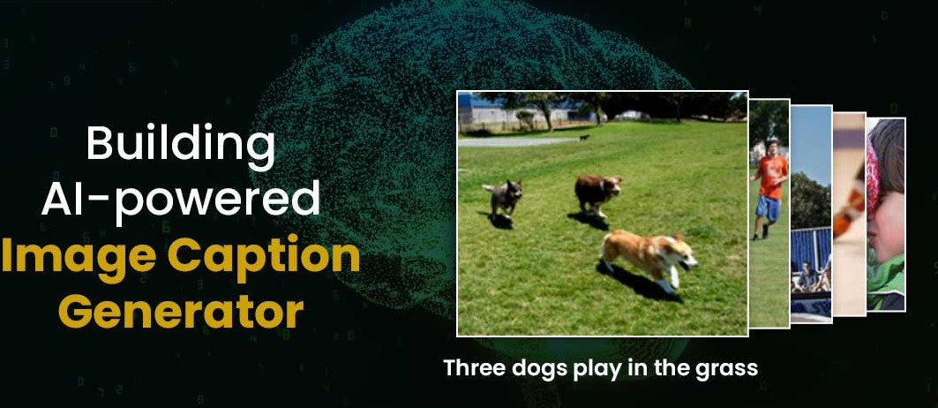
OBJECTIVE:
AIC Group-4 Members:
  Chiru Toleti (2201497)
  Praveen Kumar K (2201598)
  Satyam Kumar (2200718)
  Yashwanth Kumar P (2201896)

Slide 3
Architecture
A captioning model relies on two main components, a CNN and an RNN.
Captioning is all about merging the two to combine their most powerful attributes
CNNs (Convolutional Neural Networks) excel at preserving spatial information and recognize objects in images.
RNNs (Recurrent Neural Networks) work well with any kind of sequential data, such as generating a sequence of words.
So by merging the two, you can get a model that can find patterns and images, and then use that information to help generate a description of those images.

Slide 4
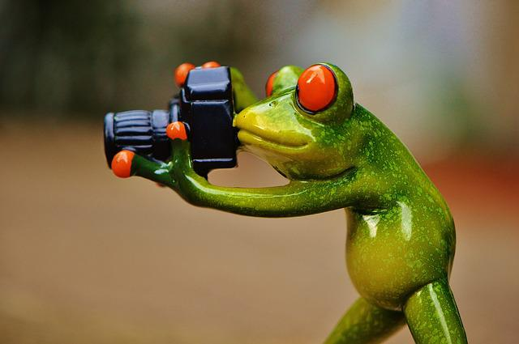
Architecture
Encoder
(ResNet50)
Decoder
(LSTM)
Output:
A Frog Holding a Camera
ResNet50 Pre-trained Model as Encoder:
  ResNet50 acts as a feature extractor that compresses the information in the original image into a smaller feature vector representation hence, called Encoder.
LSTM as Decoder:
  When we process the CNN generated feature vector and use it as an initial input to the following RNN, then it would be called Decoder since RNN would decode the processes feature vector and turn it into natural language.
  The attention mechanism that enables to dynamically highlight relevant features of the input data.
  Transformers for generating a caption with semantic representation.

Slide 5
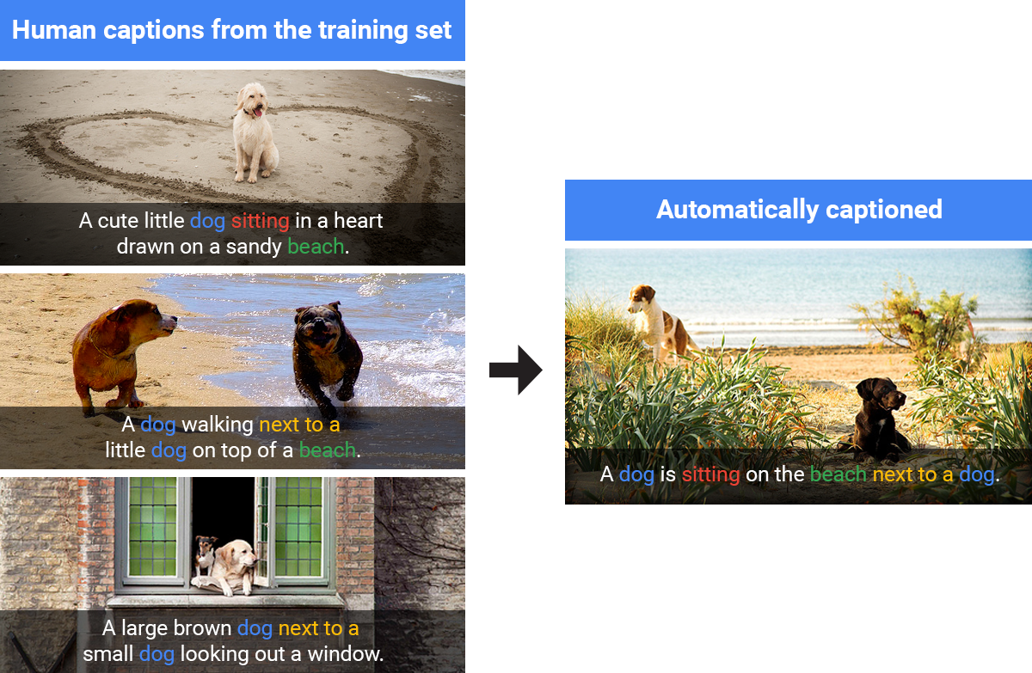
Data Sets Used
There are many open source Datasets available :
  Flickr 8K ( containing 8k images)
  Flickr 30k ( containing 30k images)

Slide 6
Project WorkFlow
Images
Pre-process
Image
ResNet50
(encode Features)
LSTM Model
Captions
Pre-process
(Generate Clean Descriptions)
Prepare
Vocabulary
Process
Image Captions
Glove Data
(200d)
Generate
Embedding
Index

Slide 7
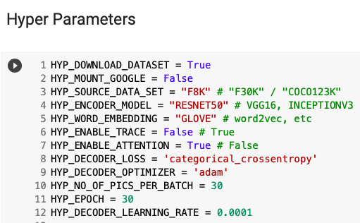
Configurable Execution Flow
Generalised Colab notebook for various Encoders and Decoders.
Flexible to configure and Run with different Hyper Parameters.
  Loss function, Data sets, learn rate, enable attention etc.
Easy to share among the Team Members for Training and Testing different flow control executions.

Slide 8
Results
Model Architecture | BLEU-1 | BLEU-2 | BLEU-3 | BLEU-4 | Meteor score
ResNet50+LSTM | 0.2476793999 | 0.00E-01 | 0.00E-01 | 0.00E-01 | 0.06329113924
ResNet50+LSTM+Attention | 0.4545454545 | 0.4545454545 | 2.23E-308 | 2.23E-308 | 0.2652310924
ResNet50+Transformer | 0.4444444444 | 2.23E-308 | 2.23E-308 | 2.23E-308 | 0.1388888889
All the above models have been trained with “categorical_crossentropy” loss function and “adam” optimizer.
The Models are trained on Flicker-8K dataSet.

Slide 9
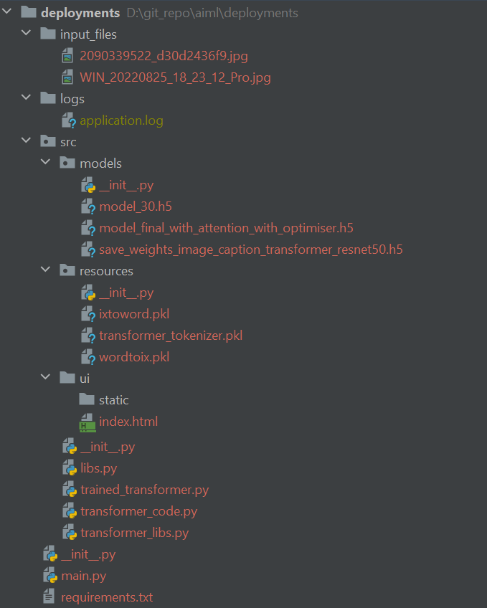
Deployment
Tech-Stack used
  FastAPI Web Framework
  Azure VM

Slide 10
Challenges
Integrate Attention mechanism
Re-organize different Datasets into a common format.
  Make Existing Colab notebook compatible with Flick8k and Flickr30k DataSets
Identifying the cloud platform for Deployment
  Deta.sh was not capable for deployment
Generate a fluent description in natural language.

Slide 11


Slide 12
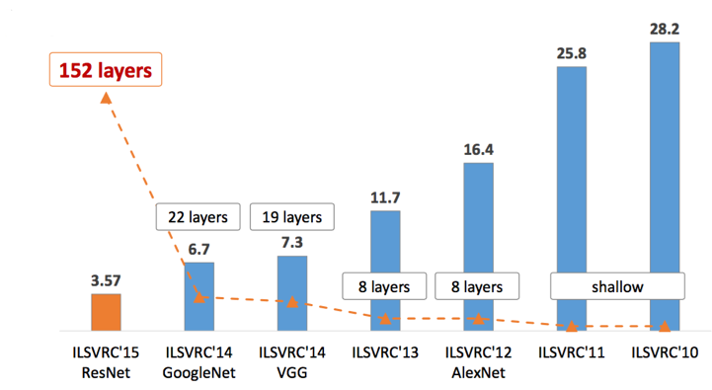
It achieves a top-5 error rate of 3.57% which beats human-level performance on this dataset.
ResNet-50 has more number of parameters to be used so shows better performance
ResNet-50 is more sensitive to the edges of target objects

